Slide 1
Mindfulness Presented by Joshua Green, M.S. Doctoral Intern at UMaine Counseling Center

Slide 2
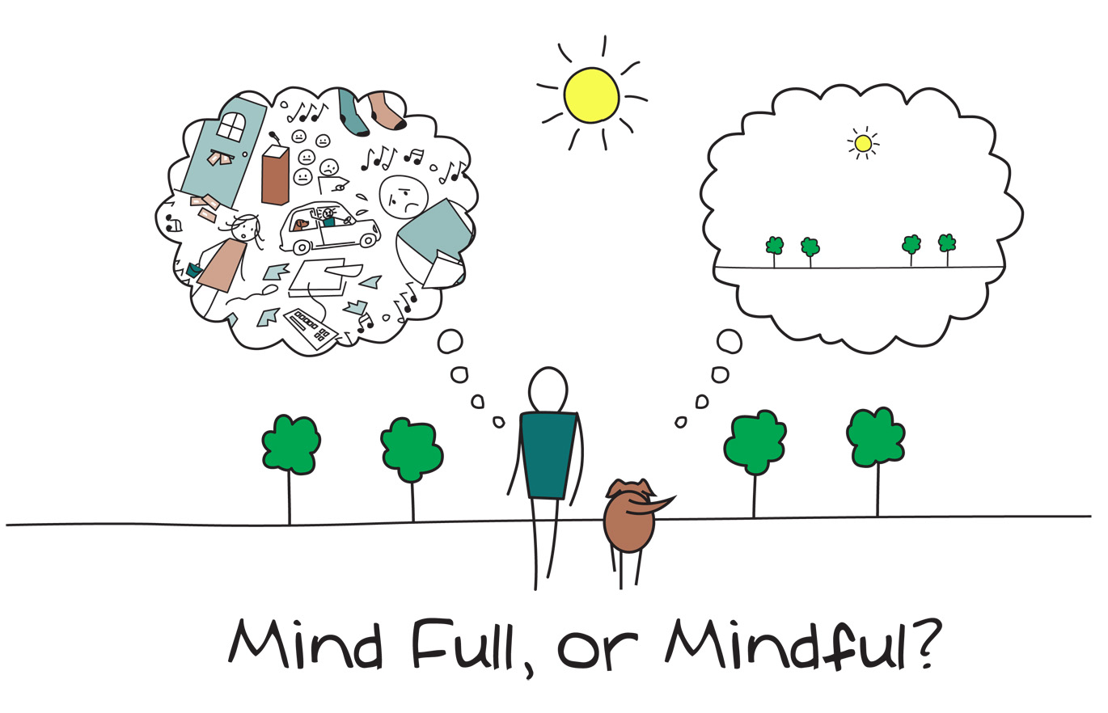
Introductions
What brings you here?
What is your experience with meditation/mindfulness?
What interests you about meditation/mindfulness?

Slide 3
Mindfulness Defined
“the awareness that emerges through paying attention on purpose, in the present moment, and nonjudgmentally to the unfolding of experience moment by moment”
~Jon Kabat-Zinn
Most of us spend each day having silent conversations with ourselves. Mindfulness is thus a kind of listening.
It is a kind of mental exercise for the mind much like physical exercise for the body.

Slide 4
What is Mindfulness/Meditation?
Formal and informal practice
Silent retreats
Practicing at home
Buddhist tradition (Vipassana)
Vipassana, which means to see things as they really are, is one of India's most ancient techniques of meditation. Vipassana is a way of self-transformation through self-observation. When practiced routinely, life becomes characterized by increased awareness, non-delusion, self-control and peace.*
Focused attention
Open monitoring
Mindfulness-Based Stress Reduction
Developed by Jon Kabat-Zinn, MBSR uses a combination of mindfulness meditation, body awareness, and yoga to help people become more mindful
* https://www.dhamma.org/en/about/vipassana

Slide 5
Why? How does it change the brain (and us?)

Slide 6
Benefits / Neuroscience findings
Research has found that meditators appear to lose less gray matter and that meditating reduced the cognitive decline associated with normal aging.
More gyrification, or “folding,” of the cortex, which is associated with faster mental processing
Increased thickness in the prefrontal cortex and right anterior insula, areas of the brain associated with attention and awareness of sensations and emotions in oneself and others.
Meditators who had practiced five years or more had “significantly larger volumes” of gray matter in the hippocampus, an area crucial to memory and learning.
Much, much more… there are now hundreds of studies on meditation and mindfulness which show that it can help with addiction, depression and anxiety.

Slide 7
How/Why does it help? By reconnecting the body
Mindfulness of the Body: Any experience we have is rooted in the body, and contacting that experience will help us feel more grounded, aware, and alive (i.e., a state of mind expresses itself as a felt sense).
It is also a way to “know” ourselves. Who are we? We are partly whatever is going on in our bodies.
Signs of dissociation from the body (mind-body split):
Obsessive thinking
Judgmental thinking or behaving
Distracting/numbing
Speeding/Rushing

Slide 8
Consequences disconnection from the Body
Fatigue. It takes a lot of energy to keep shutting off a part of ourselves.
Chronic anxiety.
Feeling cut off: from love, power, & bodily signals.
Confined in a small identity, a limited sense of self.
Symptoms: loss of vitality, chronic pain, and stress related conditions (e.g. fibromyalgia, bodily pains).

Slide 9
How to reconnect to the body?
Mindfulness!
Notice when time-traveling, predicting, mindreading. Come back.
Pause: Become aware of what is happening in our body instead of getting lost in our reactive thoughts, emotions, and actions. You can then instead relate differently to your experience, and act rather than re-act.
Body Scan helps to reestablish contact with the body, to reconnect the conscious mind to the feeling states of the body, to feel more relaxed and more at home in our bodies.

Slide 10
How? Adopt helpful attitudes (in our mindfulness practice)
Adopt certain attitudes
Non-judging (of ourselves and others)
Patience
Beginner’s Mind
Trust
Non-striving
Acceptance
Letting go

Slide 11
Different methods – let’s practice!
Focused attention:
-Using your non-dominant hand: notice what it feels like, stay present.
Focused attention
Senses
Focusing on breath
Count 10 in and out breaths
Notice when your mind goes somewhere else and bring it back to the breath.
Open monitoring
Senses
Body scan

Slide 12
Thank you ☺

