Slide 1


Workshop on Faculty Recruitment for Diversity and Excellence
ADVANCE Office of Faculty Development
Strategies and Tactics for Recruiting to Improve Diversity and Excellence
Notes:
Introduce us
Go around the room and let everyone introduce themselves
Ask everyone to put their name on the table tent

Slide 2
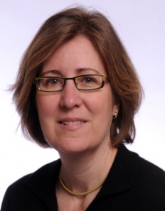
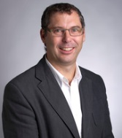
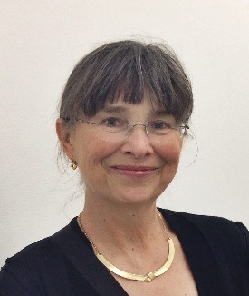
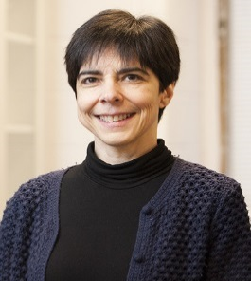
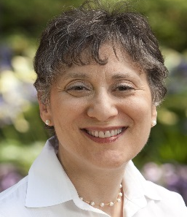
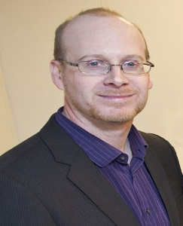
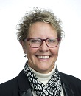
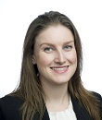
Strategies and Tactics for Recruiting to Improve Diversity and Excellence
Jackie Isaacs, Professor of Mechanical and Industrial Engineering, Chair
Jack Dennerlein, Professor of Physical Therapy
Judith Hall, University Distinguished Professor of Psychology
Carla Mattos, Professor of Chemistry and Chemical Biology
Marjorie Platt, Professor of Accounting
Mark Williams, Professor of Physics
Jan Rinehart, Executive Director ADAVNCE Office of Faculty Development
Kathleen Kenney, Assistant Director ADAVNCE Office of Faculty Development
Previous STRIDE members: George Adams, Mechanical & Industrial Engr.; Dana Brooks, Electrical & Computer Engr.;
Agnes Chan, Computer and Information Sciences; Barry Chung, Counseling and Applied Educational Psychology;
Max Diem, Chemistry and Chemical Biology; Luis Falcon, Sociology and Anthropology; Craig Ferris, Professor Psychology; Miriam Leeser, Professor Electrical and Computer Engineering; Ineke Marshall, Sociology and Anthropology, Criminal Justice; Ramiro Martinez, Professor Criminology and Criminal Justice; Sanjeev Mukerjee, Chemistry and Chemical Biology; Rajmohan Rajaraman, Professor Computer and Information Sciences; Kathrin Zippel, Sociology and Anthropology

Slide 3
The Goal of STRIDE
Raise awareness and educate the university community about concerns and best practices for diversity and excellence in hiring and evaluation processes.

Slide 4
Overview of Presentation
Introduction
Why recruit for diversity and excellence?
What is a “schema”?
Stages of a faculty search
Activity: Highest risk for bias (15 min)
Research on schemas
Activity: Effective practices (25 min)
Neutralizing schemas
Activity: Scenario analysis (30 min)
Evaluation

Slide 5
Diversity Brings Excellence to Your Campus
Valuable part of the University of Maine’s aspirations
Diversity benefits everyone: more points of view & diverse approaches to research and teaching
The first generation of automotive airbags were designed to fit adult male bodies, resulting in avoidable deaths for women and children
Drug prescribed for seizures and bipolar disorder is safe but those of South and East Asian descent can develop a life-threatening skin condition due to skin genetic variation
Diversity is a key driver for creativity and innovation
Brings a greater number of valuable and talented candidates to campus (broadens the candidate pool)
Margolis, J., & Fisher, A. (2002). Unlocking the clubhouse: Women in computing. Cambridge, MA: MIT Press.
Carrell, S. E., Page, M. E., & West, J. E. (2009). Sex and science: How professor gender perpetuates the gender gap (No. w14959). National Bureau of Economic Research.
Temm in Schiebinger, L. (Ed.). (2008) Gendered Innovation in Science and Engineering. (pp. 131-149). [book, not included]
Page, S. (2007). The Difference: How the Power of Diversity Creates Better Groups, Firms, Schools, and Societies: Princeton University Press. [book, not included]
Sommers, S. R. (2006). On racial diversity and group decision making: Identifying multiple effects of racial composition on jury deliberations. Journal of Personality and Social Psychology, 90(4), 597-612.
Schumaker, R (2015) How The Lack Of Diversity In Medical Research Holds Us Back. Huffington Post http://www.huffingtonpost.com/entry/lack-of-diversity-in-health-research_us_56705cc2e4b0e292150f6d0b

Slide 6
Diversity Brings Excellence to Your Campus
Ensures diverse faculty to educate a more diverse group of students, including women and minority role models
More diverse committees make more informed decisions
Companies in the top quartile for women in the executive committee from 2007–2009 had 41% greater return on equity, and 56% greater earnings before interest and taxes than companies with no women in the executive committee
Organizations with greater racial diversity were associated with greater sales revenue, a larger number of customers, greater market share, and greater profits
Desvaux, G., Devillard-Hoellinger, S. and Sancier Sultan, S. (2010). Women Matter: Women at the top of corporations: Making it happen. McKinsey Report.
Herring, C. (2009). Does Diversity Pay?. American Sociological Review.

Slide 7
Is It Reverse Discrimination to Recruit for Diversity?
It is legal to expand applicant pool by adding diverse candidates
Goal is to increase diversity of faculty by increasing diversity of highly qualified pool
University of Maine fully complies with federal and state laws: Law prohibits discrimination on the basis of race, ethnicity, national origin, gender, age (>40), sexual orientation, religion, genetic information

Slide 8
Schemas in Faculty Searches

Slide 9
Schemas are…
…automatic patterns of thought that organize our social information and assumptions
Reduce the amount of info to process
Reduce ambiguity
Allow people to act without effort
Make decisions faster, easier  We keep using them
Well-developed schemas, such as those about gender, can be difficult to change even in light of new information
Widely culturally shared
Both men and women hold them about gender
Both whites and people of color hold them about race/ethnicity
People are often not aware of them
Fiske, S. T. (2002). What We Know Now About Bias and Intergroup Conflict, the Problem of the Century. Current Directions in Psychological Science Current Directions in Psychol Sci, 11(4), 123-128.
Notes:
Emphasize we all have schemas and implicit biases

Slide 10
Unintended Consequences of Schemas
Applied more under circumstances of:
Ambiguity (including lack of information)
Stress from competing tasks
Time pressure
Lack of critical mass
Research shows that we all perceive and treat people based on our schemas about their social groups (race/ethnicity, economic and social status, gender, sexual orientation, disability, academic institution etc.).
It is tempting to believe that discrimination of some groups is a thing of the past, but nonconsciously applying schemas may result in bias
Greenwald, A. G., & Pettigrew, T. F. (2014). With malice toward none and charity for some: Ingroup favoritism enables discrimination. American Psychologist, 69(7), 669-684.

Slide 11
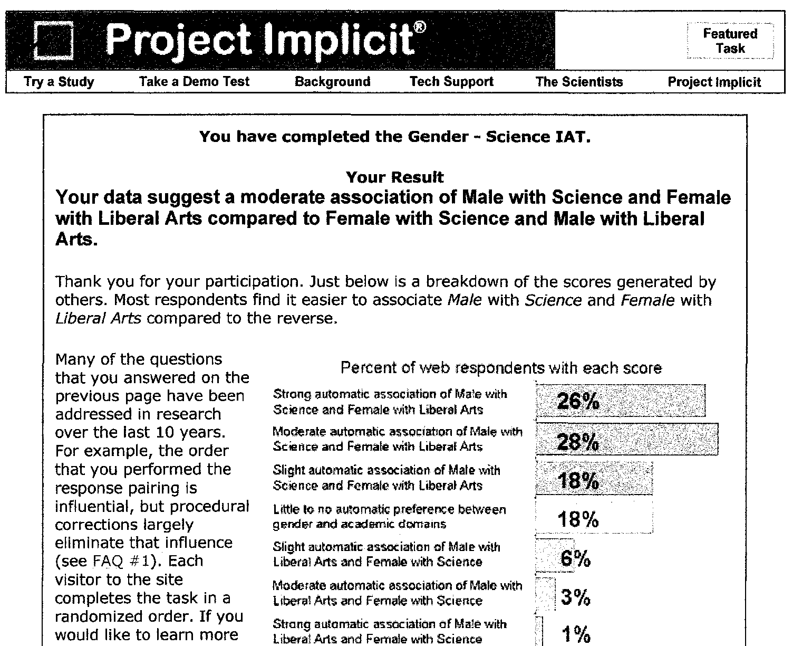
Testing for Unconscious Biases Against Women in Science
“Your data suggest a moderate association of Male with Science and Female with Liberal Arts compared to Female with Science and Male with Liberal Arts.”
Implicit Association Test: https://implicit.harvard.edu/implicit/

Slide 12
Five Stages of a Faculty Search
Define criteria and qualities required for position
Actively recruit a diverse pool and develop strategies about senior faculty hiring
Review and identify the long/short list
Conduct an effective on campus interview
Recommend finalist(s) to Chair

Slide 13
Exercise 1: Identify Challenges
Decide what stage your group believes is most “at risk” of schemas that would negatively impact the outcome of the search (5 minutes)
Debrief with the larger group (10 minutes)
Notes:
All stages of the faculty search process are at risk of schemas coming into play. For this exercise, discuss and come to a consensus within your group of which stage you think carries the highest risk of schemas negatively impacting the search process.
Watch participants and begin debrief when they become restless or at 10 minutes

Slide 14
Five Stages of a Faculty Search
Define criteria and qualities required for position
Actively recruit a diverse pool, and develop strategies for senior faculty hiring
Review and identify the long/short list
Conduct an effective on campus interview
Recommend finalist(s) to Chair
Notes:
Jackie sets up the exercise and Jan debriefs the discussion
Show this slide during the discussion and debrief…
Raise the letter which represents the stage your group decided carries the highest risk of schemas.
Ask each table to tell us why they selected that stage.
Scribe the reasons for each stage as they are listed (scribe by stage).
Are there any minority reports from those who didn’t agree with the majority of people at your table? What stage did you think?

Slide 15
Research on Schemas

Slide 16
Bias in Evaluation of CVs
When evaluating applications for a lab manager…
…male and female science faculty rated men more competent and hire-able than identical female applicants and offered higher salaries to the men
A meta analysis of 111 studies showed…
Men were rated more favorably than women for male-dominated jobs
No strong preference for either gender for female-dominated and integrated jobs
Gender bias was reduced when information clearly indicated high competence during evaluation
A MIT study…
Applicants with African-American-sounding names received 50% fewer call-backs than applicants with white-sounding names
Karen
Brian
Emily
Lakisha
Jamal
Greg
Moss-Racusin, C.S., Dovidio, J.F. et. al. (2012). Science Faculty’s Subtle Gender Bias Favor Male Students. PNAS, 109, 41.
Koch, A. J., D’Mello, S. D., & Sackett, P. R. (2015). A meta-analysis of gender stereotypes and bias in experimental simulations of employment decision making. Journal of Applied Psychology, 100(1), 128-161.
Syal, R. (10/2009). Undercover job hunters reveal huge race bias in Britain’s workplaces. The Guardian
Bertrand, M., & Mullainathan, S. (2004). Are Emily and Greg more employable than Lakisha and Jamal?
A field experiment on labor market discrimination. The American Economic Review, 94(4), 991-1013.

Slide 17
Recommendation Letters for Faculty Applicants
Letters for men:
More agentic descriptors – ambitious, dominant, self-confident
More references to…
CV
Publications
Colleagues
Letters for women :
More communal descriptors – affectionate, warm, kind, nurturing
More references to personal life:
“She has overcome so much as a single mother with 2 kids.”
More comments that raise doubts:
“It’s amazing how much she’s accomplished.”
“It appears her health is stable.”
“She is close to my wife.”
May reveal protected status, i.e., martial status, children, etc.
Communal characteristics have a negative relationship with hiring decisions in academia
Madera, J. M., Hebl, M. R., & Martin, R. C. (2009). Gender and letters of recommendation for academia: agentic and communal differences. Journal of Applied Psychology, 94(6), 1591.

Slide 18
Impact of Schemas about Mothers
Equally qualified men and women evaluated…
Mothers rated less competent
Mothers received half as many call backs as men
Fathers advantaged over childless men
In a 2007 study, the recommended salary for female job applicants was 7.4% lower for mothers vs. childless women
However, women academics who marry and have families publish as many articles per year as single women
Correll, S. J., & Benard, S. (2007). Getting a job: Is there a motherhood penalty? 1. American journal of sociology, 112(5), 1297-1339.
Cole, J. R., & Zuckerman, H. (1987). Marriage, motherhood and research performance in science. Scientific American, 256(2), 119-125.
Xie, Y., Shauman, K. A., & Shauman, K. A. (2003). Women in science: Career processes and outcomes (Vol. 26, No. 73.4). Cambridge, MA: Harvard University Press.

Slide 19
Ethnicity is a Significant Factor in Grant Evaluations, 2011
Analysis of 80,000 NIH grant applications (2000-06) found that 16% submitted by black applicants were approved, compared to 29% for white applicants
When all other factors were held constant, black applicants were significantly less likely to get funding due to their race
Factors for the significant differences include:
Bias in peer-review process
Black scientists lack professional networks and mentoring
Results point to subtle and unintentional yet systematic forms of discrimination
Stein, R. (2011). Blacks less likely than whites to get NIH grants, study finds. The Washington Post.
Notes:
19

Slide 20
Blind Auditions
When musicians auditioned behind a blind screen…
…the proportion of females hired for orchestral jobs increased significantly
Double-blind review of journal papers significantly increases female publications
Budden, A. E., Tregenza, T., Aarssen, L. W., Koricheva, J., Leimu, R., & Lortie, C. J. (2008). Double-blind review favours increased representation of female authors. Trends in ecology & evolution, 23(1), 4-6.
Goldin, C., & Rouse, C. (1997). Orchestrating impartiality: The impact of" blind" auditions on female musicians (No. w5903). National bureau of economic research.

Slide 21
Exercise 2: Brainstorm Strategies
Review the handout for the search stage your group has selected (8 min)
Brainstorm effective practices for avoiding implicit bias for a search stage (10 minutes)
Debrief with the larger group (15 minutes)
What are two things you will do during your next faculty search?
Notes:
Guiding questions for debrief:
What are two or three practical things you will do during the next faculty search?

Slide 22
What Can We Do?
Notes:
Jackie: These are all great suggestions for neutralizing schemas. Adding to your ideas, I am going to summarize what some other people have said.

Slide 23
Stage A: Define Criteria and Qualities Required for the Position
Within the search committee discuss words such as ‘fit’, ‘excellence’, ‘quality’
Write the ad using broad research area
Discuss diversity and its meaning to the dept.
Develop a matrix for initial review and final ranking
Have a meeting to discuss how your committee will evaluate the applicants – don’t use your ‘gut’
Notes:
First we need to create an applicant pool that is diverse

Slide 24
Sample of Pre-campus Evaluation Tool
Please rate the candidate on each of the following: | excellent | good | neutral | fair | poor | unable to judge
‘Fit’ with department’s priorities
Evidence of scholarly impact
Evidence of research productivity
Evidence of research funding
Evidence of collaboration
Ability to make positive contribution to department’s climate
Ability to attract and supervise graduate students
Ability to teach and supervise undergraduates
Please comment on the candidate’s research program:
Please comment on the candidate’s expertise:
Other Comments:
*Matrix adapted from work by Changiz Mohiyeddini, Northeastern
Associate Professor of Counseling and Applied Psychology
Notes:
This is just an example of an evaluation matrix for applicant review

Slide 25
Stage B: Actively Recruit a Diverse Pool…
Develop a departmental strategy for year-round strategic recruiting
Know the number of women and minorities receiving PhDs in your discipline
Build relationships with diverse scholars at national conferences
Broaden institutions from which you recruit and collaborate
Send the ad to national women and minority organizations, committees, and caucuses in your discipline
Search prestigious fellowship holders including minority fellowships

Slide 26
Stage B. …and Develop Strategies for Recruiting of Senior Faculty
Go beyond your own network – beyond the people you know
Don’t assume people are not moveable
Ask ADVANCE if they have resources for your discipline
Explore databases of funded awards for diverse candidates
NIH Research Portfolio Reporting Tool-http://RePORT.nih.gov
NSF Awards Search (http://nsf.gov/awardsearch/)
Web of Science database (available on the library website)
Resource Guide (northeastern.edu/advance/recruitment/)
National Academies directories
Look at who held leadership positions in national organizations

Slide 27
Stage C: Review and Identify the Short List
Agree on objective criteria and apply consistently, use evaluation matrix
Completely review all applications
Remember gender schemas (women rated lower than men)
Remember ethnic names receive fewer call backs
Consider letter writer and reader biases
Avoid bias for women with children
Consider PhD/postdocs from schools other than the top
Notes:
Now you have all the applications…

Slide 28
Stage D: Conduct an Effective On-Campus Interview
Value each candidate as a unique individual, not as a token
Aim for diverse and welcoming audiences when scheduling meetings – for all candidates
Ask if there are individuals or groups the candidate wants to meet while on campus
Create a list of questions to allow comparison of common factors for each candidate
Read candidate CV before you meet with them
Do not ask illegal questions or use this information in committee deliberations

Slide 29
Stage D: On-Campus… Do Not Ask Illegal /Discriminatory Questions
Federal / state laws and regulations prohibit questions about these classes to protect them:
Family status
Race
Religion
Gender
Age
Arrests
Citizenship or nationality
Disability
Sexual Orientation
Pregnancy
Because organizations have made hiring decisions based on these criteria instead of hiring the ‘best’ candidate

Slide 30
Stage D: On-Campus… Examples of Illegal Questions: Family Status
Illegal Questions:
Are you married?
Are you planning to start a family?
What is your spouse's name?
What is your maiden name?
Do you have any children?
Are you pregnant?
What are your childcare arrangements?
Asking any of these questions is:
Illegal and counter-productive (reflects poorly on the university and candidates might resent questions)
Even if you know some of this protected information, do not discuss it in search committee deliberations – your goal is to hire the BEST candidate based on the job description

Slide 31
Stage E: Recommend Finalist(s) to Chair
Complete evaluation matrix for each candidate within 24 hours
Use consistent objective criteria in evaluation of every candidate
Remember letter writer and reader biases
Do not use protected class information in any discussion about ranking or hiring
Be mindful of committee group dynamics

Slide 32
Faculty Recruitment Scenario at Teacher Scholar University
The Department of Biology at Teacher Scholar University (TSU) is nearing the end of a faculty search in which the three candidates have interviewed on campus. The first candidate has generated little enthusiasm among stakeholders, while others have backers. Candidate Morris Smith, who has completed a post-doctoral appointment, has a slightly stronger publication record of the two. His jocular style resonated well with the senior faculty, but his research seminar was poorly organized and hard to follow. Rhea Jones, a recent Ph.D. recipient, presented her research coherently in the seminar and has more teaching experience than Smith, an important consideration given TSU’s mission. However, Smith’s backers describe Jones as “a little mousy” and “maybe too green” and question her overall fit within the department.
The department’s faculty has voted in favor of Smith, although not by a large margin. The vote is technically advisory to the chair; however, past chairs have almost always accepted the faculty recommendation and forwarded it to the dean, who makes all offers in the college. In this instance, though, the new chair, Dee Parks, believes that Smith’s muddled seminar presentation and relatively limited teaching experience are significant issues. She also thinks that the faculty members who appreciated Smith’s joviality (incorrectly) interpreted Jones’ more low-key style as inexperience or lack of self-confidence. Fundamentally, she suspects that Jones lost votes for being female. Parks is about to meet with the dean to discuss her recommendation and is mulling over how she should proceed.
Notes:
Jan lead this section:
Ask someone to read the case aloud
Give them 10 minutes to discuss the questions on the next slide
Debrief their responses.

Slide 33
Discussion Guiding Questions
Based on the information provided, is there evidence for Park’s concern that gender bias has factored into the evaluation of the two candidates? Is so, what is it?
What candidate do you recommend Parks endorse?
How should she justify her selection to the dean?
How should she justify her selection to the faculty?
If Jones is the selected candidate, what steps might Parks consider to support her success within the unit?
Council of Colleges of Arts & Sciences http://www.ccas.net/i4a/pages/index.cfm?pageid=3660

Slide 34
Faculty Search Resources
STRIDE slides http://www.northeastern.edu/advance/recruitment/stride-faculty-search-committee-workshop/
University of Maine Provost https://umaine.edu/provost/chairs-and-directors-resources/
ADVANCE Rising Tide Center https://umaine.edu/advancerisingtide/resources-2/
Northeastern ADVANCE Resources - NU and External http://www.northeastern.edu/advance/resources/

Slide 35
Thank you!
GOAL: Raise awareness and educate the university community about concerns and best practices for diversity and excellence in hiring and evaluation processes.
What questions and comments do you have?
Please take 5 minutes to complete
the STRIDE Workshop Evaluation in your packet.

Slide 36
STRIDE
THANK YOU!

Slide 37
Exercise: Writing a Job Ad
Objective: Create a position description that conveys the value of diversity held by the department to potential candidates
Three example ads
Concepts, words, thoughts
Discussion Questions
What did you hear that was new?
Was there anything you plan to add to your job ad?

