Slide 1



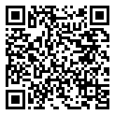
Research Study for Maine Youth
Are you between the ages of 13-17?
RESEARCH STUDY PURPOSE:
  Understand the stressors affecting Maine youth's mental health
PARTICIPATION INCLUDES:
  One 30-minute Zoom interview
  One 20-minute online survey about how you cope with daily stress
COMPENSATION:
  Up to $15 for participation
ELIGIBILITY:
  Between 13-17 years old
  Lives in Maine
  Permission from your parent or guardian
HOW CAN YOU PARTICIPATE?
Have your parent or guardian contact our research team!
Scan here for more information:
Jane Doe
jane.doe@maine.edu
207-581-1234

