Slide 1

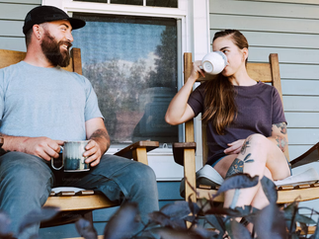

ARE YOU A COFFEE DRINKER?
You are invited to participate in a research study
on consumer use of and preference for various
coffee products.
You will be asked to....
  Participate in a 15–20-minute evaluation session
  Taste and evaluate black, caffeinated coffee
  Answer questions about your consumption habits
Compensation
  $5.00 for participation
Are you eligible?
  At least 18 years old
  Enjoys drinking black, caffeinated coffee
Location & Time
  University of Maine campus in August 2033
Contact Jane Doe with questions
jane.doe@maine.edu
207-581-1234
Jane Doe
jane.doe@maine.edu
207-581-1234
Jane Doe
jane.doe@maine.edu
207-581-1234
Jane Doe
jane.doe@maine.edu
207-581-1234
Jane Doe
jane.doe@maine.edu
207-581-1234
Jane Doe
jane.doe@maine.edu
207-581-1234
Jane Doe
jane.doe@maine.edu
207-581-1234
Jane Doe
jane.doe@maine.edu
207-581-1234
Jane Doe
jane.doe@maine.edu
207-581-1234

