Slide 1
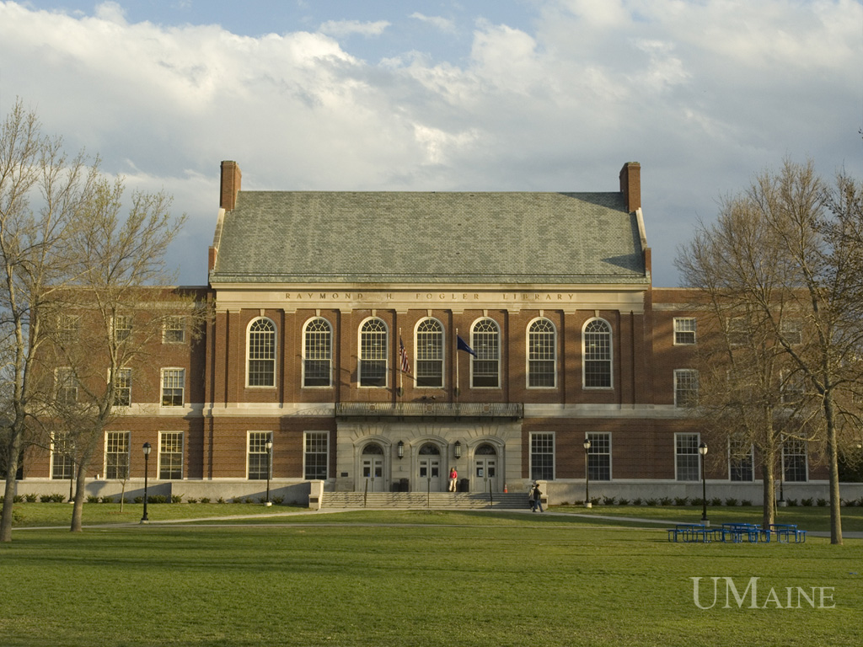
Building a Better Orono Together
Notes:
http://www.govloop.com/group/universityofmainealums

Slide 2
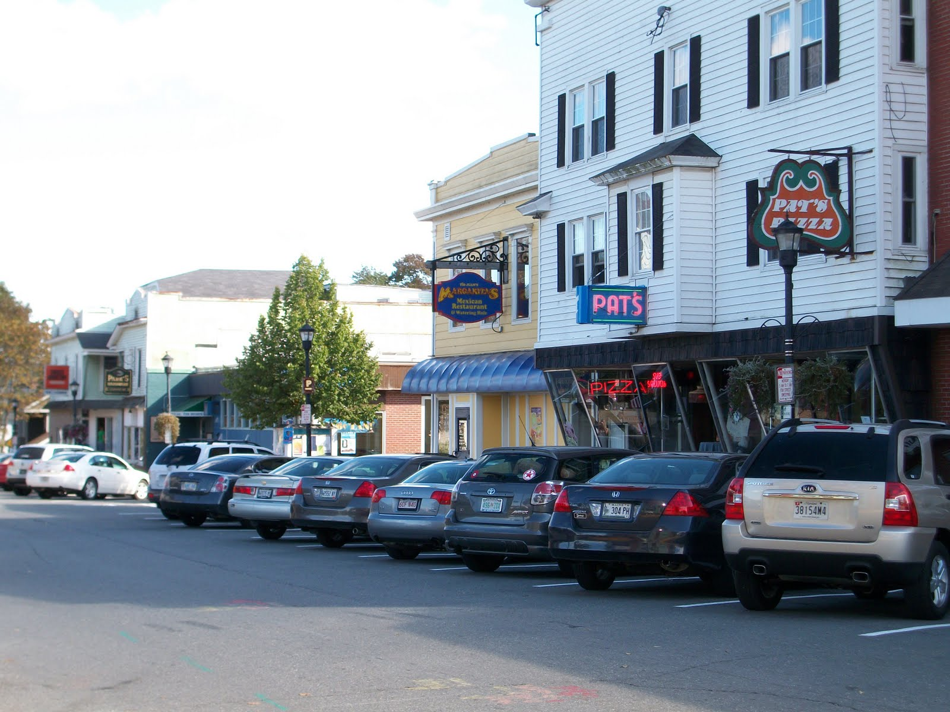
Cultivating Organic Community Connection with University and Orono Stakeholders
Notes:
http://2.bp.blogspot.com/_Eb2paOZxNeE/TEbmFxoKfgI/AAAAAAAAAB4/uq15bLj7neI/s1600/100_0013.JPG

Slide 3
Introduction
Professor Rob Glover
Benjamin Algeo
Shannon Brenner
Alexandria Jesiolowski
Joshua Morse
Victoria Schuyler
Braden Sinclair

Slide 4
Practicum in Engaged Policy Studies
Taught by Professor Rob Glover, POS 364 and POS 365 make up a year-long research project that focuses on a local policy issue or community challenge.
In order to best represent all parties involved with the research project, a strong emphasis is placed on engaged research.

Slide 5
What Is Engaged Research?
Engaged research occurs when…
A collaborative partnership conducts an investigation for the mutual benefit of external partners and researchers.
… And helps to:
Facilitate and guide partnerships between the university and the community.
Address community-defined concerns.
Generate new knowledge through research, evaluation, and community change models.
Notes:
http://ncsue.msu.edu/files/KU_EngagedResearch_hef_112906.pdf

Slide 6
Using Engaged Research to Build a Better Orono Together
This study aims to bring to the surface…
ways in which the University of Maine and the town of Orono might collaboratively and innovatively work together to make Orono a more connected and vibrant college town utilizing input from university and community stakeholders.

Slide 7
Using Engaged Research to Build a Better Orono Together (continued)
The project is part of a year-long collaboration between…
The students in POS 364-365:Practicum in Engaged Policy Studies and Orono Town Planner Evan Richert and Town Manager Sophie Wilson.

Slide 8
Using Engaged Research to Build a Better Orono Together (continued)
The study seeks to gauge the preferences of…
Residents
Students
Staff
And faculty…
…to gauge existing satisfaction, knowledge, and connection within the community as well as where improvements could be made.

Slide 9
Using Engaged Research to Build a Better Orono Together (continued)
The responses from the stakeholders will be used to…
envision ways in which the town and the university can creatively utilize existing assets to engage in a process of connected growth and organic development together, in the true spirit of cooperative community engagement.

Slide 10
Research Methods
Online surveys to gauge preferences of:
Students
Faculty
Staff
Orono Residents
Focus groups to gain insight from:
University Administrators
Orono Village Association
This data has been analyzed and interpreted and will be compiled into a final report.

Slide 11
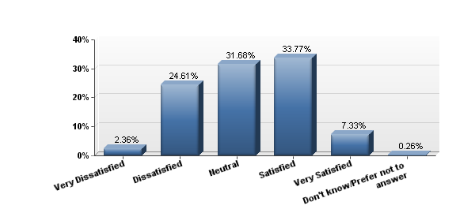
Findings: Students
Satisfaction with the town of Orono: Students

Slide 12
Findings: Students
Distance and Transportation
Town History
Green Space
Events/Festivals
Dining and Entertainment
Post Graduation

Slide 13
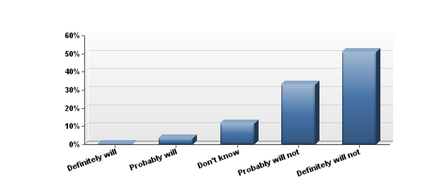
Findings: Students
Student likelihood of staying in Orono after graduation
“There aren't many businesses that attract college graduates. It seems like the town is mainly there to supply students with pizza, alcohol, and other fun things. While Bangor is close, I would think that something like an insurance company or engineering firm would do well in Orono because of all the potential interns and such. Unless it's to teach, there isn't any incentive to stay in Orono post-graduation.”

Slide 14
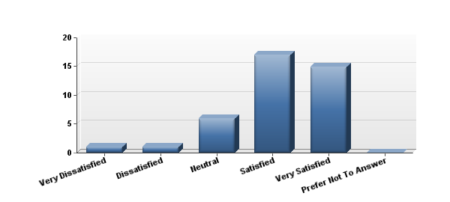
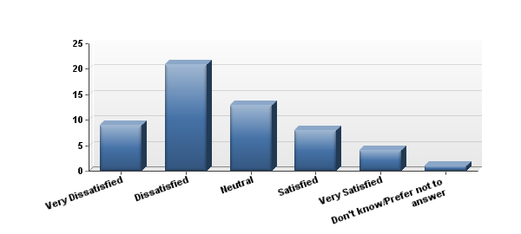
Findings: Faculty
Faculty Orono-Resident satisfaction with Orono as a place to live
Faculty Non-Orono Resident satisfaction with Orono as a college town

Slide 15
Findings: Faculty
Similar levels of knowledge and importance between residents and non-residents.
Disjuncture between levels of satisfaction
Outdoor Recreation (85% satisfaction resident, 40% satisfaction nonresident).
Dining & Restaurants (54% satisfaction resident, 24% satisfaction non-resident).
Artistic and Creative Expression (50% satisfaction resident, 13% satisfaction non-resident).

Slide 16
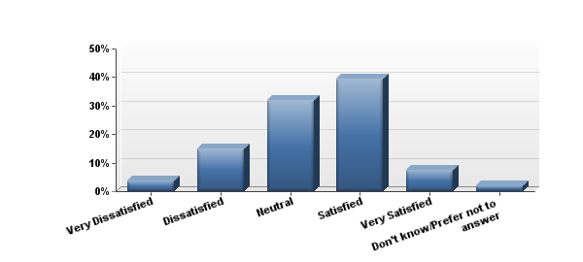
Findings: Staff
Staff Satisfaction with Orono as a College Town
“Small, quaint, friendly.”

Slide 17
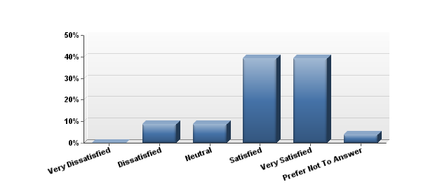
Findings: Residents
Unaffiliated Residents Satisfaction with Orono as a Place to Live

Slide 18
Findings: Residents
 | Satisfaction (% answered very satisfied or satisfied)
Entertainment & Nightlife | 24
Dining & Restaurants | 47
Artistic & Creative Expression | 31
Historical Sites/Area Heritage | 19
Outdoor Recreation | 60
Shopping | 19
Events/Festivals | 32
Public Transportation | 35
Overall Appearance | 23
“It seems like we are lacking the ‘bare necessities’ in town.”

Slide 19
Findings: Residents
Age disparity
Outdoor Recreation
60% satisfaction
68% frequency
71% knowledgeability
83% importance

Slide 20
Findings: General Trends
There is a broad perception of distance between the University and the community.
There is a desire and need for a reciprocal relationships between the town and the University.
There is a need for more effective lines of communication between the University and the town.
High demand for more cultural, artistic and musical opportunities.

Slide 21
Next Steps…
Improved communication and publicity
Integrating community needs into university curriculum.
Better coordination of student volunteerism with community needs.
Utilize liaison positions as a “front door” to the University.
Create a culture in which the lines between university and community activities are “blurred.”
A business could capitalize on the lack of a setting where people can socialize, study and work in the late afternoon and evening hours.

Slide 22
Thanks to…
Orono Town Planner Evan Richert & Orono Town Manager Sophie Wilson.
Orono Town Council.
The university and community participants in our surveys and focus groups.
The Orono Village Association.
The University of Maine.

