Slide 1
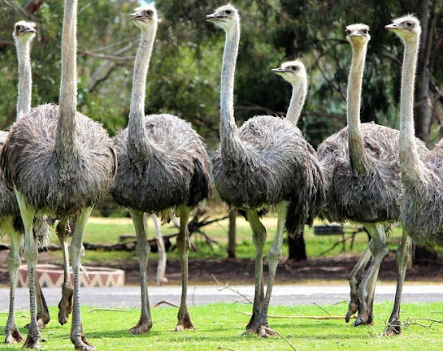
Herding Ostriches:
Building Climate Resilience in Polarized Places

Slide 2
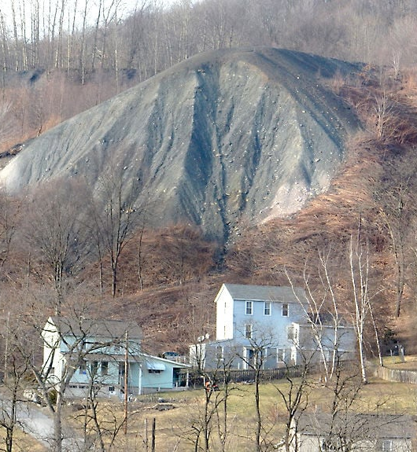
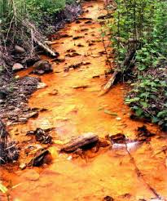

Slide 3
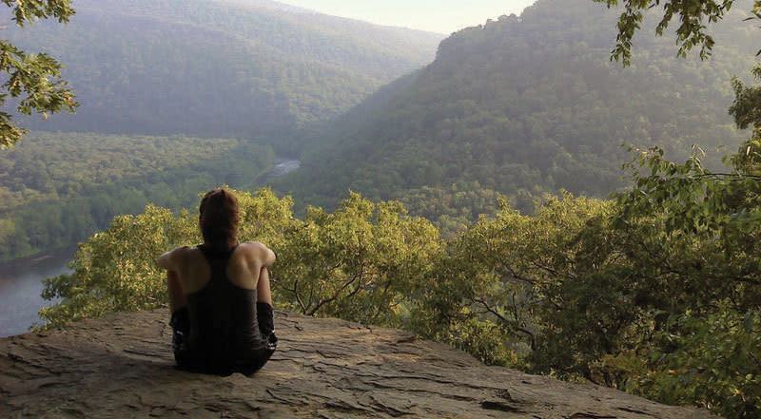

Slide 4


Slide 5
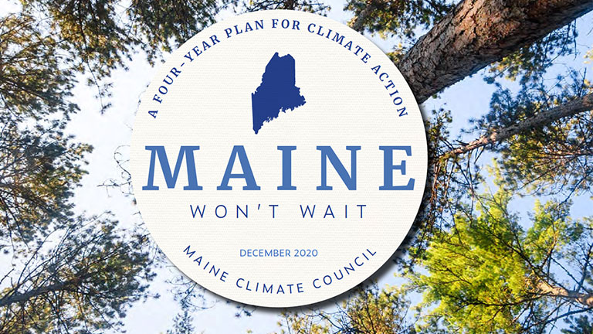

Slide 6
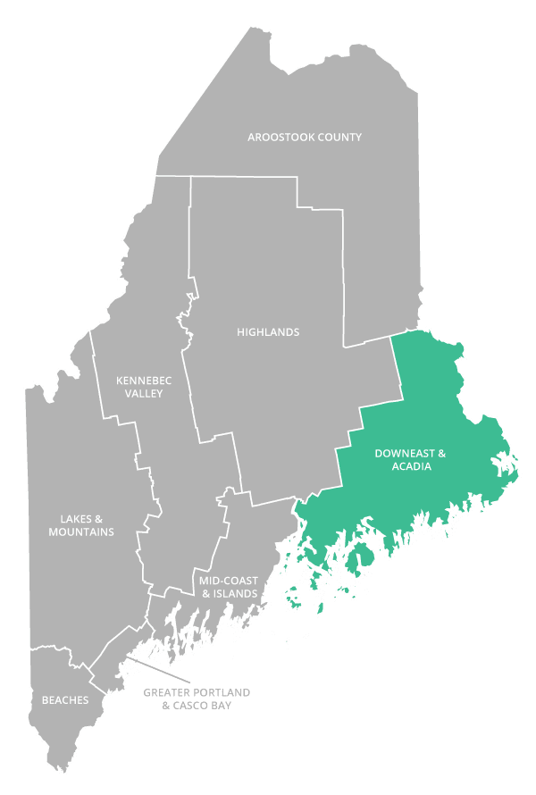

Slide 7
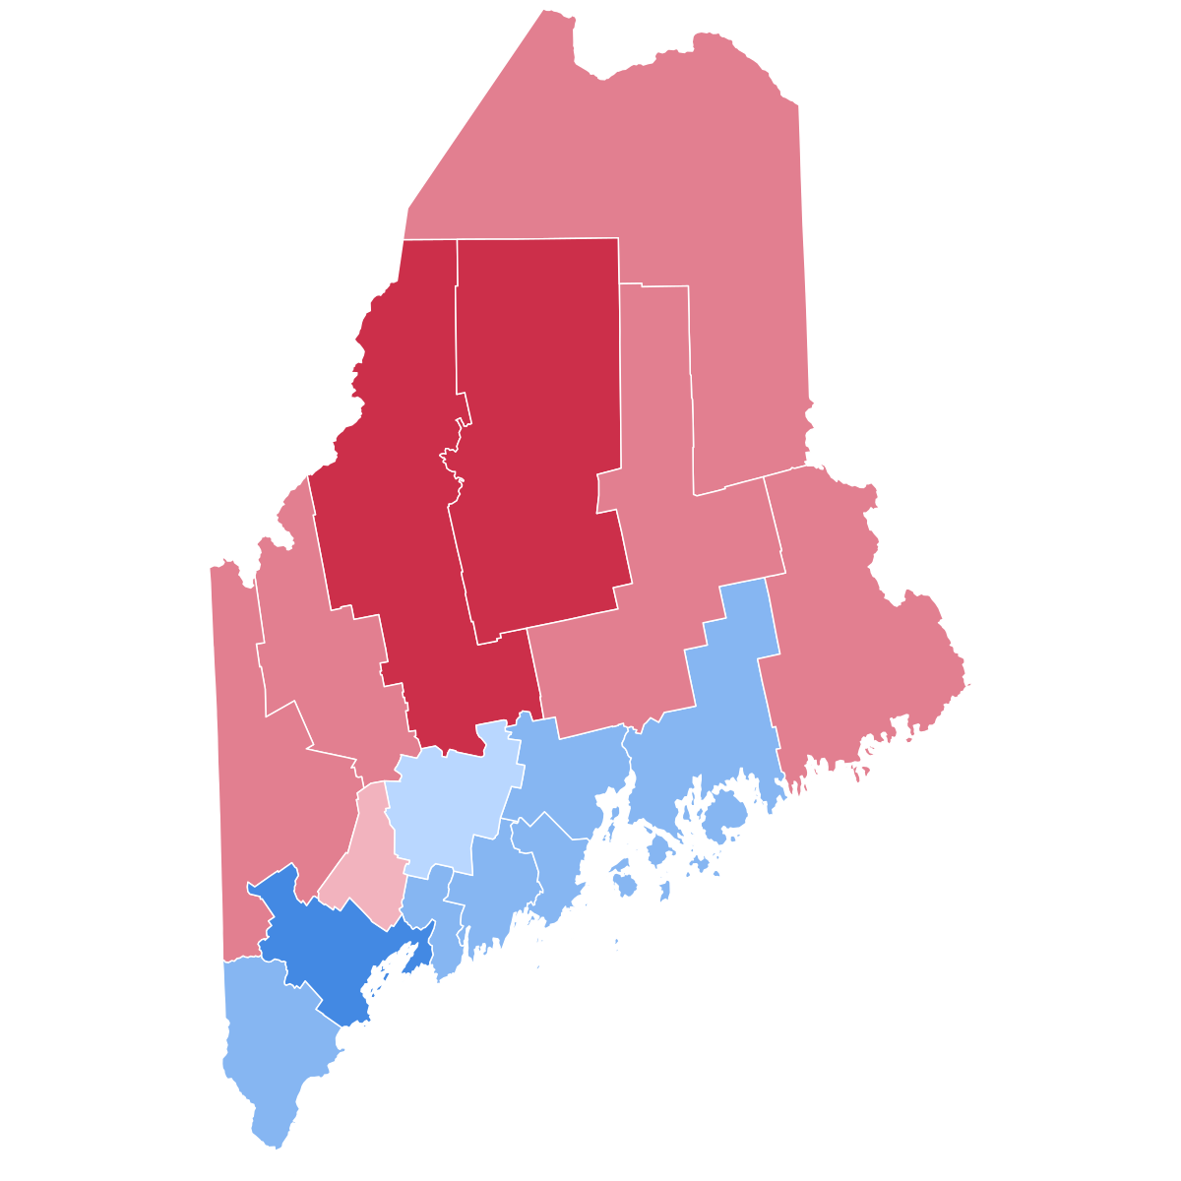

Slide 8


Slide 9


Slide 10

Meaningful and on-going participation in planning and decision-making processes by those who have lived experience with an environmental problem can result in outcomes that are equitable and responsive to local needs and aspirations
(Brunacini, J. From Theory to Practice: Participatory Approaches to Understanding the Social Dimensions of Managed Retreat. Michigan State University ProQuest Dissertations Publishing, 2023. 30248911.)

Slide 11
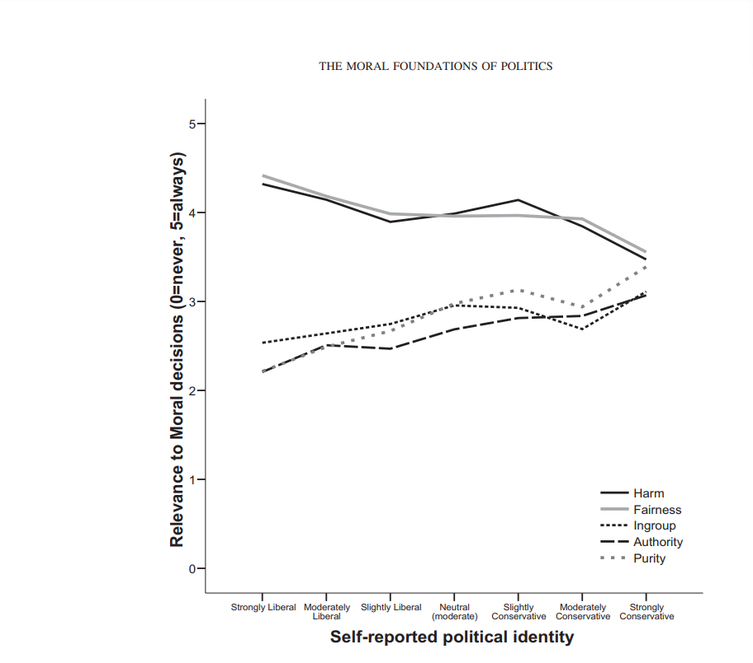
“Liberals and Conservatives Rely on Different Sets of Moral Foundations” Jesse Graham, Jonathan Haidt, and Brian A. Nosek University of Virginia

Slide 12
Liberal Moral Foundation
Fairness
Harm reduction
Conservative Moral Foundation
Purity
Respect for Authority/In Group (Loyalty)

Slide 13


Slide 14
Frame conversations with the audience’s moral foundation in mind
Purity
“A clean place to live”
Loyalty
“Helping our friends and neighbors”
Authority
“Protecting our communities”

Slide 15
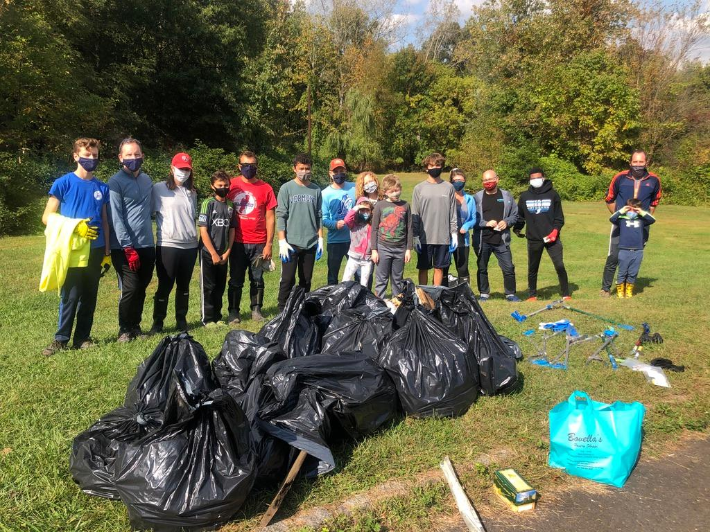

Slide 16

Build on Principles of Respect and Empathy

Slide 17

Genuinely thank people for taking part in the conversation

Slide 18

Be Generous
Time
Attention
(And don’t forget the food!)

Slide 19
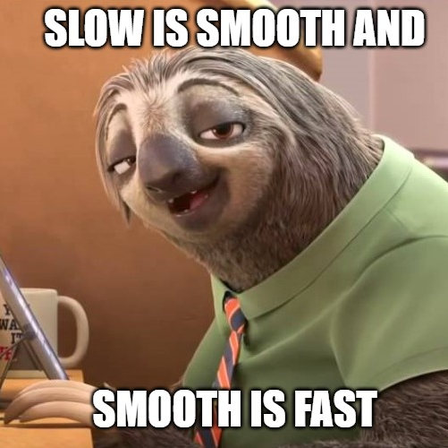
Speak slowly and don’t expect others to be wedded to your timeline

Slide 20

Meet people’s fears with:
Love,
Dignity,
Space
Time

Slide 21
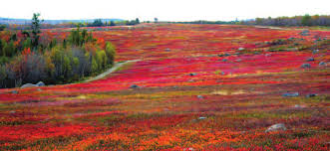
Seek Common Ground

Slide 22
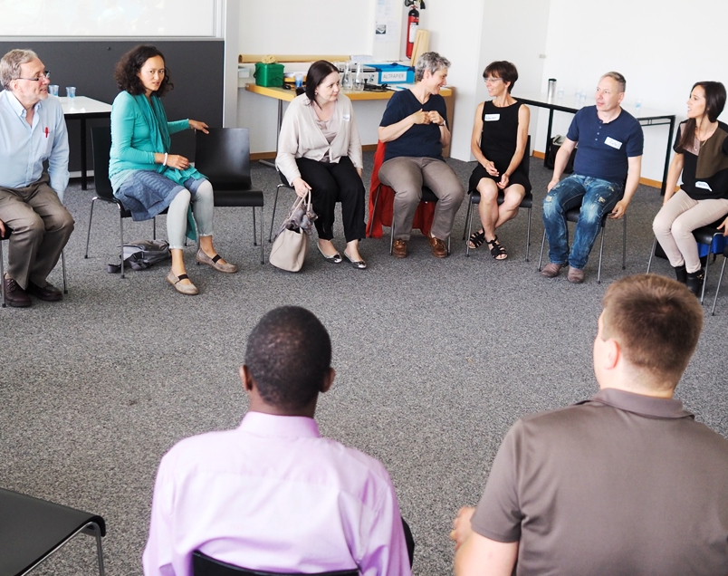
Open Circle Conversations

Slide 23
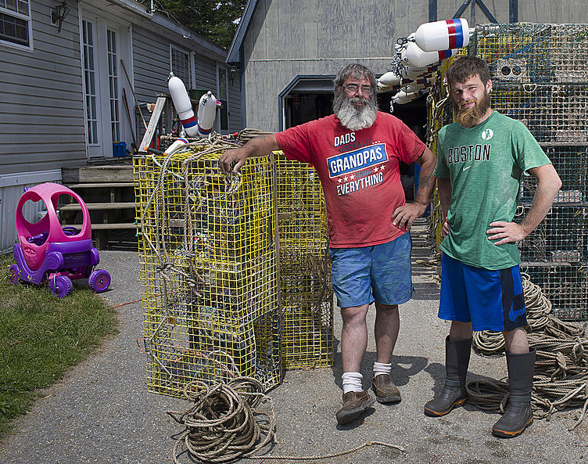
Foster a “Come as you are” attitude

Slide 24

Be willing to be vulnerable
It is important in building trust to be seen as a person, not a “Cog in the wheel…”

Slide 25

Set your ego aside and don’t be afraid to poke fun at yourself

Slide 26


Slide 27

Taking the energy out of disagreements

Slide 28

Start by agreeing

Slide 29

Show you are hearing them by telling them what you’ve learned

Slide 30

Acknowledge and add
“ I think you have a point; I would add… “

Slide 31


Slide 32
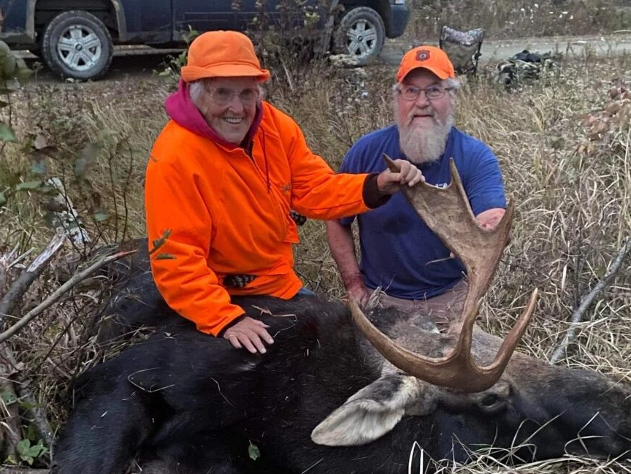
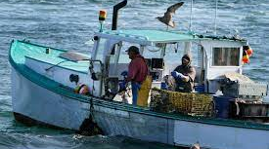
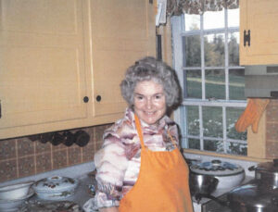

Slide 33
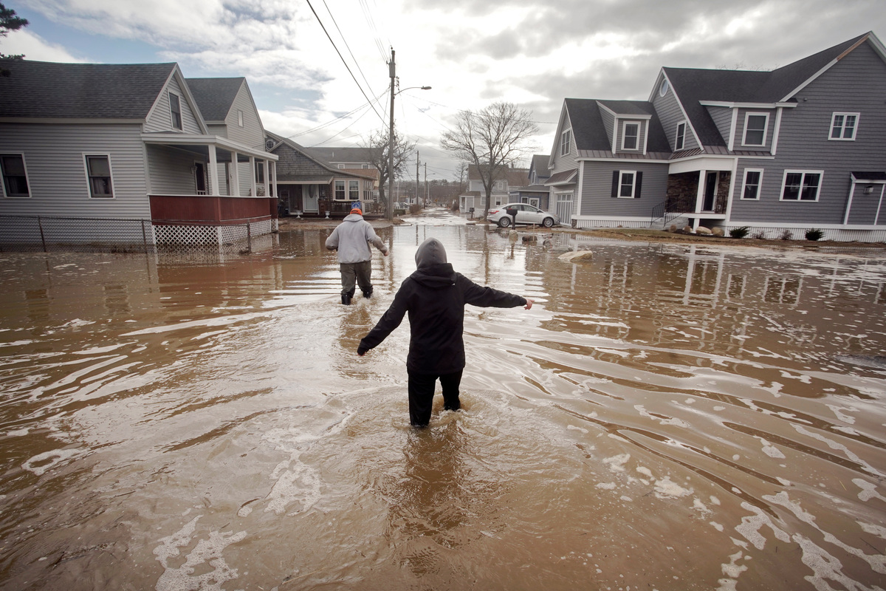
Mainer’s are practical

Slide 34
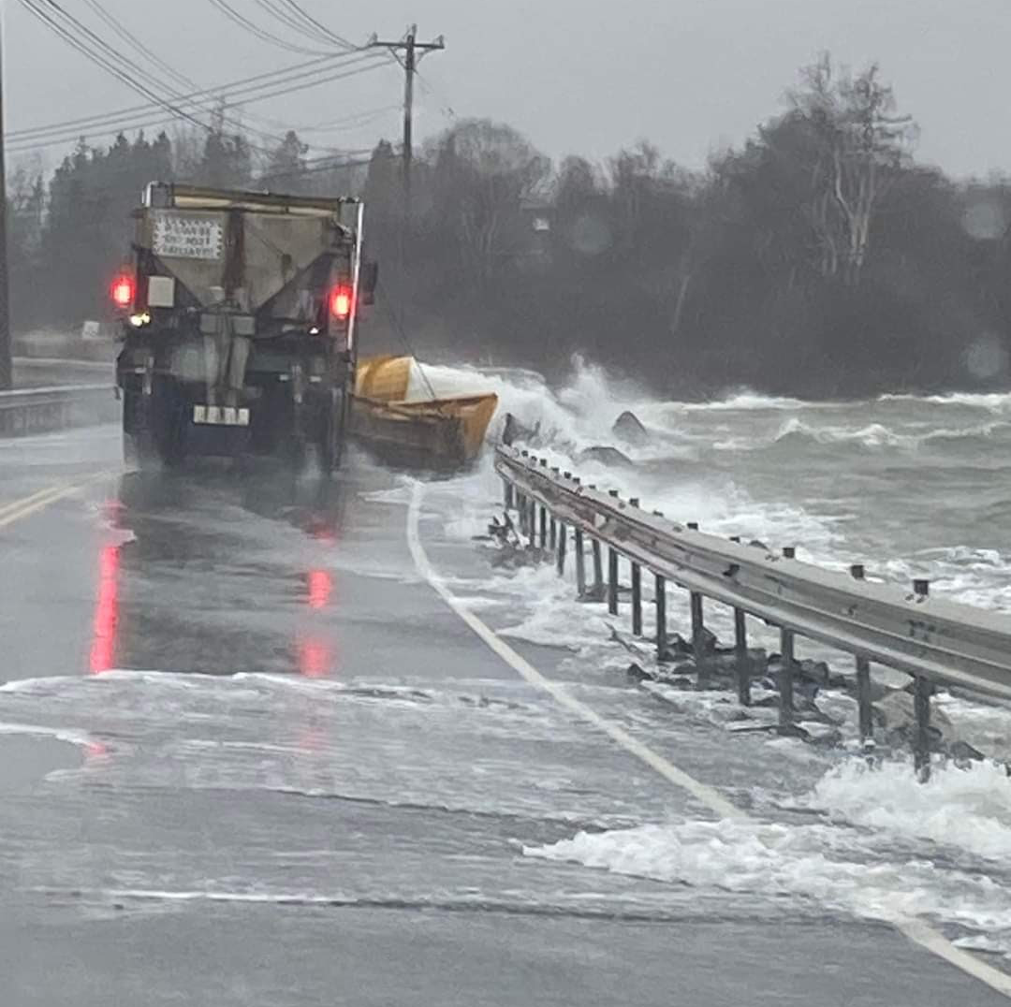
They see sea level rise

Slide 35
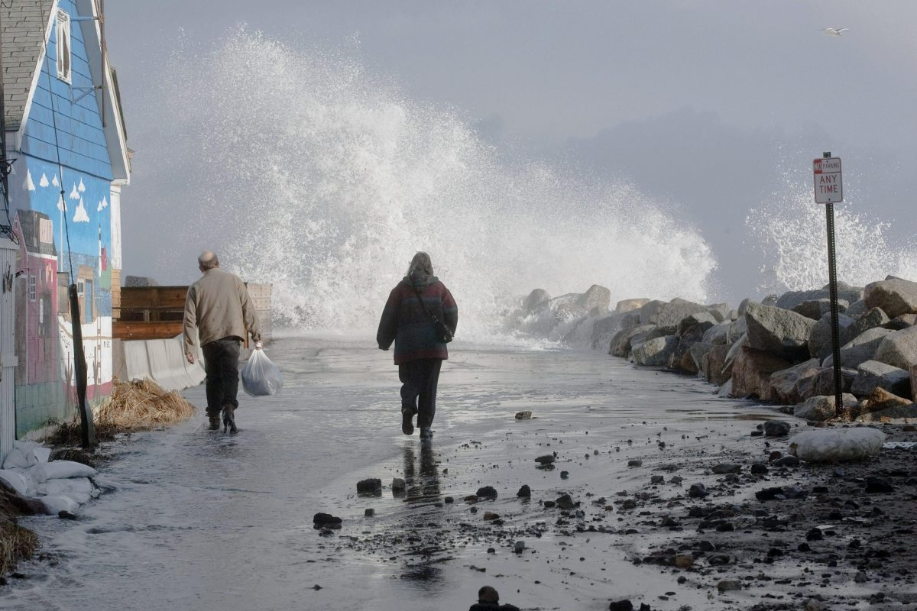

Slide 36
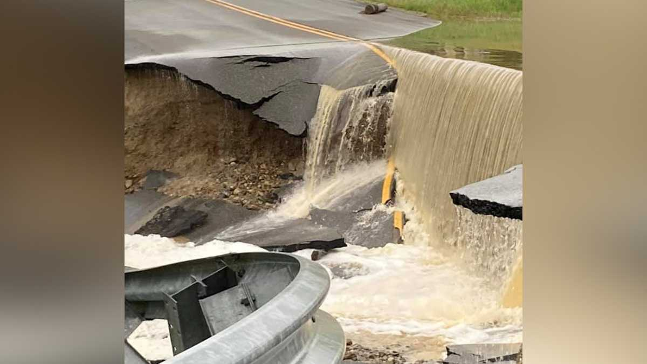

Slide 37
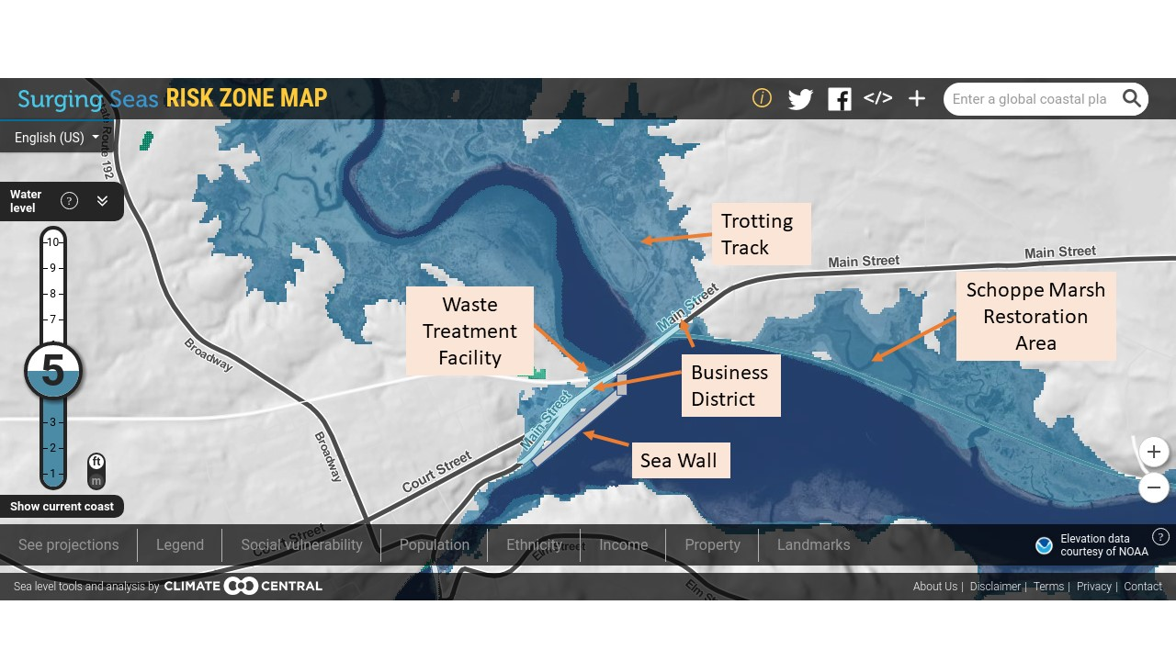
Relevance to local area

Slide 38
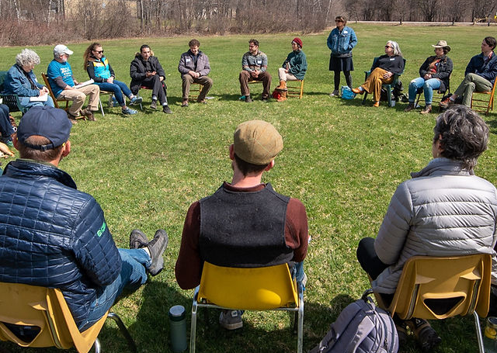
CRP enrollment Process

Slide 39
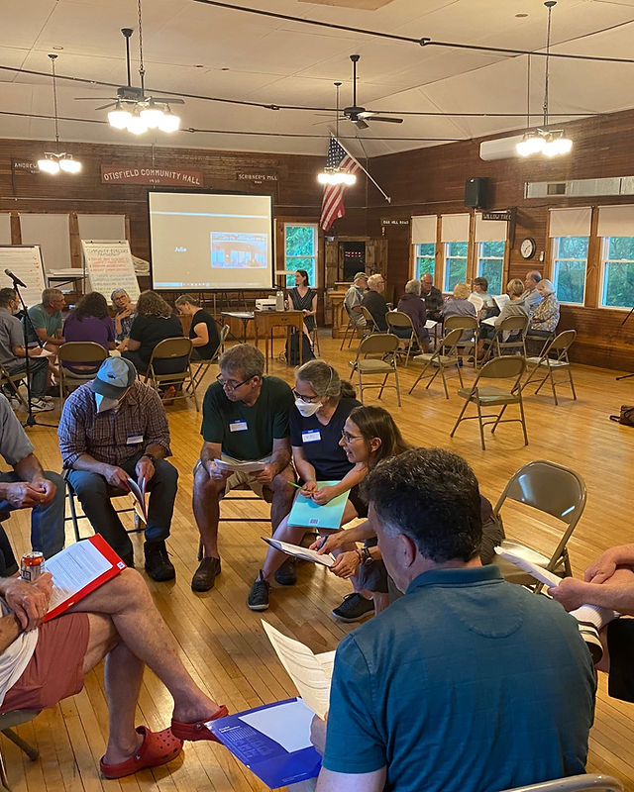

Slide 40








72 actions in 8 different focus areas
Menu
Lower carbon transportation
served with crackling EV chargers
Protecting nature
Served raw on fresh balsam fir
Building healthy communities
Covered in dollops of planning and flood maps
More efficient buildings
in a rich sauce of domestic hot water
Cleaner energy
with a sprinkling of state and federal rebates
Improving infrastructure
Artistically plated on 500 -year flood bridging
Protecting nature-based jobs
swirled with economic development and youth Opportunities
Engaging with people
With leadership and justice for all

Slide 41
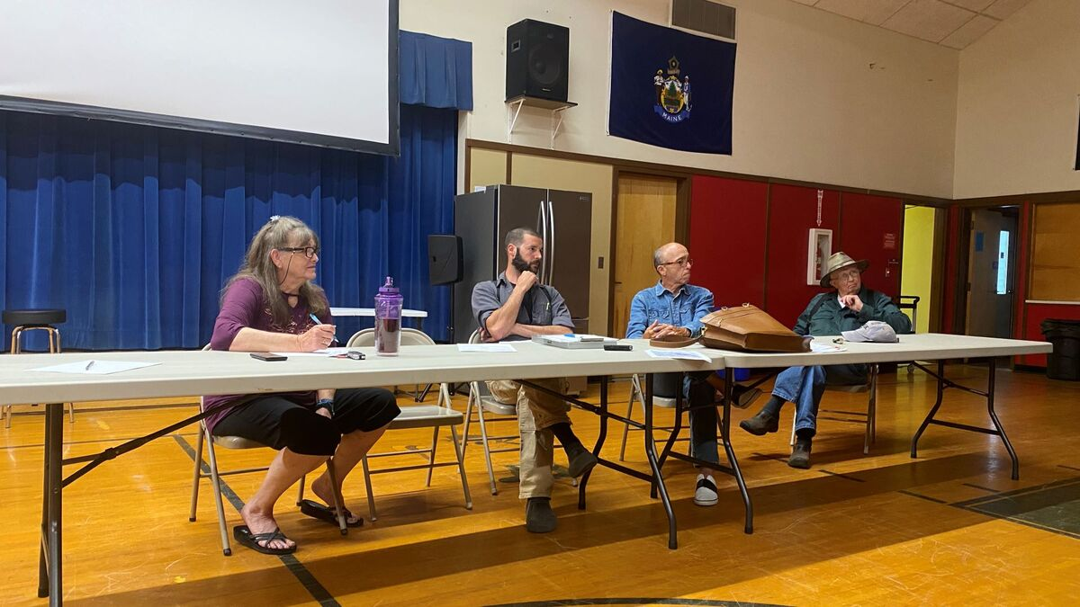

Slide 42
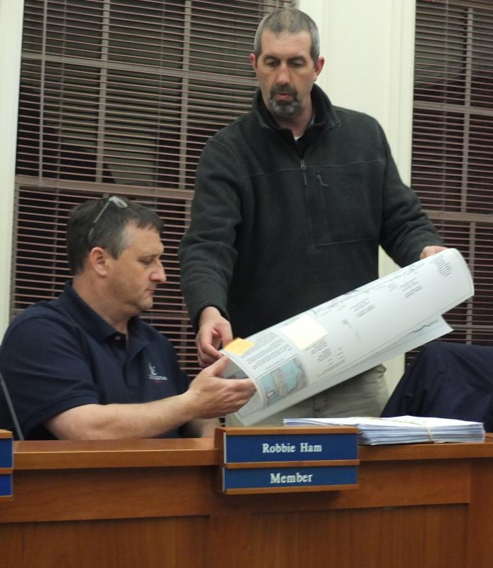
Neighbor to neighbor engagement

Slide 43
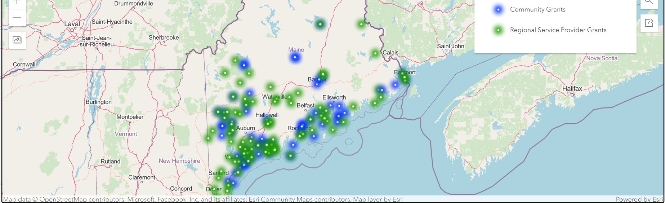
148 towns enrolled covering 50% of Maine’s population

Slide 44
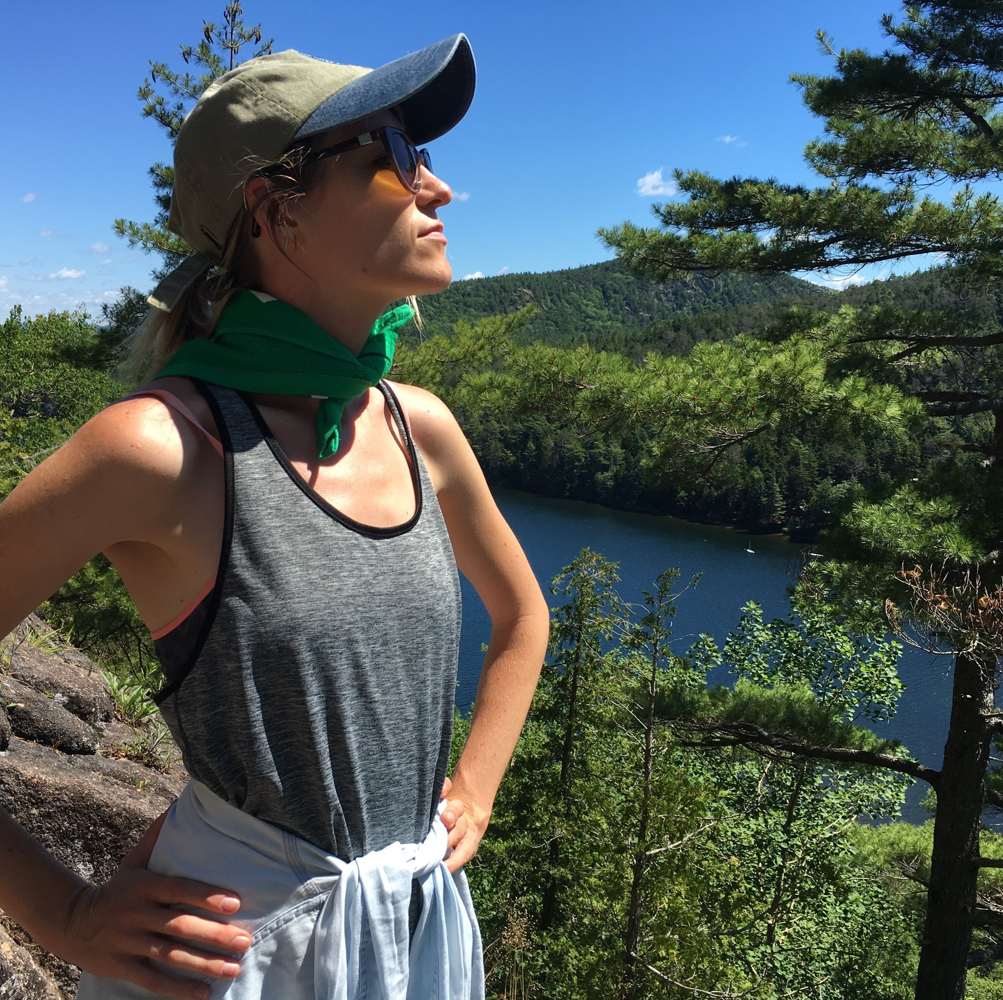
Projects are locally focused, developed and controlled

Slide 45

Taxes funding this have already been collected

Slide 46
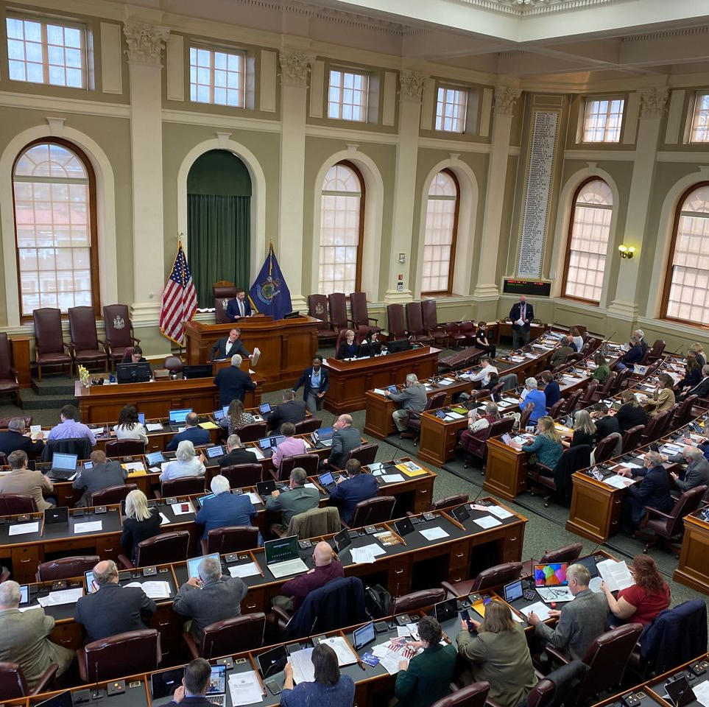
CRP fund were approved by BOTH sides of the aisle

Slide 47

Flexible to the needs of each community

Slide 48
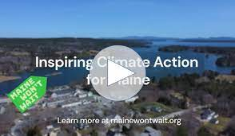

Slide 49

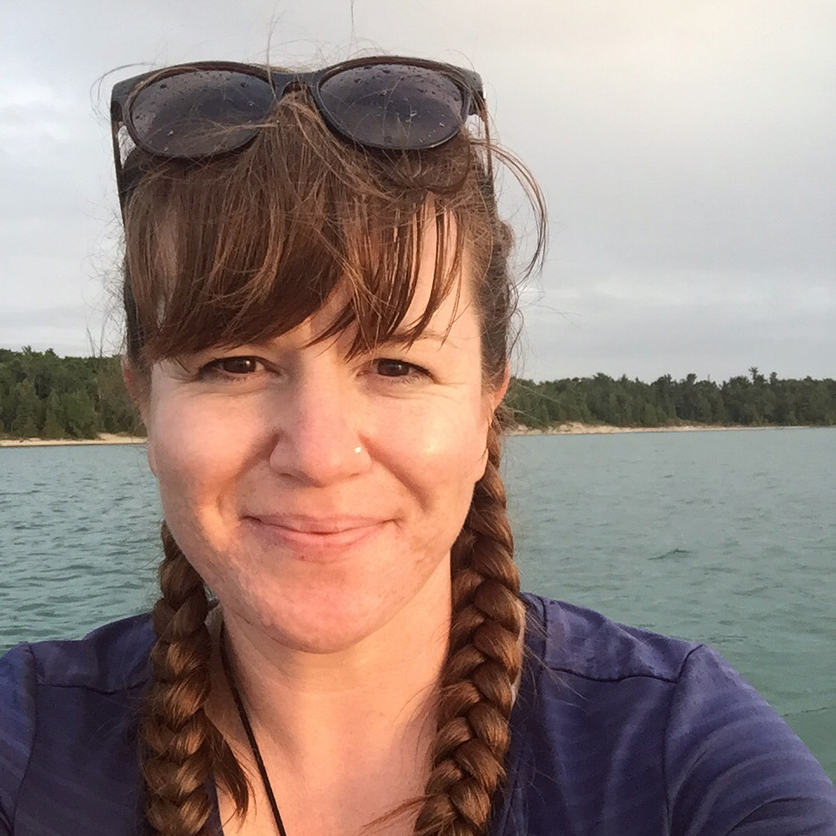
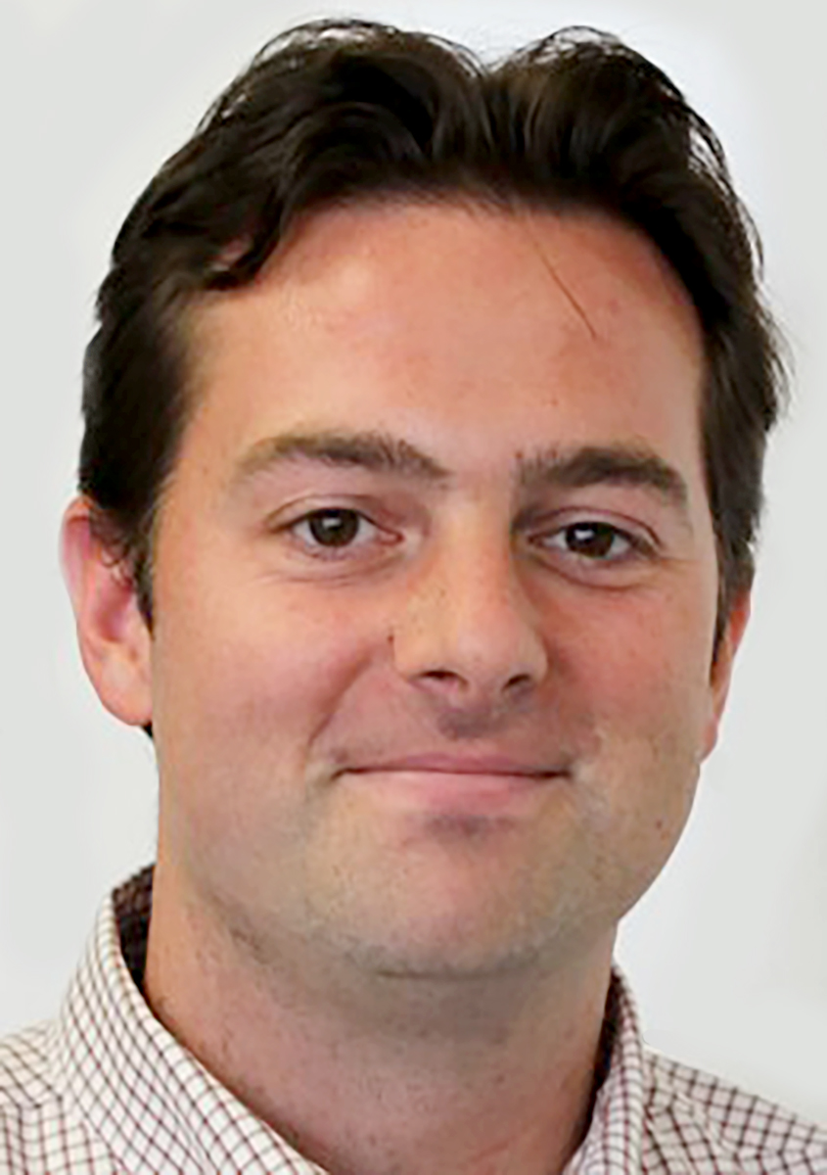
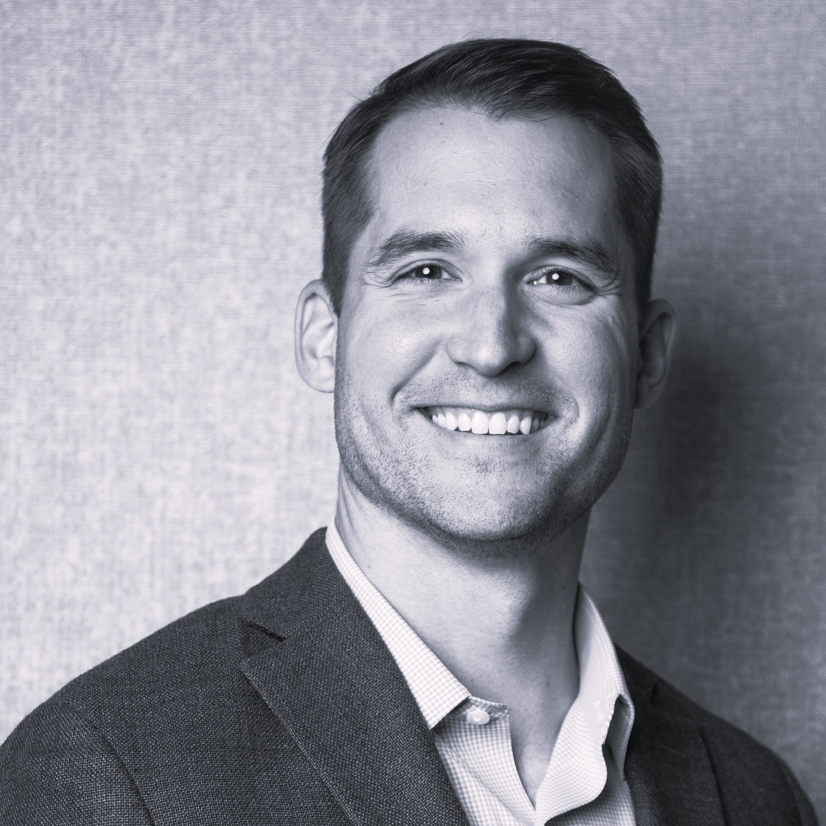
References and Further Reading
Jessica Brunacini
Maine Sea Grant
Coastal Community Resilience Extension Associate
From Theory to Practice: Participatory Approaches to Understanding the Social Dimensions of Managed Retreat.
Jesse Graham
Associate Professor of Management at the Eccles School of Business at the University of Utah
“Liberal and Conservatives Rely on Different Moral Foundations”
Moral Foundations Theory and Political Ideology with Dr. Jesse Graham- Podcast
Instragramer Jefferson Fisher

Slide 50


Slide 51


