Slide 1
In-Person Class Meetings: What to Expect, What to Do
Emily Haddad, Dean
College of Liberal Arts and Sciences

Slide 2
Covering Your Face
University of Maine System policy: Face coverings “are required to be worn indoors and outdoors on University of Maine System campuses.” (8/10/20)
Exceptions: 1. when a person is alone in an office or other room with a closed door; 2. when a person is alone outside in a space where and when they can reasonably expect to be alone and they have a face covering available in the event it is needed; 3. when eating or drinking in a space where eating or drinking is permitted; 4. when a medical accommodation has been granted by appropriate University officials; 5. When a situation (i.e. childcare settings) or a person (i.e. children younger than 2) are specifically exempted by Maine civil authorities; and, 6. in other special circumstances as may be determined by campus leadership.”
Full Guidance:
https://www.maine.edu/together/community-guidance/everyone/

Slide 3
What if I forget?
There’s a place to get a disposable mask in most campus buildings. Go get one.
What if I don’t want to wear a mask?
Everyone has to cover their face on campus. Students who don’t may be referred to the Dean of Students for a conduct violation. Employees who don’t may be referred to Human Resources.

Slide 4
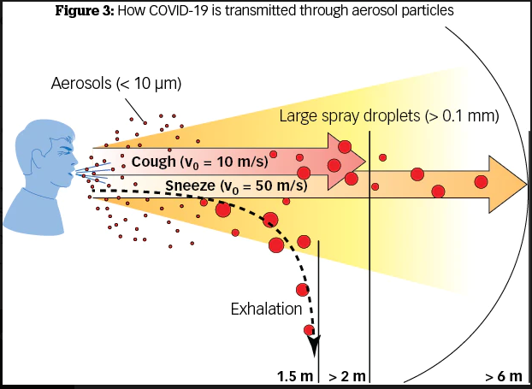
Why is this so important?
And remember, with Covid-19, it’s easy to shed the virus and infect other people even if you don’t feel sick!
https://www.youtube.com/watch?v=wnafrAtfMzE to watch sneeze aerosol in real life.
2 meters = 6 feet
https://www.perioimplantadvisory.com/periodontics/oral-medicine-anesthetics-and-oral-systemic-connection/article/14173521/covid19-and-the-problem-with-dental-aerosols

Slide 5
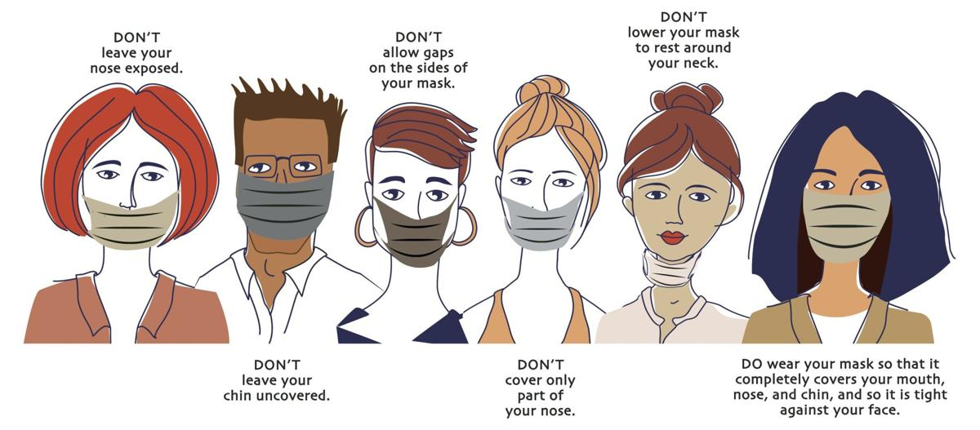
Avoid touching the front of your mask!
How to wear a mask properly
https://bloximages.chicago2.vip.townnews.com/journalinquirer.com/content/tncms/assets/v3/editorial/a/4d/a4df6a62-80ba-11ea-a6b9-c7c2ce178309/5e99c25680766.image.jpg?resize=1200%2C527

Slide 6
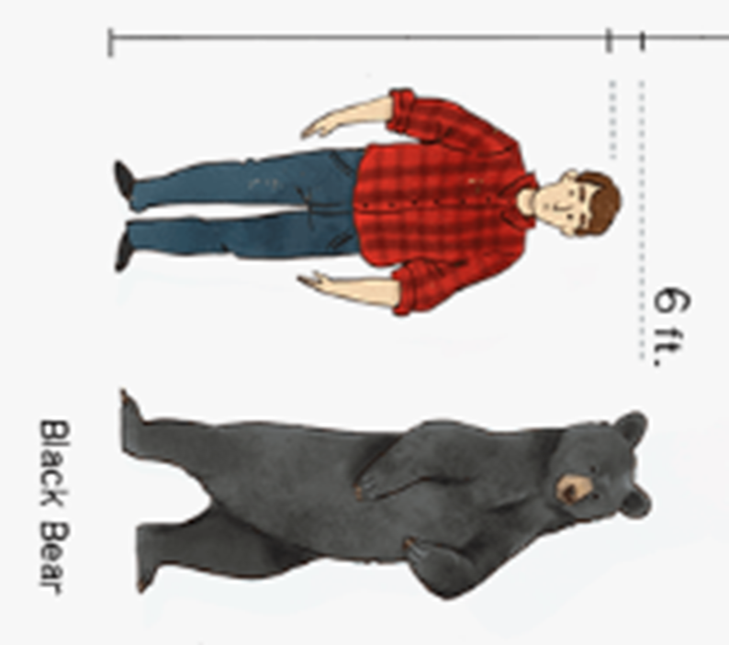
Keep your distance:
Stay one black bear away!
https://www.kindpng.com/imgv/ixiwhJm_comparison-of-commonly-found-bears-and-their-sizes/

Slide 7
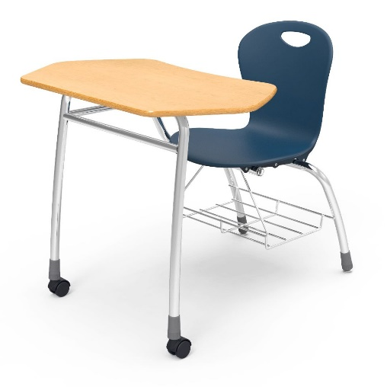
When you’re in class
Leave stored furniture where it is. Don’t move it into the active part of the room.
Sit only in the seats designated for use. Don’t move furniture around.
Sit in the same seat every day. That way, if someone in the class gets Covid-19, they will know who was sitting near them.
Don’t eat or drink during class.
Use a wipe to clean your area at the end of class.

Slide 8
What if I don’t feel well?
What if I believe I may have been exposed to Covid-19?
Don’t come to class!
Notify your professor so that they are aware of why you are absent and can help you stay caught up. If your class has the opportunity for remote participation, try to join that way instead.
Feeling sick? Call Cutler Health Center at 207.581.4000
Concerned about possible exposure? Call the Dean of Students Office 207.581.2681

Slide 9
Thank you for being a Black Bear who cares!

