Slide 1
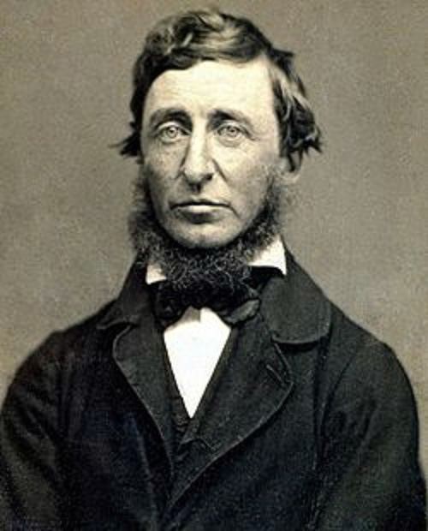

Richard Judd
“Was Henry a Hippie?
Locating Thoreau in
a Changing Modern
World”
Monday, December 5
3:10 PM
Hill Auditorium, Barrows Hall
In the 1960s, Henry David Thoreau became an symbol of American dissent: a Walden Pond drop-out, an anti-war anarchist, a theorist of civil disobedience, and even a drug-user. Dr. Judd will describe this unprecedented notoriety as an episode in Thoreau’s rise from obscurity in 1862 to near universal recognition a century later. The intense controversy over Thoreau’s life and work in this decade laid the groundwork for his status as an icon of the environmental movement in the 1970s.
Dr. Judd received his PhD from the University of California at Irvine in 1979. Among his recent publications are the co-authored Historical Atlas of Maine; Second Nature: An Environmental History of New England; and The Untilled Garden: Natural History and the Origins of American Conservation, 1730-1850. This talk is based on a book manuscript titled “Finding Thoreau: The Meaning of Nature in the Making of an Environmental Icon.”
This lecture is the third in the 2016-2017 Department of History Symposium Series.
The University of Maine is an equal opportunity/affirmative action institution.

