Slide 1
Student Life Training
Division of Student Life
Title IX Student Services

Slide 2
Content Warning
The information we will be discussing and going over today can be very difficult to process. We will be discussing some tough and uncomfortable subjects such as:
  Sexual Harassment, Sexual Assault, Interpersonal Violence, Retaliation, Sex Discrimination, Gender Discrimination
  Suicide, Campus Safety, Clery
This is a Safe Space!
Notes:
Liz – Before we begin!
The information we will be discussing and going over today can be very difficult to process. In our time with you today we will be talking about sexual harassment, sexual assault, interpersonal violence, suicide, and campus safety. If at any point you need to leave or take a break that is fine. If you could just give a thumbs up if you need to take some space and are okay. If you don't give a thumbs up we can have someone come check in with you. Please know that this is a safe space and we are here to engage with you as we teach you some basic information and some more complex responsibilities that you may not have thought about before.

Slide 3
Step 1: Reach Out for Help
Who are we and when to call us?
Notes:
Kenda
Kenda introduces herself & preferred pronouns
Liz introduces herself & preferred pronouns
Heather introduces herself & preferred pronouns

Slide 4
Student Behavioral Expectations
UMPD (911 or 207.581.4040)
  Crimes (Clery, Annual Report)
  Other Issues (ex. wanted out, disruption, etc.)
Dean of Students/Student Conduct(207.581.1406)
  Hazing (new members, student orgs, honor societies, etc.)
  Drug/Alcohol Issues (Cannabis Not Permitted on Campus in any Form)
  Academic Integrity Issues (make sure your syllabus is clear)
Counseling Center (207.581.1392)
Student Behavior Review Team (207.581.1406)
  What to Report/Then What Happens
  Questions/Consultations
Notes:
Kenda

Slide 5
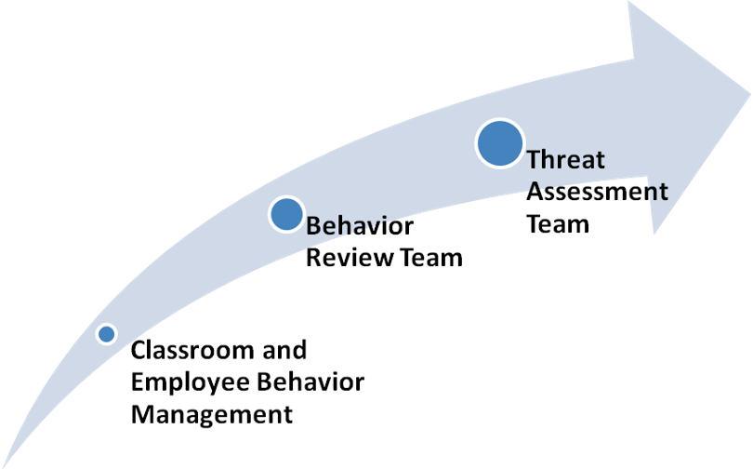
Student Behavioral Review Team
Notes:
Kenda
Mission: To promote and support: 1.) The health and safety of the campus community; and 2.) community member wellbeing and success by coordinating information and developing support plans for people of concern.

Slide 6
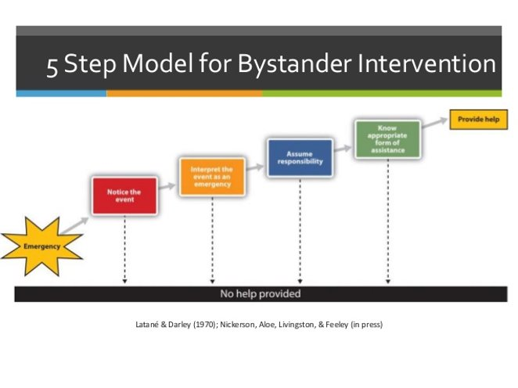
Bystander Intervention
Notes:
Kenda
Notice the incident/situation
Accurately interpret the situation: is it an emergency?
Assume responsibility
Attempt to help: Ex: Call 911 or 207.581.4040, Call Student Life 207.581.1406 or intervene. For example if you see two students in a hallway and things look uncomfortable, maybe you walk up to them and ask if everything is okay? Or maybe you say, I’m sorry to interrupt but I was wondering if you could help me. Then ask the person who looks uncomfortable to walk with you to your next meeting because you forgot how to get to Neville Hall. Anything to disrupt the course of the conversation. However, if at anytime you don’t feel comfortable call the police.
Bystander Intervention Training is Offered by the Student Wellness Center 207.581.1406.

Slide 7
Step 2: Do Not Discriminate
Protected Criteria . . .
  Race/Color
  Sex (gender identity, transgender, gender expression, sexual orientation, pregnancy)
  National Origin/Citizenship Status
  Religion
  Age
  Pregnancy/Parenting
  Disability
  Veteran Status
  Genetic Information
Bias Response Team
Notes:
Liz – Heather or Kenda to chime in and talk about the Bias Response Team (BRT).
The Equal Opportunity Office was not able to join us today. However, these our the protected criteria under the federal and state laws. You can’t discriminate on someone based on their race, color, sex, national origin/citizenship status, religion, age, pregnancy/parenting, disability, veteran status, or genetic information.
Pregnancy, parenting, and nursing. These are all protected under Title IX, which is one of my area of expertise. We should never ask someone if they are pregnant or expecting. However, if they mention it, it would be a good time to see if they are aware of services. For example, a student may come to you and say that their partner is expecting and they may miss some classes. Did you know that Heather can assist them with the missed classes? Both parents have protections under the law, not just the birthing parent. This also include adoption, abortion, miscarriage, etc.

Slide 8
And . . .
Sexual Orientation: homosexuality, bisexuality, heterosexuality (actual or perceived), AND
  Gender Identity: An individual’s gender-related identity, whether or not that identity is different from that traditionally associated with that individual’s assigned sex at birth, including, but not limited to, a gender identity that is transgender or androgynous
  One’s inner concept of self as male or female or both or neither
  Gender Expression: The manner in which an individual’s gender identity is expressed, including, but not limited to, through dress, appearance, manner, speech, or lifestyle, whether or not that expression is different from that traditionally associated with that individual’s assigned sex at birth
  The external communication of one’s gender identity
  Transgender
Be Sure to Use Preferred Names/Pronouns on Rosters and When Talking to Students.
Notes:
Liz, mention that your class roster may include legal name and preferred name
Let’s break down some of these categories a little more. When I say sex, I am referring to biological sexual organs. When we say gender we are talking about how a person identifies or is perceived to identify. Just because someone has a more feminine or masculine look, we should never assume they go by she/her or he/him pronouns. We want everyone to feel included in spaces on campus.
When in doubt ask a person their preferred pronouns. Or if you are uncertain use their preferred name. If you make a mistake acknowledge it, apologize, and move on.

Slide 9
Activities also may be protected . . .
For example, if:
  An individual raises a complaint that they were discriminated against; or
  An individual participates in an investigation of a complaint of discrimination;
The individual may not be retaliated against because of these actions
Note: See also University policy on Reporting Wrongdoing
Notes:
Liz. So, what if a student goes to your supervisor and complains about what you are doing in class?

Slide 10
Discrimination 101
Classic Example = Discrimination
  Treating someone differently (e.g., refusing to hire, firing, demoting, giving a bad grade, etc.)
  Because of . . .
  A protected criteria or a protected activity
Notes:
Liz

Slide 11
But also discrimination if . . .
Discriminatory Harassment - Hostile Environment
  Harassment that is severe or pervasive enough to alter the terms and conditions of employment or educational experience because of a protected criteria (race, disability, veteran status, sexual orientation, sex etc.)
  Title IX Sexual Harassment must be sex/gender based severe, pervasive and objectively offensive
The more severe the behavior the less often it must occur to create a hostile environment, and vice versa
Important Note: Harassment does not need to reach the level of a hostile environment to get you into lots of trouble!!!
Notes:
Liz

Slide 12
Most Common Form of Harassment = Sexual
Sexual harassment can include harassment based on gender, such as:
  a pattern of demeaning jokes or comments about women or men
  or exclusionary behavior that negatively impacts the terms or conditions of an individual’s employment or education
Sexual harassment is also unwelcome conduct of a sexual nature
Notes:
Liz

Slide 13
Wide Spectrum of Behavior Included
Wide spectrum of behavior can be considered sexually harassing – includes unwelcome sexual advances, requests for sexual favors, and other verbal or physical conduct of a sexual nature
May include off-campus and off-hours behavior if the behavior has a connection to the work or educational environment
Notes:
Liz, sexting someone, having sexual relations in your office, telling inappropriate sexual jokes or memes.

Slide 14
What behaviors can lead to claims of sexual harassment?
Verbal:
  e.g., sexual or highly personal comments, repeated requests for dates, jokes based on sex or gender, detailed or suggestive comments about appearance
Non-verbal conduct:
  e.g., winking, lingering glances/staring, posting of sexual pictures (screen savers), gifts of a personal nature
Physical contact:
  e.g., patting (especially on leg, etc.), hugging, blocking movement, shoulder rubs, standing too close to another, blocking doorways
Notes:
Liz

Slide 15
How About in Role as a Teacher?
How is this different?
Power differential dramatically changes the equation
  Do not think of your students as peers; they do not think of you that way.
Would repeated requests for date would be required before the situation was problematic?
What about a request to go for a cup of coffee?
What about visiting students in your class in their rooms?
What about a Facebook friend request?
Boundaries are crucial . . .
Notes:
Liz What about Snapchat, TicTok, Tinder, Grindr

Slide 16
What is the problem?
Quid pro quo
  Conditioning favorable treatment on a subordinate’s agreement to provide sexual favors; e.g., telling or implying a student that you will give him/her an A if he/she kisses you
  Threatening unfavorable treatment if a subordinate refuses sexual favors; e.g., telling or implying a student that you will fail him/her if he/she refuses to go on a date with you
Notes:
Liz

Slide 17
Consenting Relationships Guidelines
What is the issue?
  Romantic or sexual relationships between those with a professional power differential may result in:
  Complaints of quid pro quo or hostile environment sexual harassment
  At the very least, complaints of favoritism from other students
Guidelines established by University of Maine System
  Entering into such a relationship with someone over whom you have authority is strongly discouraged by policy
  If in a consenting relationship, need to act promptly to eliminate the conflict of interest– must contact your supervisor promptly to disclose the relationship and ensure any conflict of interest created by the relationship is addressed appropriately
Notes:
Liz

Slide 18
Sexual Harassment and Criminal Conduct
Sometimes criminal conduct may also be a form of sexual harassment
For example, sexual assault would be a severe incident of unwelcome conduct of a sexual nature which could create a hostile environment
Other criminal behavior that may also constitute sexual harassment are stalking and relationship abuse (dating violence and domestic violence)
Notes:
Liz

Slide 19
Sexual Assault
Sexual assault means an offense that meets the definition of rape, fondling, incest, or statutory rape.
For full definitions, please see University of Maine Policy and Procedure on Sex Discrimination, Sexual Harassment, Sexual Assault, Relationship Violence, Stalking and Retaliation
Notes:
Heather

Slide 20
Dating and Domestic Violence
Dating violence is violence committed against a person by an individual who is or has been in a social relationship of a romantic or intimate nature with that person.
Domestic Violence is a felony or misdemeanor crime of violence committed—
  By a current or former spouse or intimate partner of the victim;
  By a person with whom the victim shares a child in common;
  By a person who is cohabitating with, or has cohabitated with, the victim as a spouse or intimate partner or by someone who is similarly situated to a spouse of the victim, or
  By any other person against an adult or youth victim who is protected from that person’s acts under domestic or family violence laws
Notes:
Heather

Slide 21
Consent – “Yes means yes”
Consent must be informed, freely and actively given, and consist of a mutually agreeable and understandable exchange of words or actions
Consent is clear, knowing and voluntary
Consent is active, not passive
  Silence, in and of itself, cannot be interpreted as consent.
  Consent can be given by words or actions, as long as those words or actions create mutually understandable clear permission regarding willingness to engage in (and conditions of) sexual activity
Notes:
Heather

Slide 22
When “Yes” Is Not Enough . . .
Any consent that is given is invalid or moot when:
  the exchange involves unwanted physical force, coercion, intimidation, and/or threats
  If an individual is mentally or physically incapacitated or impaired such that one cannot understand the fact, nature or extent of the sexual situation, and the incapacitation or impairment is known or should be known to a reasonable person, there is no consent
  This includes conditions resulting from alcohol or drug consumption, or being asleep or unconscious
Maine law provides further information about when consent is not adequate
Notes:
Heather

Slide 23
Sexual Misconduct
Sexual misconduct includes, but is not limited to:
  prostituting another
  nonconsensual image capturing of sexual activity
  presentation or unauthorized viewing of a nonconsensual videotaping of sexual activity
  letting others watch you have sex without the knowledge or consent of your sexual partner
  possession of child pornography
  peeping tommery
  knowingly transmitting an STD or HIV to another person
Notes:
Heather, mention stealthing and revenge porn

Slide 24
Stalking
Stalking is intentionally or knowingly
  engaging in a course of conduct
  directed at or concerning a specific person
  that would cause a reasonable person to suffer serious inconvenience or emotional distress
Notes:
Heather, could be a form of dating violence

Slide 25
Mandatory Reporting
As a student employee, if within the scope of your employment, you
  witness or are told about possible sexual discrimination (which can include sexual harassment, sexual assault, stalking, and relationship abuse)
  that involves members of the University community
You MUST report what you observed or are told to appropriate University officials
  The Rule of 3
Notes:
Heather
Rule of 3: If the person telling you is a student, staff, faculty, volunteer, or guest on campus you must report it. If the person states that it happened on campus you must report it. If the person they are alleging is a student, staff, faculty, volunteer on campus.
Why would you report something that someone disclosed to you that happened as a child? Or before they came to the University?

Slide 26
“Who You Gonna Call?”
If you witness criminal conduct while it is occurring or perceive an immediate threat to the safety of the campus - call 911
Otherwise, if you learn of (reported to you or witnessed) sexual discrimination (including sexual harassment, assault, dating/domestic violence, and stalking) involving members of the University community
  Report incidents of sexual discrimination by students to the Title IX Student Services at 207.581.1406
  Report incidents of sexual discrimination by employees or other non-students to the UMS Title IX Coordinator Liz Lavoie 207.581.5866
Notes:
Heather

Slide 27
What information must be reported?
Whatever you know
You will need to report all relevant details about the alleged sexual discrimination or violence that the University will need to determine what happened–including
  the names of those involved
  the identity of any witnesses
  any other relevant facts, including the date, time and specific location of the alleged incident
Note: You do not need to ask questions to collect this information.
Notes:
Heather

Slide 28
Respecting Privacy
To the extent possible, information reported should only be shared with those responsible for handling the University’s response to the report
Unless you perceive an immediate danger, you should not share information with law enforcement without the student’s consent, unless the student has already reported to the law enforcement or you are otherwise required to do so by law
  You should encourage the student to make a report to police and offer to connect the student with support services for doing so
  Suggest that he or she preserve any evidence of a possible crime to share with police at a later date if the person does not wish to go right away
Notes:
Heather

Slide 29
What about confidentiality?
If possible, you should try to ensure that students understand your reporting obligations before they reveal information to you that you are required to report
  Language about mandatory reporting and resource information MUST be included on your syllabus – see http://umaine.edu/upcc/forms/
If the student wants to maintain confidentiality, you should direct him or her to confidential resources (but anything reported to you before this must be reported)
For confidential resources on campus: Counseling Center: 207.581.1392 or Cutler Health Center: at 207.581.4000
For confidential resources off campus: Rape Response Services: 1.800.871.7741 or Partners for Peace: 1.800.863.9909
Notes:
Heather

Slide 30
Confidentiality Requests
However, once a disclosure is made, you are required to report even if the student would prefer to maintain confidentiality
You should inform the student that the University will consider her or his request for confidentiality, but cannot guarantee that the University will be able to honor it
If a student has requested confidentiality, you should share this information when you make the report
Notes:
Heather, However, once a disclosure is made, you are required to report even if the student would prefer to maintain confidentiality.
You should inform the student that the University will consider her or his request for confidentiality, but cannot guarantee that the University will be able to honor it.
If a student has requested confidentiality, you should share this information with the appropriate campus office when you make the report.

Slide 31
How Does the University Decide?
The University will weigh the individual’s request for confidentiality against the institution’s obligation to provide a safe, nondiscriminatory environment for all students
If the University determines that it can maintain confidentiality, the student must understand that the institution’s ability to meaningfully investigate the incident and pursue disciplinary action, if warranted, may be limited
Although rare, there are times when the University may not be able to honor a student’s request for confidentiality because doing so would pose a risk to its ability to provide a safe, nondiscriminatory environment
  If the University determines that it cannot maintain confidentiality, the University will advise the student, prior to starting an investigation and, to the extent possible, will share information only with those responsible for handling the institution’s response
Notes:
Heather, The University must weigh the individual’s require for confidentiality against the institution’s responsibility to provide a safe, nondiscriminatory environment for all.
Most of the time the University will be able to honor the individual’s request for confidentiality. If the University determines that it can maintain confidentiality, the student must understand that the institution’s ability to investigate meaningfully and pursue disciplinary action, if warranted, may be limited.
In those relatively rare situations in which the University may not honor an individual request for confidentiality, the student will be advised of this decision prior to starting an investigation when possible. Further, the information will be shared only with those with a need to know it.

Slide 32
What Happens Once a Report is Made?
An employee from the Title IX Student Services or the The UMS Title IX Coordinator will reach out to the person and offer support, resources, and information
The student will be invited to meet with the employee to discuss the situation and the various options available to him or her
The University can offer a number of different services to individuals involved in a report of sexual discrimination including: housing changes, academic accommodations, no-contact orders, advocacy services, and information about the internal complaint procedures
For more information, please see the Title IX Student Services website: umaine.edu/titleIX
Notes:
Heather: After a report is made, staff from either the Office of Sexual Violence Prevention or the Office of Equal Opportunity will reach out to the student who made the report and invite him or her to meet with the staff member. This is usually done through email.
The University can provide a number of services to those individuals involved in a report of sexual discrimination, depending upon the circumstances. These can include housing changes, academic accommodations, no-contact orders, advocacy services, and information about the internal complaint procedures available.
Typically a faculty member who provides information about a student report does not need to be involved in the process further. However, sometimes, a faculty member who makes a report may be asked to prepare a written statement or otherwise participate in a disciplinary or investigatory process.

Slide 33
What to Do if You are Being Harassed?
If someone in the University community engages in harassing behaviors toward you
  Of course, you can address situation yourself
    Change your interactions with that person -- become more formal or physically step away from someone who is standing too close to you
    Directly and honestly address the situation with the person
Notes:
Liz: It is important to know how to respond if you feel that you are being sexually harassed.
First, of course, you should not hesitate to address the situation. Sometimes, you can change the way someone is interacting with you by changing the tone of your communications with him or her or by physically moving away from someone who is standing too close to you. If these indirect approaches are not successful, you should be direct and honest with the other person. Do not worry about offending the person.

Slide 34
Getting Help
  BUT, if you are not comfortable approaching the situation directly or your efforts are unsuccessful
    Bring the situation to University officials for help
      If the person discriminating against you is a student, contact the Title IX Student Services, 581.1406
      If the person discriminating against you is an employee or other non-student, contact the Office of Equal Opportunity, 581.1226
    Various options available from an informal approach to a formal investigation, depending upon the circumstances
    For more information, see the Equal Opportunity Complaint Procedure in your materials.
Notes:
Liz: If you have tried to address the situation and the behavior continues, or, if you are uncomfortable approaching the situation directly, call the Office of Equal Opportunity at 581-1226 if the person involved is another employee or non-student; call the Office of Sexual Violence Prevention if the person is a student. Staff from these offices can describe options available to you from informal approaches to filing a formal complaint.

Slide 35
How to make a complaint of discrimination
Internally: Contact the Office of Equal Opportunity
  University of Maine EO Complaint Procedure http://www.umaine.edu/eo/policy/complaint-internal.htm
    Informal Process
    Formal Process
Notes:
Liz: If you feel that you have been a victim of discriminatory treatment, please contact the Office of Equal Opportunity. They will give you information about the University of Maine Equal Opportunity Complaint Procedure. That procedure, which can be found on the Equal Opportunity website at the link above, has both informal and formal ways to resolve concerns.

Slide 36
External Options
External Agencies also have processes for complaints of discrimination –
  Maine Human Rights Commission - www.maine.gov/mhrc
  Equal Employment Opportunity Commission - www.eeoc.gov
  U.S. Department of Education’s Office of Civil Rights - www.ed.gov/ocr
Notes:
Liz, In addition there are also external agencies that handle complaints of discrimination. Contact information for the Maine Human Rights Commission, the Equal Employment Opportunity Commission, and the U.S. Department of Education’s Office of Civil Rights has been provided on this slide.

Slide 37
Thank You
Kenda Scheele, Assoc. VP Student Life 207.581.1406
UMPD, 207.581.4040 or 911
Elizabeth Lavoie, UMS Title IX Coordinator 207.581.5866
Heather Hogan, UM/UMM Deputy Title IX Coordinator 207.581.1406
Office of Equal Opportunity 207.581.1226
Notes:
Liz, It is now important for you to certify that you have completed this training. In order to do this, you must click on the link provided on the following screen and complete the form that you find at the site provided. If you have any questions about any of the materials covered in this training, please contact the Office of Equal Opportunity at 581-1226. Thank you for your participation.

