Slide 1
Division of Student Life
New Graduate Student Orientation
Thursday, August 24, 2023
316 Aubert Hall
Notes:
Kenda

Slide 2
Division of Student Life
Dean of Students Bodwell Center for Service
Campus Recreation & Volunteerism
Career Center Student Involvement
Community Standards (Student Conduct) (Greek Life, Student Orgs, Campus Activities, Leadership)
Commuter/Nontraditional Programs Counseling Center
Diversity and Inclusion Police & Security Services
Residence Life Accessibility Services
Student Wellness Title IX Student Services
Veterans Education & Transition Services

Slide 3
Title IX Student Services
Title IX Student Services
235 Memorial Union, 581-1406
Heather Hogan, Deputy Title IX Coordinator for UM/UMM
Notes:
Liz
You have a student who is 70 enrolled in your class. You can't grade them differently because of their age. You need to ensure that you are grading all students equally.

Slide 4
Bystander Intervention
Notes:
TJ

Slide 5
Mandatory Reporting
As a student employee, if within the scope of your employment, you
witness or are told about possible sexual discrimination (which can include sexual harassment, sexual assault, stalking, and relationship abuse)
that involves members of the University community
You MUST report what you observed or are told to appropriate University officials – Answer yes to ANY of these three questions
If the person reporting/complaining is a student, staff, faculty, volunteer, or vendor.
If the person they are reporting/complaining about is a student, staff, faculty, volunteer, or vendor.
If it happened on campus.
Notes:
Liz
You are a mandatory reporter! If you did your undergraduate degree here or have a friend network here – make sure they know that you are a mandated reporter.
If you fail to report, you will be referred to Equal Opportunity for an investigation.

Slide 6
“Who You Gonna Call?”
If you witness criminal conduct while it is occurring or perceive an immediate threat to the safety of the campus - call 911
Otherwise, if you learn of (reported to you or witnessed) sexual discrimination (including sexual harassment, assault, dating/domestic violence, and stalking) involving members of the University community
Report incidents of sexual discrimination by students to the Title IX Student Services at 581.1406
Report incidents of sexual discrimination by employees or other non-students to the Office of Equal Opportunity (Chadbourne Hall) at 581.1226
Notes:
Liz

Slide 7
Student Accessibility Services
Student Accessibility Services
121 East Annex/UCU Blg. (Rangeley Road)
Um.sas@maine.edu
Umaine.edu/studentaccessibility
207.581.2319
Notes:
Sara

Slide 8
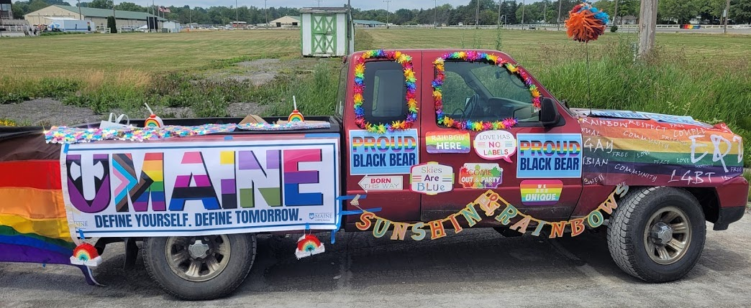
ODI Centers
Memorial Union
227 Intersectional Feminist Resource Center
224 Rainbow Resource Center
312 Multicultural Student Center

Slide 9
Diversity and Inclusion
Anila Karunakar (Director)
anila.karunakar@maine.edu 312 Memorial Union 207-581-1437
Taylor Ashley (Coordinator)
taylor.ashley@maine.edu 224A Memorial Union 207-581-4655
https://umaine.edu/diversity-and-inclusion/

Slide 10
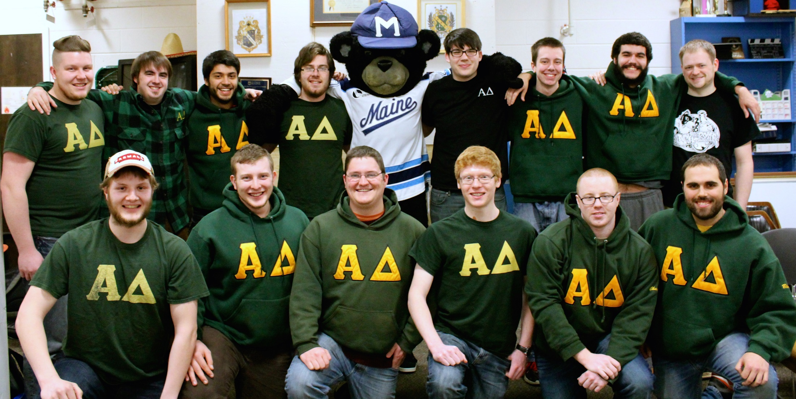
Student Involvement/Activities/Organizations
CENTER FOR STUDENT INVOLVEMENT
145 Memorial Union, 207-581-1406
Fraternity and Sorority Life
Campus Activities
Leadership Development
Student Organizations
Student Event and Risk Management
https://umaine.edu/studentinvolvement/

Slide 11
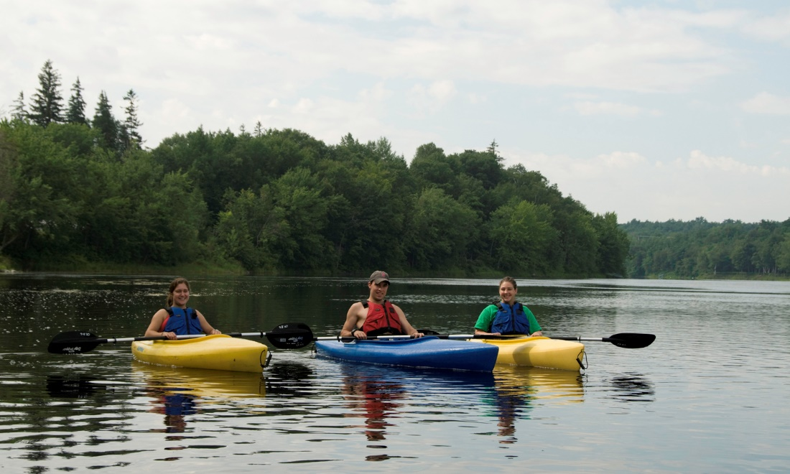
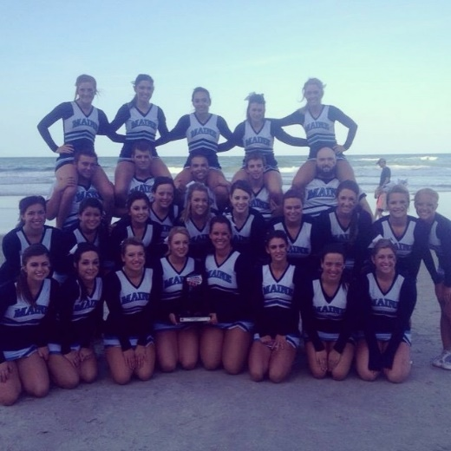
Campus Recreation
Campus Recreation
https://umaine.edu/campusrecreation/
Aquatics
Group Ex
Personal Training
Maine Bound
Intramurals
Sport Clubs
Kid/Youth Programs
Special Events
First Year Orientation Programs
Maine Bound Adventure Center
New Balance Student Recreation Center

Slide 12
Community Standards, Rights, & Responsibilities
David Fiacco, Director
315 Memorial Union
207-581-1406
*Academic Integrity
*Student Conduct
*First Amendment
https://umaine.edu/communitystandards/

Slide 13
Police and Security Services
William Flagg, Interim Chief
207-581-4040/911 (emergency)
Community Policing
Annual Security & Fire Safety Report
umaine.edu/police/clery-annual-safety-report/
Black Bear Safe App
umaine.edu/police/crime-prevention/black-bear-safe/
Emergency Warning System
umaine.edu/emergency/

Slide 14
Career Center
Crisanne Blackie, Director
300 Memorial Union https://umaine.edu/career/
Jobs
Internships
Career Fairs
Health and Legal Professions Advising
Career Link

Slide 15
Bodwell Center for Service & Volunteerism
Current Location: 120 Memorial Union
New Location: UCU Building/Rangeley Road
Lisa Morin, Coordinator
207-581-1406
Programs/Services
Black Bear Mentors
Black Bear Tutors
Alternative Breaks
Service Learning
Black Bear Exchange/Food Pantry

Slide 16
Veterans Education and Transition Services (VETS)
Veterans Center
161 Memorial Union
Tony Llerena, Associate Director
207-581-1316
https://umaine.edu/veterans/
Certification Requests
Veterans Week
Green Zone Training
Veteran Resources

Slide 17
Counseling Center
Angela Fileccia, Director
207-581-1392/911 (emergency)
https://umaine.edu/counseling/
Services/Resources Offered
Community and Online Support
Video Workshops
In-Person Counseling
Crisis Appointments
Emergency & Crisis Support
988: Suicide & Crisis Lifeline
911: Police

Slide 18
Additional Student Life Resources
Residence Life
311 Memorial Union
https://umaine.edu/reslife/
Student Accessibility Services
East Annex/UCU Building on Rangeley Road
https://umaine.edu/studentaccessibility/
Student Wellness Resource Center
149 Memorial Union
https://umaine.edu/wellness/
Commuter/Non-Traditional Students
Wade Leadership Center/Memorial Union
https://umaine.edu/cntsp/

Slide 19
Thank You!!
Kenda Scheele 581-1406
315 Memorial Union

