Slide 1
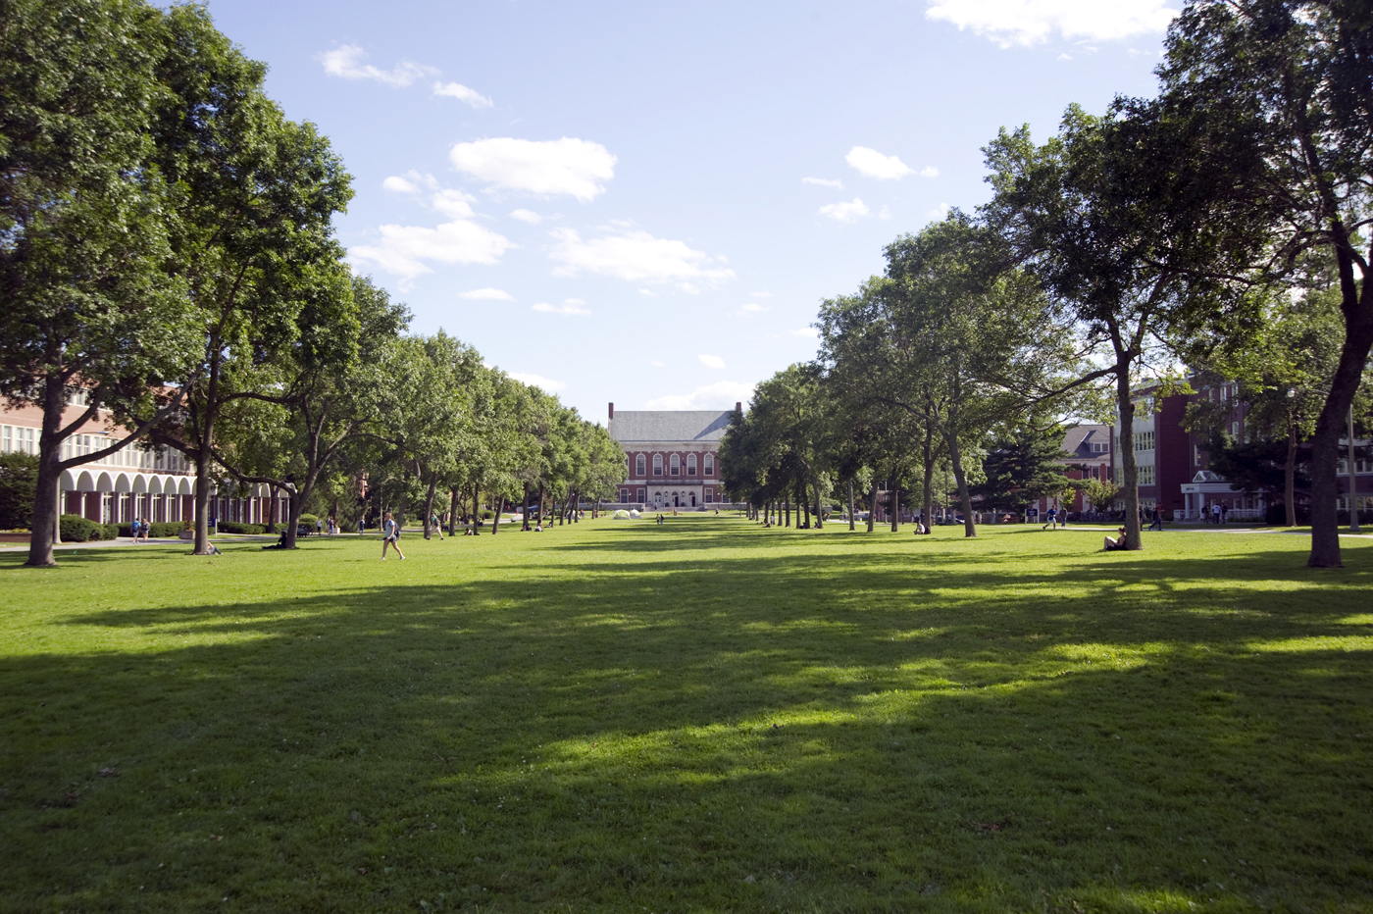
SUSTAINABILITY HANDBOOK
Made for students by students.
Learn about sustainability!
Notes:
-Required Oxford commas?
-volunteer opportunities

Slide 2
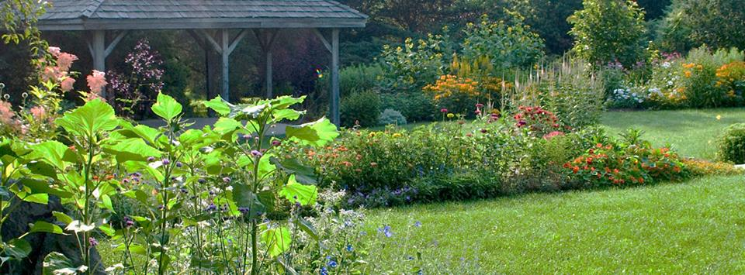
Sustainability Handbook
This Sustainability Handbook should act as your little guide throughout every day life to reduce your carbon footprint and live more environmentally friendly!
Please DO NOT print this handbook!
It wastes tons of paper and would cost a fortune if you accidentally print it in color at the library…
Notes:
Element of each: University of General for right hand side facts

Slide 3
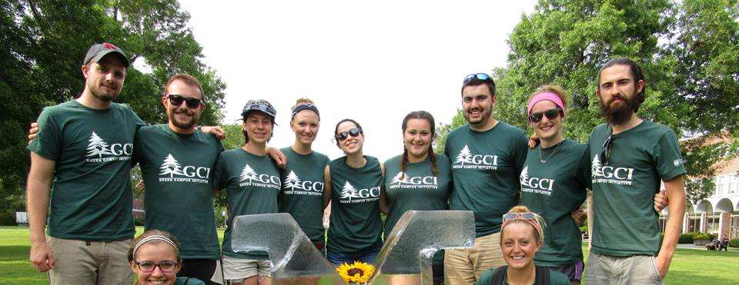
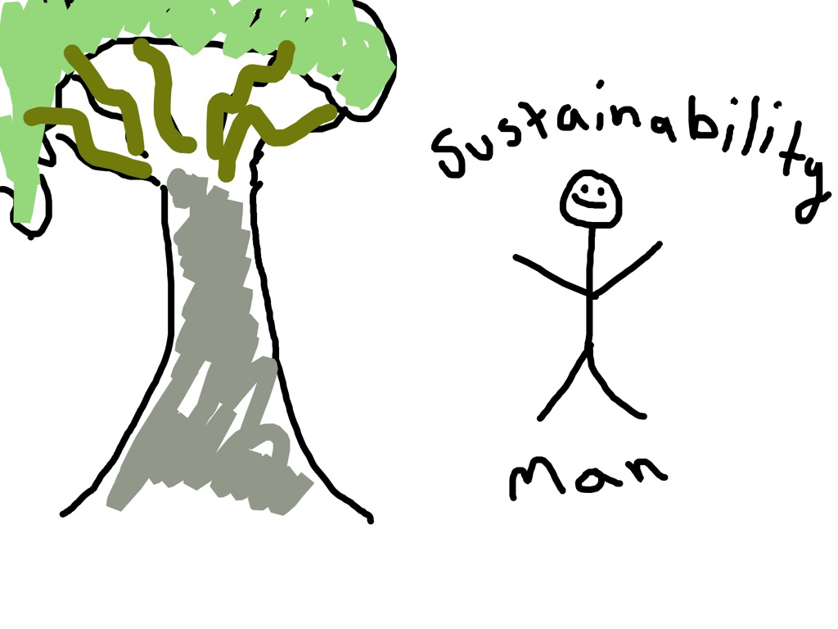
Green Campus Initiative
Questions?
Meet GCI and Sustainability Man!
Please contact: laura.lommler@umit.maine.edu or george.lindbom@maine.edu at the University of Maine.
The Green Campus Initiative is a student employee group that promotes sustainability on campus! Yes, we’re the rock stars who hang the Green Zines in the bathrooms!
Follow Us!
He will teach us all about sustainability tips here on the UMaine campus!
facebook.com/UMaineGCI @UMaine_GCI
@GreenCampusIntiative

Slide 4
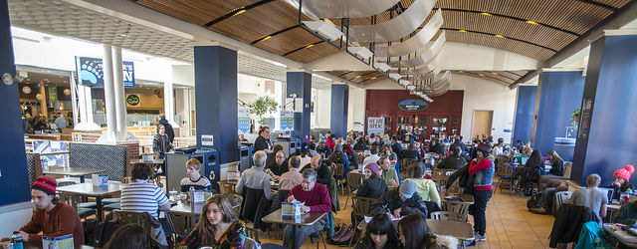
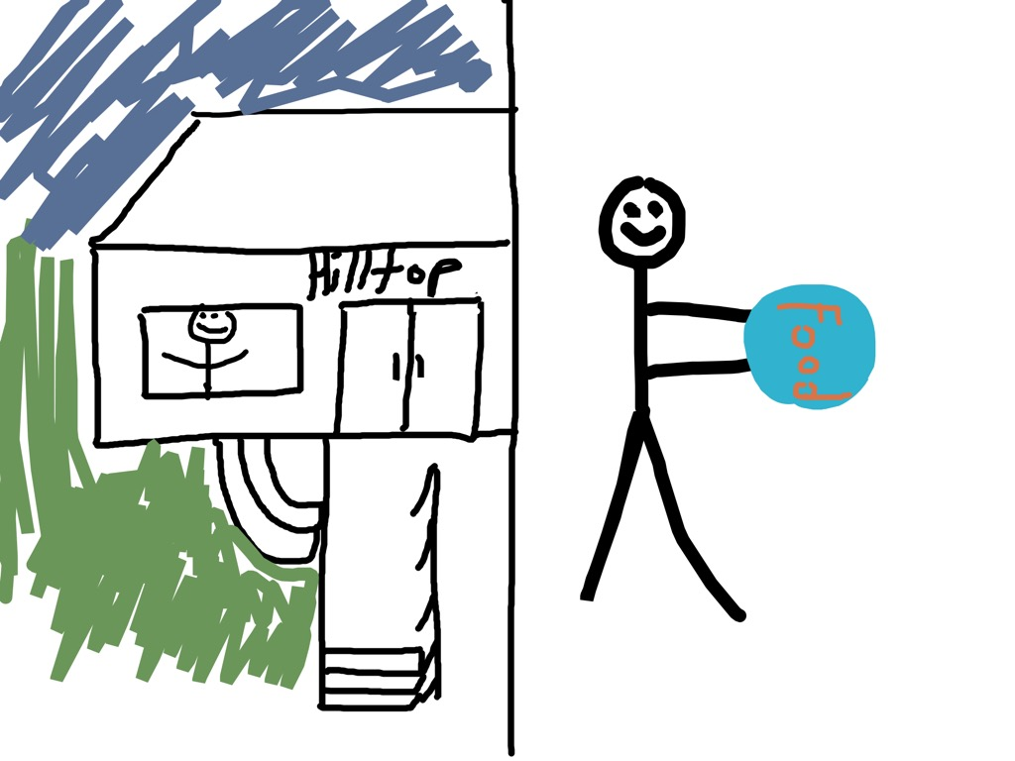
Dining - Yummmm
What you can do
Eat locally grown foods.
Carry a reusable cup or water bottle. Some water bottles come with built-in filters if you're worried about the quality of the tap water.
Limit the use of paper napkins.
Only take what you will eat to limit food waste.
Do not remove reusable plates, bowls, cups, or utensils from the dining facilities.
Dispose of waste in the correct container.
Look - Trayless dining at Hilltop! Don’t take more than you are going to eat – if you do, the leftover scraps are going into the compost and eventually used on the UMaine grounds!
Notes:
Add references and change 35 billion bottles fact

Slide 5
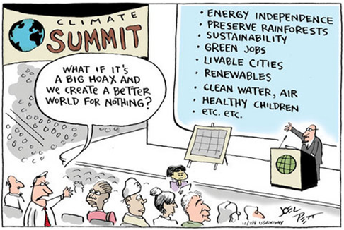
Printing
What you can do
Always print double-sided so you save paper and energy.
Print only documents that you absolutely need. In today’s world, most everything is done electronically.
Use recycled paper for printing if you can.
Give paperless presentations.
Minimize the use of coated, glossy, or laminated paper.

Slide 6
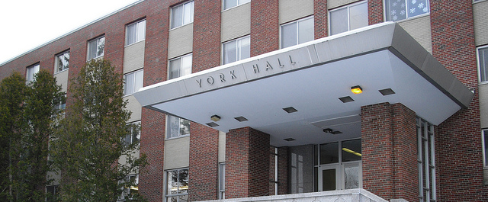
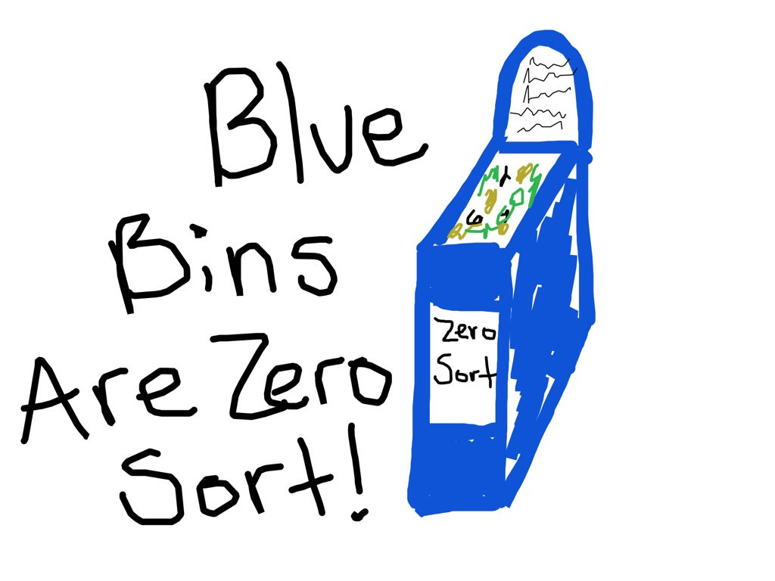
Resident Life
What you can do
Sustainability Man doesn’t know if he should take his recyclables out to the Zero Sort dumpster just outside his residence hall OR just ignore everything, throw his recyclables into the trash, and have a NOT SO environmentally friendly day.
Use compact fluorescent bulbs.
Turn off unnecessary electrical devices when you leave a room for more than 15 minutes.
Do not leave computers on all night.
Wash your clothes in cold water.
Buy inexpensive mugs and plates that you can wash rather than disposable ones and avoid over-packaged takeout food.
Take shorter showers.
Only wash full loads of laundry.
Air dry whenever possible.
I think we all know the right decision here….

Slide 7
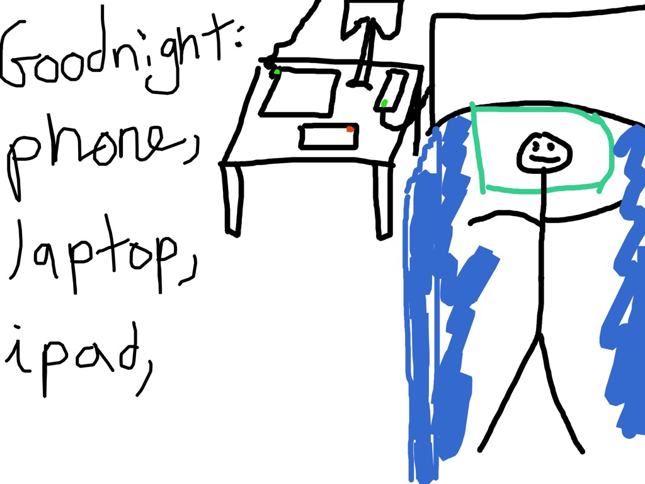
Energy
What you can do
Put your computer to sleep during lunch and during the day when it is not in use.
Close window shades on hot summer days.
Shut down electronics and turn off your power strip at the end of the day.
Use smart power strips.
Remove light bulbs from fixtures where possible and encourage daylighting.
Notes:
Stuff that’s going on on campus,

Slide 8
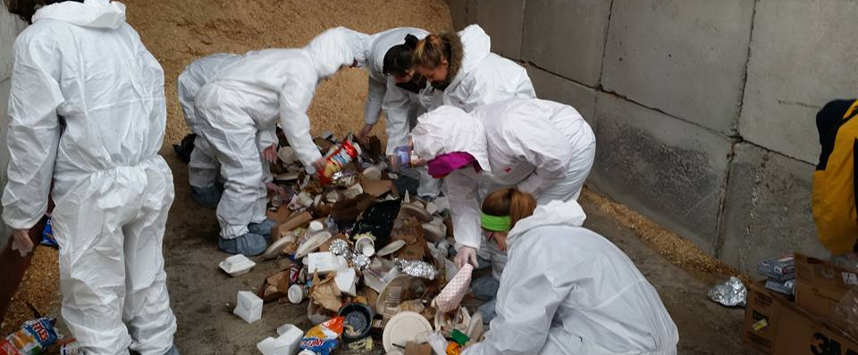
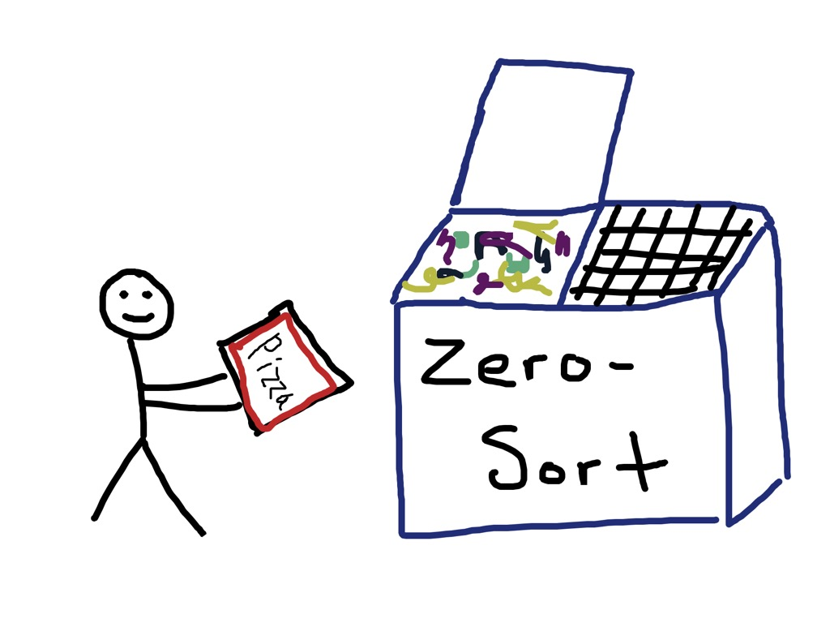
Waste and Recycling
What you can do
Reduce, Reuse, and Recycle as much as possible.
Know what you can and can’t recycle with the Zero-Sort recycling system.
Compost your food waste.
Recycle! It’s YOUR choice!
Notes:
Remove Casella Information – add facts about on campus

Slide 9
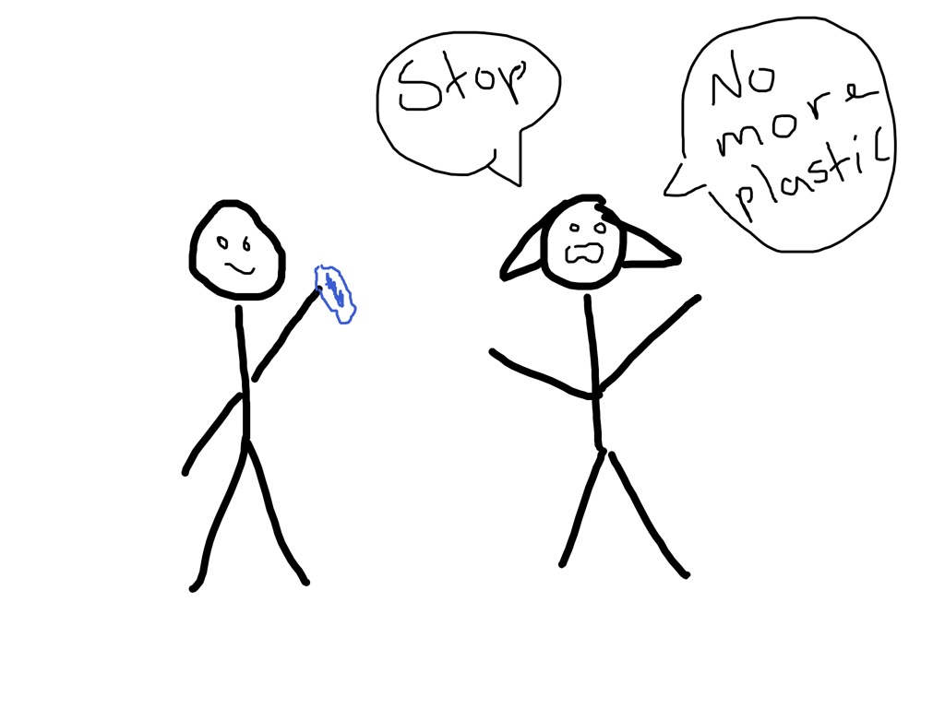
Water
What you can do
A leaky faucet that drips at the rate of one drip per second can waste more than 3,000 gallons per year (3,000 gallons = enough to fill a small tanker truck), and a running toilet can waste 200 gallons of water in a day.
Energy Star – Rate dishwashers are required to use less than 4.25 gallons of water per cycle. In contrast, the average kitchen faucet releases 2-3 gallons every minute. Unless you can wash the eight place settings a dishwasher can hold without running the faucet for more than 2 minutes, the dishwasher is more sustainable.
Report all leaking faucets/fixtures.
Use a dishwasher instead of hand washing individual dishes.
Don’t buy bottled water, use a reusable mug.

Slide 10
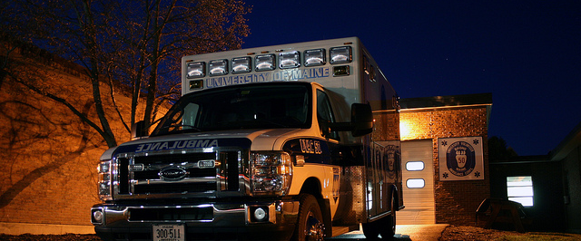
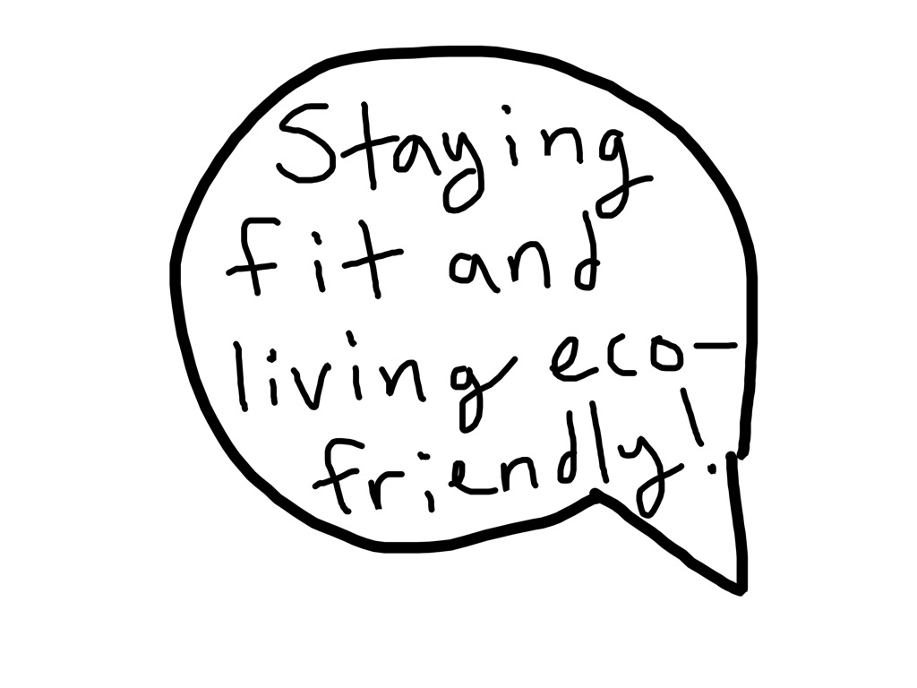
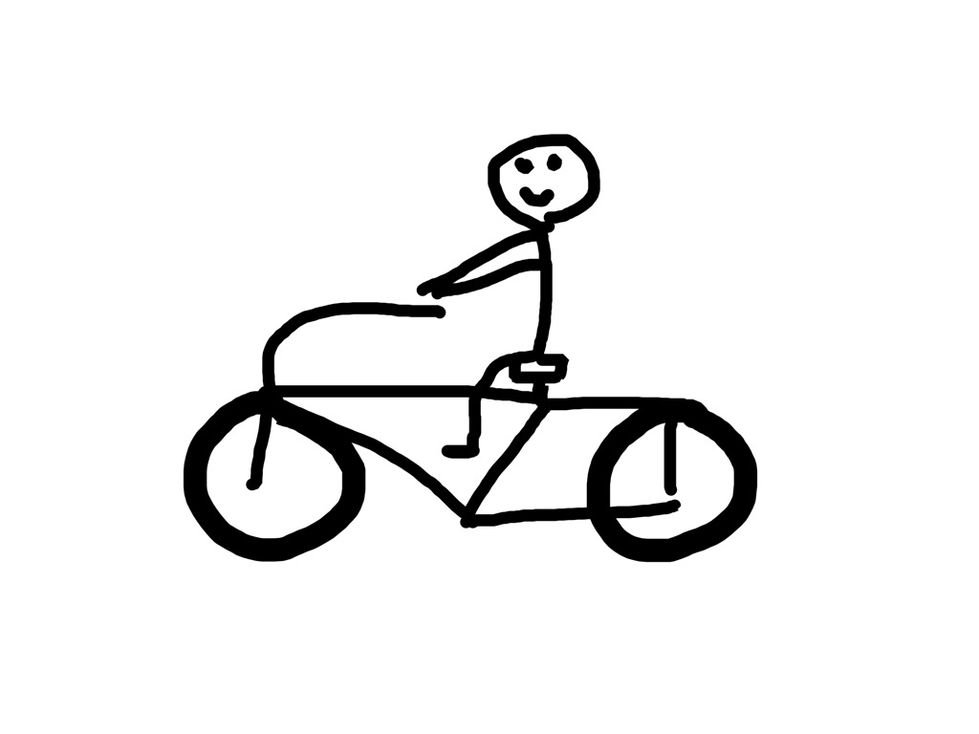
Transportation
What you can do
Using an alternative method of transportation (even for just one day a week) can decrease UMaine’s carbon footprint. Join your fellow students and coworkers who walk, bike, carpool, and use public transportation to get to campus.
When choosing a rental vehicle, select a hybrid.
Videoconference instead of traveling to meetings.
Commute by foot or bike to campus to save money and gas.
Carpool to campus with friends or coworkers. The University of Maine offers special parking passes to those who carpool.
Take advantage of the bike path from campus to Old Town.
A bike? Maybe?

Slide 11
Summary
Serve water from pitchers
Minimize paper use and print double-sided
Report all leaking faucets/fixtures
Put your computer to sleep during lunch and during the day when it is not in use
Use reusable dishware, glassware and silverware
Make any leftover food available to others
Use 100% recycled content, totally chlorine-free paper
When choosing a rental vehicle, select a hybrid
Commute using alternative methods of transportation
Use a dishwasher instead of hand washing individual dishes
Take advantage of the bike path from campus to Old Town
Don’t buy bottled water, use a reusable mug

Slide 12
Closing
Thank you for making environmentally friendly choices each and every day!
The University of Maine is an equal opportunity/affirmative action institution.

