Slide 1
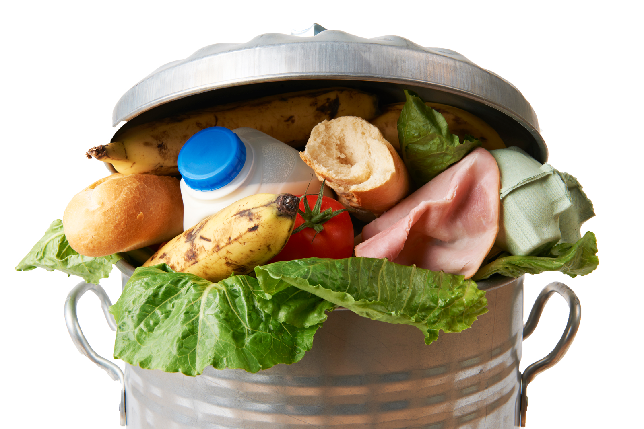

GRADES K–5
What is Food Waste?
GRADES K-5
Notes:
Begin with a discussion of food. This can include favorites (meal, dessert, fruit, etc.), what kids enjoy on their birthday or certain holidays, what they like to eat when they don’t feel well, what they can cook/fix themselves, etc. The emphasis is on the goodness of food!

Slide 2
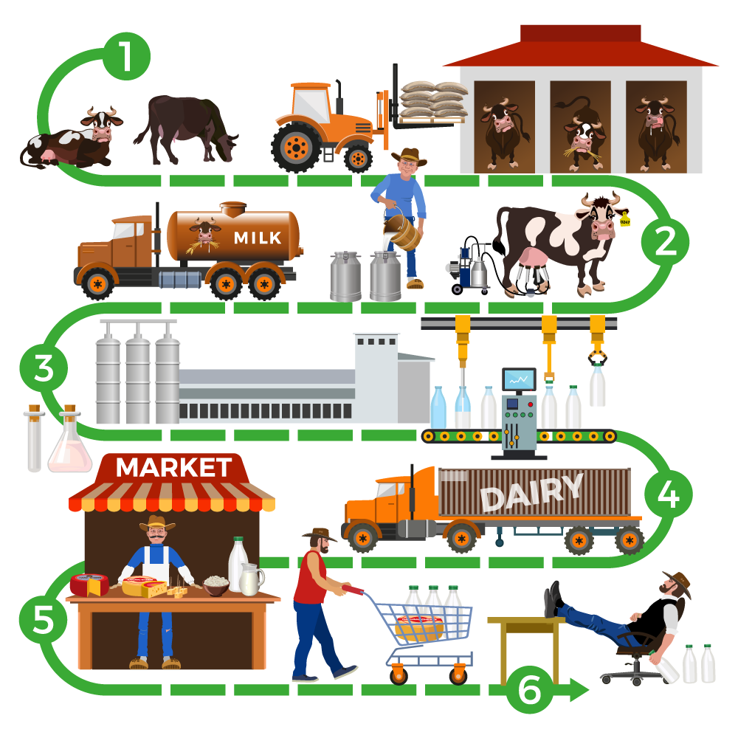
How does food end up on our plates?
Notes:
Talk about the process by which food reaches our plates with something like the following script:
We all know that food doesn’t just magically appear in our refrigerators. Before we eat it, it goes on a journey. That journey begins at farms where fruits and vegetables are grown, and animals are raised for meat, milk, and eggs. Then our food gets processed—that means that milk gets put into cartons, peanuts get made into peanut butter, and wheat gets made into bread. After it is processed, food is transported to stores where it is sold. Food can be sold to restaurants, hotels, schools, and of course, to people like you and me. Have you ever visited a farm or a place where food is processed? (Share experiences if you want.)

Slide 3
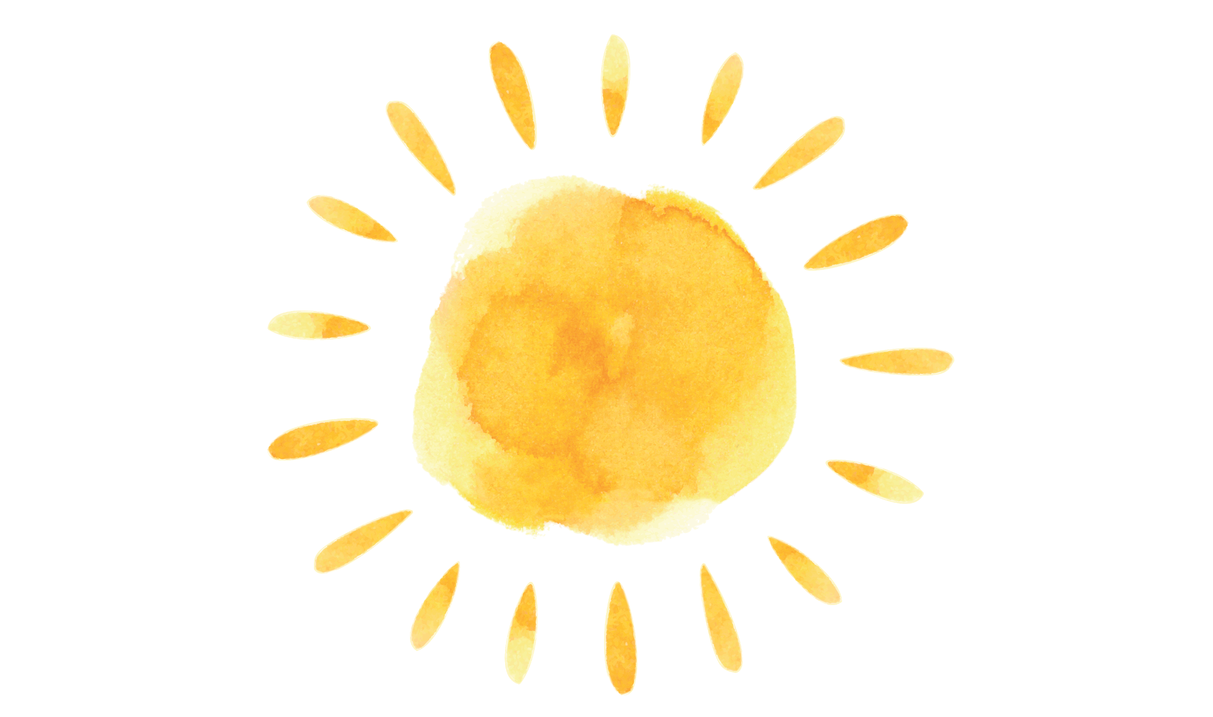
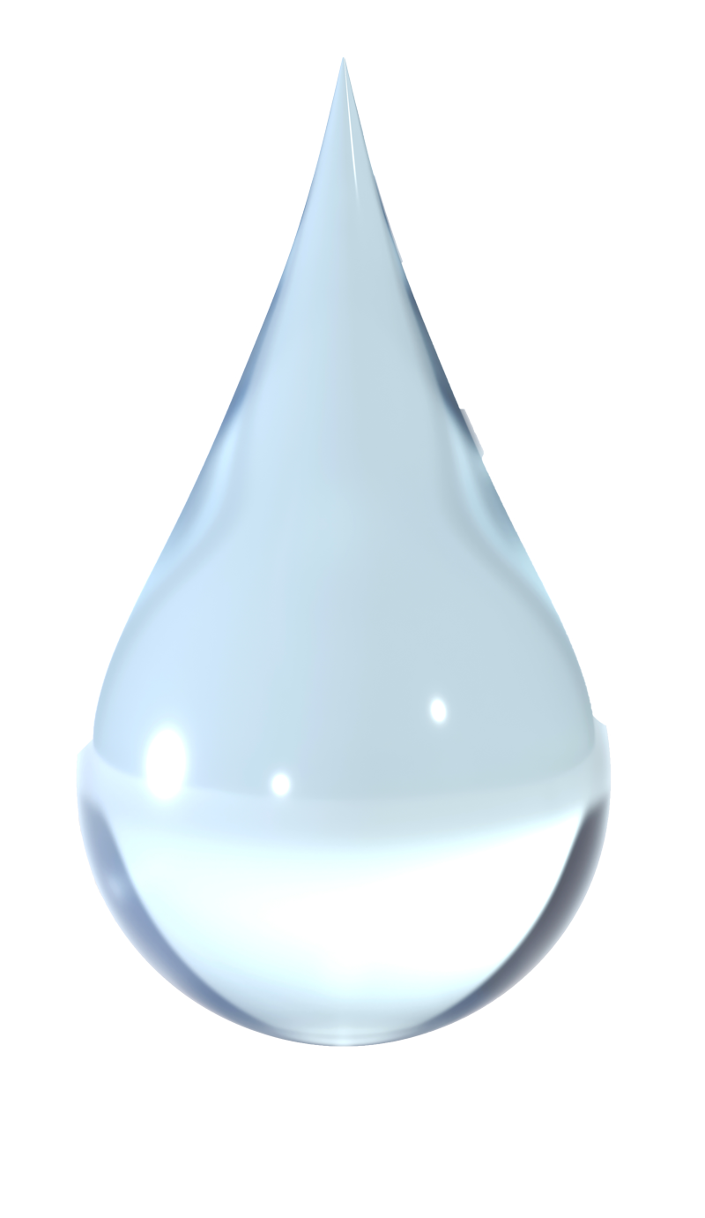
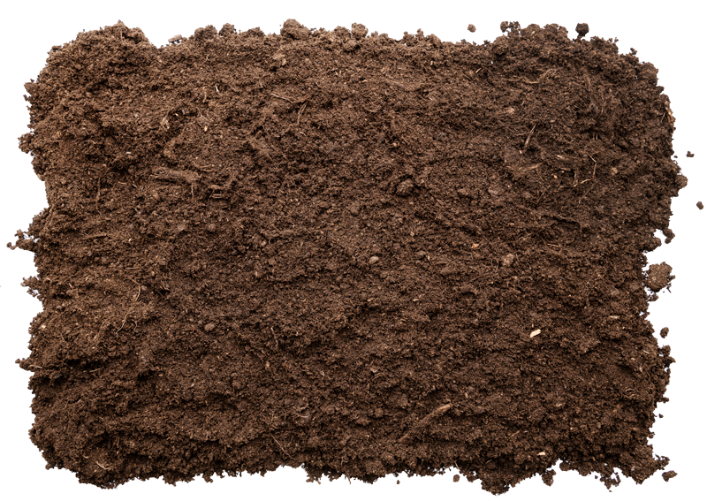
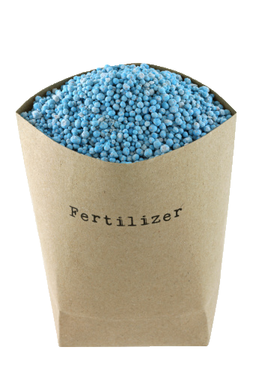
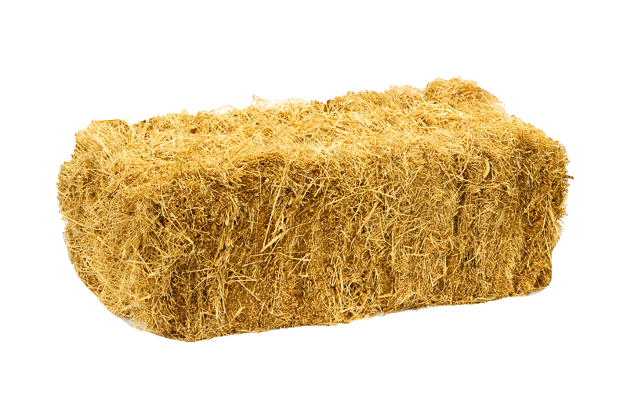
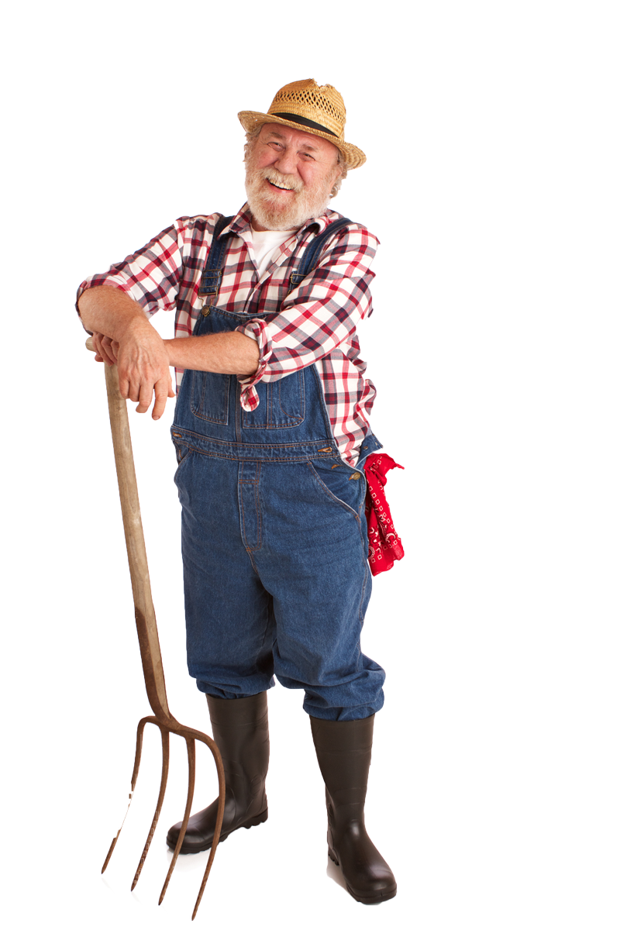
Growing our food: What does it take?
Sunlight
Water
Soil/land
Fertilizers
Food
Work!
and pesticides (fruits and vegetables)
(animals)
Notes:
What does a plant need to grow? What does an animal need to live? (Reveal each bullet as you name it.)
All living things need sunlight and water. They also need land. Plants draw nutrients from the soil, and animals need land to live on. In the United States, we use a LOT of our water and land for farming—80 percent of our water and 50 percent of our livable land!
Farmers use fertilizer to make the soil better for plants. They might also use chemicals called pesticides to keep insects from eating the food they grow. Animals need food to eat, like grass, wheat, and oats. And all food, whether it’s a vegetable, a fruit, or an animal, takes hard work! People plant seeds, pick fruit, care for animals, and do many other jobs to make sure we have food on our tables.

Slide 4
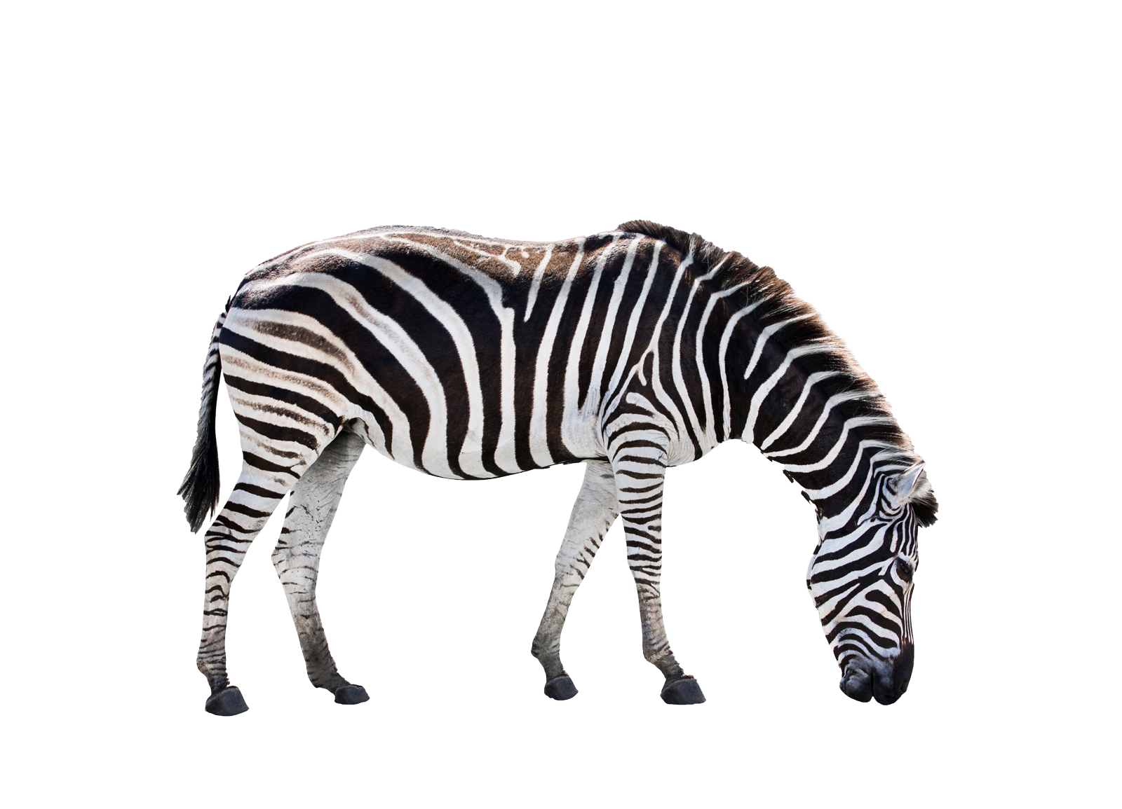
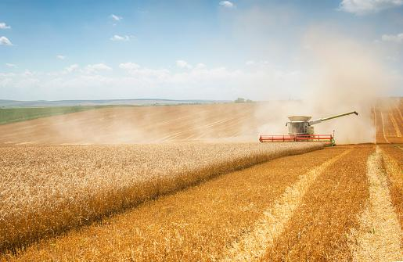
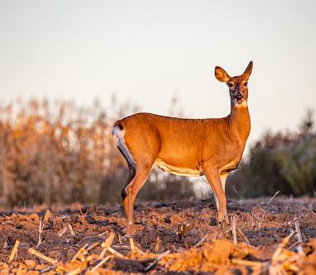
End food waste, save wildlife
When we waste food, farmers need to grow more food.
This means they need more land.
Then, animals don’t
have as much land
to live on or natural
food to eat.
Notes:
Ask the children to name their favorite animal. Talk about where that animal lives and how much land they need.

Slide 5
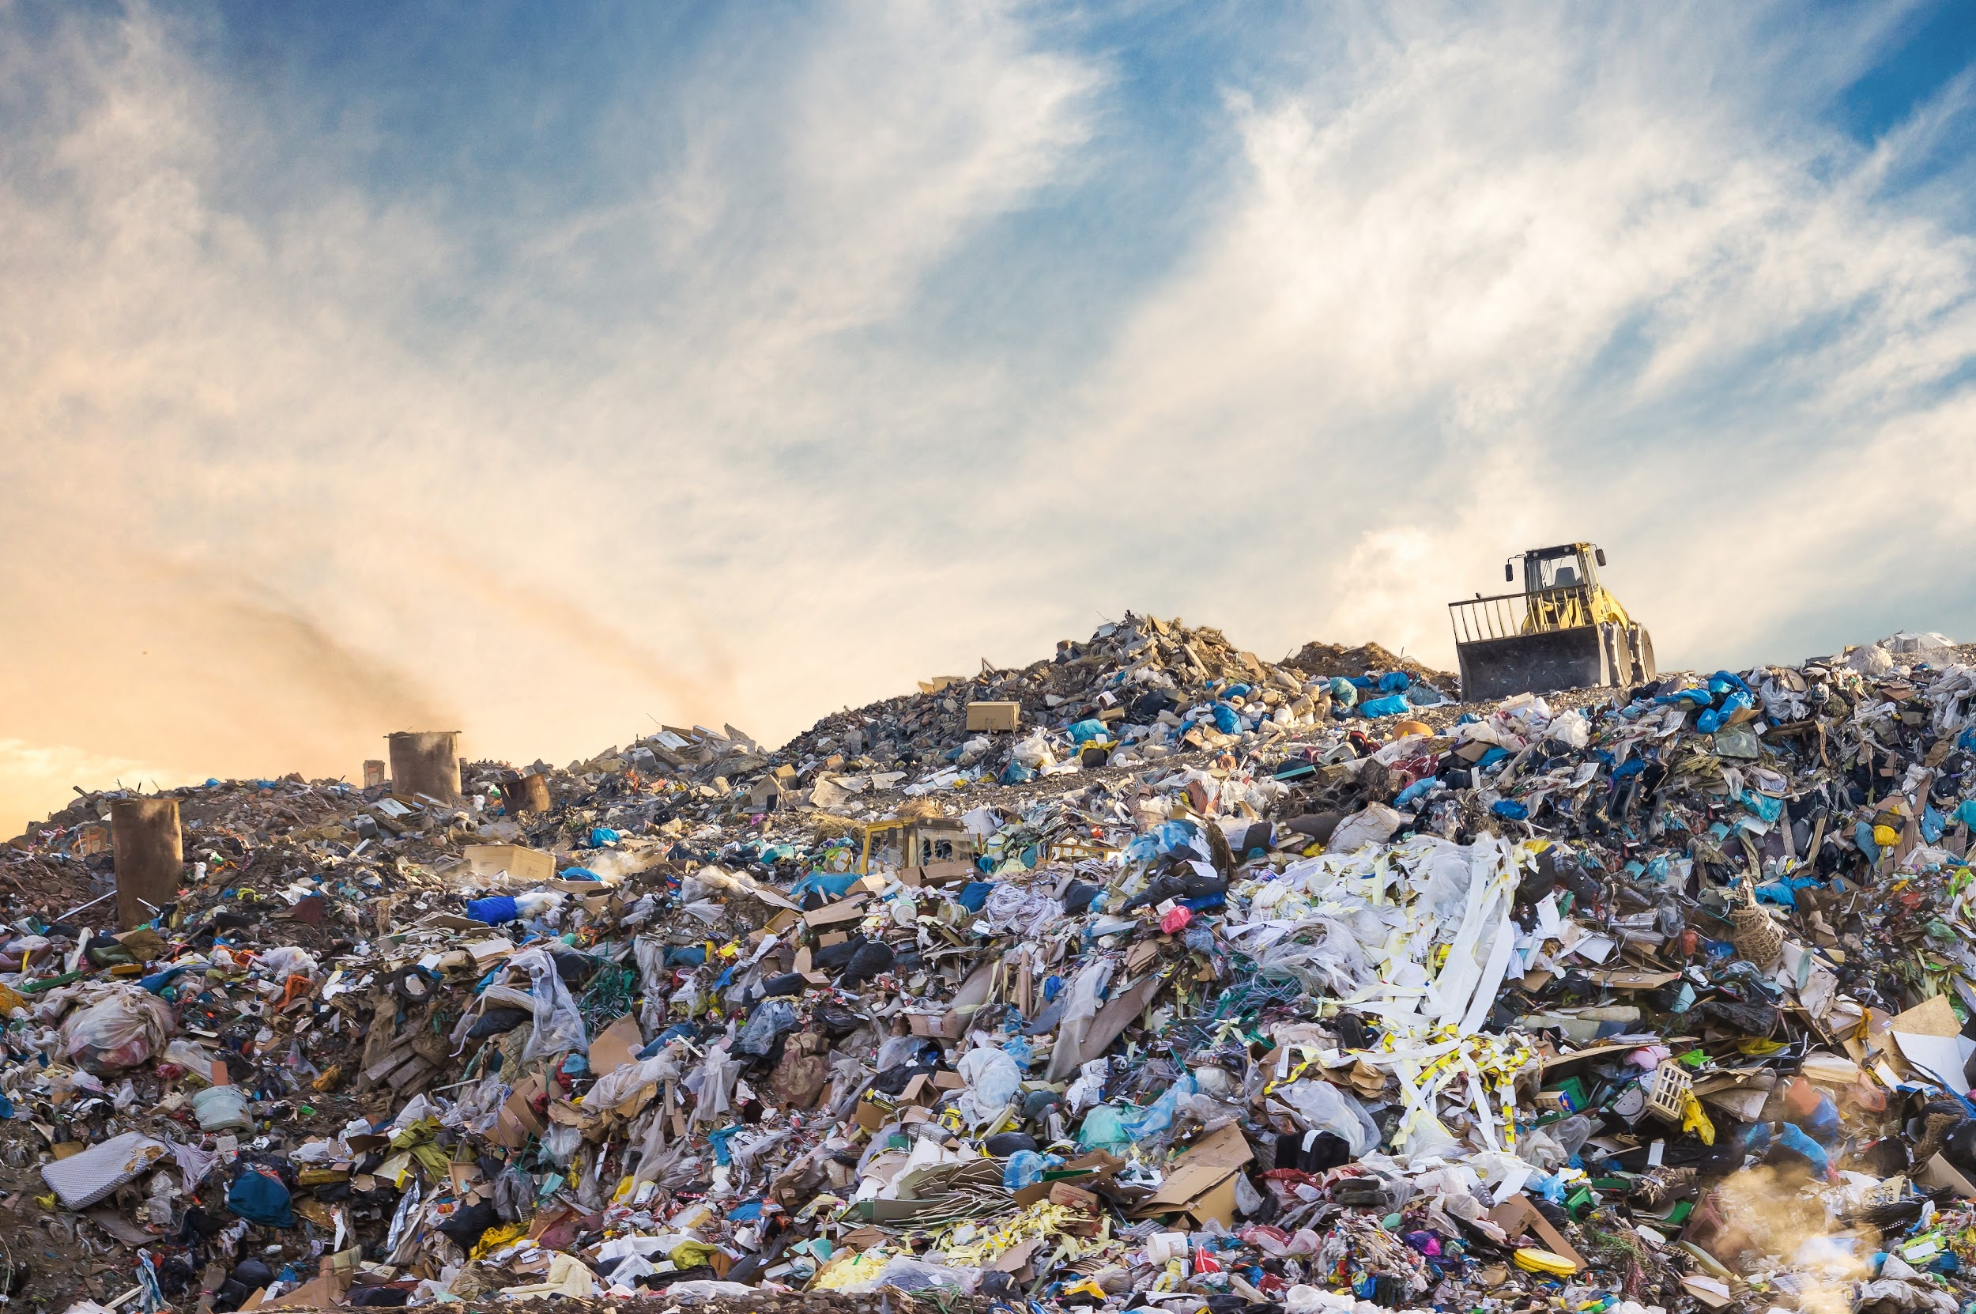
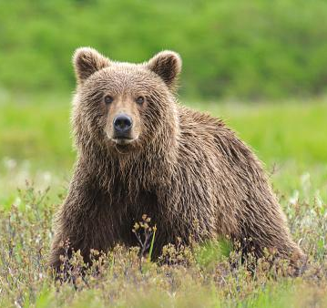
End food waste, save wildlife
When we waste food, it goes into a landfill.
Rotting food in a landfill makes
too much greenhouse gas.
This is bad for the
environment where
animals live.
Notes:
Now talk about the air we breathe and why we need to protect it.

Slide 6
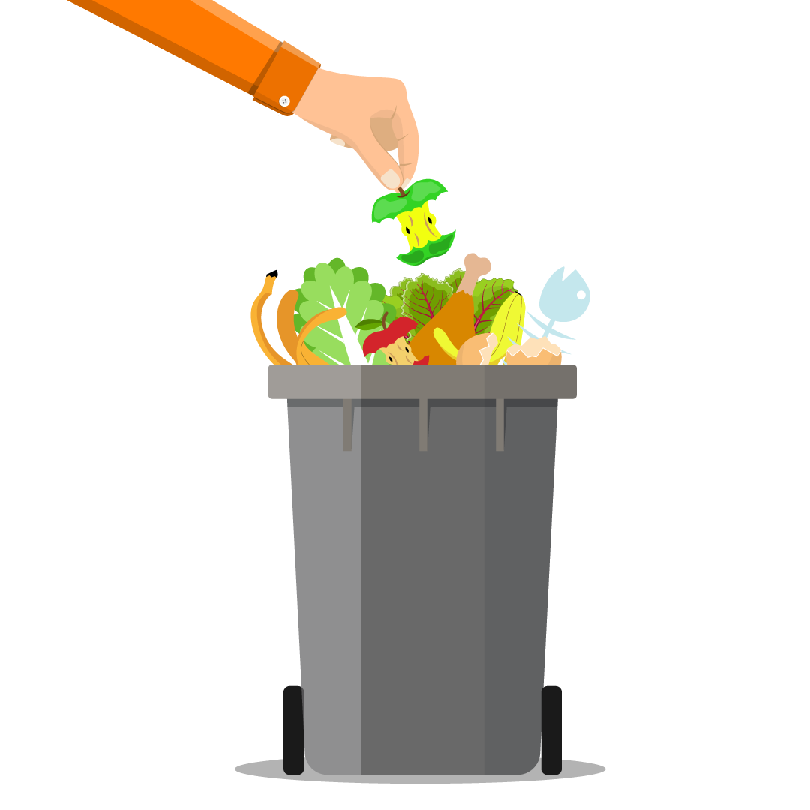
Food costs a lot money and important resources
We waste
30–40%
of our food!
Notes:
How do we treat things that are precious or cost a lot? (Give some examples—new bike, electronics, family heirloom, etc.) We are careful with them, protect them, don’t lose them/waste them, etc. You would think we would be the same way about our food. Why do we waste so much food?

Slide 7
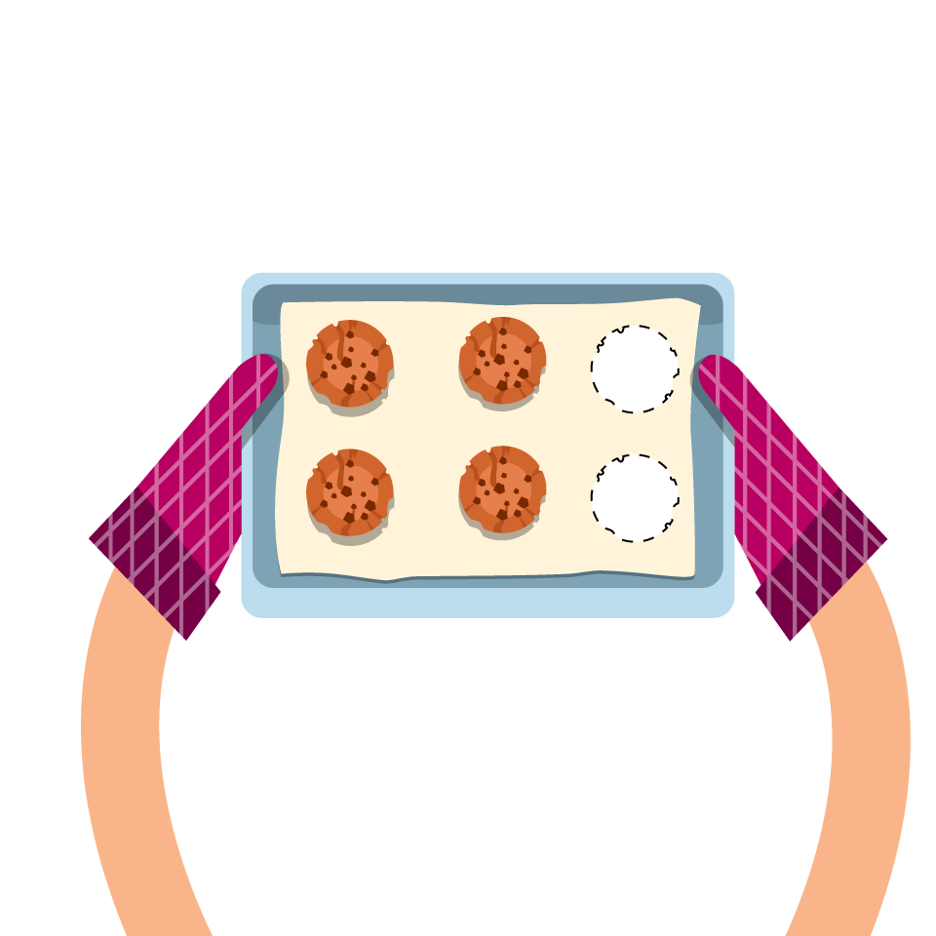
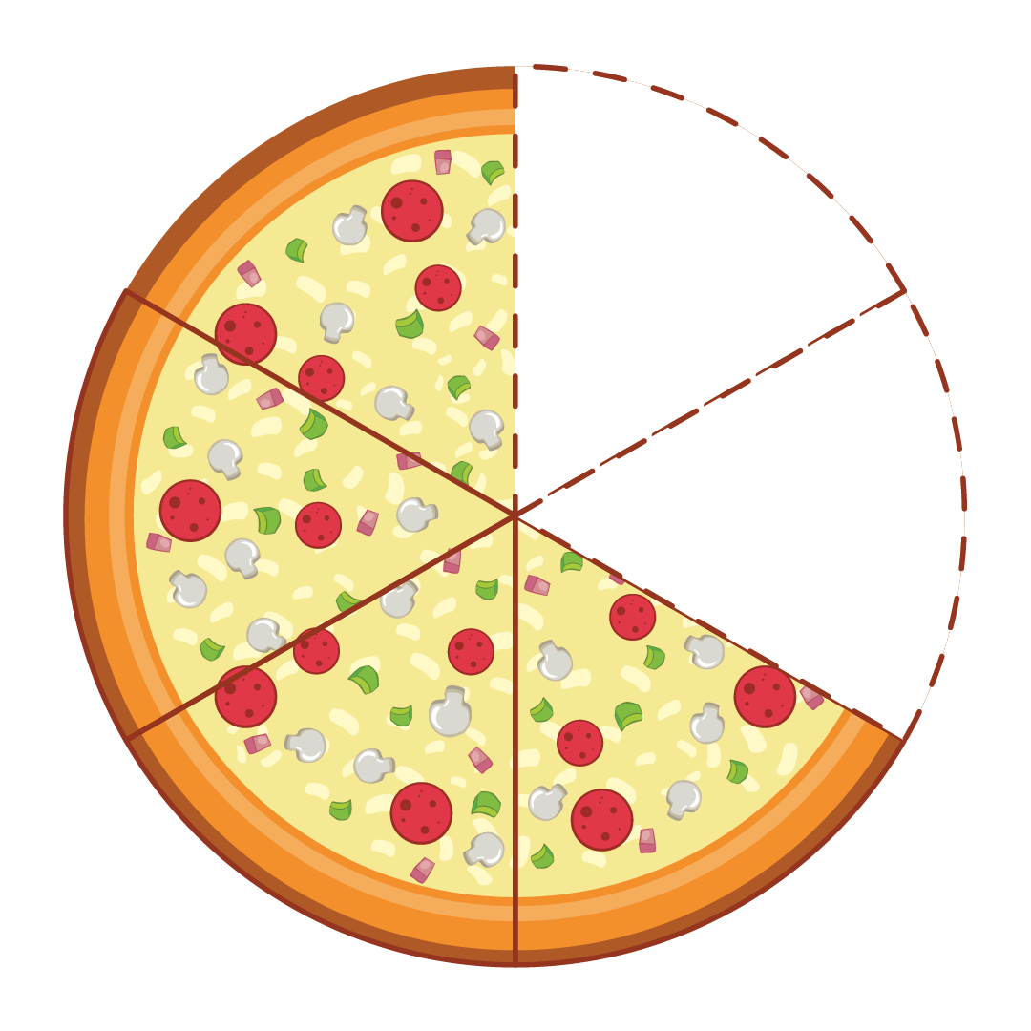
What does 30-40% look like?
Notes:
30-40% is a lot but it’s hard to know what that means without seeing it. This slide shows what it looks like. When we throw away our food, we are also wasting everything that went into making that food, using up all that land and water for nothing!

Slide 8
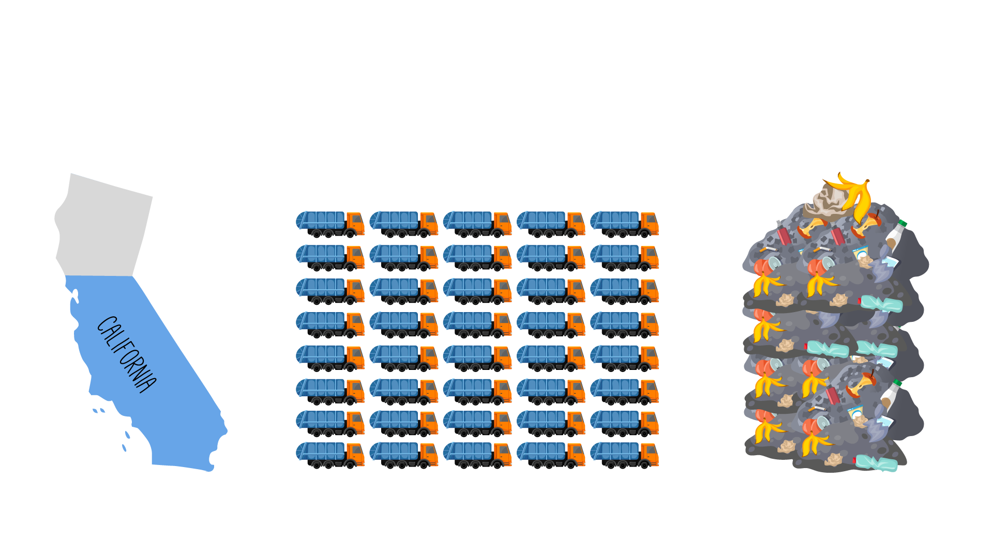
A farm for wasted food
40 TONS EVERY 20 SECONDS
76%
of food waste goes into
landfills
Notes:
Here is another way to picture it. If we grew all the food that we waste on one farm, that farm would be ¾ the size of California! Can you imagine growing that much food just to throw it away? But that’s what we do. And all that land devoted to wasted food means less land for thousands of animals. Because of all the land we use for agriculture, many kinds of animals are dying off or are extinct already. (Optional: Talk about animals that are endangered or extinct.)

Slide 9
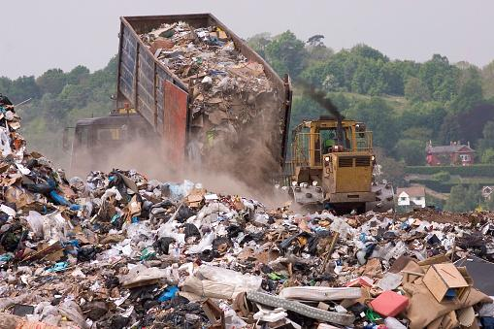
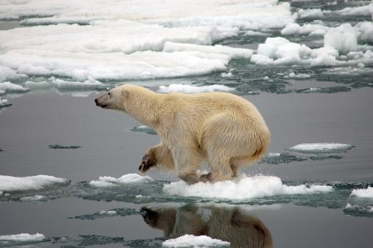
What happens to food when we throw it in the trash?
Grows
Landfills
Warms Oceans
Notes:
Where do you think our trash ends up after we throw it away? Most of the food we throw away ends up in a huge pile of trash called a landfill. Food in a landfill gives off something called methane, which is a greenhouse gas. Greenhouse gases trap heat in our atmosphere, and methane traps a LOT of heat. This leads to global warming, which causes many problems for wildlife. (Optional: Discussion of the way global warming impacts wildlife – vanishing ice for Arctic animals, warming oceans stress and eventually destroy coral reefs, mild winters don’t kill off as many insects which further causes harm to trees, polluted air hurts all land animals, etc.)

Slide 10
Making a change
The reasons we waste food
How we can waste less
Notes:
Changing what we do starts with figuring out the whys.
Start a short conversation about why we waste food. Some ideas could include they don’t like it, they were too full (snacking?), they didn’t have enough time to eat it, the food was cold/undercooked/burned, etc.
Now talk about what students could do differently to avoid this waste. Examples: We can tell our parents and cafeteria worker if we don’t like something, we can only take what we can eat, and we can snack less. (Optional: Studies also show that a longer lunch period and having lunch after recess helps kids eat more of their food!)

Slide 11
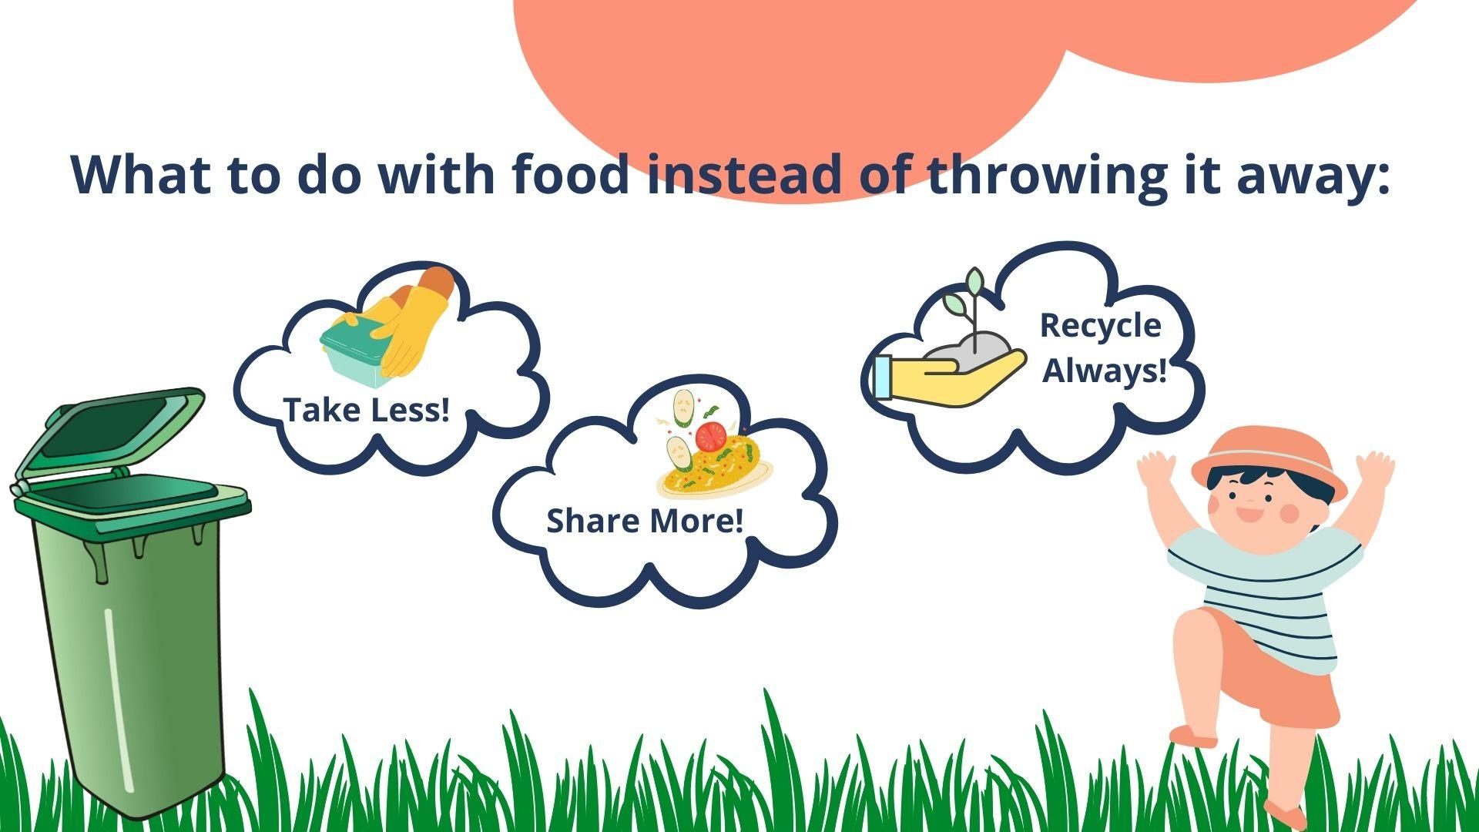
Notes:
The most important thing we can do to fight food waste is not to create it in the first place by remembering the ideas we just talked about. But there are also better things we can do with the food we don’t want instead of throwing it in the trash. Those things are taking less, sharing more, and recycling always. (Review the three things until students can name them independently.)

Slide 12
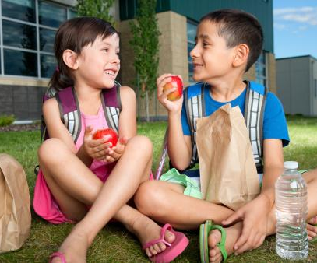
Take Less!
Put it away for later
Eat leftovers
Use it in something else
Notes:
We can put food away to enjoy later. What are some foods that are good to save? What foods are not good to save for later? Do you remember to eat food that you saved? Do you like to eat leftovers? Why or why not? Do you ever use brown bananas in smoothies or banana bread? Enjoying food later is a great way to fight food waste!

Slide 13
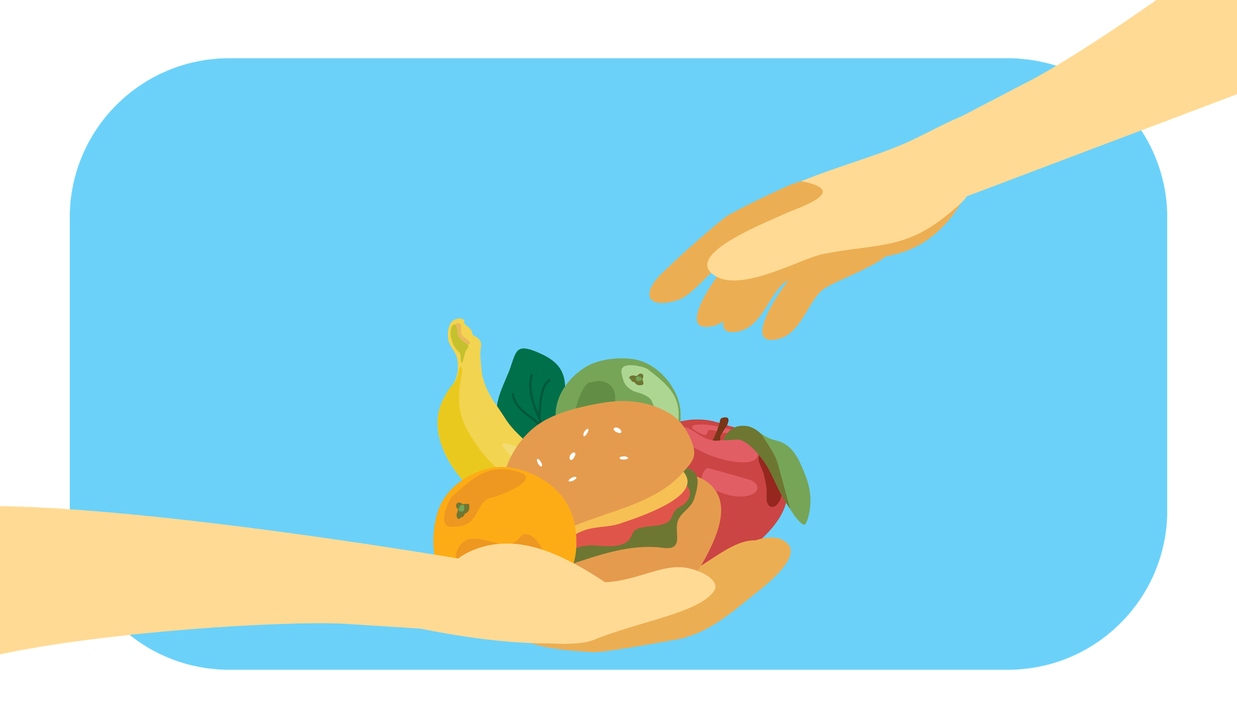
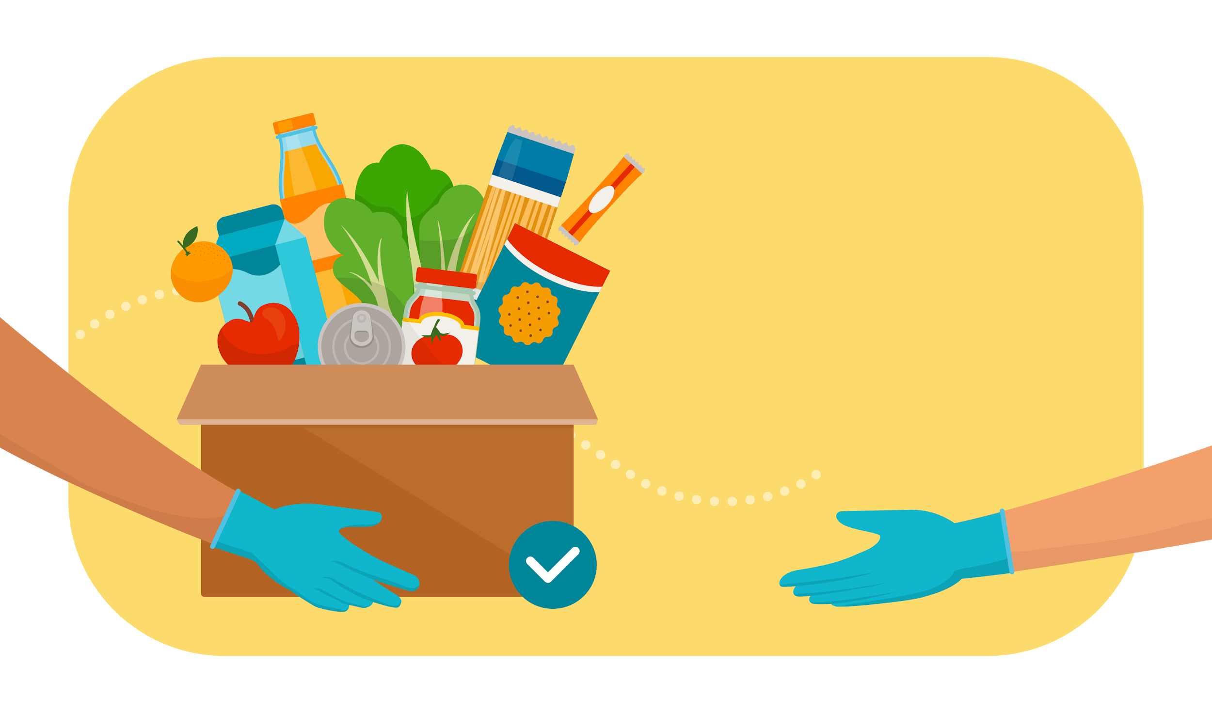
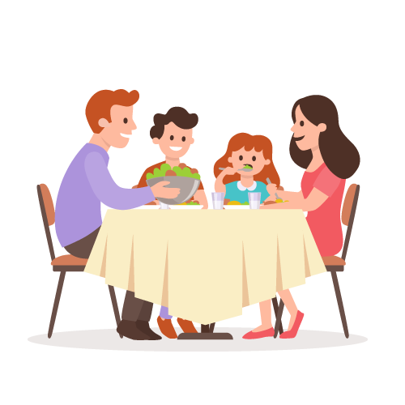
Share More!
A friend
Food
banks
Share table
Notes:
Another thing to do besides throwing away food is to share it. You can share food with a friend. Some schools have a “share table” where students can put unwanted food to share with others for free. Foods need to be in an unopened wrapper or fruits with inedible skins (like a banana or an orange). Another way to share food is to donate it to organizations that help feed the hungry, like food banks or soup kitchens. Did you know that one out of every seven Americans doesn’t have enough food? We can help each other out by sharing our extra food.

Slide 14
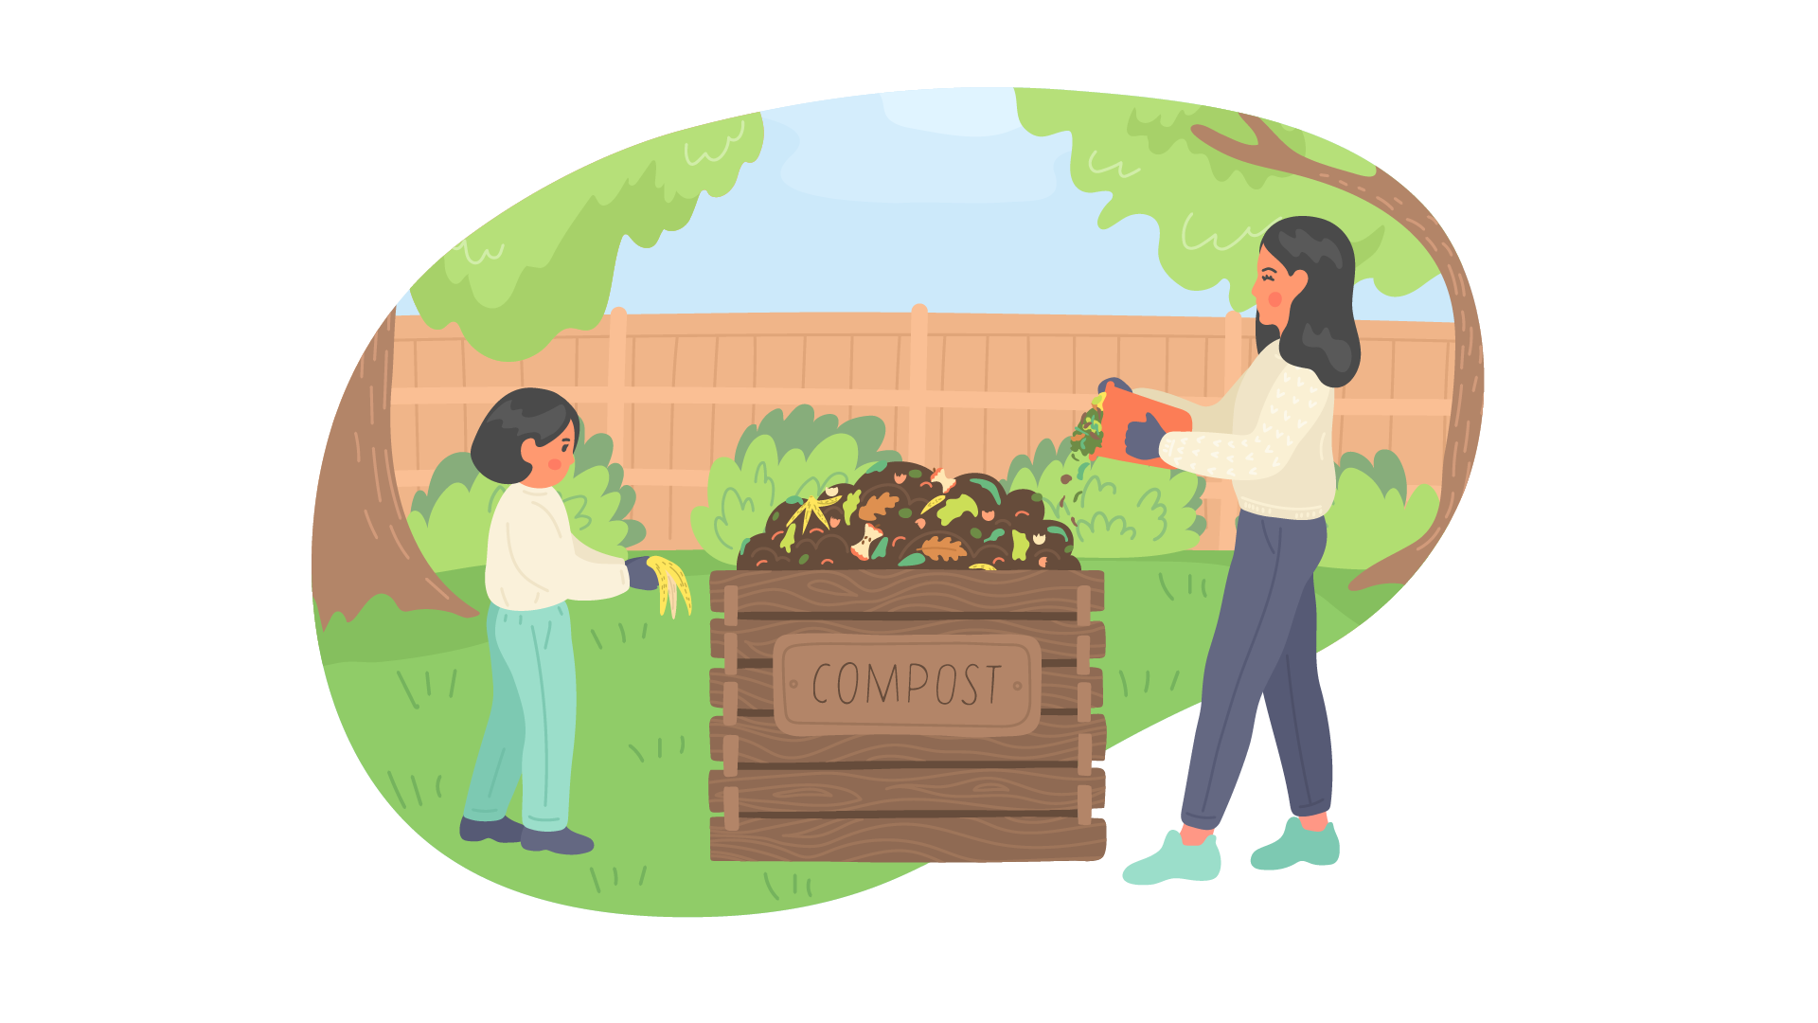
Recycle Always!
Helps gardens
Less greenhouse gas from landfills
Notes:
Do you know what composting is? Instead of throwing all your food waste in the trash, some of it can be recycled by going in a special pile called “compost.” As the food in a compost pile breaks down, it becomes excellent fertilizer for gardens. Food waste also gives off a lot less greenhouse gas as compost than it would in a landfill. The following things are great to compost: fruits and vegetables, eggshells, nutshells, tea bags, and coffee grounds.

Slide 15

One more way to fight food waste:
Measure it!
Notes:
Did you know that the act of measuring how much we waste actually helps us waste less? Sometimes all we need to do is increase our awareness of something in order to change it. (Describe how you will be implementing the food waste audit as a class.)

Slide 16
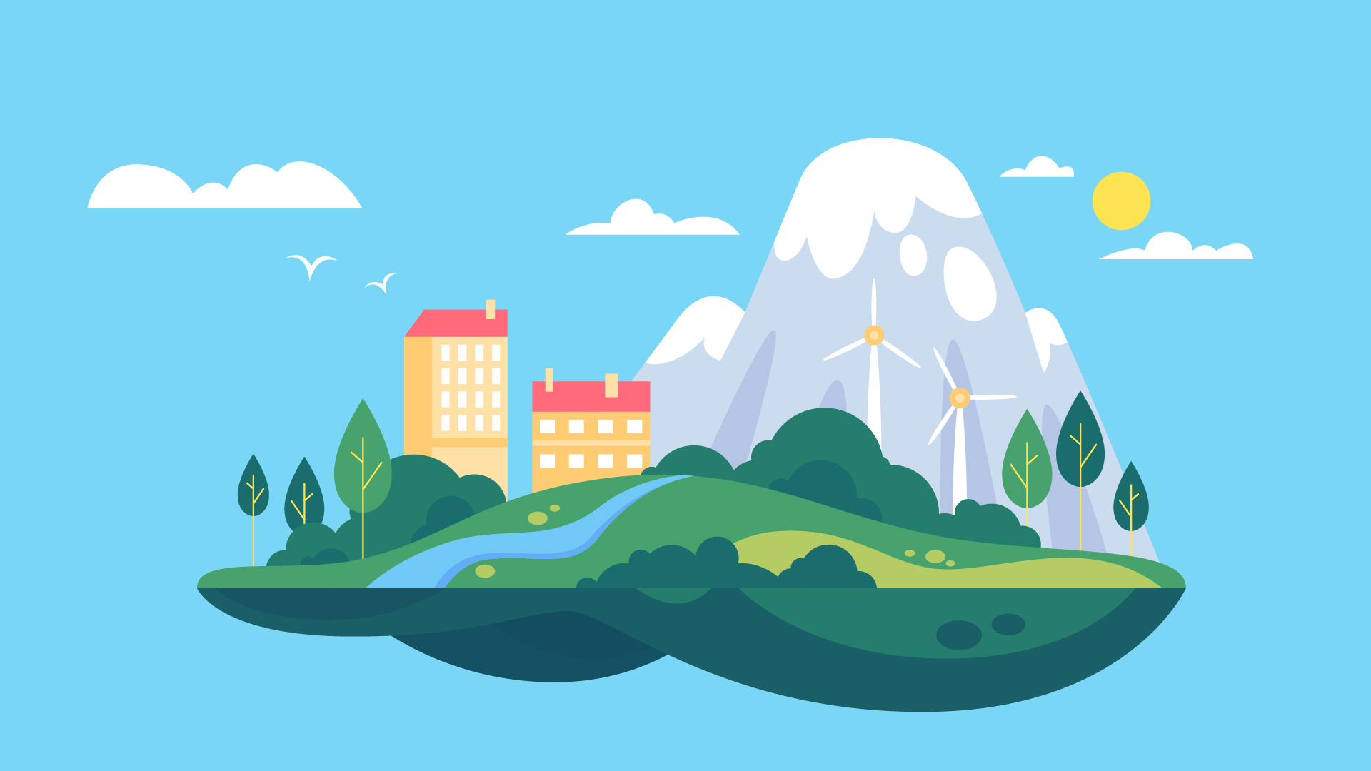
Fighting food waste helps save:
Water
Land
Our Planet
Notes:
Hopefully, you are willing to do your part to reduce the amount of food that is wasted! Our small choices can make a big difference for our land, water, animals, and other people. Be a Food Waste Warrior!

