Slide 1
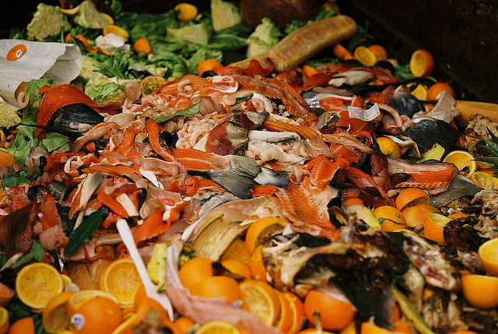
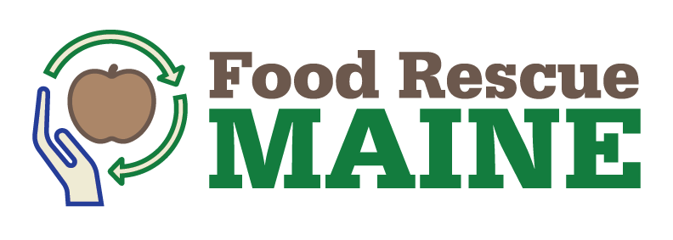
{Town Name} Food Waste Management Opportunity
Consolidated Collection: A Food Waste Management Triple Bottom Line Solution

Slide 2
Meeting Agenda
Why do we need sustainable food waste management practices?
How can we approach sustainable food waste management?
Triple Bottom Line
Food Recovery Hierarchy
How can we benefit?
Comments and Questions
Additional Resources/How to Begin

Slide 3
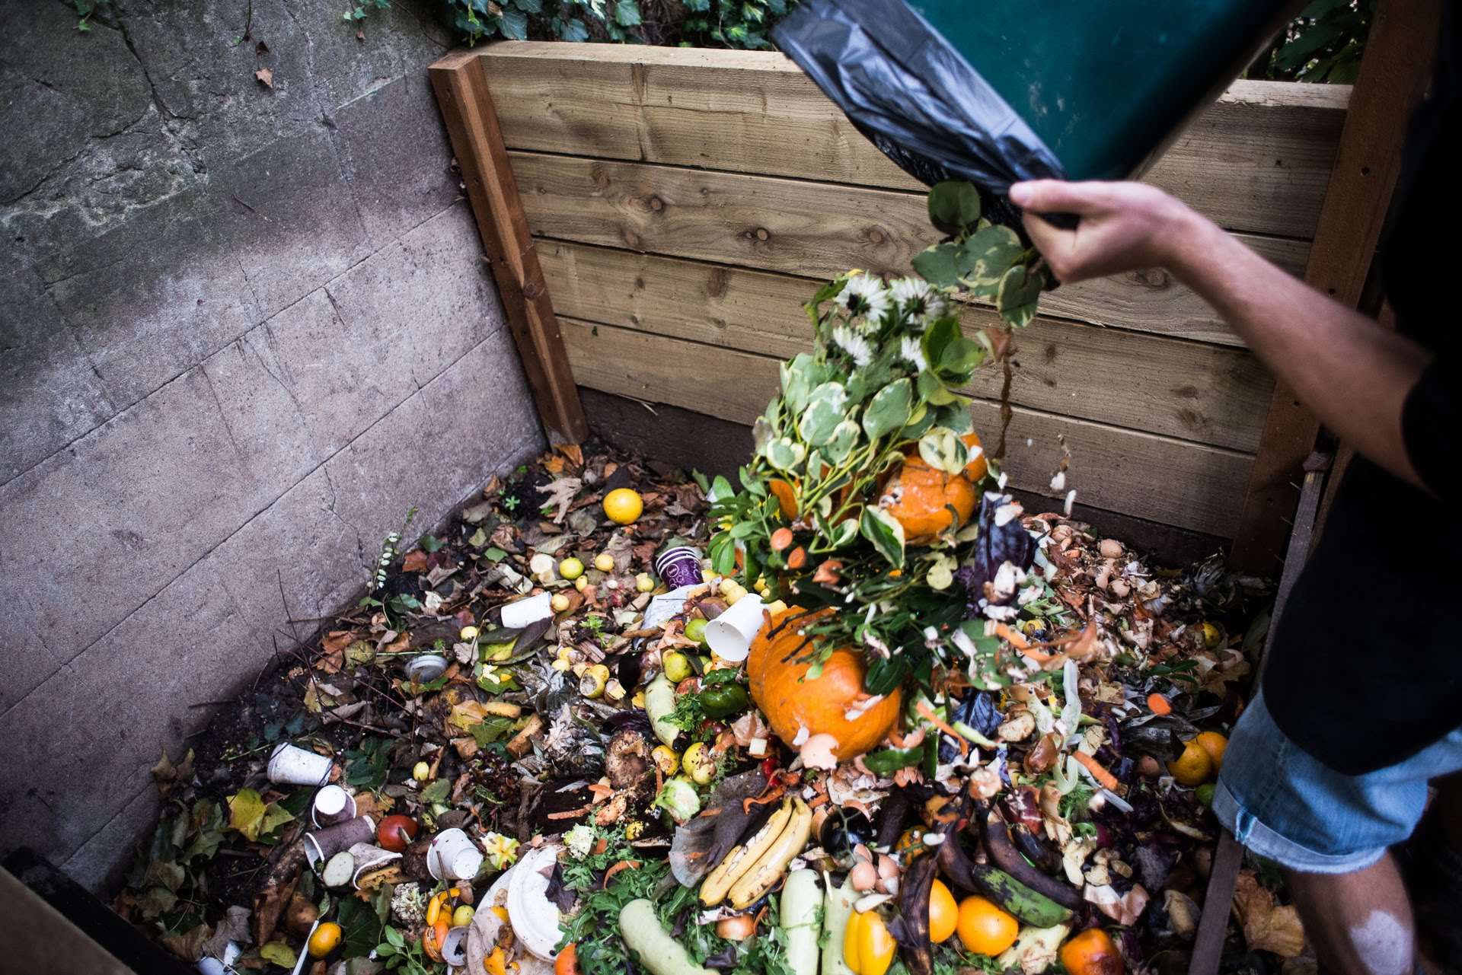
B
Background
About 40% of Food Produced Is Never Eaten
Nearly 30% of Maine’s Solid Waste Stream is Food Waste
Wasted Food Results In Wasted Dollars
Food Waste in Landfill Causes Climate and Water Problems
Consolidated Food Waste Collection is a triple bottom line solution

Slide 4
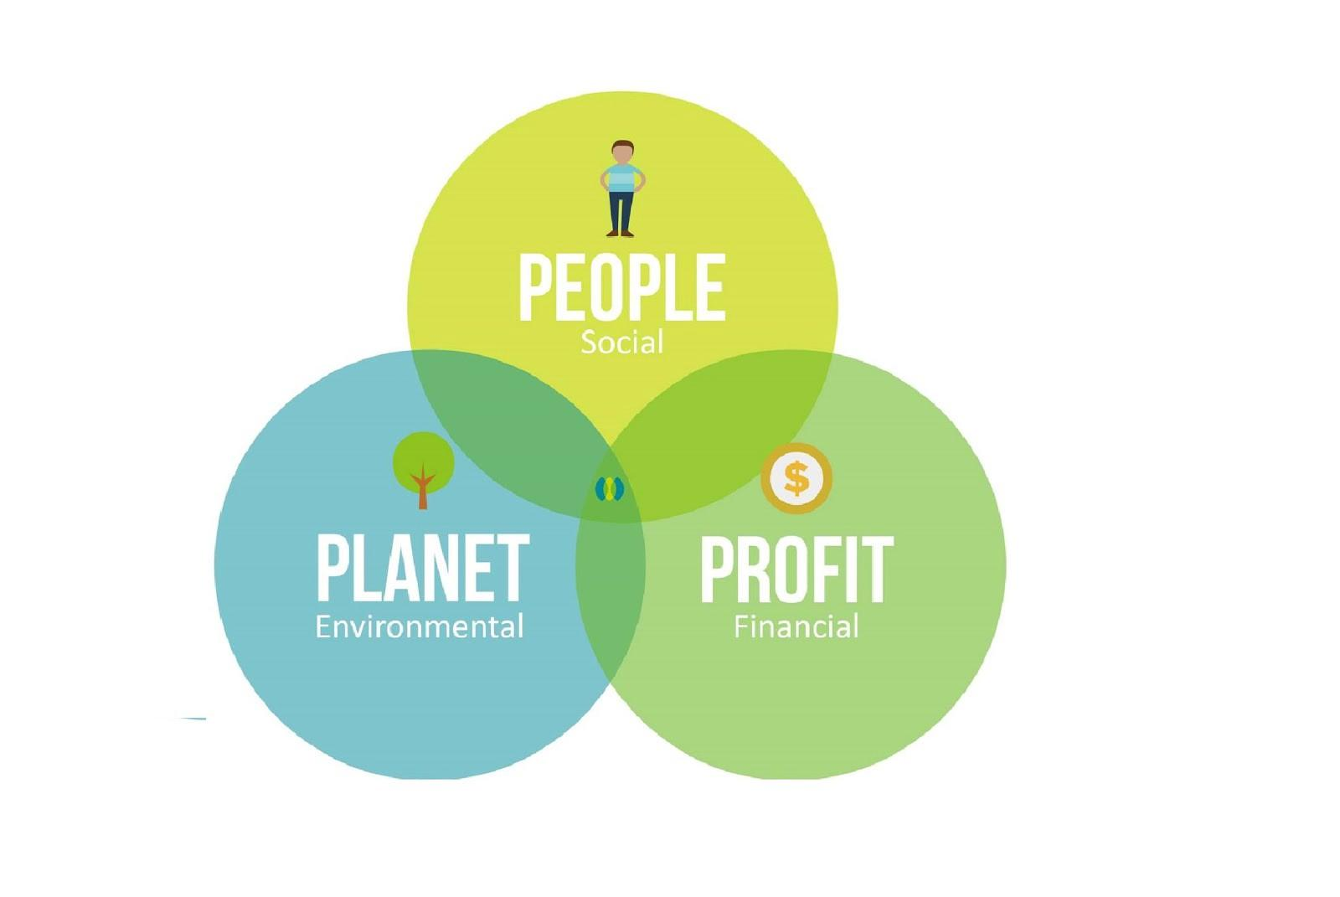
What is the triple bottom line?
Sustainable food waste management requires a triple bottom line solution.
PEOPLE: Divert good and edible food to suffering from food insecurity
PLANET: Reduce GHG emissions that occurs when food waste goes to landfills
PROFIT: Generate savings from reduced landfill disposal costs.

Slide 5
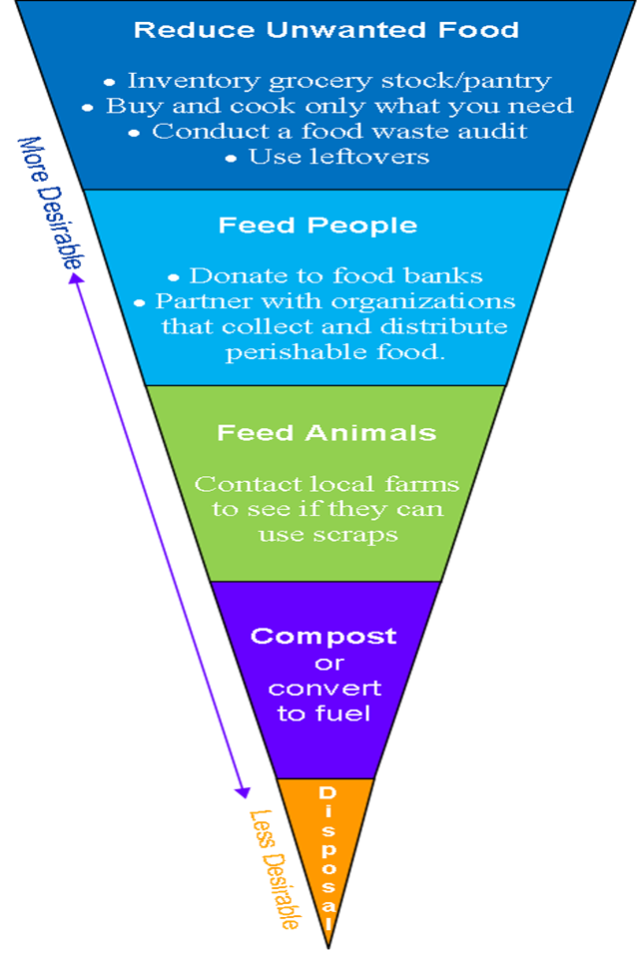
Food Recovery Hierarchy
Community Food Waste Management Objectives

Slide 6
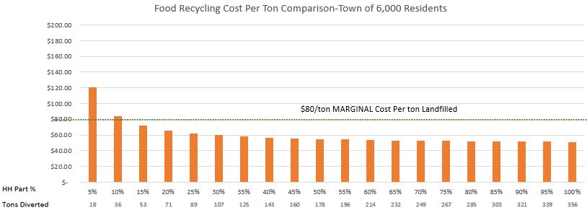
How can we benefit?
Cost Savings: Landfilling vs. Recycling Food

Slide 7
How can we benefit?
Maine Food Recycling Generates Profits
Revenue Growth: New Businesses and Services
Collection (Truck/Trailer, Buckets, and a Hose)
Haulers
Processors – AD and Composting
Compost Product Manufacturing – Commercial/Residential (Bulk and Bagged)
Upcycled Food Product Makers
Renewable Energy - Biogas

Slide 8
How can we benefit?
Maine Food Recycling is Sustainable for Individuals
Increases Food Donation
Vermont Food Donations tripled with food recycling
Saves Households Money
Save families $1800/year on wasted food
Increases Food System Education
Most cost-effective food waste solution
Improves Local Food Quality and Access
Less waste more feeding people
Improve Health/Quality of Life
General fund savings spent on people not trash

Slide 9
How can we benefit?
Maine Food Recycling is Sustainable for the Planet
Improve Air/Water Quality
Reduces GHG Emissions/Climate Impact
**New York State’s cost-benefit analysis identified reduction in greenhouse
gas emissions as one of the largest societal benefits stemming from the proposed organic waste ban.
Builds Maine Soil Health & Drought Resilience
Builds Maine Renewable Energy Resources

Slide 10
Questions or Comments?

Slide 11
Additional Resources
Where to Begin
Service provider list
Data Tracking
At Home Tracker
Community Tracker
Self Compost
Service Provider
Community education and outreach portfolio
Information about other communities in Maine

Slide 12
Thank you!

