Slide 1
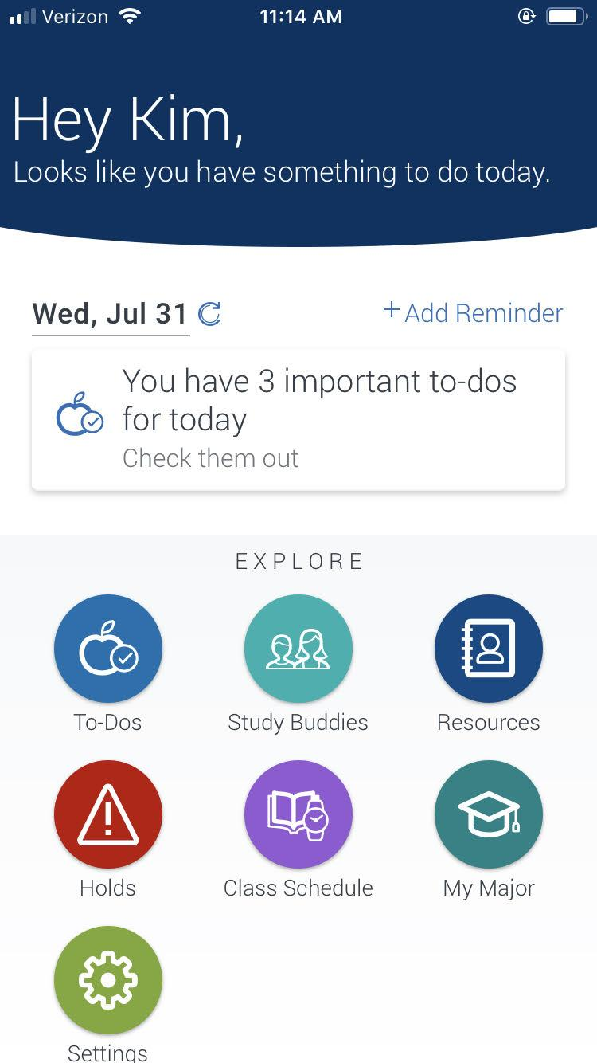
Navigate – Now, Next, Future
Platform Update
Spring 2021

Slide 2
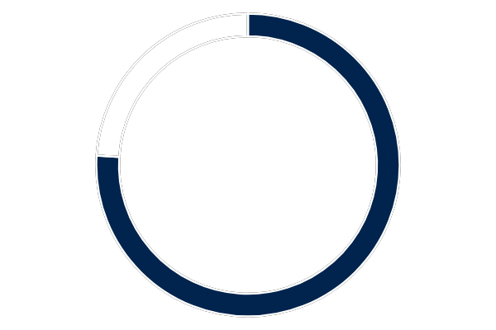
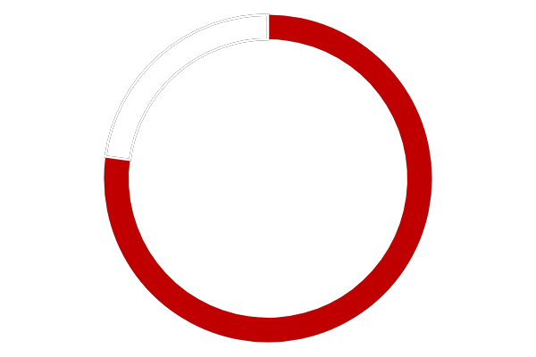
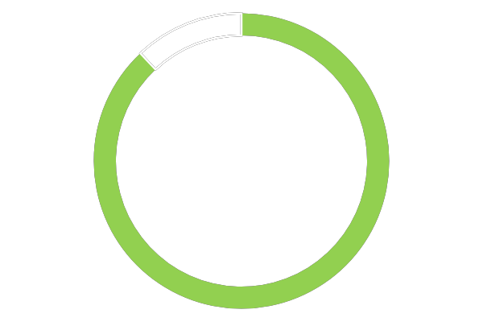
Now - What have we done so far?
Why Navigate?
A component of the First-Year Student Success Initiative
Enhance advising of all students
Expand communication
Improve retention
First-Year Success at UMaine
First-Year Retention Rate
Compared to Peers
Compared to Competitors
76%
81%
88%
UMaine
Hanover Selected Peers
Other New England Land Grant Universities
*data from Provost’s First Year Success Forum 9/27/2018

Slide 3
Now - What have we done so far?
Navigate Teams
52 staff and faculty members on 5 teams who built and tested the platforms
Navigate Student App
Downloaded by:
5,158 undergraduate students
Study Buddies
2020-2021: used by 600 students in 302 courses
2019-2020: used by 71 students in 123 courses

Slide 4
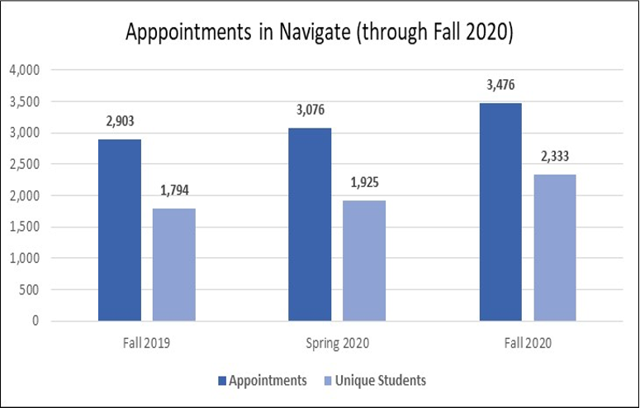
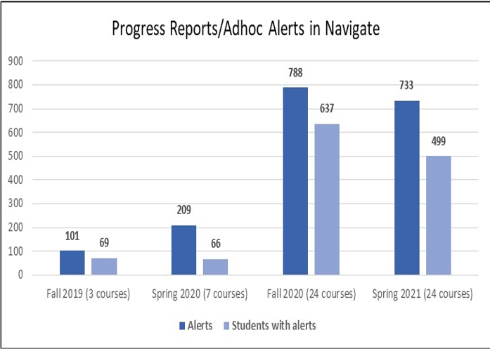
Now - What have we done so far?
Navigate Staff Platform
Growth in scheduled appointments and use of alerts
Note: Alerts for spring 2021 are not yet complete

Slide 5
Now - What have we done so far?
Navigate Staff Platform
Evaluating progress report impact: Work in progress
Examining usage, completion, retention
Must control for confounding factors
COVID-19 introduces challenge for drawing comparisons
Plan to collect information on user experience from faculty and advisors

