Slide 1
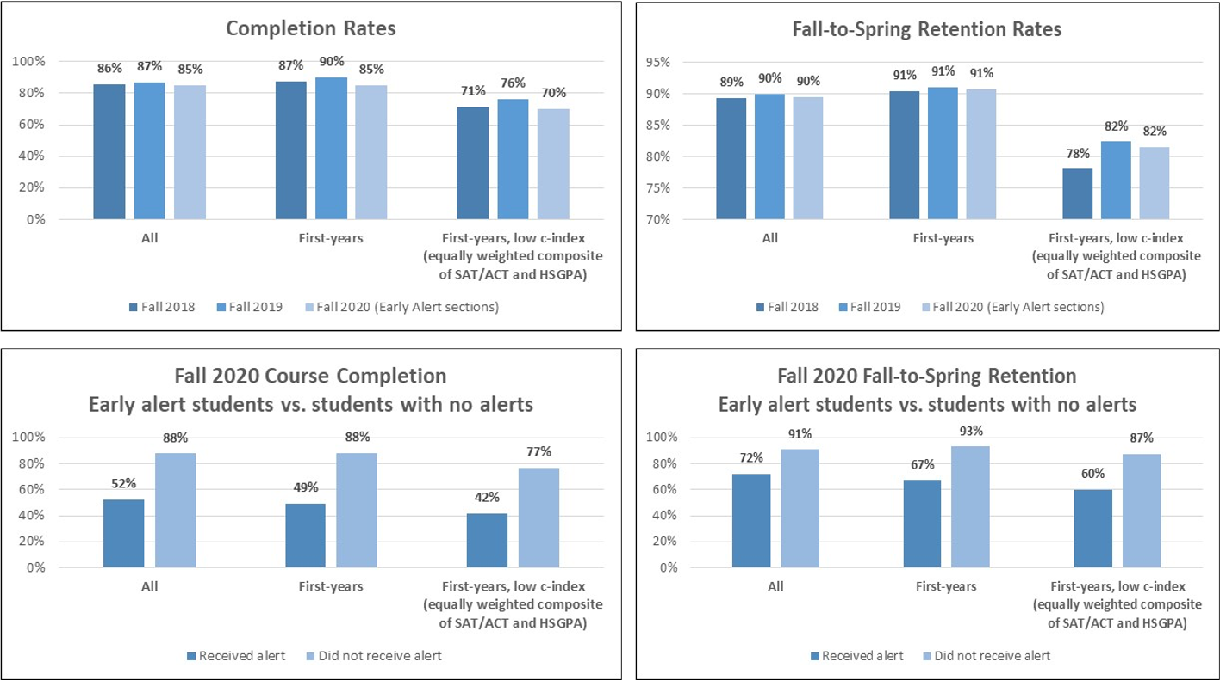
Now - What have we done so far?
Students in Progress Report Courses: Topline Summary

Slide 2
Next - What are we rolling out this summer?
Success Markers
MBS will be the first college to begin using Success Markers to help identify students who miss important program requirements
Additional units
Additional units (such as Career Center) are being included in the Navigate platform to help provide more holistic student support
New Student Orientation
In conjunction with live Zoom sessions, Navigate will the platform used to deliver an ongoing NSO experience from June-August to keep new students engaged over the summer

Slide 3
Next - What are we rolling out this summer?
Positive alerts
In addition to alerts for students of concern, faculty and advisors will have the ability to issue positive alerts to reinforce positive behaviors
Surveys
We will utilize Navigate’s new survey feature to send out surveys including the New Student Survey and an end-of-semester retention survey

Slide 4
Future - How will Navigate help with retention and student success?
Strengthen connections between Student Affairs and Academic Affairs for more holistic student support experience
Alert and Progress Report data: Intervene with students of concern early
Historical and population analytics: Design strategic interventions
Navigate App: Connect students with key campus resources

