Slide 1
The University of Maine Graduate School
Faculty Senate
12-12-12
Dan Sandweiss
Dean and Associate Provost for Graduate Studies

Slide 2
Graduate School Mission
The Graduate School articulates a vision of excellence for The University of Maine graduate community. The School is charged with serving as an advocate for graduate education within and outside the campus community, ensuring quality and equity across all graduate disciplines, supporting the academic and non-academic interests of graduate students, promoting the synergy between graduate education and research, teaching and outreach, and ensuring that all graduate students are prepared for future professional pursuits.

Slide 3


Graduate School Mission
Promote and facilitate interdisciplinary graduate programs and research
Master of Arts in Liberal Studies (MALS)
Interdisciplinary Doctor of Philosophy (IPh.D.)

Slide 4
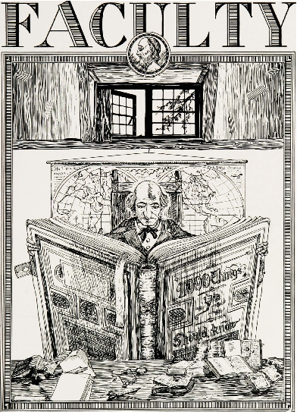
Graduate School History
1925 Prism
(UMaine Yearbook)
First Masters Degree: 1881
Graduate School Founded: 1923
First Ph.D.: 1960
10 Deans and Directors
Notes:
1925 Graduate Faculty included: Professors Ashworth, Drummond, Hart, Peterson, and Segall – the more things change…
Also: Professors Boardman, Colvin, Barrows, Patch, Corbett, and Little among others.

Slide 5
Graduate School Numbers
AY 12: 64 doctorates granted (UMaine record)
AY 13: 463 doctoral students enrolled (UMaine Record)
AY 13: 384 new masters students (10+ year record)
AY 13: 41 new doctoral students (10+ year record)
AY 13: 655 graduate students supported on assistantships and fellowships
AY 13: 2123 graduate student headcount

Slide 6
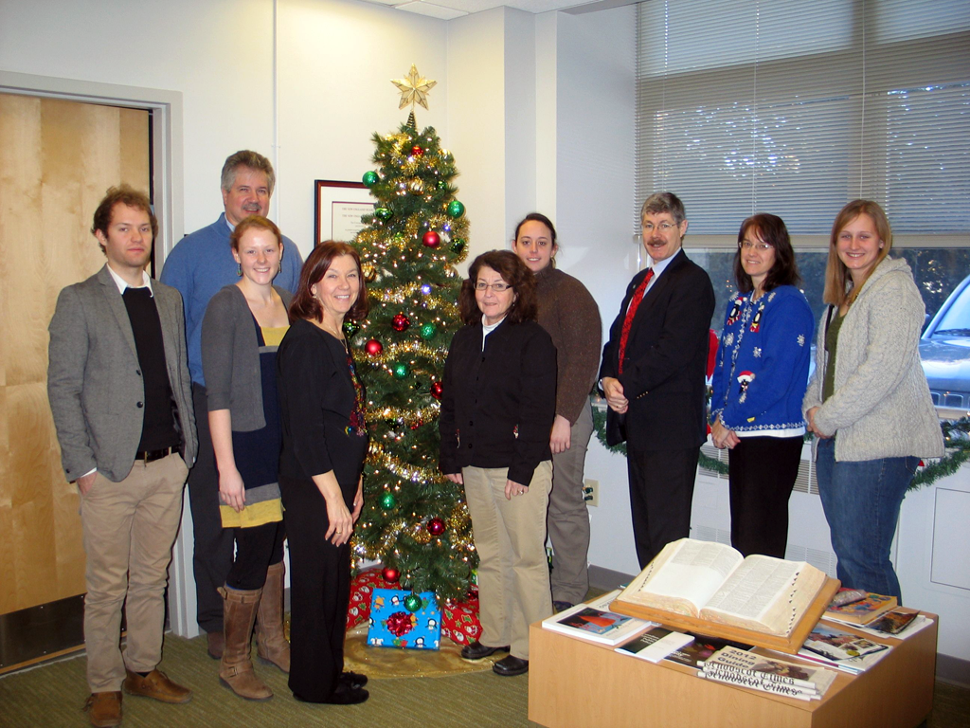
Graduate School Units
The Graduate School

Slide 7
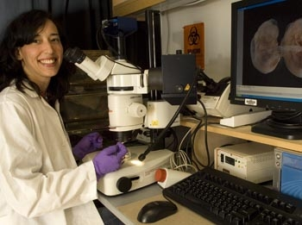
Graduate School Units
The Graduate School of Biomedical Sciences and Engineering
Notes:
Director Carol Kim. 6 institution collaboration.

Slide 8
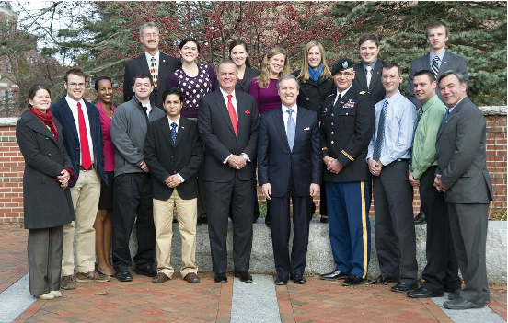
Graduate School Units
The School of Policy and International Affairs
Notes:
Director Mario Teisl, Assoc Director Jim Settele (will be new director on Jan 1). Will probably move to CLAS.

Slide 9

Graduate School Units
The Hudson Museum in Collins Center for the Arts
Notes:
Director Gretchen Faulkner. Shameless Plug.

Slide 10
Graduate Faculty
6 Graduate Faculty Statuses:
Full: 588
Associate: 160
External: 418
Emeritus/a: 12
Instructor: 261
Ex Officio: 3

Slide 11
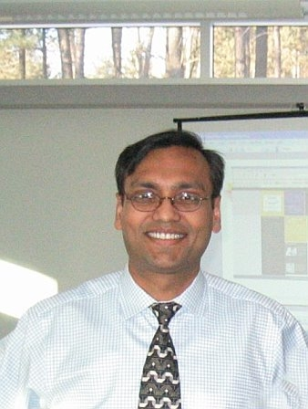
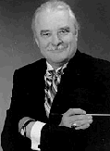
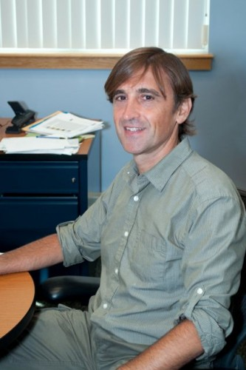
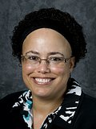
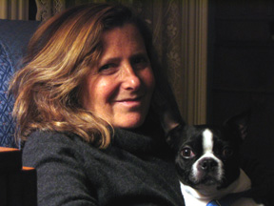
Graduate Board
Oversight of grad policy and programs
Representative faculty body
Executive Committee
Photos from www.umaine.edu and http://www.taft2009.org/program/thursday-17-september/

Slide 12
Graduate Board-Senate Relations
Since AY 10, Faculty Senate President invited as ex officio member of Grad Board
PCRRC also reviews new grad programs
Grad Dean’s Recognition Award

Slide 13
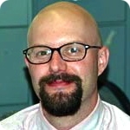
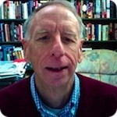
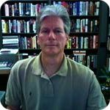
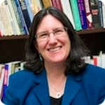
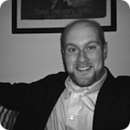
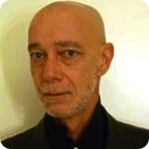
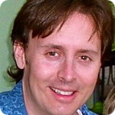
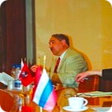
Graduate Board
Non-graduate units invited to participate in graduate studies
Political Science
Photos from www.umaine.edu

Slide 14
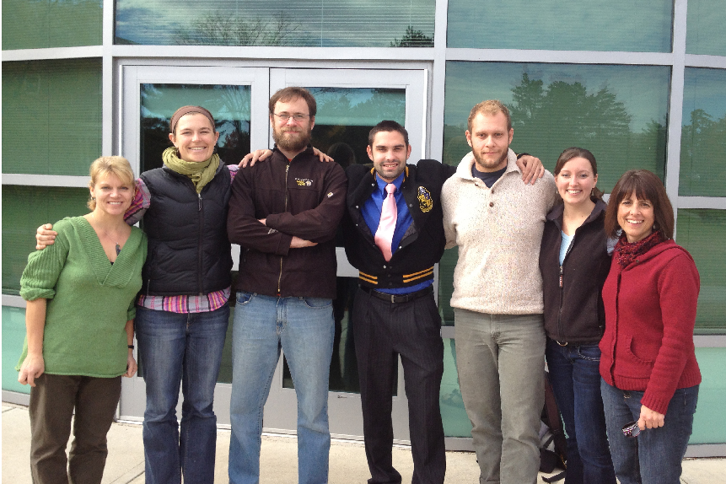
Graduate Student Govt
Independently chartered; close partner with Graduate School

Slide 15
New Graduate Degree Programs
PSM (Engineering and Business, Bioinformatics)
PhD in Communication (in process)
MS in Spatial Informatics (in process)
MS in Bioinformatics (in process)

Slide 16
New Graduate Certificate Programs
Graduate Certificate in Classroom Technology Integrationist*
Graduate Certificate in Education Technology Coordinator*
Graduate Certificate in Early Childhood Teacher*
Graduate Certificate in Response to Intervention for Behavior*
Graduate Certificate in Nursing Education*
Graduate Certificate in Digital Curation*
Graduate Certificate in Innovation Engineering
Graduate Certificate in Innovative Communication Design*
Graduate Certificate in Environmental Economics, Law, and Regulation
Graduate Certificate in Gerontology* (in process)
* = online

Slide 17
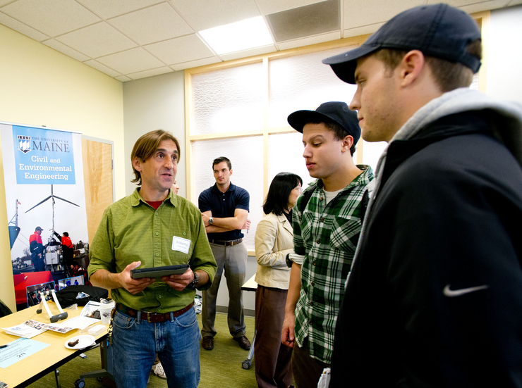
Recruiting
Second Annual Open House (October 17)
Photo © Division of UMaine Marketing and Communication
Virtual Open Houses

Slide 18
Recruiting
Communications Template
Fact Sheets
Standardized response to inquiries
Paperless processes
Recruiting plan (Blue Sky)

Slide 19
Recruiting
Graduate Students in the Spotlight
Graduate Student of the Month

Slide 20
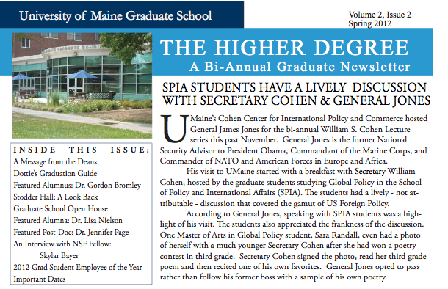
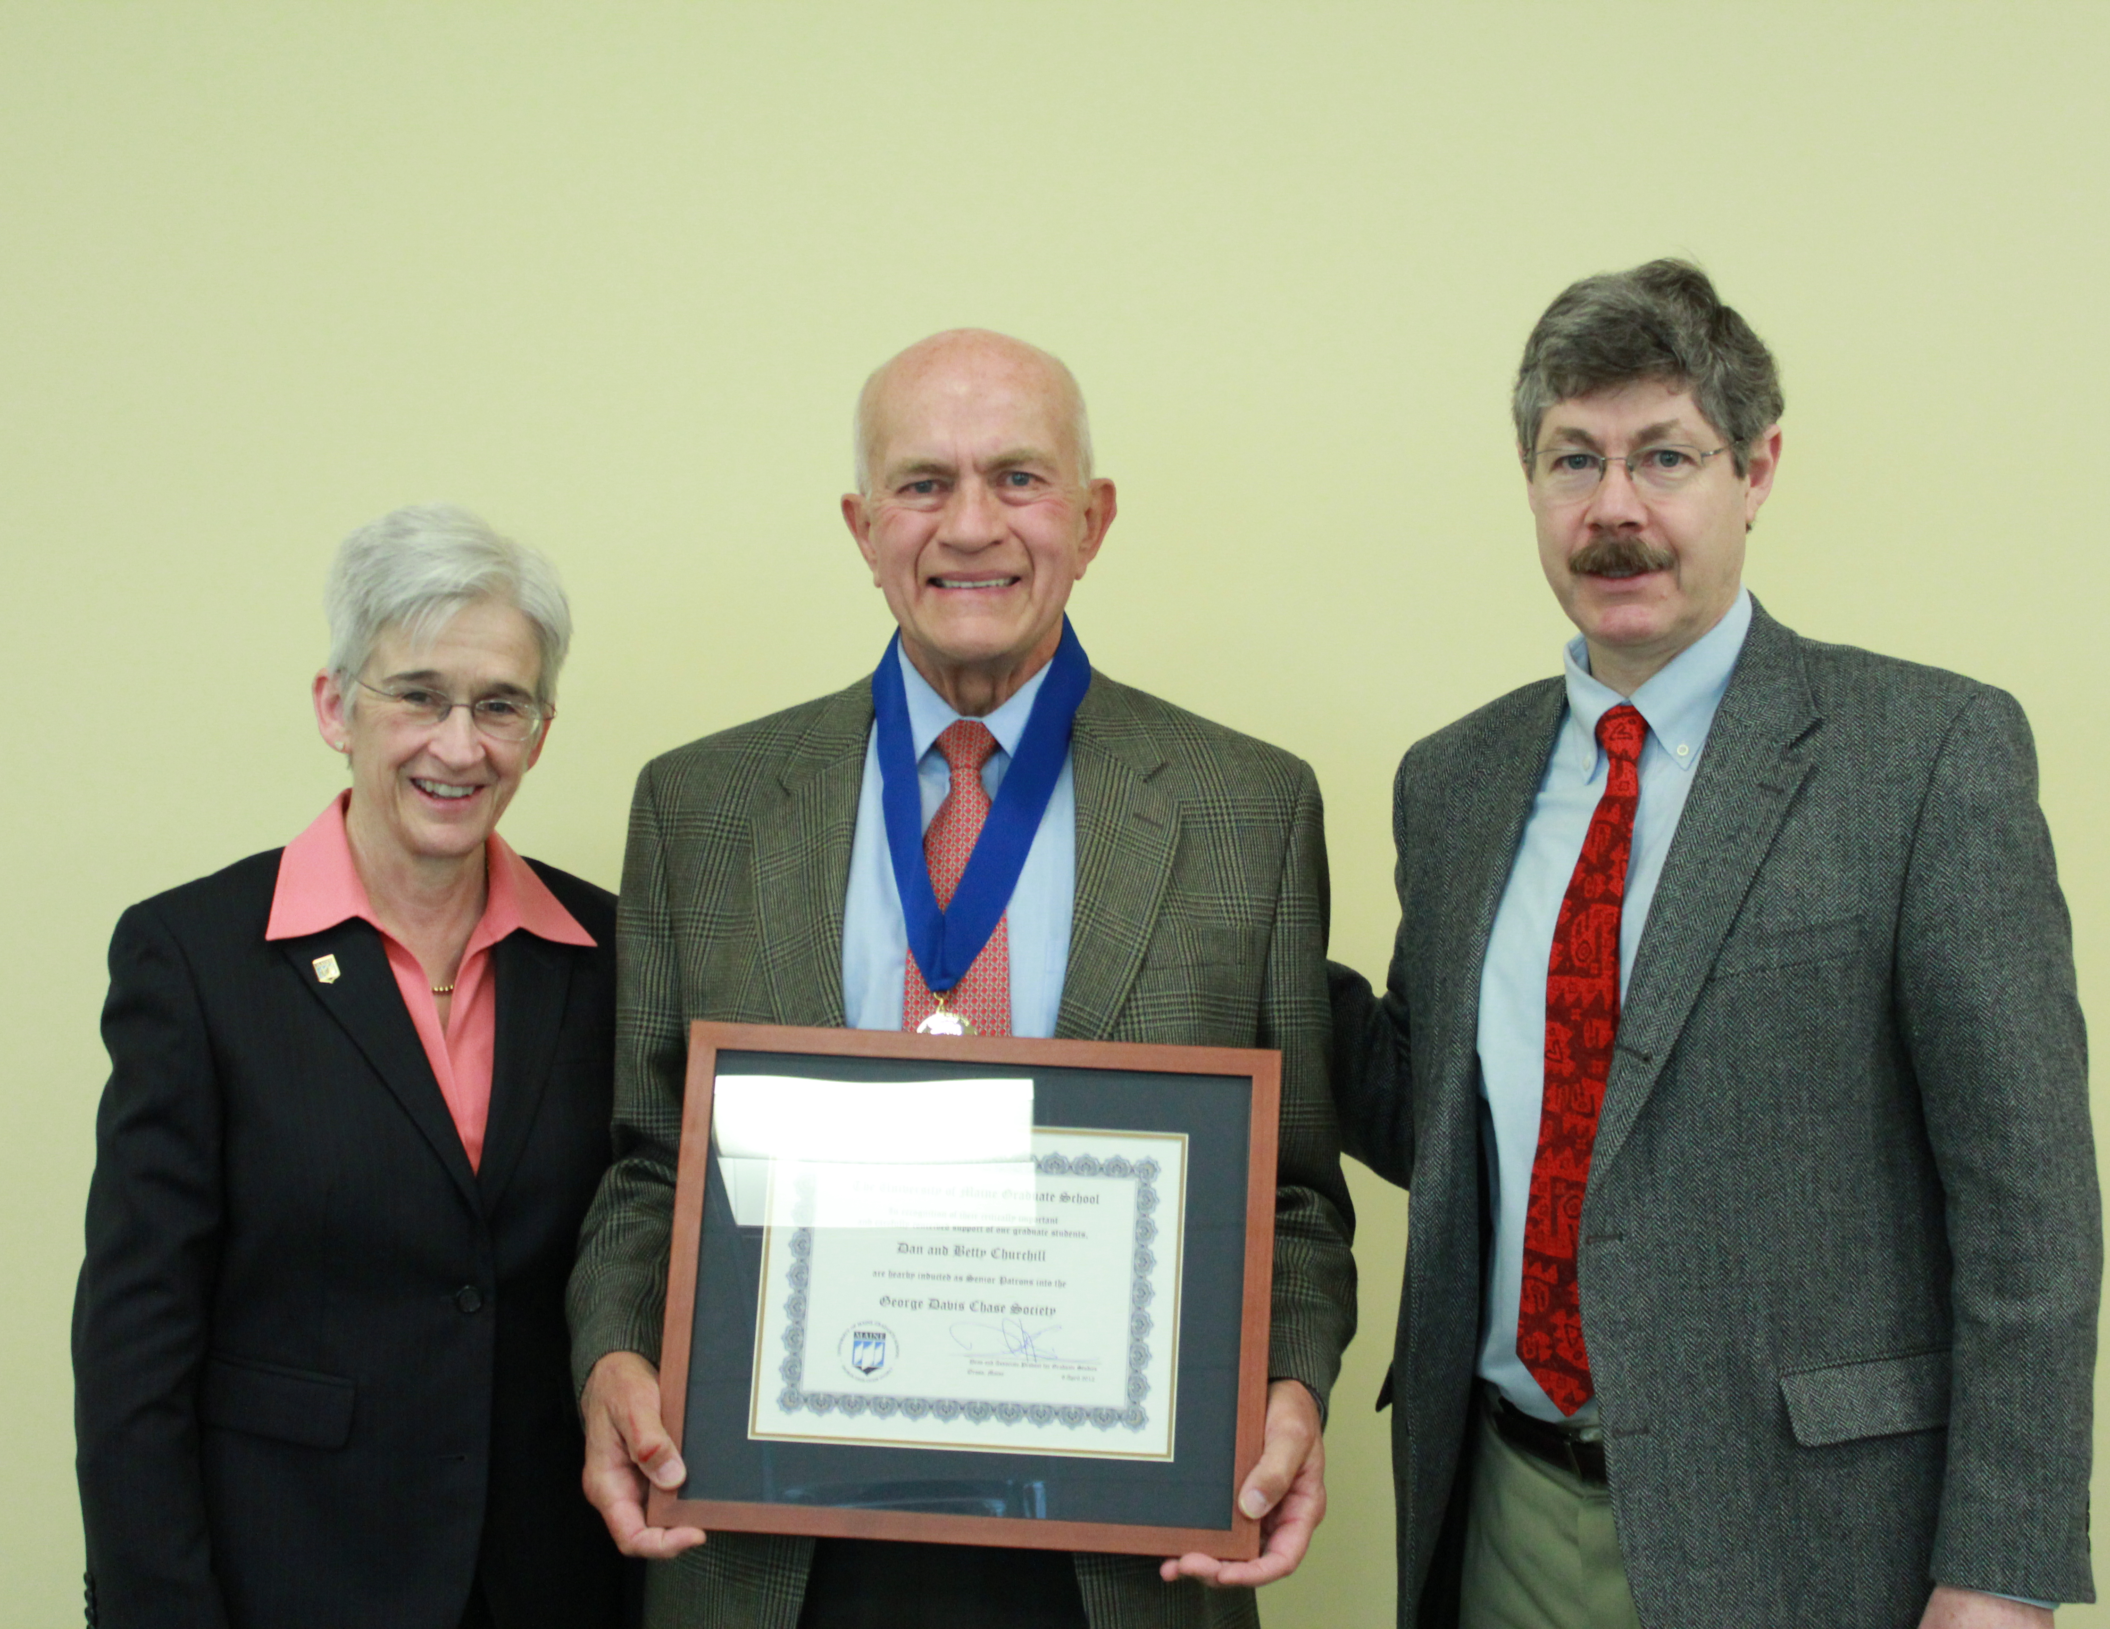
Development Initiatives
$10M for Graduate Fellowships (Blue Sky Plan)
George Davis Chase Society
Hooding Ceremony Speaker
Wall of Honor
The Higher Degree (Grad School Newsletter)
Notes:
Chase: Dan Churhill, Penelope Wolfe, Haywood Talcove, Jamal Al-Suwaidi

Slide 21
Challenges
Great Faculty, Great Grad Students,
Innovative Programs, but…
$$$
Notes:
Many reasons, many solutions of which we can and must be a part…but at recent Council of Grad Schools meeting, my two professional sides—archaeology and graduate studies—merged briefly in an image intended to capture one of the root causes of the difficult economic situation in which the country finds itself…

Slide 22
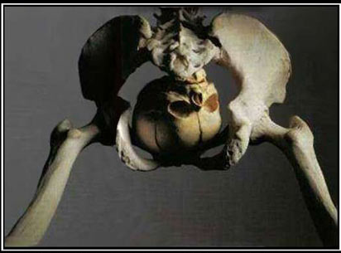
Skeletal Remains of Early Politician
http://bestdemotivationalposters.com/tag/skeleton/

