Slide 1
Research
Learning
Experiences
Notes:
SSR has three components with committees and co-chairs. We’ve met and started to information needs, task lists, and time lines for conducting this work across all UMS campuses

Slide 2
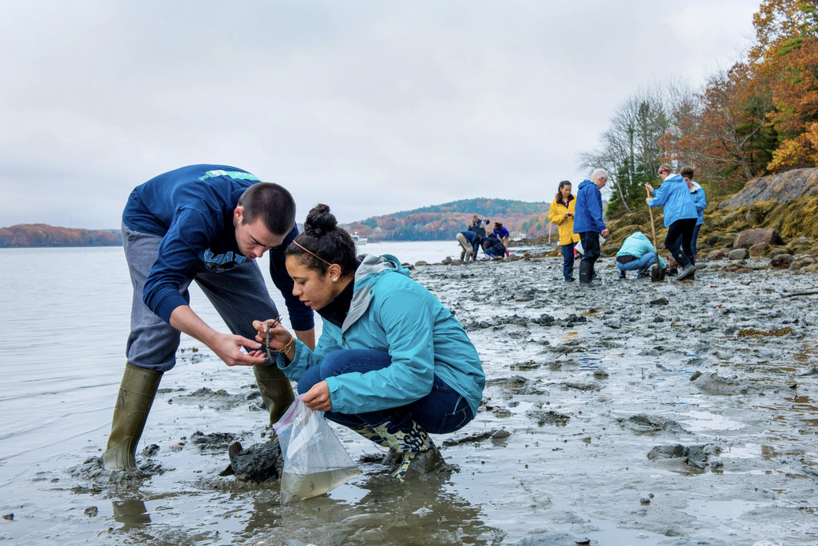
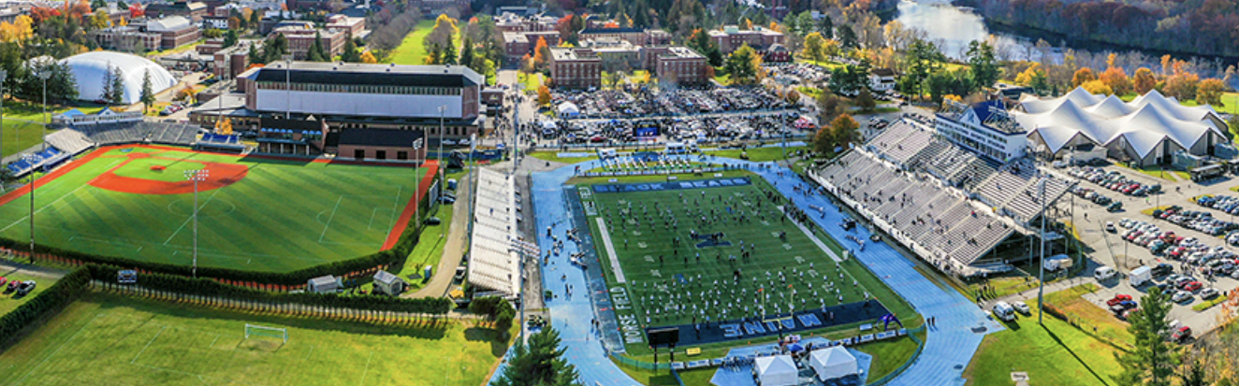
A once in a generation gift for the next generation of Maine students
Student Success & Retention
$20m support + $25m challenge
Engineering, Computing & Info Science
$75m support + $75m challenge
Graduate & Professional Center –
$55m support + $50m challenge
Black Bear Athletics – $90m support + $20m challenge
Notes:
The Maine Difference is supported largely by the SSR goals of UMS TRANSFORMS

Slide 3
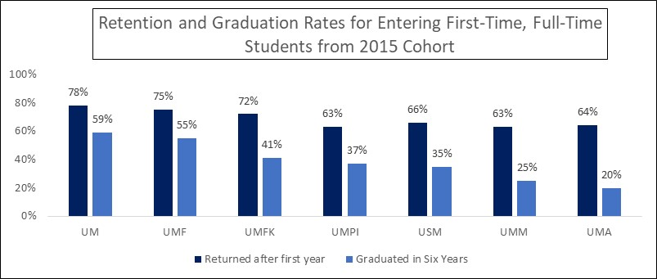
1st-year Student Retention & 6-year Graduation Rate
Almost 2/3 of those who don’t graduate leave before their sophomore year &
> 80% who don’t graduate leave before their junior year

Slide 4
RLE – What are the Objectives?
Student Success & Retention
Increase first-year retention
Increase independent scholarship

Slide 5
RLE 101 – What is “Research?”
a process or approach for scholarly exploration.
Explore questions for which there is no certain answer
Frame questions that inform next steps
Use an iterative approach that aligns with professional practice
Expect to encounter obstacles
Develop skills to overcome obstacles and continue exploration.

Slide 6
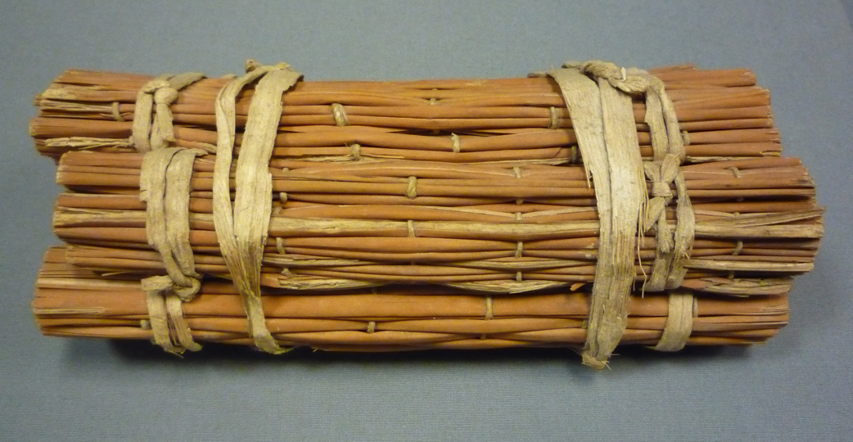
Research Learning Experiences: A SHARED PEDAGOGY
Peer/Near-Peer Mentoring
“Summer Bridge” Experience
Experiential or Active Learning
Cohort-based Learning
Inquiry-based Learning
First-year Experiences
Problem-based Learning
Growth Mindset or Teaching “Grit”
Cooperative Learning
Contributing-Student Pedagogy
Constructivism
Notes:
It’s a combination of proven designs, linked together

Slide 7
RLEs – The Basic Bundle
Research Learning Experiences: A SHARED PEDAGOGY
The First-year RLE
Bridge Week
First Academic Semester
Small cohort, credit-bearing courses that establish connections early that can last throughout their time at the university
Engagement in authentic, open-ended research and scholarship, where the student shapes the narrative, and the product has meaning outside of the classroom
Near-peer mentoring that provides achievable developmental examples and relatable student support
Formal assessment to inform next steps in RLE design

Slide 8
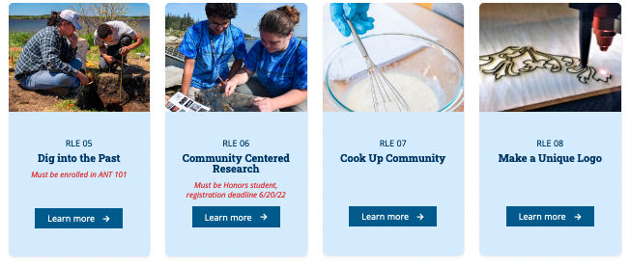
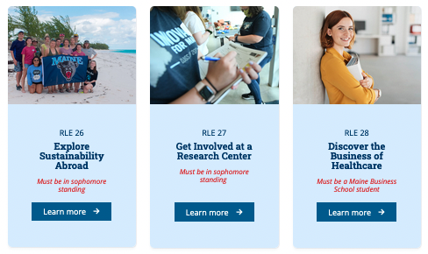
Fall 2022 - Options in diverse disciplines across UMS
Fall 2021 UMaine only
31 Course Sections
225 students
Fall 2022 Across UMS
54 Course Sections
501 students
University of Maine | 362
University of Maine Farmington | 92
University of Maine Fort Kent | 20
University of Maine Augusta | 18
University of Maine Presque Isle | 9

Slide 9
Pilot Assessment Plan
Pre-survey
(students - dispositions)
Post-survey
(students - dispositions)
1st year retention
4yr Grad Rate
1st Year September
December
Sophomore September
Graduation
Notes:
Presenter: John Volin
Key takeaway: How’s it going? Early retention assessment is positive.
93% of students indicated they are still interested in research/exploration
Most students would take the RLE again, with the most common reason being that it was a fun/enjoyable experience
Most common benefits:
> having a support system with peers
> having a support system with a faculty member
RLE students showed gains in many survey items, with significant pre-to-post gains in:
> Confidence in research tasks
> Collaboration
Analyzing effects on retention from Fall 2021 to Fall 2022

Slide 10
Pilot Assessment Plan
1st year retention
4yr Grad Rate
Student Cognitive Assessment
(by faculty)
Pedagogy Survey
(faculty)
1st Year September
Oct/Nov
December
Sophomore September
Graduation
Notes:
Presenter: John Volin
Key takeaway: How’s it going? Early retention assessment is positive.
93% of students indicated they are still interested in research/exploration
Most students would take the RLE again, with the most common reason being that it was a fun/enjoyable experience
Most common benefits:
> having a support system with peers
> having a support system with a faculty member
RLE students showed gains in many survey items, with significant pre-to-post gains in:
> Confidence in research tasks
> Collaboration
Analyzing effects on retention from Fall 2021 to Fall 2022

Slide 11
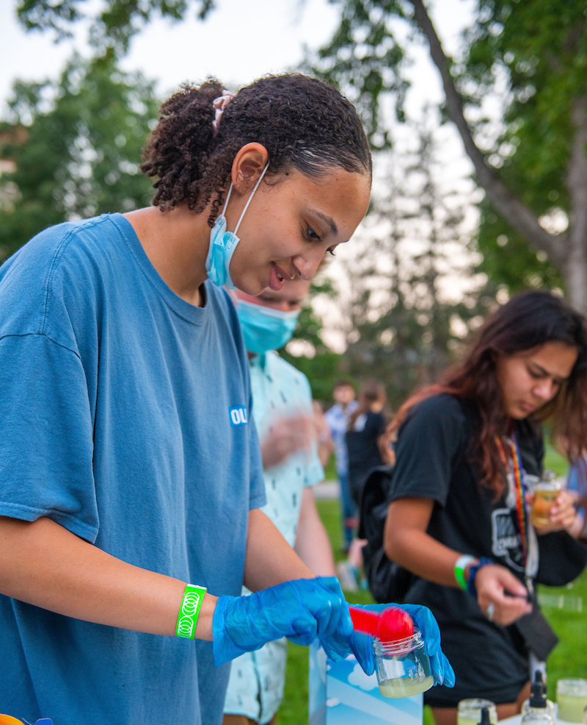
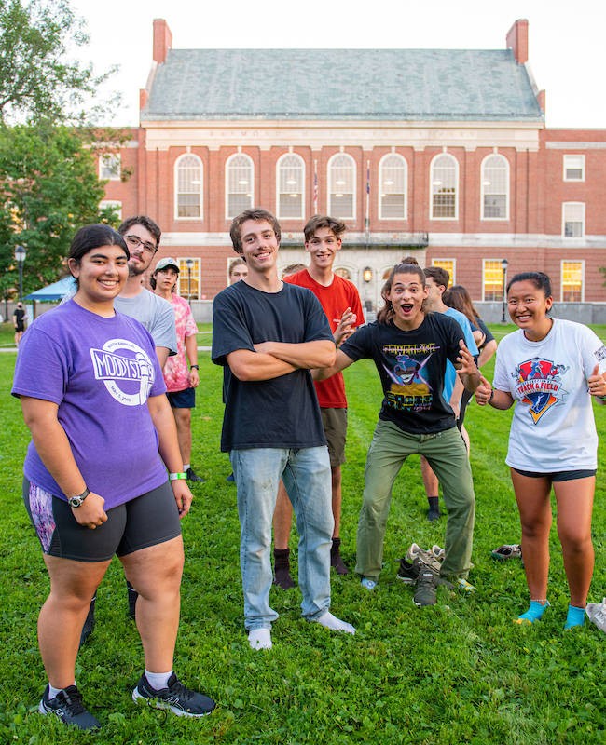
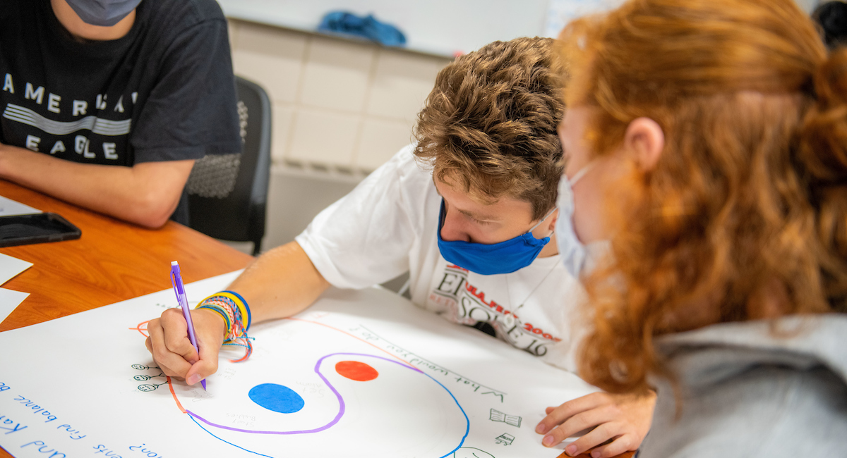
Preliminary outcomes from the 2021 pilot
Fall-to-spring retention for RLE students than non-RLE students: 90% vs. 87%
Fall-to-spring retention for non-Honors RLE students was similar to non-Honors students who did not participate in the RLE program (86.5% vs. 86.1%)
Fall-to-spring retention for Honors RLE students was slightly higher than for non-RLE Honors students (96% vs. 93%)
Notes:
Presenter: John Volin
Key takeaway: How’s it going? Early retention assessment is positive.
93% of students indicated they are still interested in research/exploration
Most students would take the RLE again, with the most common reason being that it was a fun/enjoyable experience
Most common benefits:
> having a support system with peers
> having a support system with a faculty member
RLE students showed gains in many survey items, with significant pre-to-post gains in:
> Confidence in research tasks
> Collaboration
Analyzing effects on retention from Fall 2021 to Fall 2022

Slide 12
Preliminary outcomes from the 2021 pilot
RLE students showed significant pre-to-post gains in:
Confidence in research tasks
Collaboration
RLEs with off-campus experiences have greater gains in confidence in research tasks
Similar, and significant drop in morale for both RLE and non-RLE students.
Interaction between gender and Sense of Belonging
Females in RLE courses with greater sense of belonging on both the pre- and post-surveys. No gender difference in the non-RLE group
Belonging in non-RLE Males dropped, but not in RLE Males
Most students would take the RLE again, with the most common stated reasons:
It was a fun/enjoyable experience
Formed a support system with peers or with a faculty member
Notes:
Presenter: John Volin
Key takeaway: How’s it going? Early retention assessment is positive.
93% of students indicated they are still interested in research/exploration
Most students would take the RLE again, with the most common reason being that it was a fun/enjoyable experience
Most common benefits:
> having a support system with peers
> having a support system with a faculty member
RLE students showed gains in many survey items, with significant pre-to-post gains in:
> Confidence in research tasks
> Collaboration
Analyzing effects on retention from Fall 2021 to Fall 2022

Slide 13
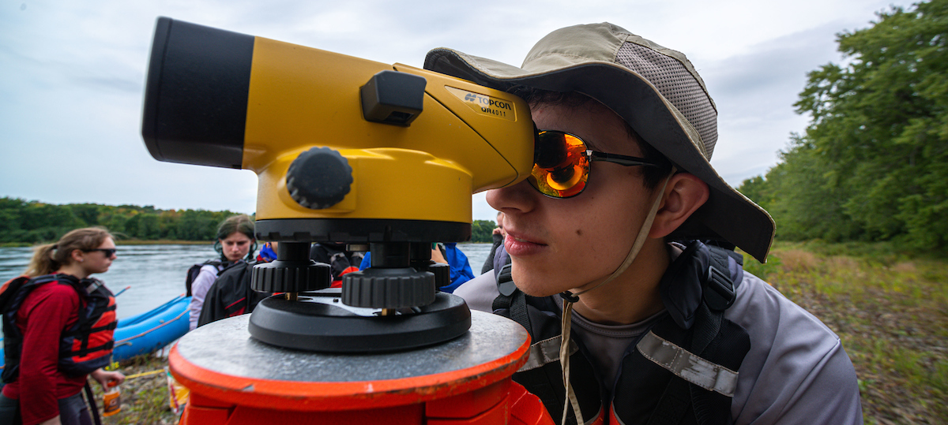
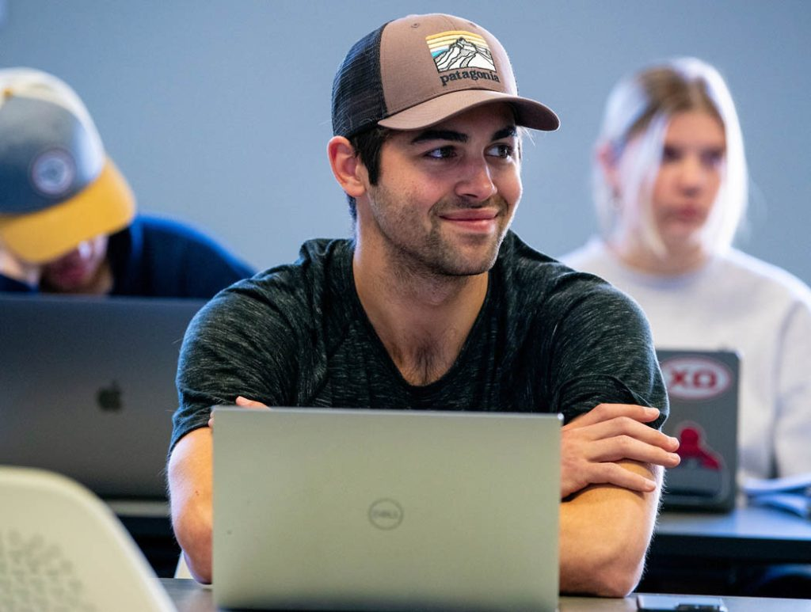
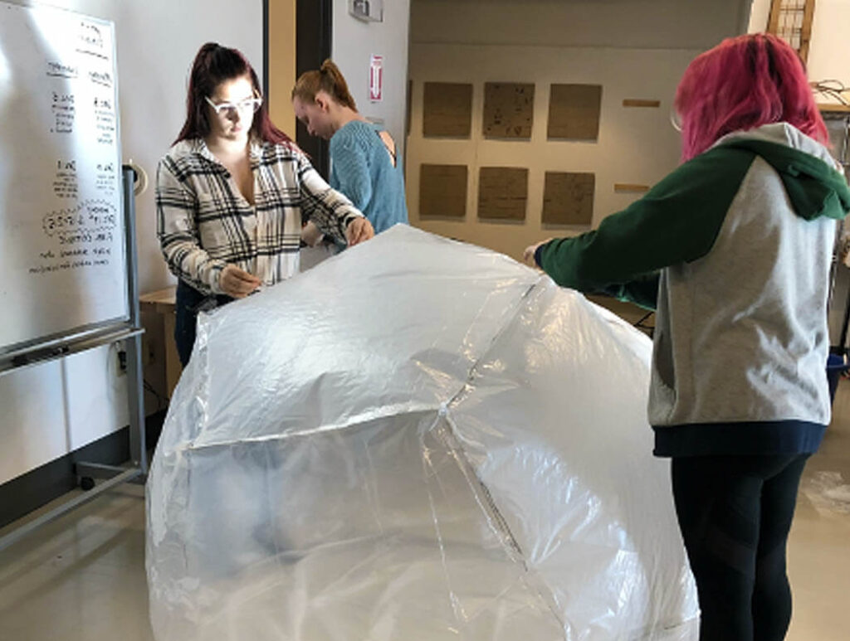
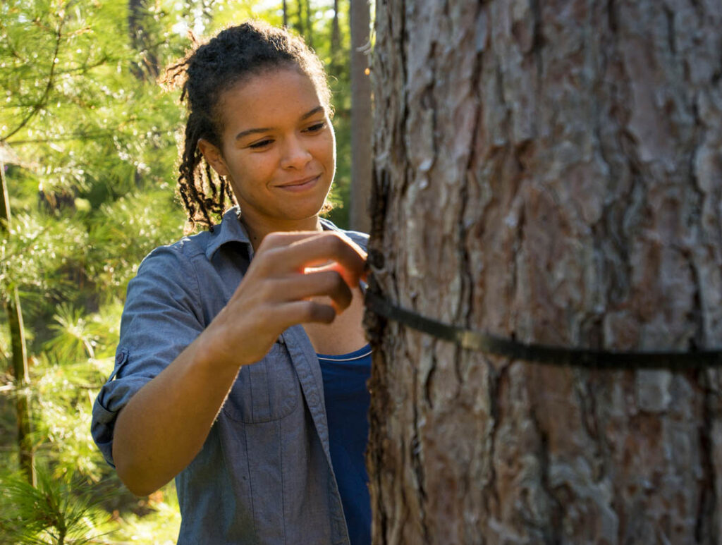
More Digging to Come!!

