Slide 1
Experiential programs innovation central (EPIC)
Prof. Ali Abedi, Associate Vice President for Research Director, Center for Undergraduate Research University of Maine, Orono
27th NSF EPSCoR National Conference - Undergraduate Research Learning Experiences Workshop

Slide 2
Recruiting
Engaging
How to change confused to confident?
training
discovery

Slide 3
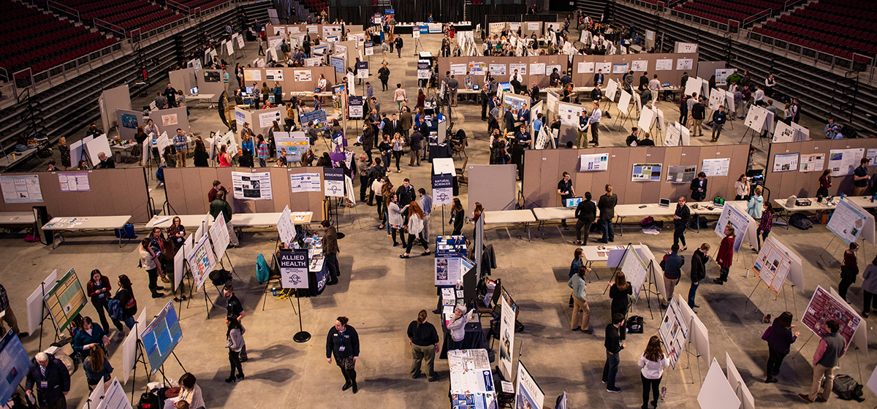
Recruiting
Best practices:
Active vs Passive
School visits vs University tours
Challenges:
Faculty and staff time
Budgetary limitations
Opportunities:
What has changed in the past few years?
What are the new opportunities?

Slide 4
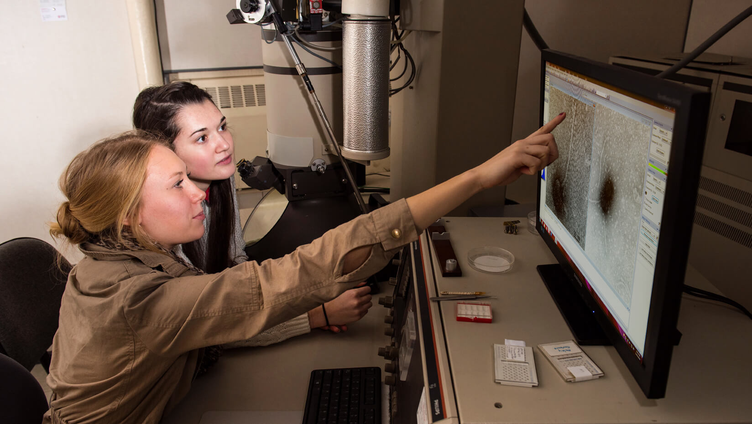
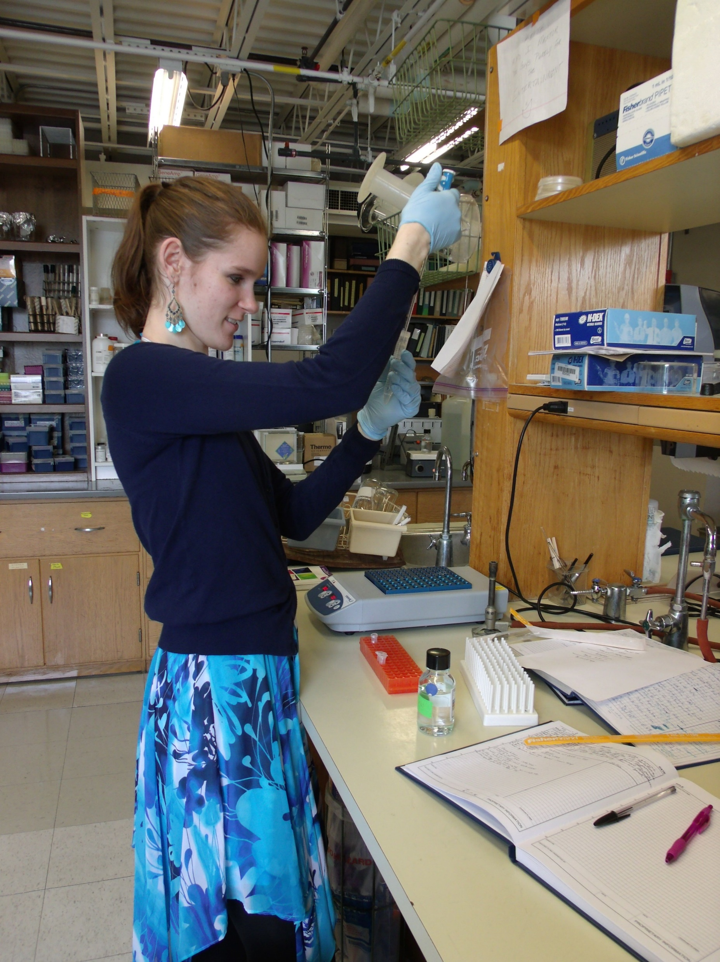
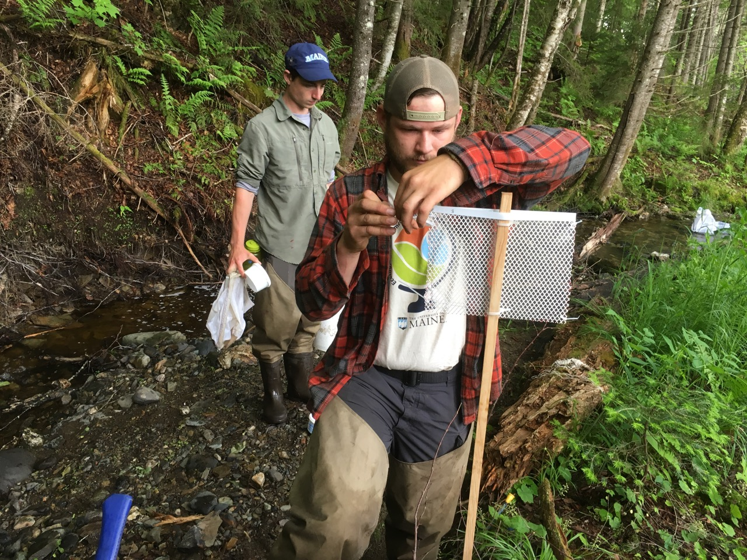
engaging
Inside classroom
Within the lab
Off campus

Slide 5
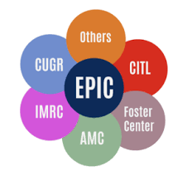
Training
Research methods
Innovation and design
Responsible Conduct of Research
Diversity, Equity, and Inclusion
Presentation Skills
Research center tours

Slide 6
Who should mentor undergraduate Students?
ⓘ Start presenting to display the poll results on this slide.

Slide 7
Discovery
Specific
Measurable
Attainable
Realistic
Time limited
Mentoring
Faculty
Graduate Students
Undergraduate peers
SMART Objectives
Recognition
Physical
Virtual
All of the above

Slide 8
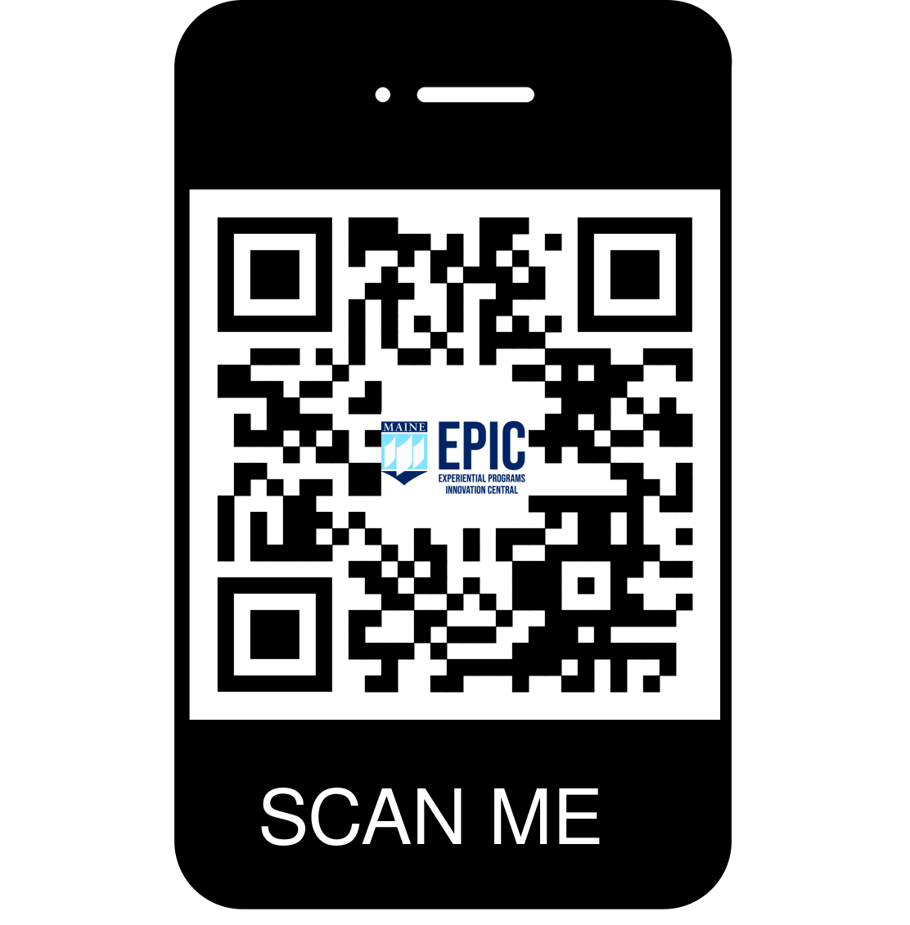
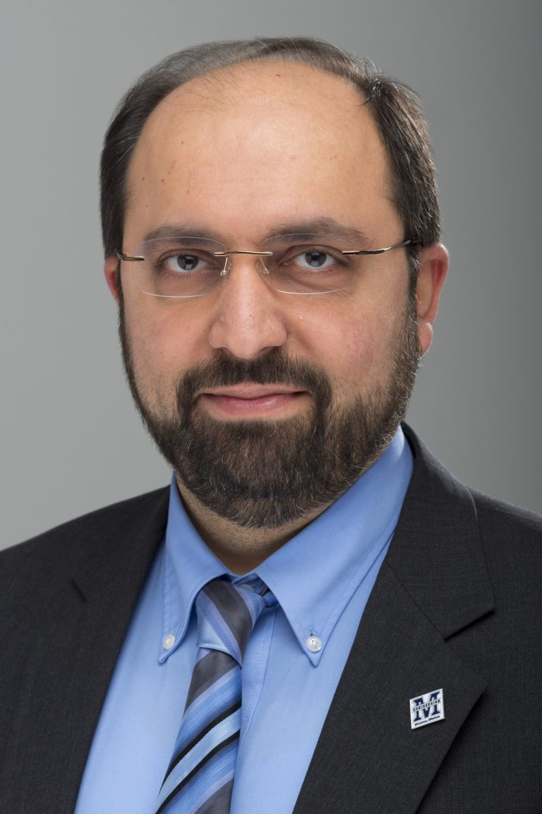
Questions/Discussions
Thank you for your attention
Contact: ali.abedi@maine.edu

