Slide 1
A Comparative Longitudinal Study of Research Outputs in EPSCoR versus Non-EPSCoR States
Prakash Nagarkatti, Ph.D.
Senior Research Advisor to the President
Vice President for Research Emeritus
Carolina Distinguished Professor University of South Carolina

Slide 2
How to take EPSCoR projects to the next level?
NSF Track-1: Completed 5 years; Materials Assembly and Design Excellence in SC (MADE in SC): MGI approach
256 publications: 6.00 average impact factor;
Over $30 million in new research funding
50 patent disclosures; 18 patents awarded
Over 60 faculty, 25 post-docs, 100 graduate students, and over 180 UG students
17 new faculty hired
Two Bridge to Doctorate programs funded
Significant EOD impact
NAS Report: "NSF Efforts to Achieve the Nation’s Vision for MGI"

Slide 3
What's Next?
Centers: MERSEC, STC, ERC--EPSCoR states find it challenging to compete
Why is it a Challenge?
Lack of research infrastructure?
Not competitive?
Peer-review bias?
That raises an important question:
How do the EPSCoR states perform in research productivity when compared to non-EPSCoR states?

Slide 4
Comparing EPSCoR vs Non-EPSCoR States in Research Outputs
Data gathered from Academic Analytics
Number of Journal articles and books published
Number of Citations of journal articles
Presentations at scientific conferences
Patents
Gathered data from PhD granting universities: 77 in EPSCoR States and 300 in non-EPSCoR states
Data expressed: per faculty member and per $1 million in federal research grant dollars

Slide 5
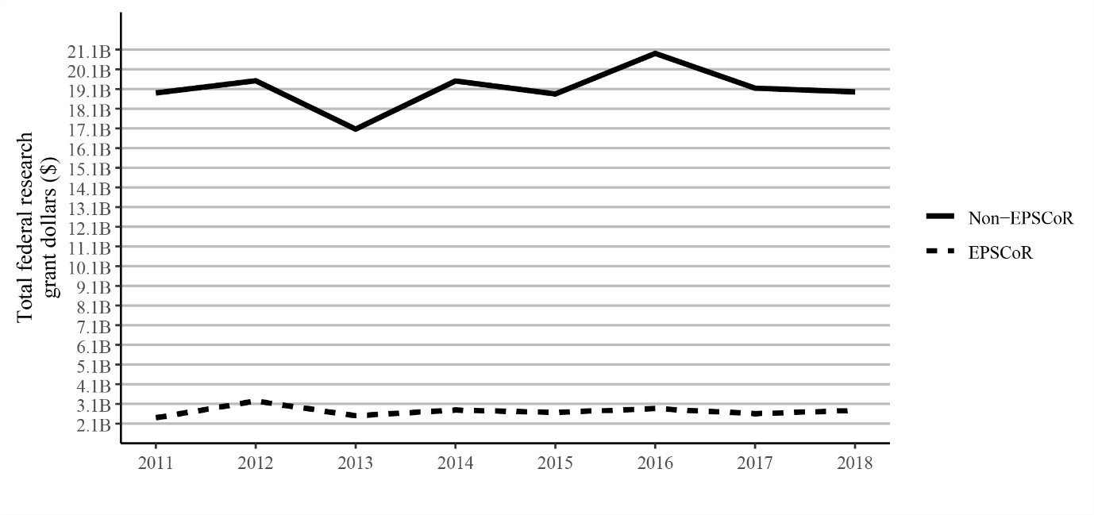
Total federal grant dollars received by faculty
~$20 B
Non-EPSCoR
EPSCoR
~$2 B

Slide 6
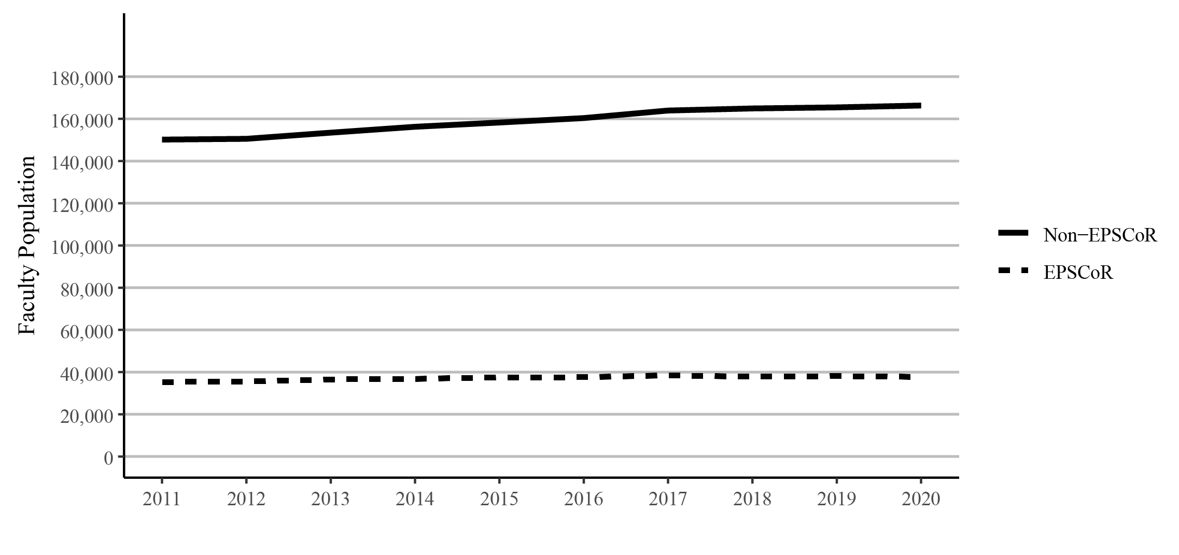
Total faculty numbers
Non-EPSCoR
~160,000
EPSCoR
~40,000

Slide 7
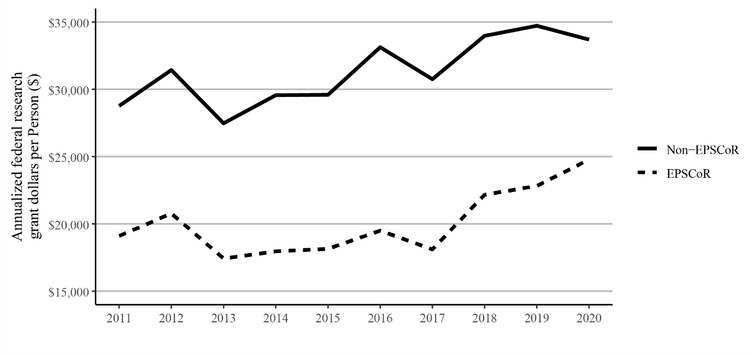
Federal grant dollars per faculty member/year
Non-EPSCoR
EPSCoR

Slide 8
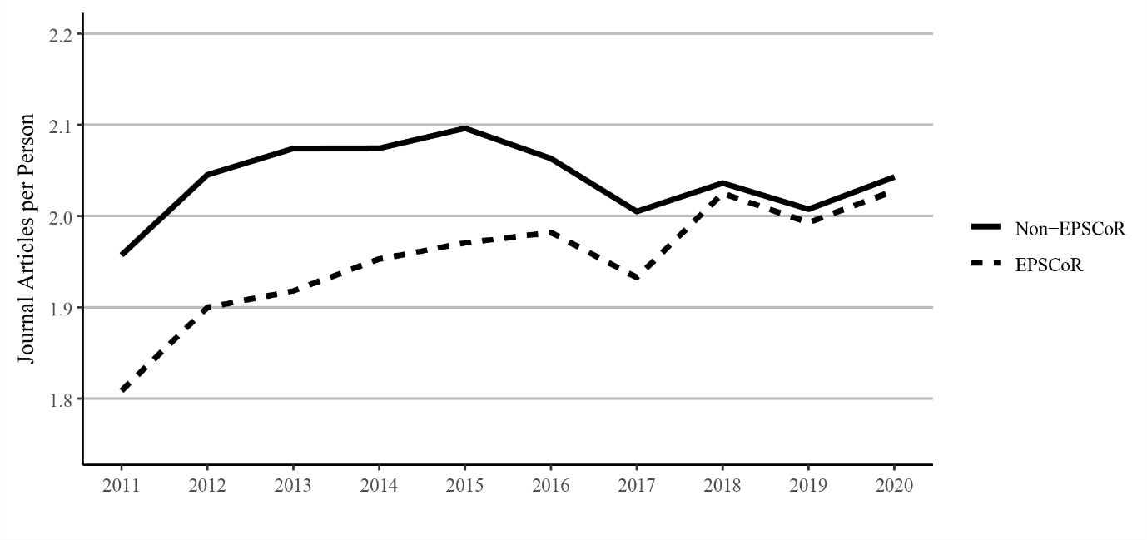
Journal articles per faculty member published
Non-EPSCoR
1.96
EPSCoR
1.8

Slide 9
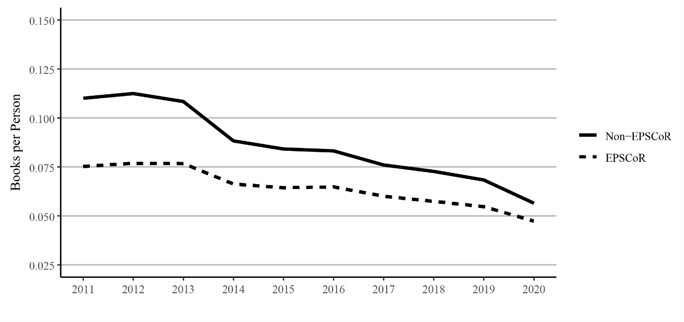
Books per faculty member published
Non-EPSCoR
EPSCoR

Slide 10
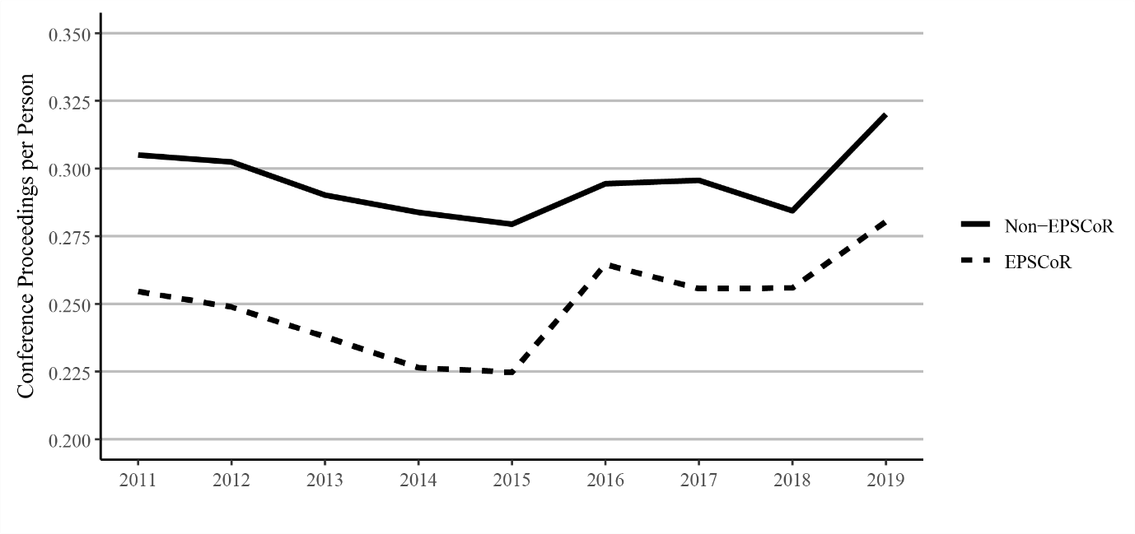
Conference proceedings per faculty member
Non-EPSCoR
EPSCoR

Slide 11
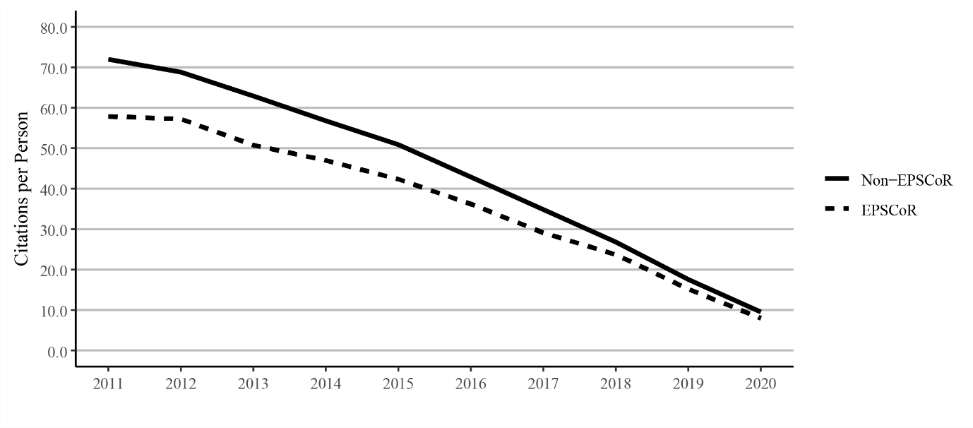
Citations to journal articles per faculty member
Non-EPSCoR
EPSCoR

Slide 12
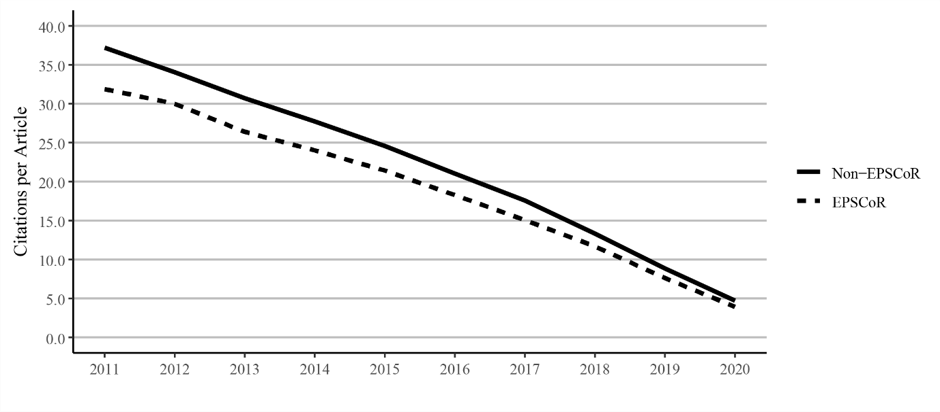
Citations per journal article
Non-EPSCoR
EPSCoR

Slide 13
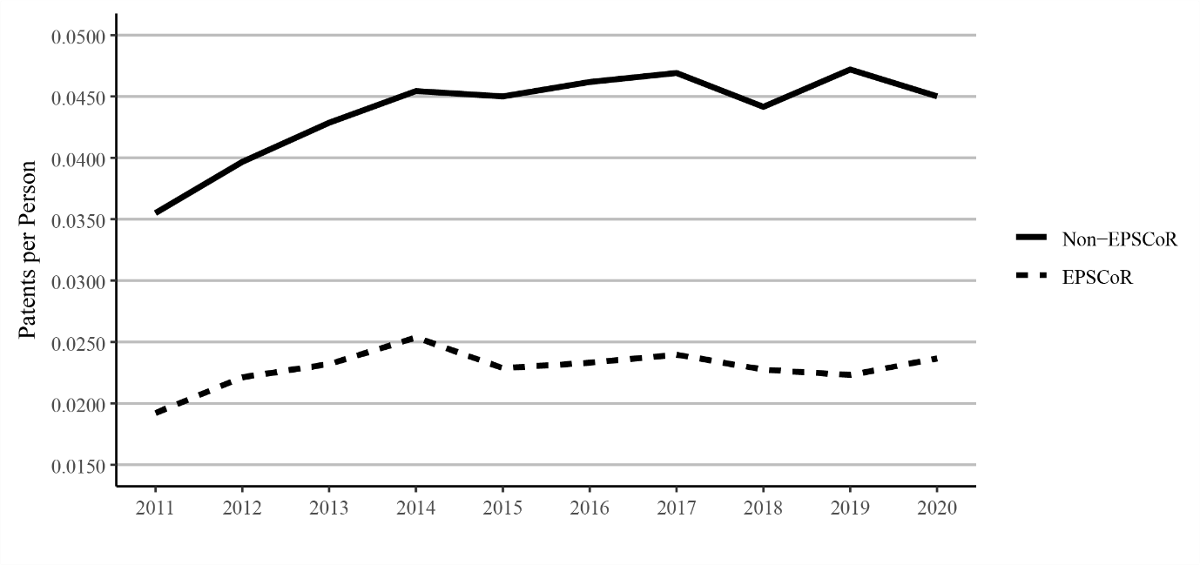
Patents per faculty member
Non-EPSCoR
EPSCoR

Slide 14
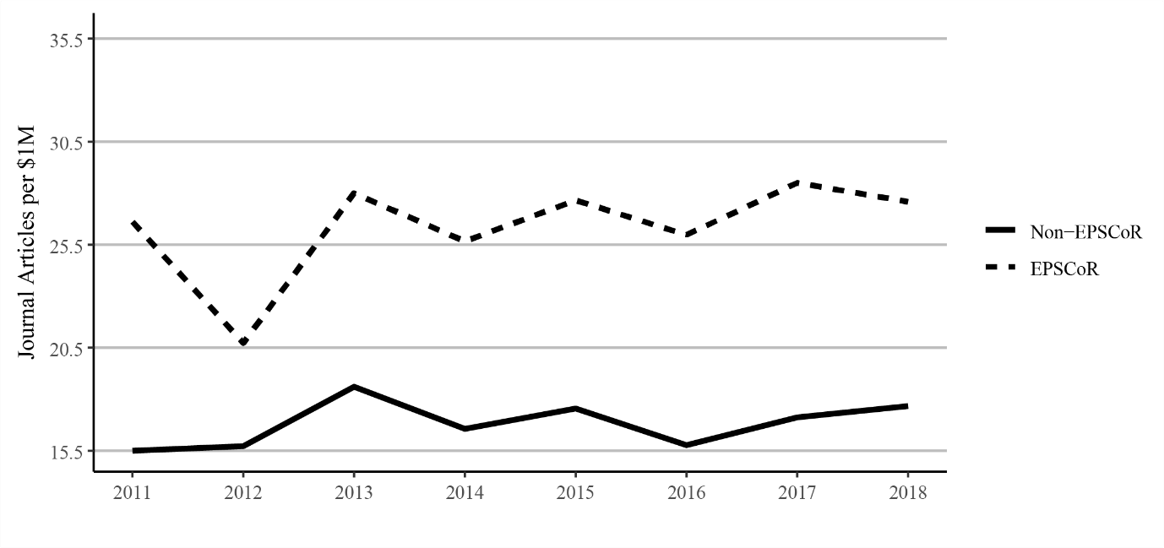
Journal Articles per $1million in Federal Funding
EPSCoR
Non-EPSCoR

Slide 15
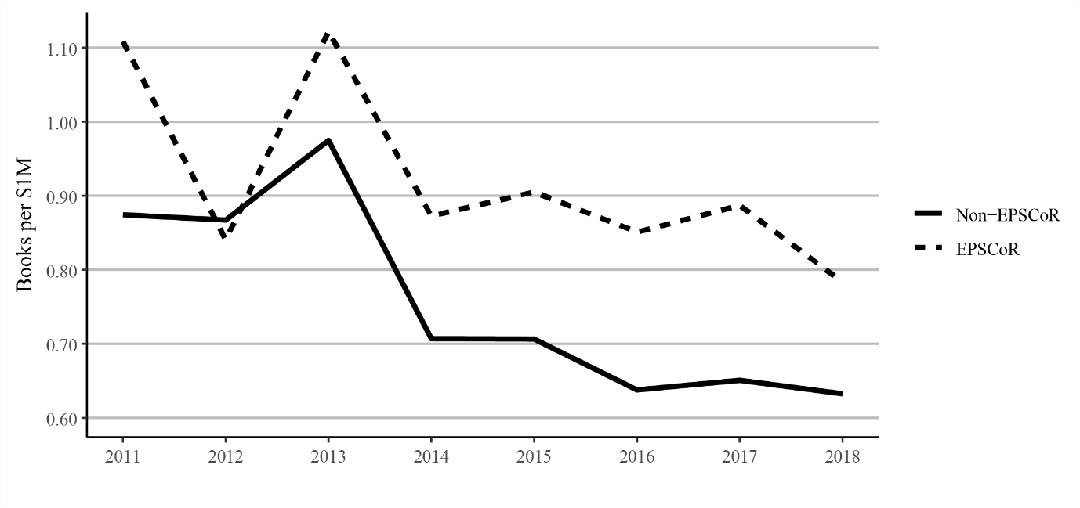
Book publications per $1million federal research funding
EPSCoR
Non-EPSCoR

Slide 16
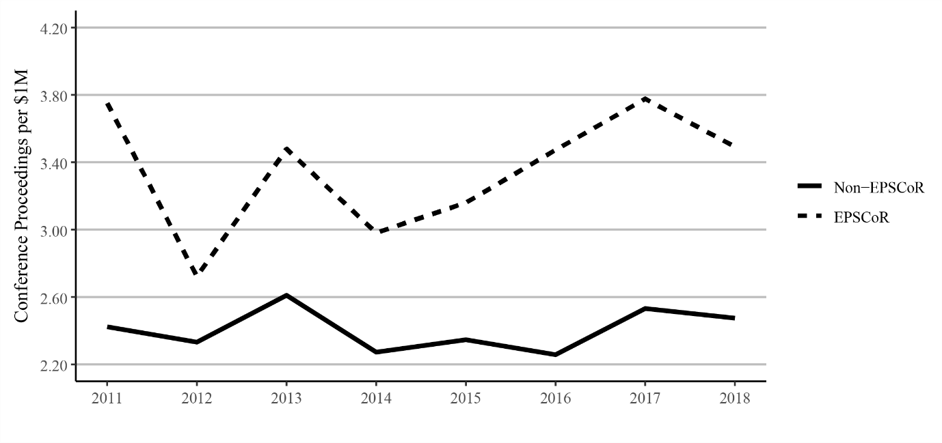
Conference proceedings publications per $1million federal funding
EPSCoR
Non-EPSCoR

Slide 17
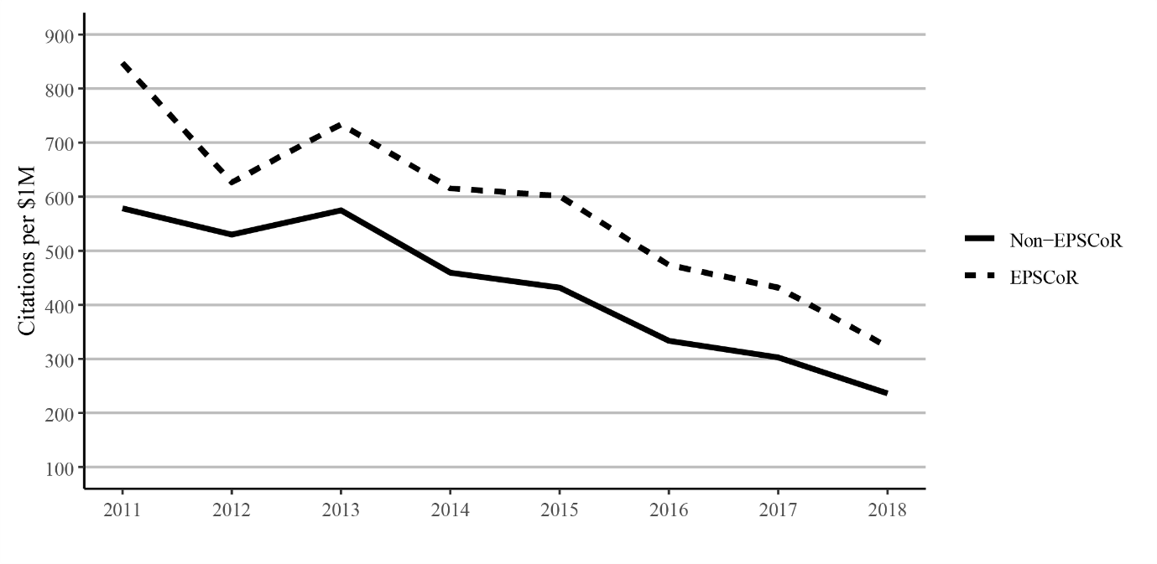
Citations to journal articles per $1million federal funding
EPSCoR
Non-EPSCoR

Slide 18
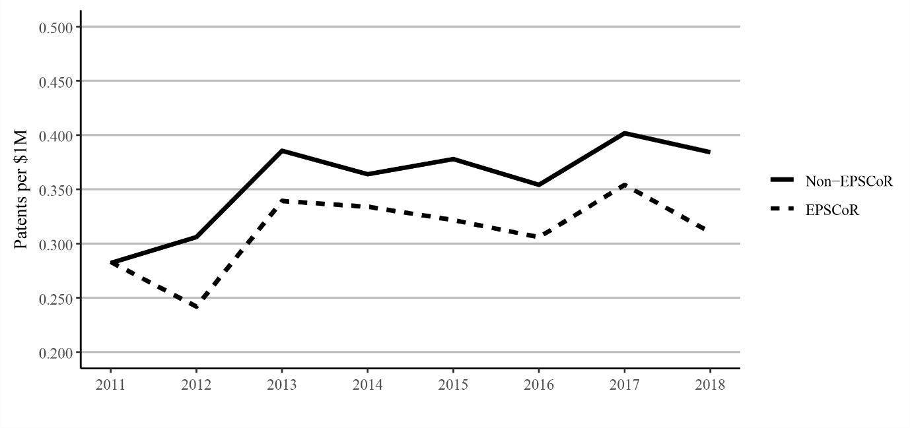
Patents per $1million federal funding
Non-EPSCoR
EPSCoR

Slide 19
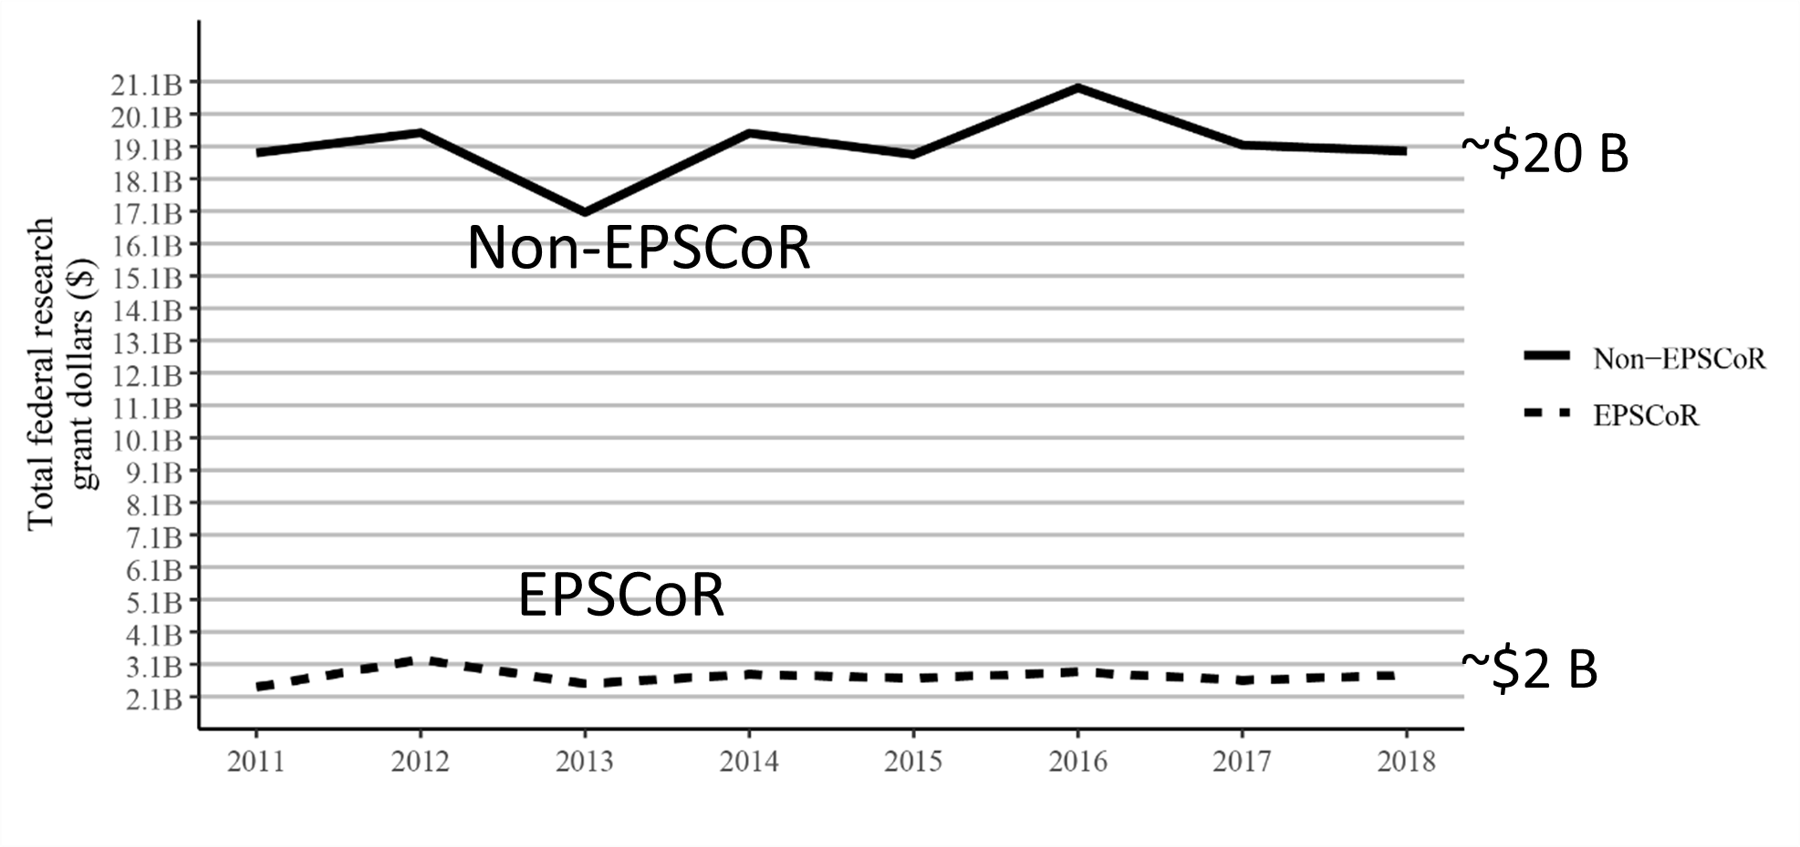
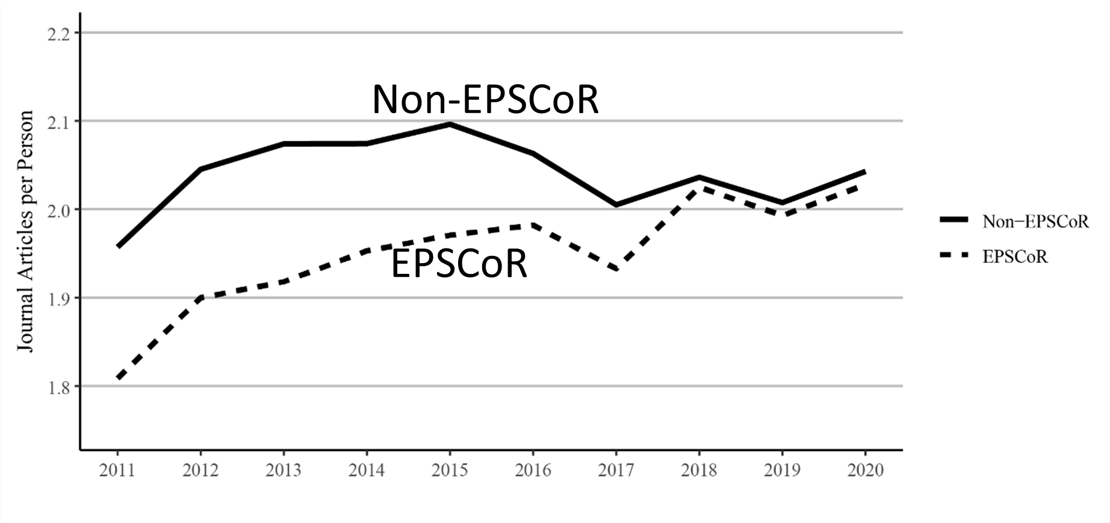
On per $ 1 million in federal funding, EPSCoR states perform better than non-EPSCoR

Slide 20
Limitations
Research quantity is not a measure of research quality.
Thus, the number of publications does not reflect of the quality of publications. However, we did look at citations as well.
We considered all faculty, not just those doing research
Some disciplines publish books or conference proceedings.
Teaching loads are likely to vary between institutions (e.g., Carnegie “R1” vs “R2” institutions).
Our analysis was limited to only Ph.D. granting institutions and excluded Puerto Rico and the US Virgin Islands due to the unavailability of data by AA.

Slide 21
Summary
There is a huge disparity in Federal funding for EPSCoR Vs Non-EPSCoR states.
When the impact per federal dollar invested in research is compared between EPSCoR vs Non-EPSCoR states, EPSCoR states do better than non-EPSCoR states.

Slide 22
We need to brag about our success!!

Slide 23
Suggestions
Track-1 success should be compiled: Publications, citations, PhDs, post-docs trained, patents, etc.
Impact on Education, Outreach, and Diversity
Track-1 should be extended to 10 years based on the previous 5 years' productivity; as well as more than one track-1 per jurisdiction (Suggestion from Future of EPSCoR Committee)
This will certainly make the jurisdictions more competitive for NSF Centers.

Slide 24
Acknowledgments
Ehsan Mohammadi
Anthony J. Olejniczak
George E. Walker
Academic Analytics
Preprint: SocArXiv
https://osf.io/preprints/socarxiv/r6xdu/

