Slide 1


Land Use Explorers
An outreach program of WAFERx
Water-Agriculture-Food-Energy Research Nexus
(OIA-1632810) EPSCoR Track II
Suzi Taylor
Montana State University
Montana NSF EPSCoR EOD Team

Slide 2
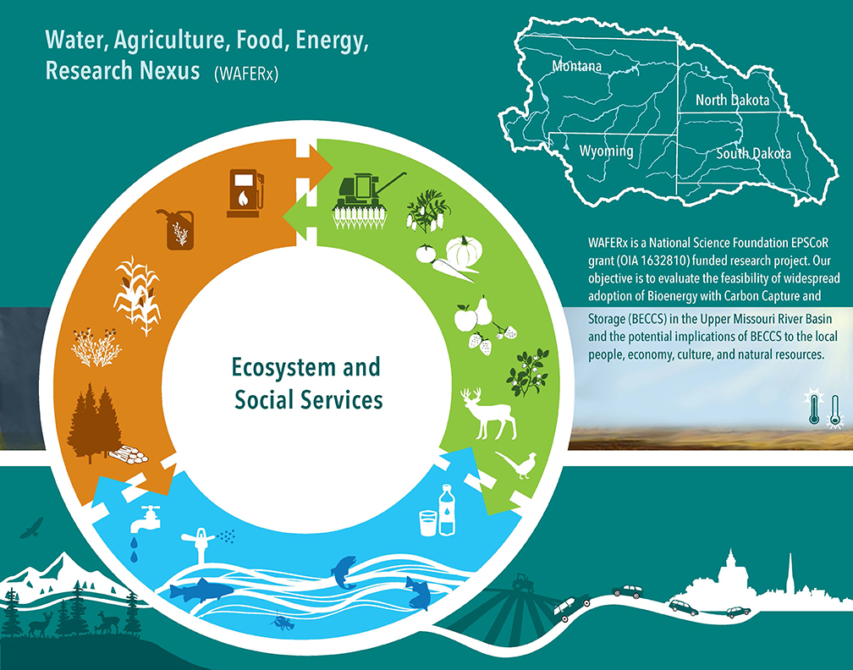
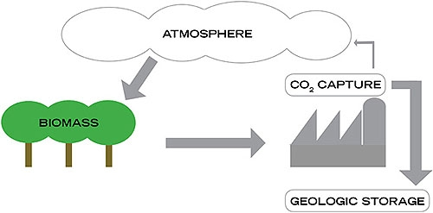
The Research
Evaluate the implications of adopting Bioenergy with Carbon Capture and Storage (BECCS) in the Upper Missouri River Basin to mitigate climate change.
BECCS, while potentially lowering CO₂ emissions, would require transformations in agriculture, land-use, and energy production systems, which could create trade-offs among food, water, energy, biodiversity, and economic opportunities. We seek to understand the implications of these trade-offs for the local people, communities, cultures, and ecosystems of the UMRB.

Slide 3
The Education and Outreach Challenge
Pretty complex science – hard to translate
Worked with research team to distill the concepts of their work
Brainstormed hands-on activities to complement those concepts
Land​
Land Cover vs. Land Use​
Changes in the land over time​
Personal connections to the land (what do we each value; do those values change over time?)​
Citizen science ​
STEM identity – “I am a scientist. I can contribute!”​
Observations through writing, art, photography, etc.​
​Connections ​
To university research —what is it?​
To researchers — who are they as people?​
Career pathways —This is cool; how can I do it?​

Slide 4
Land Use Explorers Kit: Plan A
Create a hands-on kit for use in informal learning environments
Offer training and lesson plans for adult leaders
Provide all supplies and equipment to serve 20 youth
Recruit 3-4 youth leaders from each state — March 1 - 15​, 2020
Send kits to arrive by early April 2020 (Citizen Science Month / Earth Day)​
Youth leaders finalize kit use and give feedback — by June 2020

Slide 5
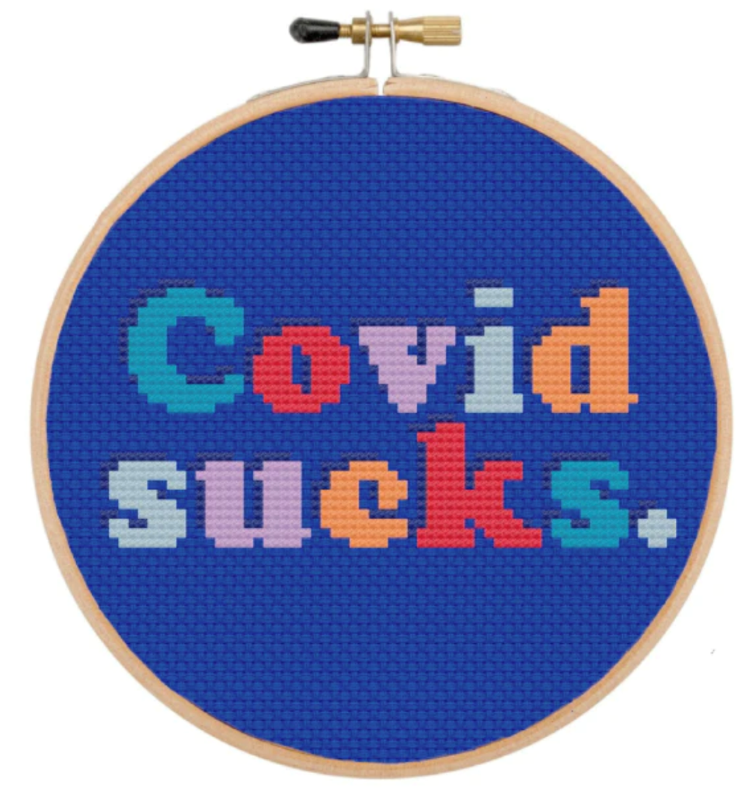
Plan B

Slide 6
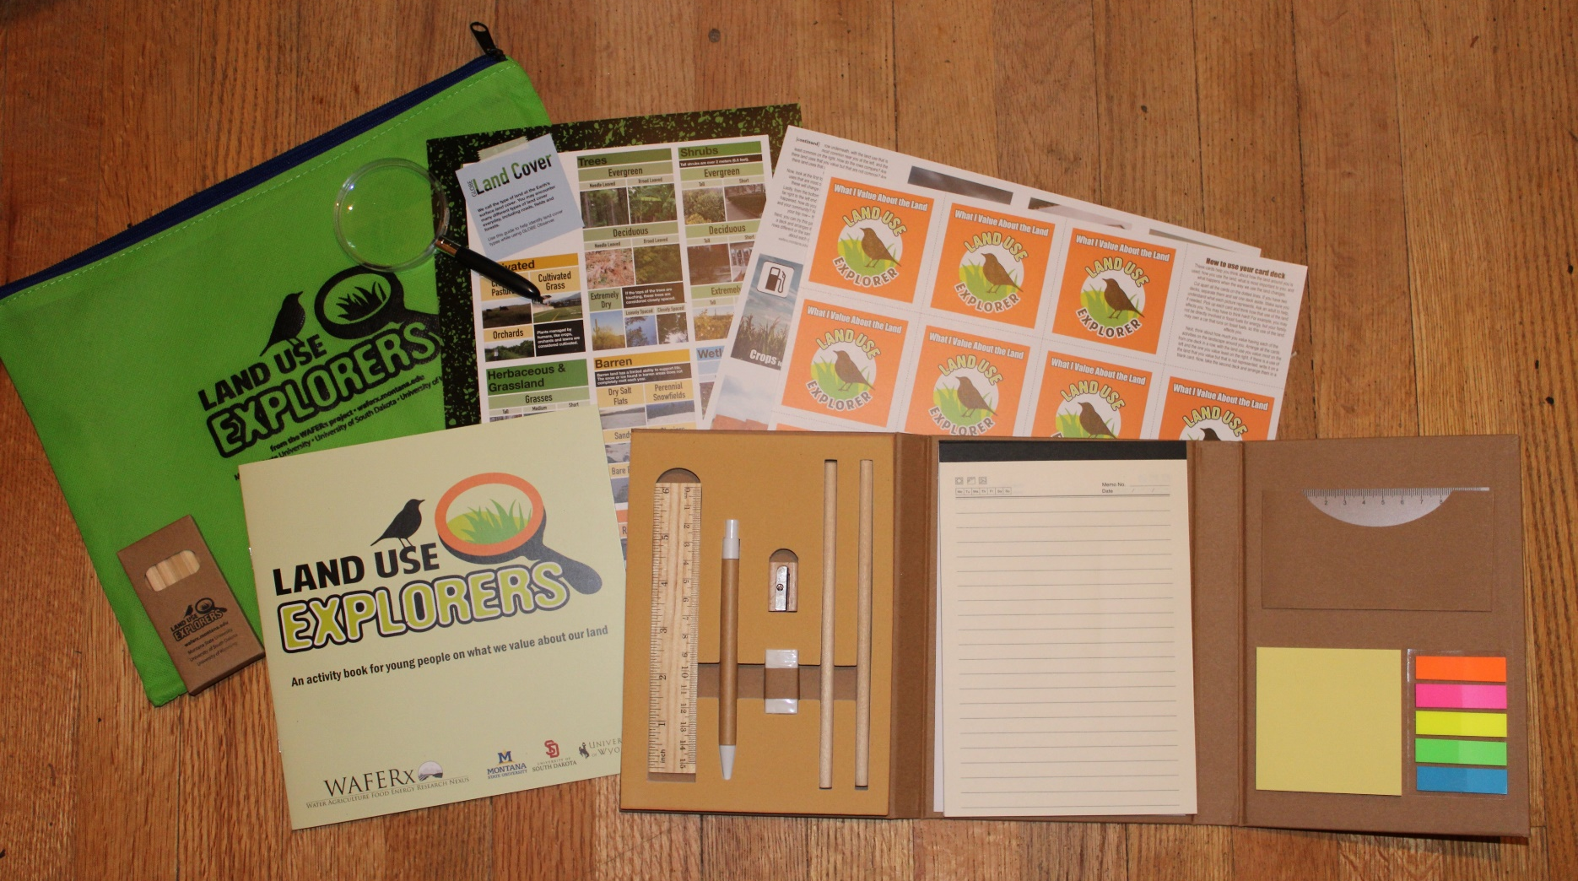

Slide 8
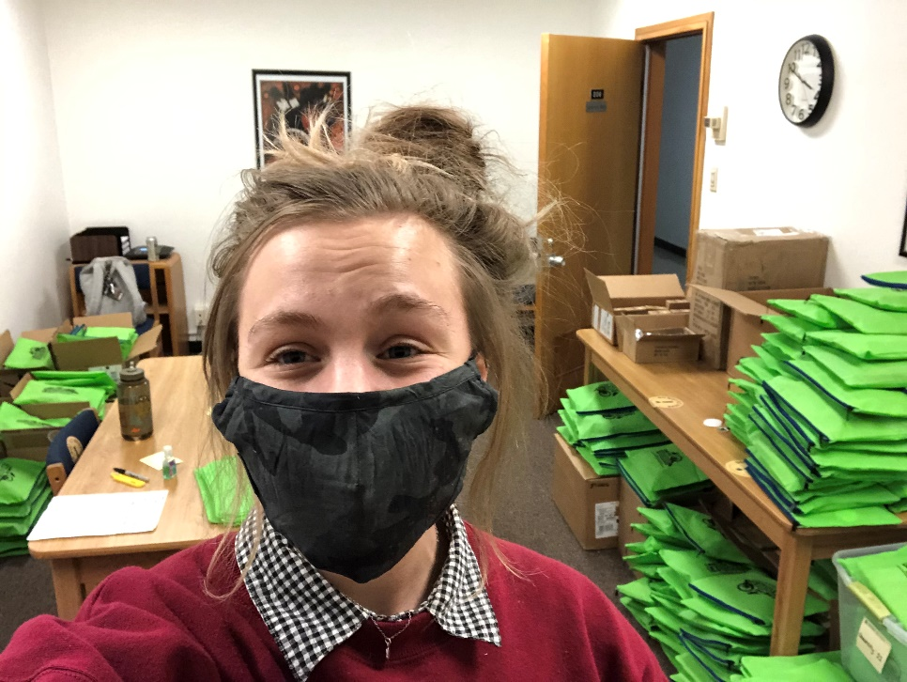
Challenges
Difficult to switch gears on short notice
Important to acknowledge that youth we aim to serve may have limited resources, including technology
More expensive per person
Kit assembly - UGH
Hard to recruit*
Youth miss direct connection
with teacher / leader
Tough to get evaluation data
/ follow through is uncertain

Slide 9
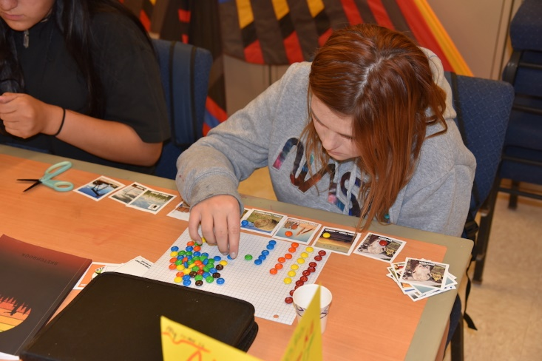
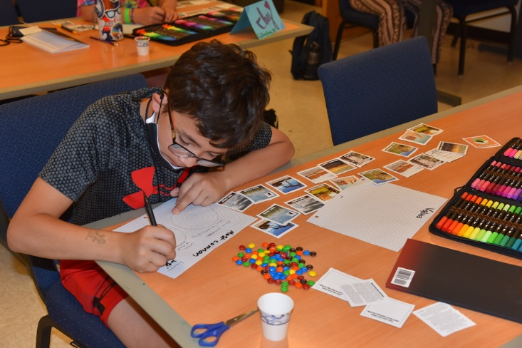
Opportunities
Were able to leverage resources from our EPSCoR Track I and Track II projects
Connected with new partners
Good way to reach rural kids / kids without transportation
Activities can still be used in non-remote setting

Slide 10
Partners
Extension Service and 4-H
Rural libraries
Schools and summer camps
Boys & Girls Clubs
Montana Migrant Education Program
Missoula (Montana) Food Bank
Canyon Hills (South Dakota) Residential Treatment Center
Dakota Rural Action
Afterschool Alliances in all three states

Slide 11
Feedback
Students learn the importance of observation and that they can be ‘scientists’ too,”
(Students learned) “that we share the land with other humans, plants, animals, insects, and other organisms and we need to take care of it. There are lots of different ways to use land and while other people may value different uses, we all need to come together to make sure that we are valuing and honoring the land appropriately.”

Slide 12
Find me!
Suzi Taylor
Montana State University
Science Math Resource Center
Montana NSF EPSCoR
taylor@montana.edu
(406) 994-2336
waferx.montana.edu > Outreach > Land Use Explorers
WAFERx is supported by the National Science Foundation under the EPSCoR Track II Cooperative Agreement No. OIA-1632810. Any opinions, findings, conclusions, or recommendations are those of the author(s) and do not necessarily reflect the views of the National Science Foundation.

