Slide 1
Delaware Bridge Program in Data Science and Psychology
Jared Medina, Tim Vickery
University of Delaware

Slide 2
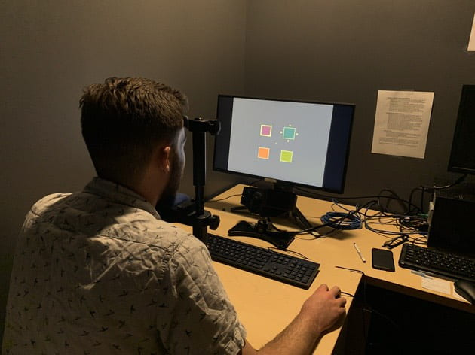
Human behavior and big data
Notes:
Introduce you to my research field. I am a cognitive psychologist and neuroscientist - people in my field research questions about how we think, perceive, understand, make decisions, etc.
Let’s say I want to understand how we filter and process visual information in a crowded environment. Typical way of studying this: well-controlled lab experiments in which we bring in individuals, examine their performance on a subject-by-subject basis. Great – lots of excellent findings.
However, the advent of the internet and mobile phones have made it such that we can collect data and understand human behavior on a much larger scale. All of us have one of these in our pockets…talk about “Airport Scanner” (20 million virtual searches, new findings about how we search with clear application – this is small data). Note that this is *a drop in the bucket* compared to the data we generate everyday for Facebook, Twitter, Google, etc.

Slide 3
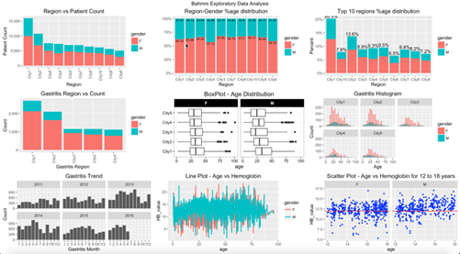
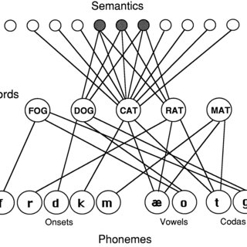
Skillset and demand
Notes:
To do this well, must have an integrative skillset. Need training in data science: Quite a bit that goes into it; processing data, cleaning data, understanding of stats to do the correct analyses, and presentation
However, also need an understanding of human behavior and neuroscience. What do we know about how people perceive, act and think, what happens in the brain, and how it all works together. Can’t just understand the data in an atheoretical background.
Discuss how in our field, huge demand for Ph.D.s with this expertise – not just newly minted Ph.D.s but tenured faculty are being hired as well

Slide 4
Problem: Lack of racial, ethnic, SES diversity
 | Black | Hispanic | Native American
US population | 12.4% | 18.7% | 1.1%
2020 U.S. Census
2020 Survey of Earned Doctorates
Notes:
- COVID-19, discuss my SOURCE students during the pandemic

Slide 5
Problem: Lack of racial, ethnic, SES diversity
 | Black | Hispanic | Native American
US population | 12.4% | 18.7% | 1.1%
Psych/soc sci Ph.D. | 5.9% | 7.3% | 0.1%
2020 U.S. Census
2020 Survey of Earned Doctorates
Notes:
- COVID-19, discuss my SOURCE students during the pandemic

Slide 6
Problem: Lack of racial, ethnic, SES diversity
Why?
Socioeconomic and racial/ethnic inequities
uGPA: Prestige bias
Resume: More opportunities for volunteer (unpaid) research for those advantaged
Rec letters/personal statement: More coaching for advantaged students
Exacerbated by COVID-19
Inequities widen due to unequal burdens of pandemic
 | Black | Hispanic | Native American
US population | 12.4% | 18.7% | 1.1%
Psych/soc sci Ph.D. | 5.9% | 7.3% | 0.1%
Cognitive Ph.D. | 1.0% | 6.7% | none
2020 U.S. Census
2020 Survey of Earned Doctorates
Notes:
- COVID-19, discuss my SOURCE students during the pandemic

Slide 7
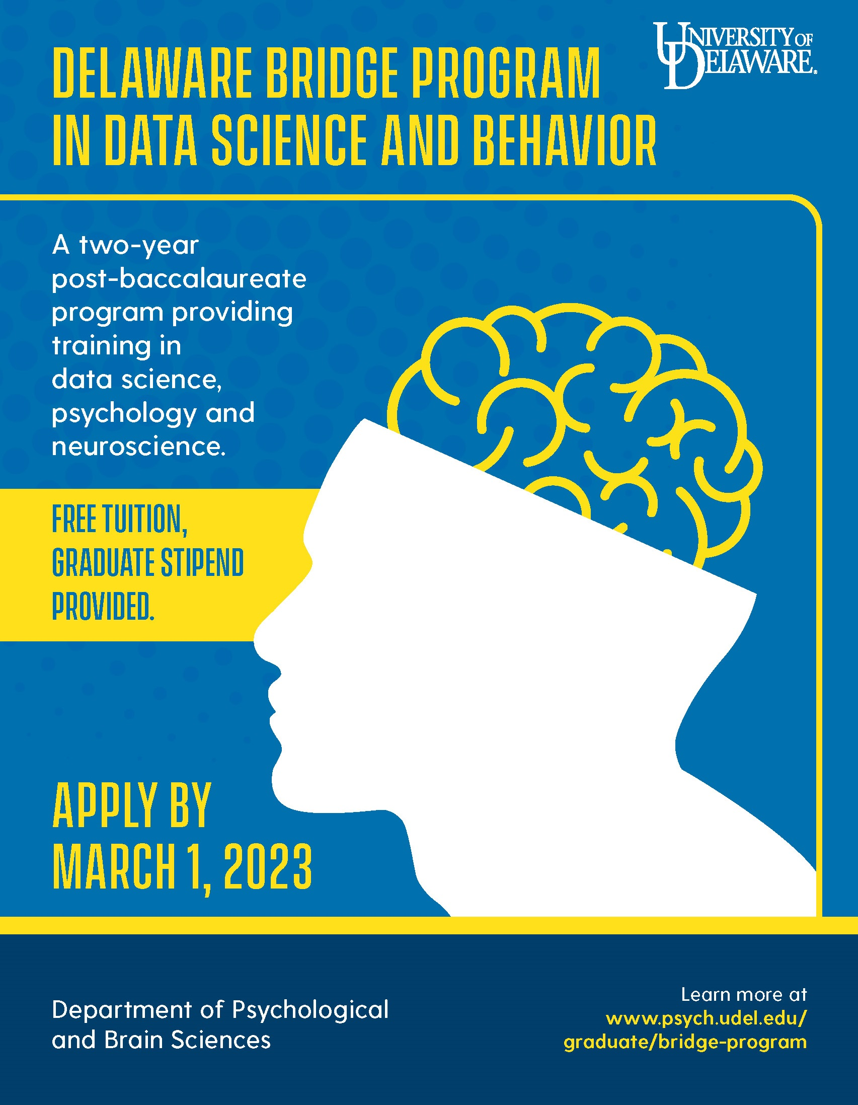
Delaware BRIDGE program
Two-year post-baccalaureate program in data science and behavior
Restricted to underrepresented students (URM, 1st-gen, low income)
Provides training in data science and behavior. How?

Slide 8
Delaware BRIDGE program
Coursework
Three course statistics + data science sequence
Three courses in cognitive psych/neuro
Research
Students provided “shovel ready” project
Career development
Academic or industry path
Goal: Develop into M.S. program
Buy-in from administration

Slide 9
Scalable programs
academy.neuromatch.io
Notes:
I’m not involved in this (many of my colleagues are), but summer course in computational neuroscience
Started during the pandemic, thousands took it in 2020
Currently $800, but ample fee waivers

Slide 10
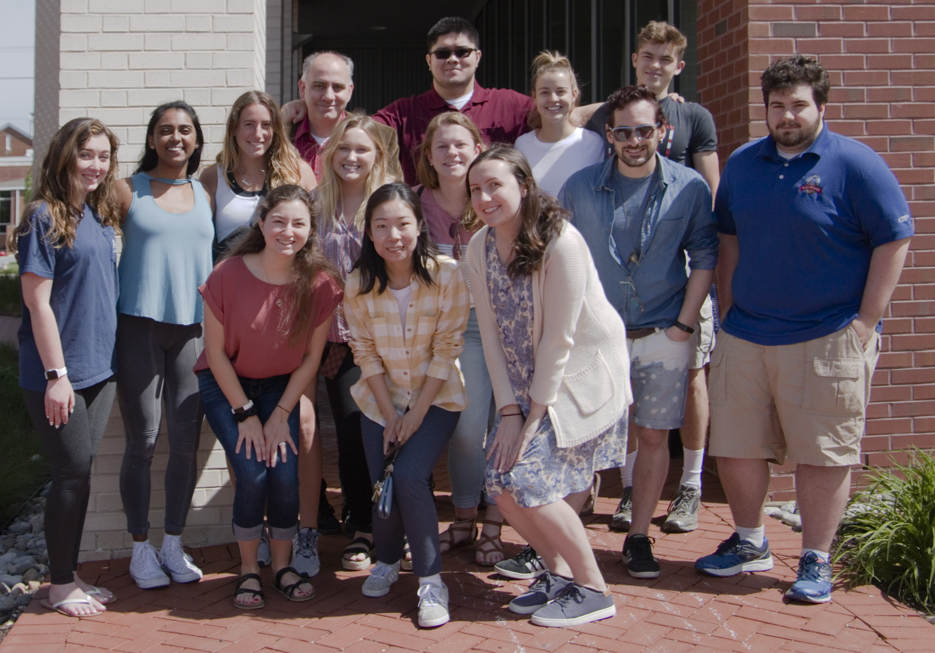
Acknowledgments
OIA 2225805
Medina lab

