Slide 1
Leveraging Intelligent Informatics and Smart Data for Improved Understanding of Northern Forest Ecosystem Resiliency (INSPIRES)
Aaron Weiskittel, Anthony D'Amato, & Scott Ollinger
27th NSF EPSCoR National Meeting

Slide 2
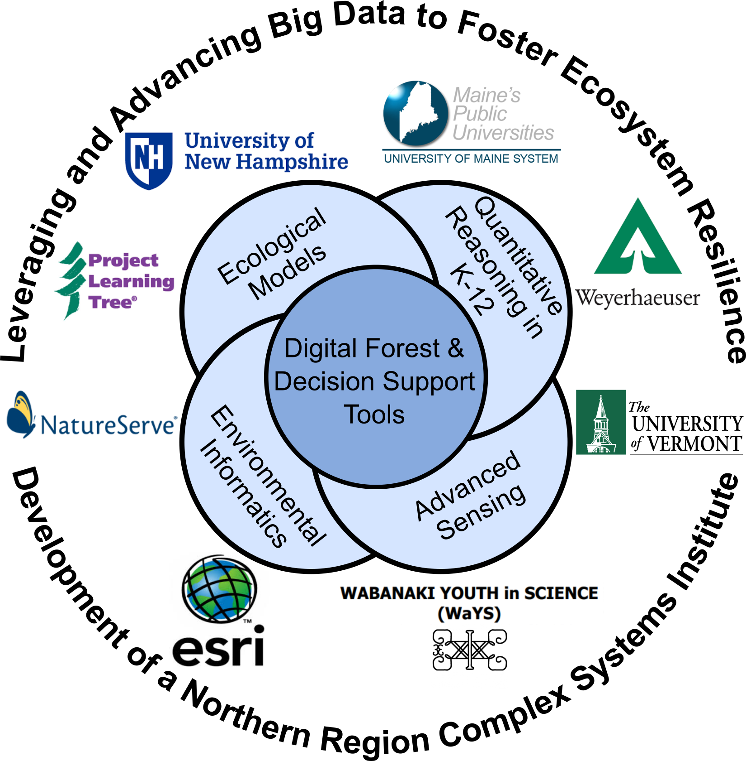
Project Overview
Overarching Hypotheses: Novel Big Data acquisition, integration, and analysis will allow us to address these questions in a way that informs how we approach challenges and opportunities related to the current and future integrity of forest ecosystem
Four Research Themes:
Advanced Sensing and Computing Technologies
Environmental Informatics and Analytics
Integrated Ecological Modeling
Quantitative Reasoning in Context
27th NSF EPSCoR National Meeting

Slide 3
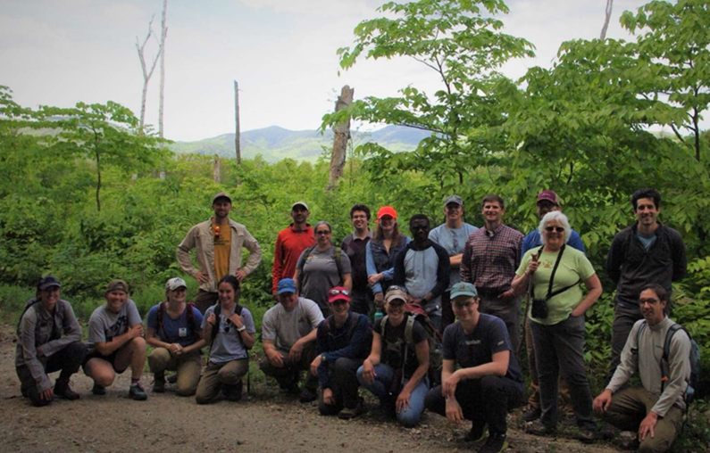
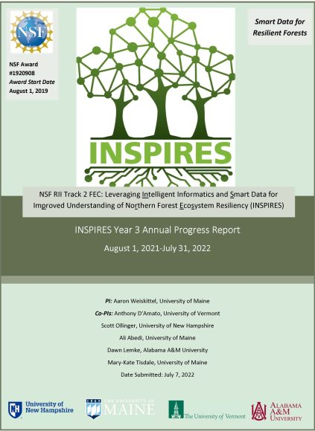
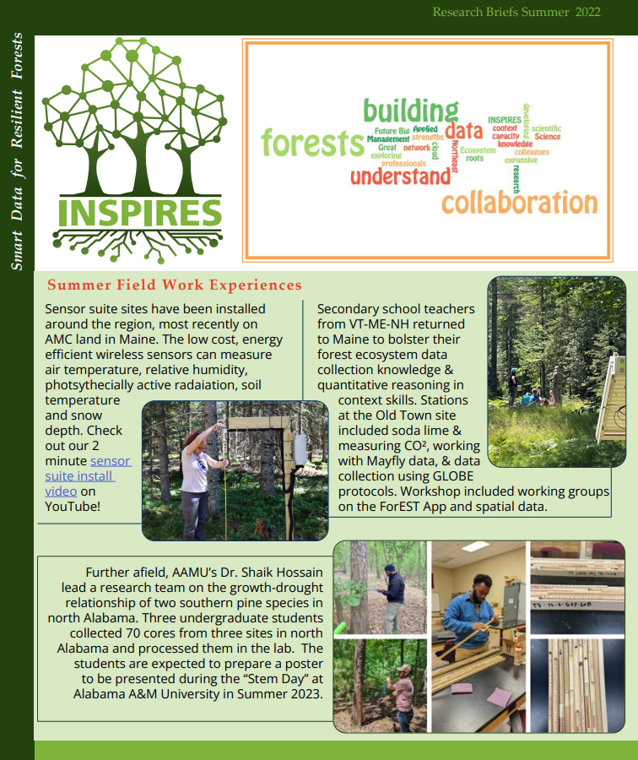
Project Outcomes
27th NSF EPSCoR National Meeting

Slide 4
Key Lessons Learned
Be flexible
Writing the proposal was the easy part yet a lot of potential opportunity
No one has answers for the current situation, but try new things
Communicate with NSF early & often
Connect with fellow Track 2 PIs
Seize the unique opportunity
27th NSF EPSCoR National Meeting

