Slide 1
Proposal Submission Modernization: From Fastlane to Research.gov
27th NSF EPSCoR National Conference
November 15, 2022

Slide 2
Presenter
Stephanie Yee IT Project Manager
Research.gov/FastLane/Grants.gov Operations & Maintenance Lead
Office of Information and Resource Management
Division of Information Systems
syee@nsf.gov

Slide 3
Agenda
January Transition from FastLane to Research.gov for New Proposal Preparation and Submission
Important FastLane Proposal Preparation and Submission Decommissioning Deadlines
Research.gov Proposal Preparation Features and Reminders
Research.gov Proposals: Current Capabilities and Remaining Functionality to be Added
Recent and Upcoming Enhancements
Research.gov Proposal Demo
Providing Feedback and Why It’s Important
Research.gov Proposal Preparation Training Resources
Other FastLane Functionality Decommissioning
Information Resources for the Research Community & Contacts for Questions

Slide 4
January Transition from FastLane to Research.gov for New Proposal Preparation and Submission
4

Slide 5
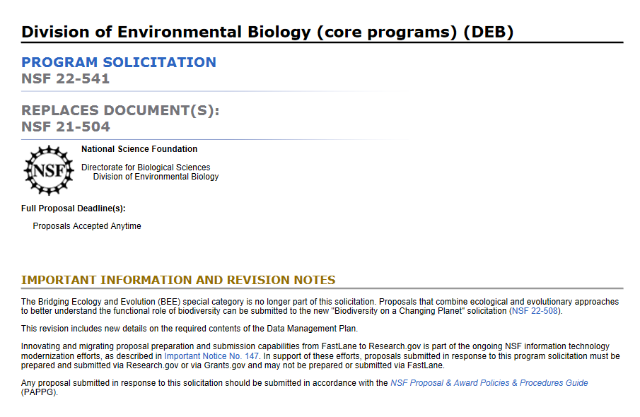
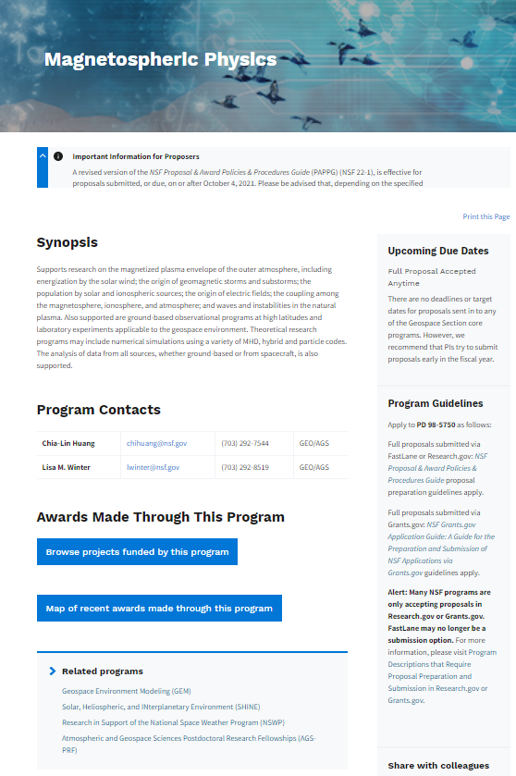
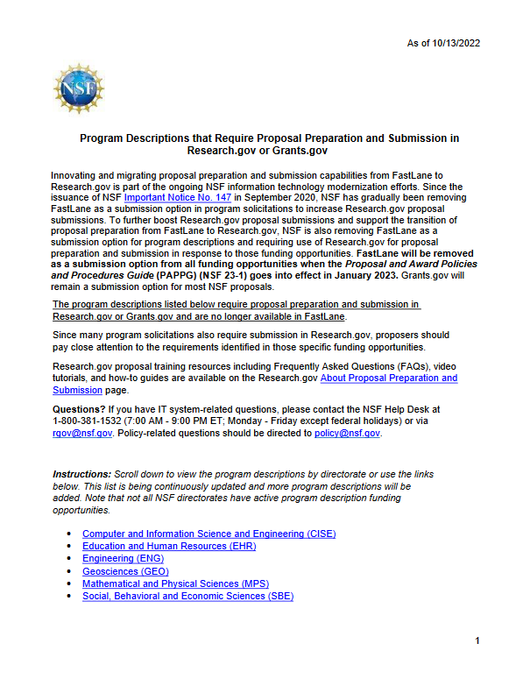
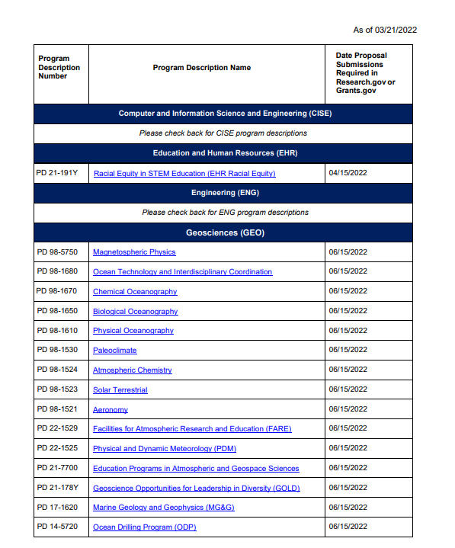
Removing FastLane as Submission Option from Remaining Funding Opportunities by January 30, 2023
Effective with implementation of the Proposal & Award Policies & Procedures Guide (PAPPG) (NSF 23-1) on January 30, 2023, FastLane will be removed as a submission option from all solicitations and program descriptions (PDs)
Currently, more than 90% of all funding opportunities require proposal submission in Research.gov or Grants.gov
Solicitation Example
Program Description Example
IMPORTANT INFORMATION AND REVISION NOTE ABOUT RESEARCH.GOV PROPOSAL PREPARATION:
Innovating and migrating proposal preparation and submission capabilities from FastLane to Research.gov is part of the ongoing NSF information technology modernization efforts, as described in Important Notice No. 147. In support of these efforts, proposals submitted in response to this program solicitation must be prepared and submitted via Research.gov or via Grants.gov and may not be prepared or submitted via FastLane.
Alert: Many NSF programs are only accepting proposals in Research.gov or Grants.gov. FastLane may no longer be a submission option. For more information, please visit Program Descriptions that Require Proposal Preparation and Submission in Research.gov or Grants.gov.
5

Slide 6
Important FastLane Proposal Preparation and Submission Decommissioning Deadlines
As of 11/3/2022
Action | Deadline
SUBMIT NEW
Last day to submit new proposals in FastLane *Note that FastLane remains a submission option for only 6% of current funding opportunities as of 11/2/22 | Friday, January 27, 2023 (5:00 PM submitter’s local time)
EDIT EXISTING
Last day to submit proposal file updates/ budget revisions in FastLane | Friday, September 29, 2023 (5:00 PM submitter’s local time)
VIEW EXISTING
Last day to access FastLane submitted proposals and print FastLane in-progress proposal PDFs | Friday, September 29, 2023 (11:00 PM Eastern Time)
Note: A comprehensive FastLane System Decommissioning webpage is being developed which will include all FastLane proposal deadlines.
6

Slide 7
Important FastLane Supplemental Funding Request Preparation and Submission Decommissioning Deadlines
As of 11/3/2022
Action | Deadline
SUBMIT NEW
Last day to submit new supplemental funding requests in FastLane | Friday, January 27, 2023 (5:00 PM submitter’s local time)
VIEW EXISTING
Last day to access FastLane submitted supplemental funding requests and print FastLane in-progress supplemental funding request PDFs | Friday, September 29, 2023 (11:00 PM Eastern Time)
Note: A comprehensive FastLane System Decommissioning webpage is being developed which will include all FastLane proposal deadlines.
7

Slide 8
Research.gov Proposal Preparation Features
Features to help reduce proposal preparation administrative burden and to minimize return without review proposals due to some formatting issues:
Intuitive and dynamic interfaces that provide only relevant proposal preparation options
Inline help features
Information tool tips indicated by the blue information icon:
Links to the PAPPG
Links to Frequently Asked Questions (FAQs)
Links to video tutorials
Fast document uploads and immediate feedback within each proposal section and for each document upload
Expanded automated compliance checking utilizing warning messages (allowing proposal submission) and error messages (stopping proposal submission)
Currently ~550 compliance checks in Research.gov across multiple proposal submission types (full proposals, renewals, preliminary proposals, and letters of intent) and supplemental funding requests versus 56 compliance checks in FastLane for full proposals only
Specific, actionable warning and error messages
PDF uploads are not altered
Notes:
Proposal Tips
Proposal information cannot be transferred from FastLane to Research.gov and vice versa
Proposal file updates and budget revisions must be executed in the same system as the proposal was submitted (i.e., Research.gov or FastLane)
Proposals submitted in Research.gov are evaluated by NSF in the same way as proposals submitted in FastLane and Grants.gov

Slide 9
Research.gov Proposal Preparation Reminders
Proposal information cannot be transferred from FastLane to Research.gov
Letters of intent and preliminary proposals must be prepared in the same system as the full proposal (i.e., all in Research.gov or all in FastLane)
All proposals in a separately submitted collaborative from multiple organizations must be prepared in the same system (i.e., all in Research.gov or all in FastLane)
Proposal file updates (PFUs) and budget revisions must be executed in the same system as the proposal was submitted (i.e., all in Research.gov or all in FastLane)
Last day to submit proposal file updates/budget revisions in FastLane is September 29, 2023
Proposals submitted in Research.gov evaluated by NSF in the same way as proposals submitted in FastLane and Grants.gov, and this migration does not affect the merit review process in any way
9

Slide 10
Research.gov Proposals: Current Capabilities and Remaining Functionality to be Added
As of 11/3/2022
Current Capabilities |  | Future Capabilities
Proposal Types Research: Single Submissions from One Organization (April 2018); Single Submission Collaborative Proposals with Subawards (June 2019); Separately Submitted Collaborative Proposals from Multiple Organizations (March 2020) Rapid Response Research (RAPID) (November 2020) EArly-concept Grants for Exploratory Research (EAGER) (November 2020) Research Advanced by Interdisciplinary Science and Engineering (RAISE) (November 2020) Facilitation Awards for Scientists and Engineers with Disabilities (FASED) (March 2021) Equipment (March 2021) Travel (March 2021) Conference (August 2021) Ideas Lab (August 2021) Grant Opportunities for Academic Liaison with Industry (GOALI) (October 2021) Planning (October 2021) Center (November 2021) Research Infrastructure (November 2021) Postdoctoral Fellowship (proposals for fellowship solicitations that do not contain reference letter requirements) (April 2022) SBIR and STTR Phases I/II (October 2022) | Submission Types Full Proposal (April 2018) Preliminary Proposal: Ideas Lab (August 2021); Non-Ideas Lab (November 2021) Renewal Proposal (August 2021) Accomplishment-Based Renewal Proposal (August 2021) Full Proposal related to a Preliminary Proposal (November 2021) Solicitation-specific Requirements Project Data Form (April 2022) Secondary Units of Consideration (April 2022) Recent Proposal Features Withdrawal (Single and Separately Submitted Collaborative Proposal Submissions) (March 2021) Project Descriptions Exceeding 15 Pages (November 2021) Separate Uploads of Multiple Supplementary Documents (April 2022) Post-award Actions Supplemental Funding Requests, including Career Life Balance requests (October 2022) Training Research.gov About Proposal Preparation and Submission Page and FAQs (April 2018) Research.gov Proposal Preparation Demo Site (October 2020) Research.gov About Supplemental Funding Requests Page and FAQs (October 2022) Research.gov Supplemental Funding Requests Demo Site (October 2022) Topic-specific How-to Guides (Ongoing) Webinars and Demos (Ongoing) | Grants.gov Integration (Grants.gov applications only; November 2022 release) Grants.gov applications will be processed in Research.gov instead of FastLane Corrections or additions to Grants.gov applications submitted to NSF on or after November 21 will also be made in Research.gov Postdoctoral Fellowship (tentative May 2023 release) Proposals for fellowship solicitations that contain reference letter requirements
10

Slide 11
Recent Research.gov Enhancements
11

Slide 12
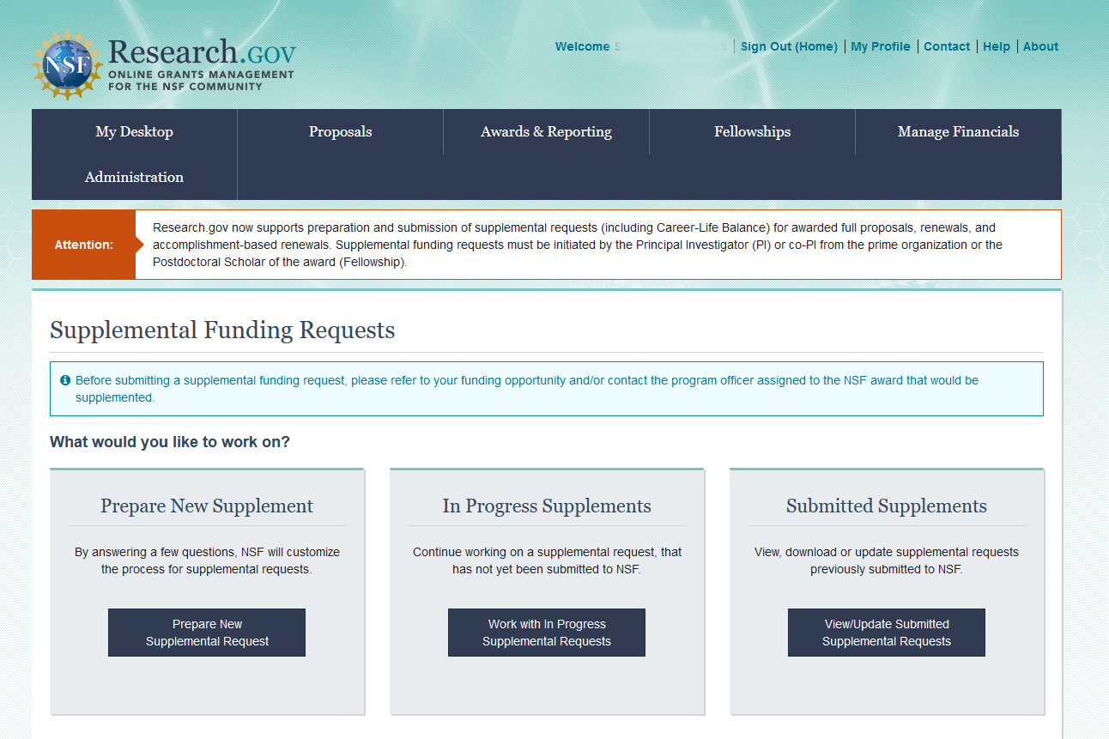
Research.gov Enhancement: Supplemental Funding Requests
As of October 24th, Research.gov supports preparation and submission of supplemental funding requests, including Career-Life Balance requests per PAPPG Chapter II.E.8.
Requests can be submitted in Research.gov regardless of the system used (Research.gov, FastLane, or Grants.gov) for proposal submission
FastLane supplemental funding request functionality will remain available in parallel for the preparation and submission of new requests until January 27, 2023
12

Slide 13
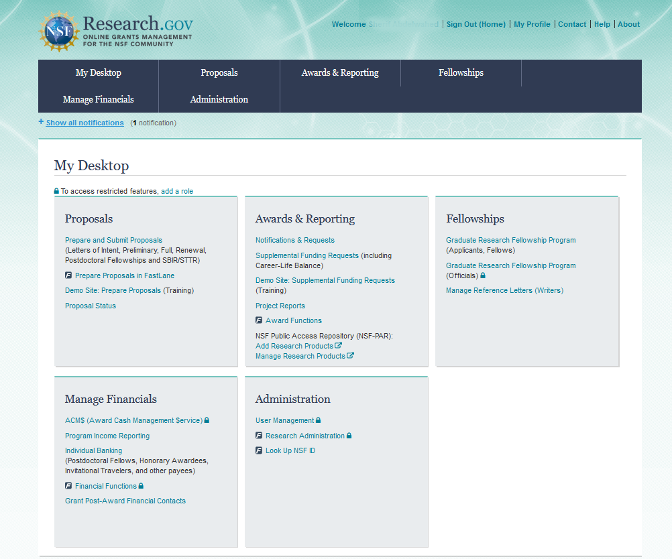
Research.gov Enhancement: Supplemental Funding Requests
Access Research.gov supplemental funding request functionality and demo site from new links within the Awards & Reporting tile on the Research.gov My Desktop page
Demo site can be used to explore preparing supplemental funding requests and to check compliance of uploaded documents
13

Slide 14
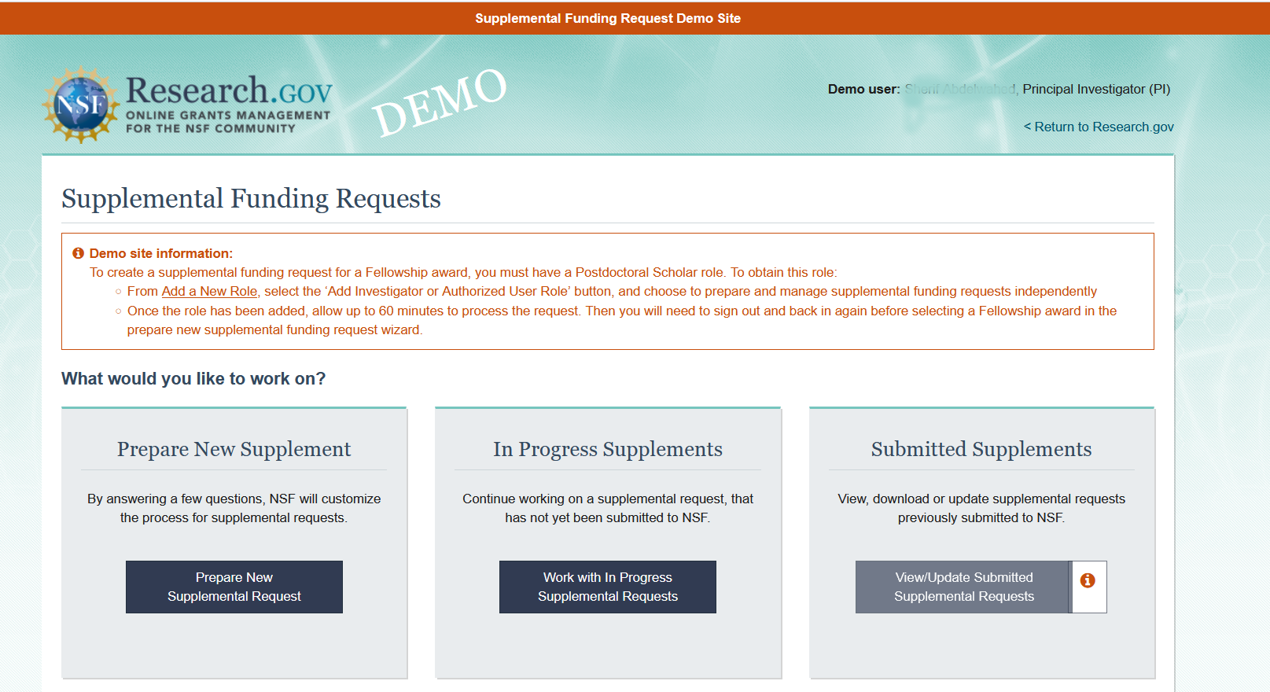
Research.gov Enhancement: New Supplemental Funding Requests Demo Site
Research.gov Demo Site: Supplemental Funding Requests Homepage
All demo site users must have an NSF ID for demo site access and authentication and will automatically be given a PI role for use in the demo site
User’s actual awards as well as “dummy” awards generated by the demo site will display for selection to try out preparing a supplemental funding request
If user does not have any actual awards, they can select from “dummy” awards generated by the demo site
Supplemental funding request submission capability is disabled
https://web.demo.research.gov/proposalprep/#/sfr
(You will be prompted to sign in to Research.gov if you are not already signed in)

Slide 15
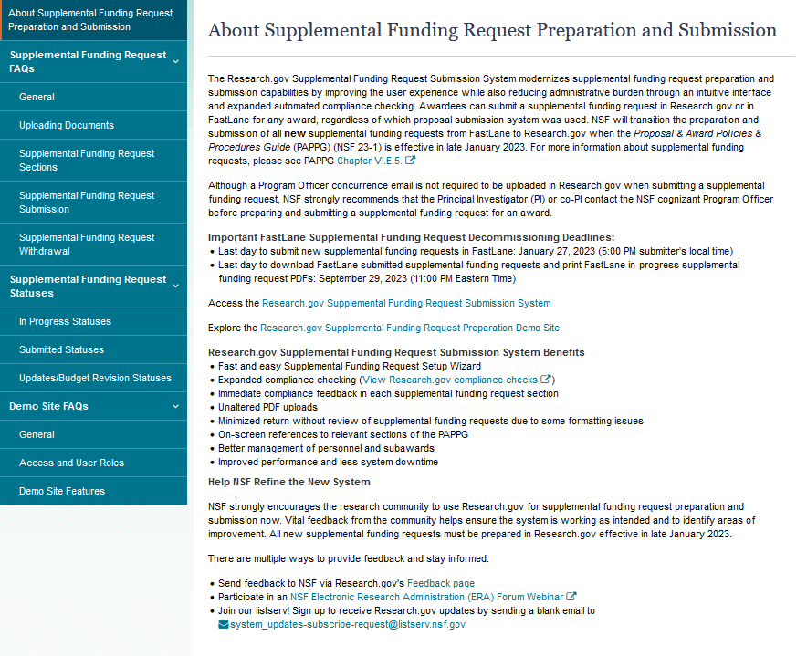
Research.gov Enhancement: New About Supplemental Funding Request Preparation and Submission Page
https://www.research.gov/research-web/content/aboutsfr
FAQs by Topic
General
Uploading Documents
Supplemental Funding Request Sections
Supplemental Funding Request Submission
Supplemental Funding Request Withdrawal
Supplemental Funding Request Statuses
Demo site FAQs
General
Access and User Roles
Demo Site Features

Slide 16
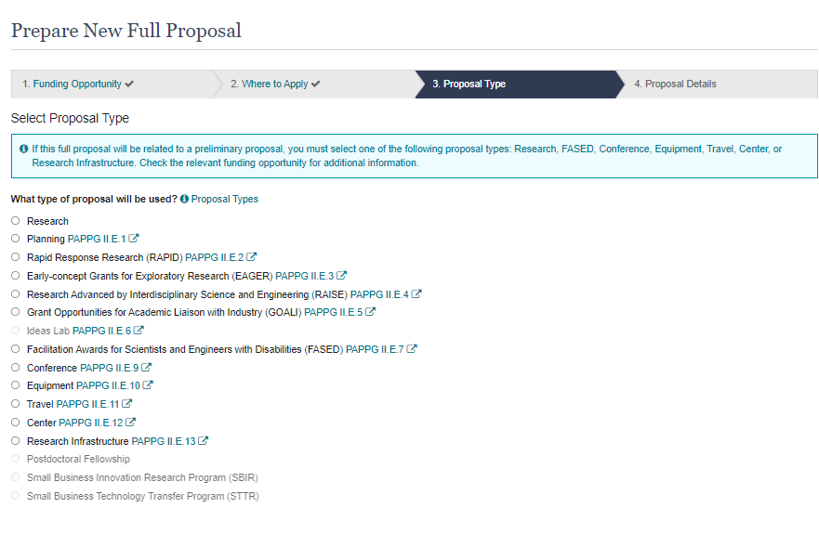
Research.gov Enhancement: SBIR and STTR Proposal Types
Research.gov Proposal Screenshot: Full Proposal Type Options
New proposal types:
Small Business Innovation Research Program (SBIR)
Small Business Technology Transfer Program (STTR)
Selection in Proposal Setup Wizard:
Proposers will be able to select these proposal types to prepare and submit SBIR and STTR Phase I/II proposals for the fiscal year 2023 competitions
All proposal types now enabled in Research.gov
16

Slide 17
Upcoming Enhancement
17

Slide 18
Upcoming Research.gov Enhancement: Integration with Grants.gov
Effective Monday, November 21st, Grants.gov applications will be processed in Research.gov instead of in FastLane
Corrections or additions to Grants.gov applications submitted to NSF on or after November 21st will also be made in Research.gov
Last day to submit proposal file updates/ budget revisions in FastLane is Friday, September 29, 2023 (5:00 PM submitter’s local time)
18

Slide 19
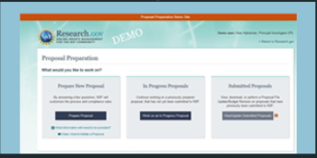
Research.gov Proposal Preparation Demo
Proposal Setup Wizard
Proposal Main Page
Document Upload and Compliance Error/Warning Messages
Budget
Highlights of Recent Enhancements

Slide 20
Providing Feedback and Why It’s Important
20

Slide 21
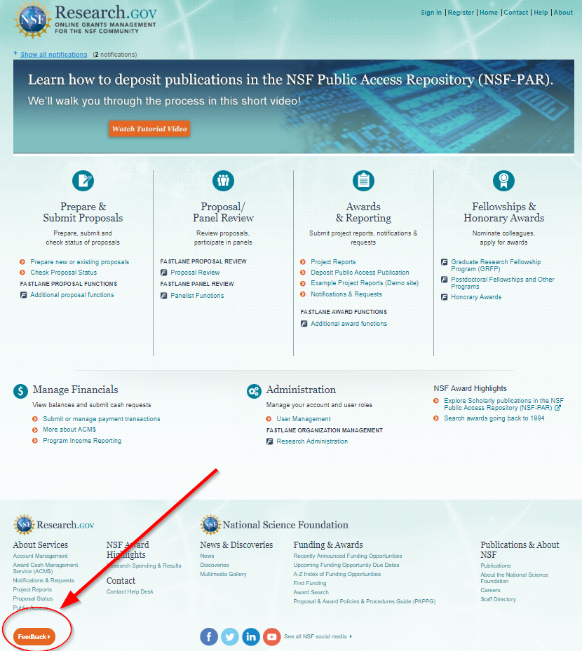
Providing Feedback and Why It’s Important
Why?
Help NSF continue to build and refine Research.gov
Help ensure the system is working as intended and identify areas of improvement
How?
Feedback may be submitted on the Research.gov Feedback page using these drop-down menu options:
Proposal Preparation & Submission
Proposal Preparation Demo Site
Supplemental Funding Request Preparation & Submission
Supplemental Funding Request Demo Site

Slide 22
Research.gov Proposal Preparation Training Resources
22

Slide 23
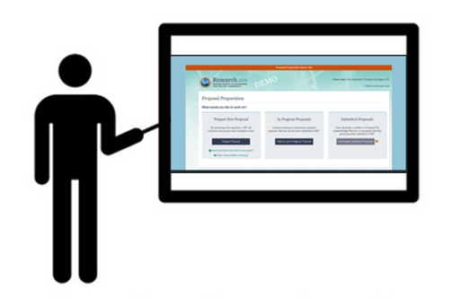
Virtual Sessions with In-depth Demo of the Research.gov Proposal Submission System
For an added transition boost, NSF is offering a limited number of small, interactive virtual sessions with an in-depth demo of the Research.gov Proposal Submission System and its companion demo site
If your organization is interested in a virtual session and demo, please send a request to rgovbusinessoffice@nsf.gov and include your organization’s name. When submitting your request, please indicate the number of people in your organization who will attend the session
23

Slide 24
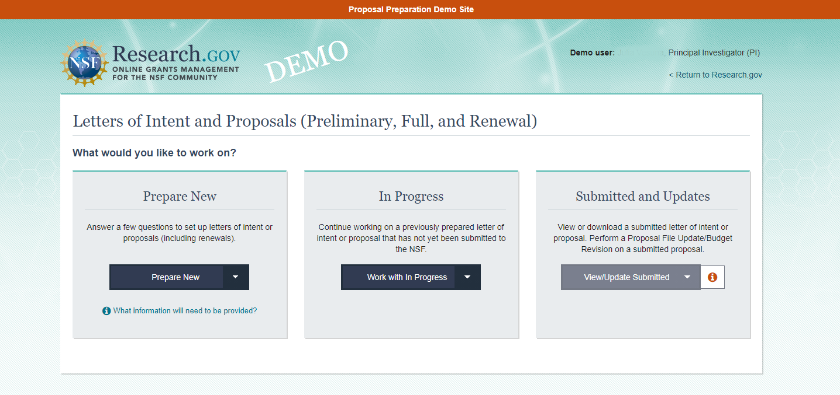
Research.gov Proposal Preparation Demo Site
Demo site can be used to explore preparing proposals and to check compliance of uploaded proposal documents (e.g., Collaborators and Other Affiliations and Biographical Sketch)
All demo site users are automatically given the PI role for demo site purposes, in order to perform the proposal preparation functions that a PI can do in the actual system. Proposal submission capability is disabled
See the demo site FAQs on the Research.gov About Proposal Preparation and Submission page for information on demo site access and features
Research.gov Demo Site: Proposal Preparation Homepage
https://web.demo.research.gov/proposalprep/#/proposal-prep (You will be prompted to sign in to Research.gov if you are not already signed in)

Slide 25
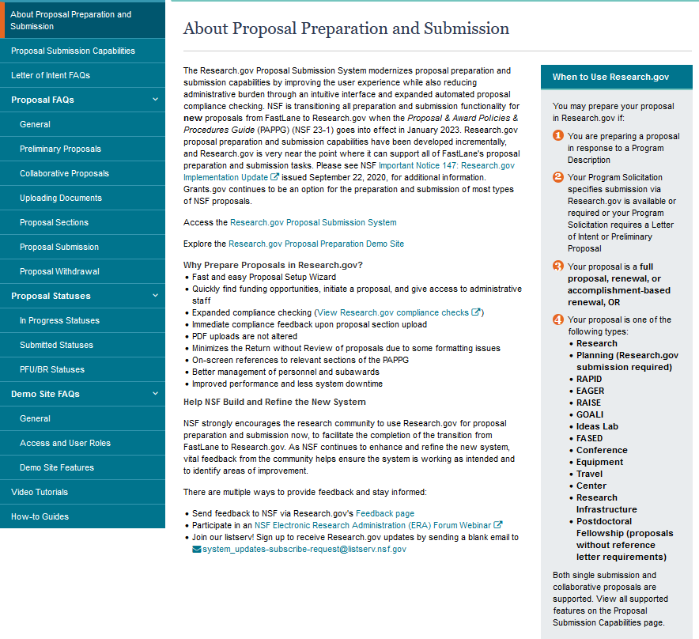
Research.gov About Proposal Preparation and Submission Page Training Resources
https://www.research.gov/research-web/content/aboutpsm
Recently Added FAQs
Managing Where to Apply and Secondary Units of Consideration FAQs (see the General FAQ topic)
Postdoctoral Fellowship Proposals FAQs (see the General FAQ topic)
Project Data Form FAQs (see the Proposal Sections FAQ topic)
How-to Guides
Initiating a New Proposal
Adding or Removing an OAU
Sharing Proposal and Proposal File Update/Budget Revision Access with SPO/AOR
Entering Proposal Budgets
Adding or Removing Subaward Organizations
Adding or Removing Collaborators and Other Affiliations
Deleting an In Progress Letter of Intent, Proposal, or Proposal File Update/Budget Revision
Submitting Letters of Intent and Proposals
Submitting Proposal File Updates/Budget Revisions
25

Slide 26
Resources for LaTeX Users
Open-source repository of compliant LaTeX/TeX sample input/output files for LaTeX/TeX users to reference for their own documents
Repository link: https://github.com/nsf-open/nsf-proposal-latex-samples
26

Slide 27
Other FastLane Functionality Decommissioning
27

Slide 28
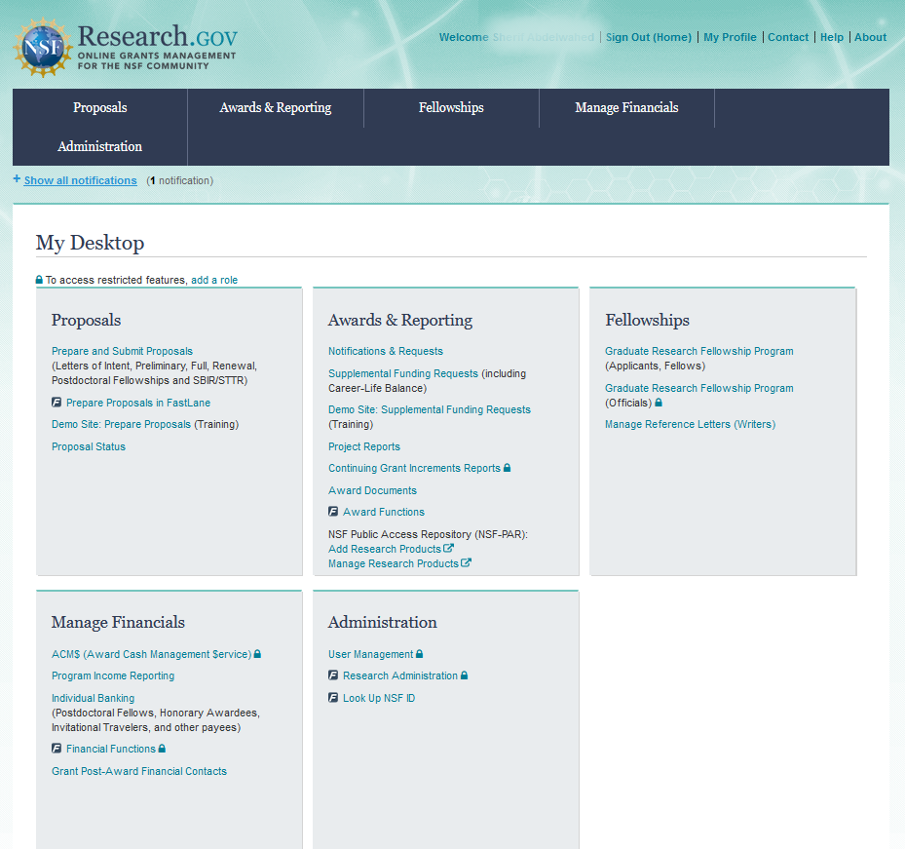
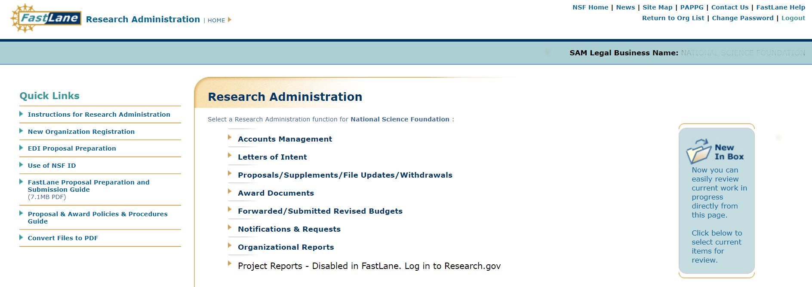
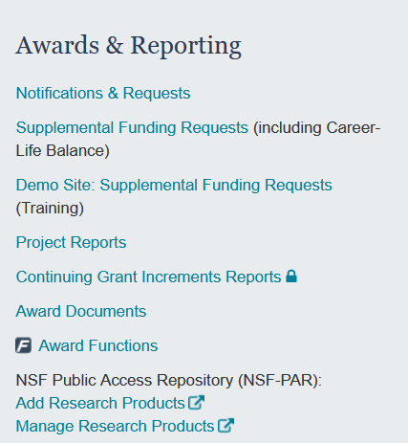
Other FastLane Functionality Decommissioning – Award Documents
As of November 21st, FastLane Award Documents functionality as well all award documents will transition to Research.gov
Access Award Documents via new link within the Awards & Reporting tile on the Research.gov My Desktop page
28

Slide 29
Other FastLane Functionality Decommissioning – Organizational Reports
Continuing Grant Increments Reports will transition from FastLane to Research.gov as of November 21st and will be accessible by users with an AOR or SPO role from a new link within the Awards & Reporting tile on the Research.gov My Desktop page
Complete:
Active Awards Report information currently available via NSF.gov Award Search
Organization Permission Report information currently available in Research.gov Account Management My Profile
29

Slide 30
Information Resources & Contacts for Questions
30

Slide 31
Information Resources
Join our NSF System Updates listserv to receive the latest Research.gov system enhancement information and FastLane decommissioning news! Sign up by sending a blank email to: system_updates-subscribe-request@listserv.nsf.gov
Automated Compliance Checking of NSF Proposals page
Research.gov About Proposal Preparation and Submission page
Research.gov About Supplemental Funding Request Preparation and Submission page
Research.gov About Account Management page
Research.gov Proposal Preparation Demo Site (You will be prompted to sign in to Research.gov if you are not already signed in)
Research.gov Supplemental Funding Requests Demo Site (You will be prompted to sign in to Research.gov if you are not already signed in)
Resources for LaTeX Users: https://github.com/nsf-open/nsf-proposal-latex-samples
NSF Electronic Research Administration (ERA) Forum page
NSF ERA Forum listserv to receive updates on ERA Forum activities. Sign up by sending a blank email to: NSF_ERA_FORUM-subscribe-request@listserv.nsf.gov
31
31

Slide 32
Contacts for Questions
For program-specific questions, please contact the cognizant NSF Program Officer
For IT system-related questions or technical questions, please contact the NSF Help Desk at 1-800-381-1532 (7:00 AM - 9:00 PM ET; Monday - Friday except federal holidays) or via rgov@nsf.gov
Policy-related questions should be directed to policy@nsf.gov
32

Slide 33
Thank you for your participation today!
33

Slide 34
Appendix
34

Slide 35
Research.gov Proposal Compliance Error and Warning Messages
Automated proposal compliance checks triggering an error message will stop proposal submission to NSF, whereas checks triggering a warning message will still allow proposal submission
Proposers receiving a compliance error or warning message should check the Automated Compliance Checking of NSF Proposals page and the solicitation for specific proposal requirements
Proposers should also review the topic-specific FAQs on the Research.gov About Proposal Preparation and Submission page
Uploading Documents topic includes document formatting FAQs
Proposal Sections topic includes Cover Sheet and budget FAQs
35

Slide 36
Research.gov Proposal Preparation Demo Site Tips
Demo site FAQs are available on the Research.gov About Proposal Preparation and Submission page via the left navigation menu. How-to guides with step-by-step instructions and screenshots are also available
The demo site is available both to the research community and to NSF staff
An orange "Proposal Preparation Demo Site" banner is at the top of each demo site page to indicate the user is on the demo site
The demo site allows users to prepare and edit proposals before preparing them in the actual Research.gov site
Demo site proposals are not visible or available in the actual Research.gov Proposal Submission System, and data cannot be transferred between the demo site and the actual proposal system
All proposal and submission types are available in the demo site
All compliance checks enabled in the actual Research.gov Proposal Submission System are also in the demo site. Proposers can use the demo site as a resource to check document compliance before uploading them in the actual system
36

Slide 37
Research.gov Proposal Preparation Demo Site Tips (cont’d)
Proposals created in the demo site will be available for six months and then will be deleted by NSF. Neither NSF nor users will be able to access deleted demo proposal data
Demo site does not support proposal submission and will not trigger any system-generated email notifications (e.g., link requests for separately submitted collaborative proposals)
The organization that you are affiliated with in your NSF account profile will be incorporated when you are in the proposal preparation demo site, but the user role(s) that you have will not be available in the demo site
All users who access the demo site will be given the role of PI and the mock organization “National Science Foundation”
This means that users from the research community will have the organization(s) they are affiliated with in their NSF account profile plus the “National Science Foundation” mock organization as available organizations in the demo site
The only time other users will be able to view and/or edit any proposals that you create in the demo site is if you add them to the proposal as a co-PI or OAU. If you don’t add any users to the proposal, no one will else will be able to access, view, or edit your demo proposal
37

