Slide 1
Broader Impacts 101
National EPSCoR Conference
Portland, Maine
November 15, 2022

Slide 2
Welcome and Introductions
Kim Goff
Large Center Development Associate
Office of Research Development
kimberly.goff@maine.edu
Laura Wilson
4-H Science Professional
Cooperative Extension/Maine 4-H
Laura.Wilson@maine.edu
Notes:
Both intro themselves

Slide 3
NSF Merit Review Criteria
The Intellectual Merit criterion encompasses the potential to advance knowledge.
The Broader Impacts criterion encompasses the potential to benefit society and contribute to the achievement of specific, desired societal outcomes.
Notes:
Kim starts

Slide 4
Examples of Societal Impact
Full participation of women, persons with disabilities and underrepresented minorities in STEM.
Improved STEM education and educator development at any level.
Increased public scientific literacy and public engagement with science and technology.
Improved well-being of individuals in society.
Development of a diverse, globally competitive STEM workforce.
Increased partnerships between academia, industry and others.
Improved national security.
Increased economic competitiveness of the U.S.
Enhanced infrastructure for research and education.

Slide 5
Broader Impacts
Grant reviewers will evaluate your Broader Impacts statement on these five criteria:
What is the potential for the proposed activity to benefit society or advance desired societal outcomes?
To what extent do the proposed activities suggest and explore creative, original or potentially transformative concepts?
Is the plan for carrying out the proposed activities well-reasoned, well-organized and based on sound rationale? Does the plan incorporate a mechanism to assess success?
How well qualified is the individual, team or institution to conduct the proposed activities?
Are there adequate resources available to the principal investigator (either at the home institution or through collaborations) to carry out the proposed activities

Slide 6
Broader Impacts and other funding agencies
Most funding agencies care about societal impact. May not use the term “broader impact” but do emphasize DEI, outreach, improved quality of life etc.
The tips and pitfalls that we’ll discuss this afternoon are relevant to preparing successful grant proposals and implementing effective programs in general.
Examples of agencies with a societal impact element include but are not limited to the Department of Energy, USDA, HRSA, EDA, Department of Labor, Department of State and many if not most private foundations.

Slide 7
BI and Research Development
Share options with PIs
Aligned with program announcement goals
Aligned with PI goals and interests
Ambitious yet feasible
Connect team with other PIs (at and well beyond UMaine)
Help make community connections (schools, non-profits, federal labs. State government etc.)
Help with budgeting around BI (especially “hidden” costs)
Help with logistics and “details” – who, what, when, where, why, how much
Urge integration with research (especially for Early Career program)
Hold PI accountable
Plan for evaluation
Take care of partners to ensure long-term relationships
Notes:
Laura here.

Slide 8
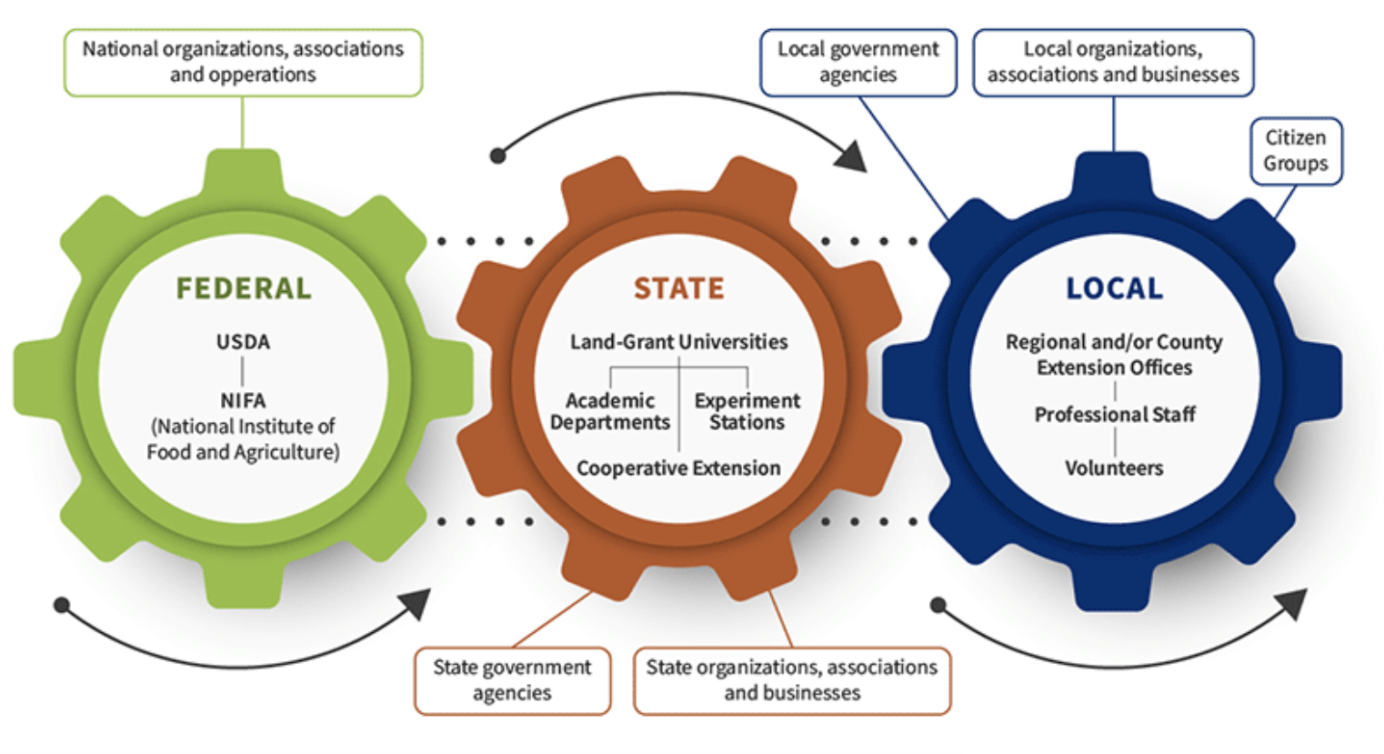
BI Partner perspective:
UMaine Cooperative Extension/4-H
What IS 4-H anyway? Extension and the Land Grant University
Logistics - Extension is nationwide, but locally engaged
Extension’s evaluation metrics/Common Measures
National connections
Source: nifa.usda.gov
Notes:
In Maine, our focus has been primarily on Maine’s food system, (hope you get to sample some of our excellent foods this week - my favorite is the Maine blueberry) from crops to small local food businesses and food safety. We also have food adn nutrition programs, and growing interest in farm to school programs. We have expertise in areas relevant to our local residents, and usually have a stron tie to communities.

Slide 9
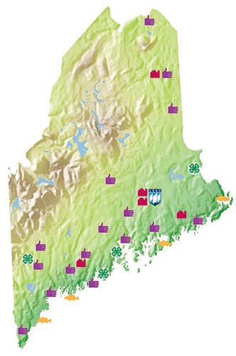
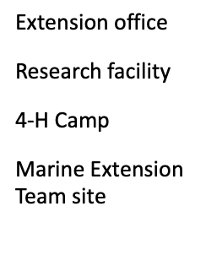
Notes:
My role within cooperative extension is to make connection for youth to the STEM resources of the university. Not every state has a Laura, but most of the EPSCoR jurisdictions have a 4-H, and our audiences are the kids of the state/territory. To work with us, though, understanding OUR purpose and goals and looking for overlap with yours should be your first step.
What does 4-H make you think?

Slide 10
BI Partner perspective:
UMaine Extension/4-H
Audiences: Youth in Maine
Rural
Urban
Low Income
New Mainers
(Tribal youth through WaYS program).
18,000 youth/year
Programming: Camps, clubs, afterschool, short-term programs, summer programs.
Notes:
My role within cooperative extension is to make connectsion for youth to the STEM resources of the university. Not every state has a Laura, but most of the EPSCoR jusistictions have a 4-H, and our audiences are the kids of the state/territory. To work with us, though, understandin OUR purpose and goals and looking for overlap with yours should be your first step.

Slide 11
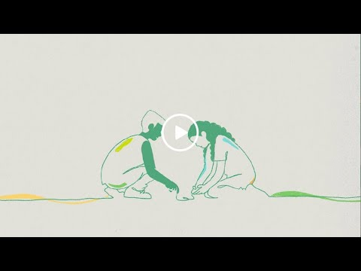

Slide 13
BI and EPSCoR
Societal needs in EPSCoR jurisdictions
Poverty
Rural
Many families with limited exposure to education beyond high school (first generation students)
Small public schools and non-profits with limited resources for STEM education etc.
Economic development and workforce needs are urgent especially in some areas
Important to be aware of needs beyond campus and local area
Notes:
Kim takes over here with detail

Slide 14
Tips for Effective BI
Start early - not an afterthought
Build on existing relationships and programs
Science Fair and other ongoing events that have already captured an audience
Consider BI preferences and interests
Work through PI relationships - Newsom and Ranco
Consider where impact will be noticed (under resourced organizations)
Think through practical issues of implementation
Driving time/distance
Outreach logistics – registration, meals, etc.

Slide 15
Tips for Effective BI
Don’t assume that all orgs have similar resources - large high school vs rural high school, small HBCU vs R1 university
Include detail in your description - how many impacted, when, how will success be measured
Build over three to five years versus doing everything at once
Competition for young people’s time - summer sports camps, etc.
Barriers - transportation, language, support at home
Engage partners in the planning process and listen carefully to what they already offer and/or need.
Thank partners frequently, even if the grant is not awarded.

Slide 16
Examples of University of Maine BI partners
Maine elementary, middle, and high schools
Land trusts
Senior colleges
Wabanaki tribes & WaYS
Coastal Maine Botanical Gardens
Maine State Science Fair
Project Learning Tree
Alabama A&M University (HBCU)
Upward Bound
Girl Scouts of America
University of Maine Cooperative Extension/4-H

Slide 17
Pitfalls to Avoid
Overly ambitious, strung together ideas (“laundry list” approach)
Failure to integrate BI with research
Not budgeting for activities
Not budgeting for partner staff time
Making assumptions about why the audience or partners would want to participate
Making assumptions about reporting
Assuming your desired outcomes match your partners’ needs and interests
Ignoring the practicalities - registration, parking, meals (partner with a unit or organization that can lift this burden)
Ignoring the importance and cost of evaluation
Notes:
Laura takes over here.

Slide 18
Examples of BI involving UMaine 4-H
4-H Science/STEM Toolkits (Track 1, other NSF and USDA funding)
4-H Summer of Science Teens (Track 1)
4-H STEM Ambassadors (Track 1)
4-H Follow a Researcher (CAREER)
Notes:
Laura What has worked - looking at the relationship as a partnership, and understanding each other’s need.NONE of these were developed uniquely as an EPSCoR Broader Impact. Our toolkit development plan has been refined and improved thanks to EPSCoR’s support and the number of kits we’ve developed.

Slide 19
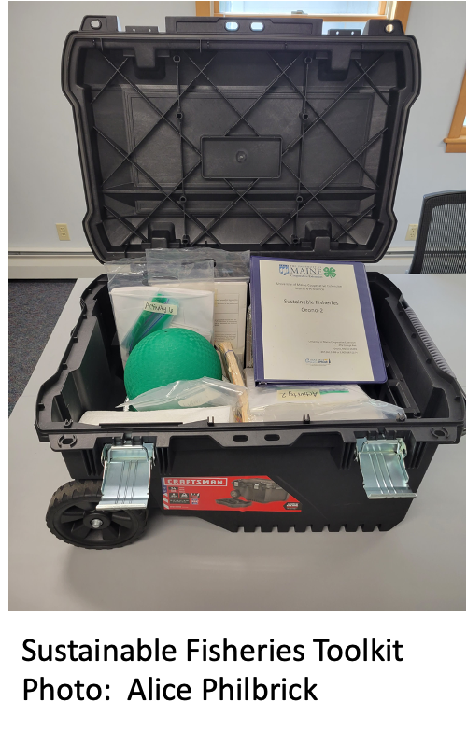
4-H Science/STEM Toolkits
Background:
Enable educators, volunteers, and students to facilitate hands-on experiential learning activities with youth
Instructions, materials, images and/or video demonstrations
Available statewide from Cooperative Extension offices/sites
Sustainable product
Components:
Backwards design (Wiggins and McTighe)(Klein),
5E Model (Bybee),
Experiential learning (Kolb)/4-H Thriving model (Arnold),
Nature of Science,
NGSS
Notes:
NONE of these were developed uniquely as an EPSCoR Broader Impact. Our toolkit development plan has been refined and improved thanks to EPSCoR’s support and the number of kits we’ve developed.

Slide 20
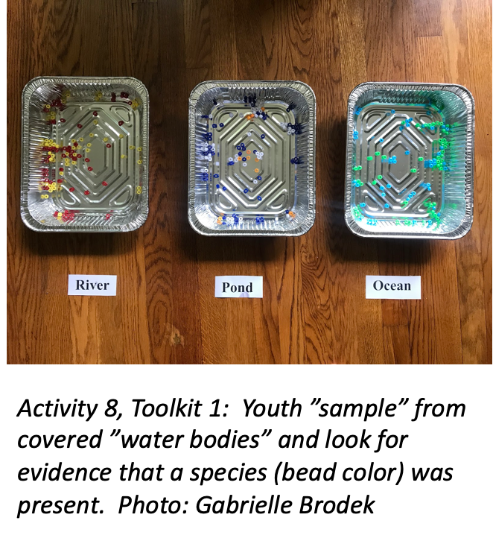
4-H Science/STEM Toolkits
Positives
Process is well defined
Long-term use/sustainable
Engages UMaine graduate students, formal and informal educators, and youth during the development phase
Popular for formal and informal educators
Fills a need in Maine for high quality instructional material
Negatives:
Time and resource intensive:
3+ months/year of staff
2 full years of a GA for one kit
Materials costs
Outputs/audience numbers are not initially large
Notes:
NONE of these were developed uniquely as an EPSCoR Broader Impact. Our toolkit development plan has been refined and improved thanks to EPSCoR’s support and the number of kits we’ve developed.

Slide 21
Examples of BI involving UMaine 4-H
4-H Science/STEM Toolkits (Track 1, other NSF and USDA funding)
4-H Summer of Science Teens (Track 1)
4-H STEM Ambassadors (Track 1)
4-H Follow a Researcher (CAREER)
Notes:
What has worked - looking at the relationship as a partnership, and understanding each other’s need.NONE of these were developed uniquely as an EPSCoR Broader Impact. Our toolkit development plan has been refined and improved thanks to EPSCoR’s support and the number of kits we’ve developed.

Slide 22
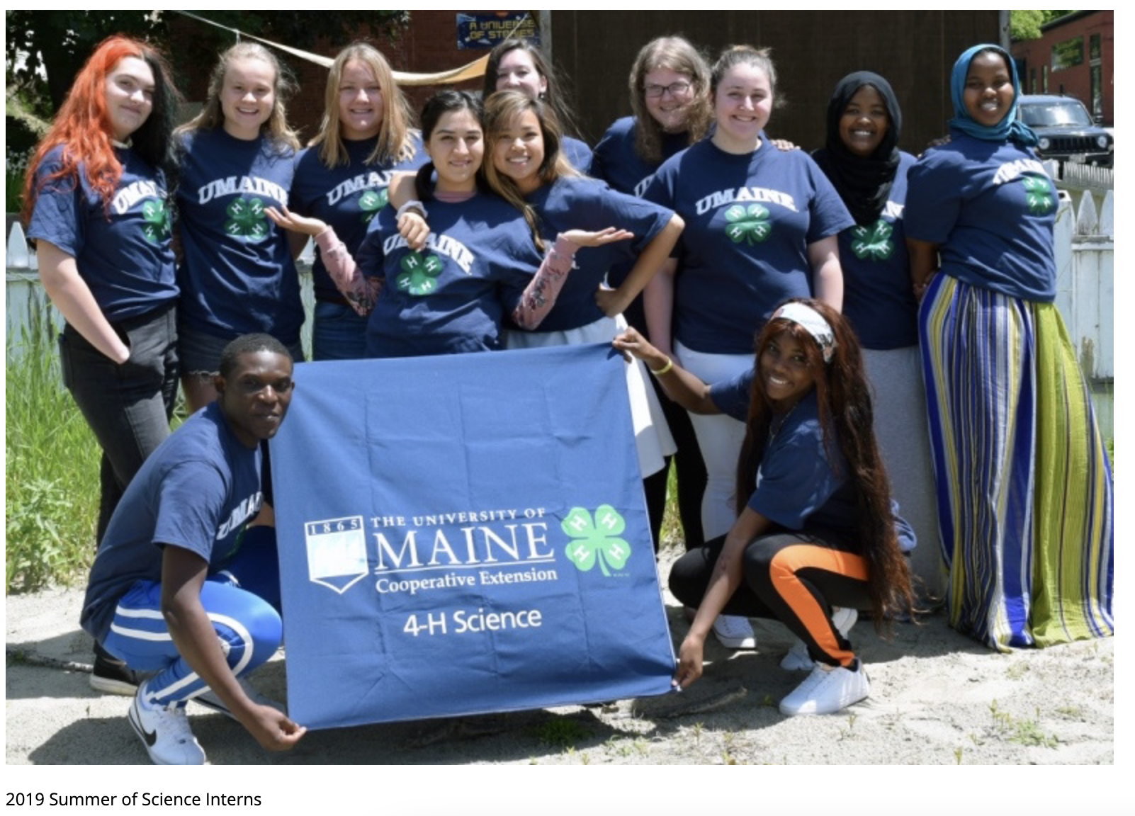
4-H Summer of Science
Notes:
NONE of these were developed uniquely as an EPSCoR Broader Impact. Our toolkit development plan has been refined and improved thanks to EPSCoR’s support and the number of kits we’ve developed.

Slide 23
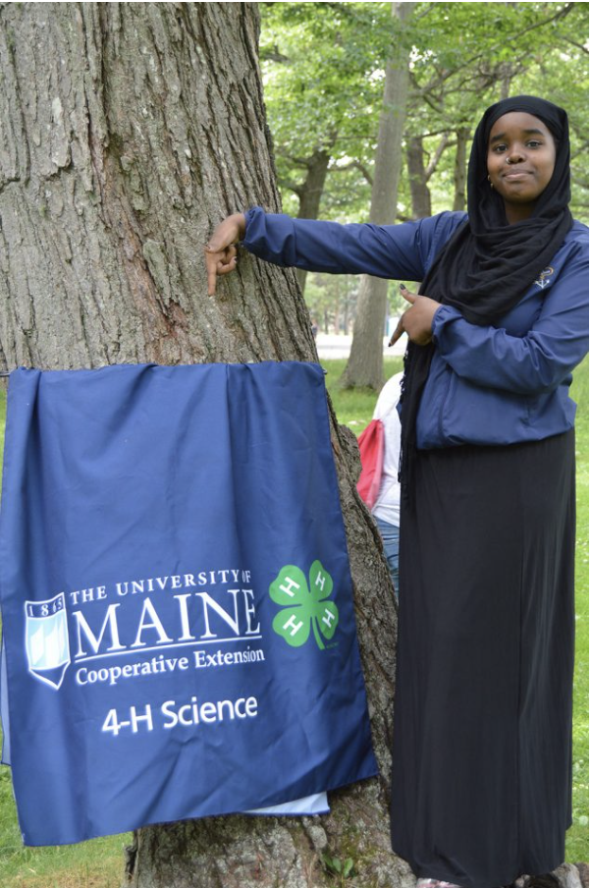
4-H Summer of Science
Background:
Long-running program in two counties where there are summer food sites for youth
Teens are recruited and trained as interns, and deliver science activities at those sites
Funding has been used to enable enhanced support the teen interns, and materials
Pros:
Enhancing a current program
Supporting urban, low income youth
Near-peer mentors with teen teachers
Cons:
Support for teens and materials, but not for additional staffing needed (think about all the pieces!)
Short-term engagement for youth
Notes:
NONE of these were developed uniquely as an EPSCoR Broader Impact. Our toolkit development plan has been refined and improved thanks to EPSCoR’s support and the number of kits we’ve developed.

Slide 24
Examples of BI involving UMaine 4-H
4-H Science/STEM Toolkits (Track 1, other NSF and USDA funding)
4-H Summer of Science Teens (Track 1)
4-H STEM Ambassadors (Track 1)
4-H Follow a Researcher (CAREER)
Notes:
What has worked - looking at the relationship as a partnership, and understanding each other’s need.NONE of these were developed uniquely as an EPSCoR Broader Impact. Our toolkit development plan has been refined and improved thanks to EPSCoR’s support and the number of kits we’ve developed.

Slide 25
4-H STEM Ambassadors
Background:
College students use 4-H toolkits with youth in the community
Began at UMaine as a way to test NSF/EPSCoR-funded toolkits
Expanded to 6 of the UMaine System Campuses, and with EPSCoR funding we’re attempting to engage community college students
Components:
College students are recruited and trained as 4-H volunteers, including reference and background checks.
4-5 hours of training includes positive youth development, experiential learning, and training on the STEM activities to be delivered.
Students are matched with community hosts, who recruit and provide oversight for the participating youth
Notes:
NONE of these were developed uniquely as an EPSCoR Broader Impact. Our toolkit development plan has been refined and improved thanks to EPSCoR’s support and the number of kits we’ve developed.

Slide 26
Notes:
NONE of these were developed uniquely as an EPSCoR Broader Impact. Our toolkit development plan has been refined and improved thanks to EPSCoR’s support and the number of kits we’ve developed.

Slide 27
Examples of BI involving UMaine 4-H
4-H Science/STEM Toolkits (Track 1, other NSF and USDA funding)
4-H Summer of Science Teens (Track 1)
4-H STEM Ambassadors (Track 1)
4-H Follow a Researcher (CAREER)
Notes:
What has worked - We’ve also been opportunistic - this program started after a grad student expressed his desire to bring kids along on his trip to a glacier in peru.

Slide 28
4-H Follow a Researcher
Notes:
NGSS practices -

Slide 29
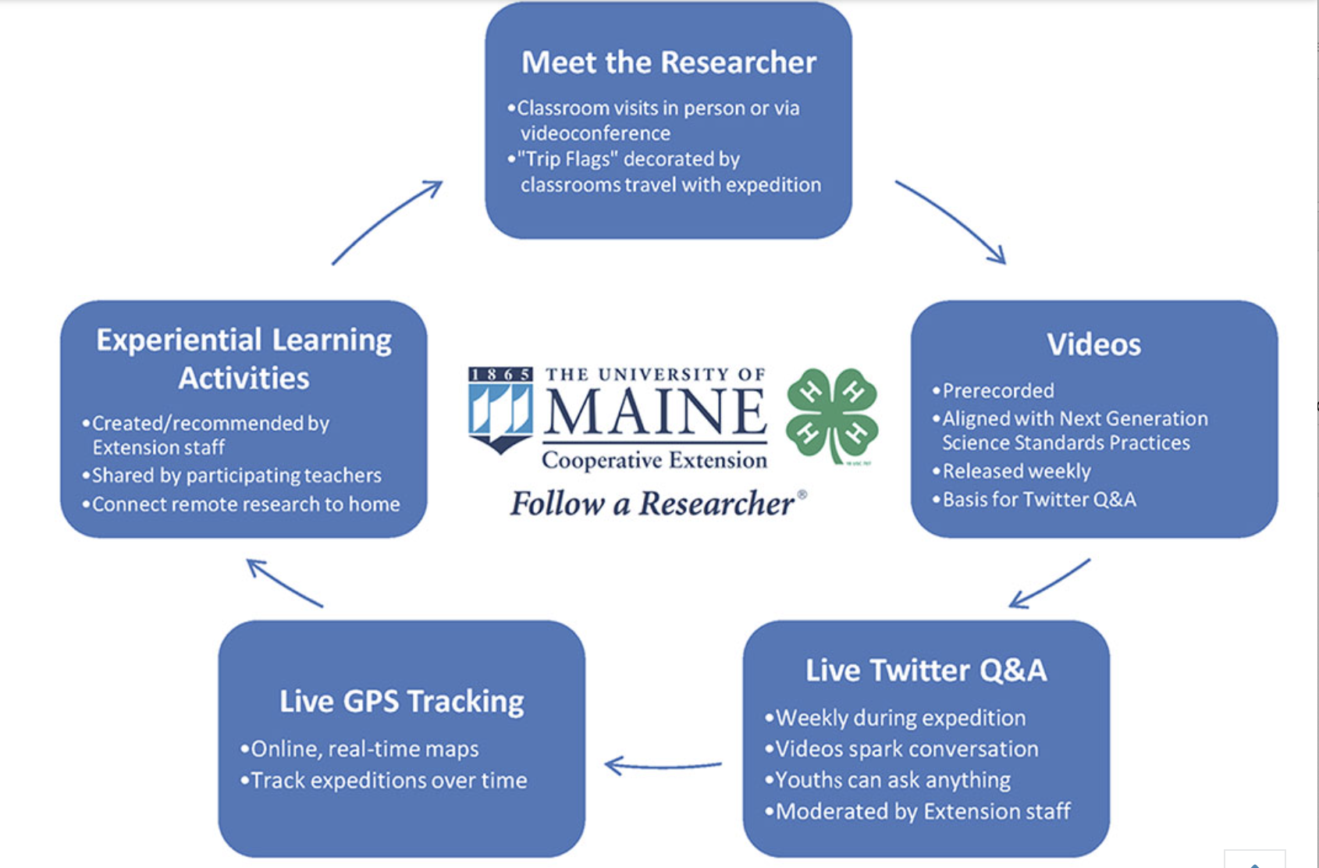

Slide 30
Lessons learned…
4-H Science/STEM Toolkits: LARGE investment of time, sustainable, underfunded, need to match research and community needs.
4-H Summer of Science: Partnering with local programs can be a win-win. Increasing numbers = increased staff time.
4-H STEM Ambassadors: All partners need to be on board from the start. Flexibility in implementation helps during pandemics.
4-H Follow a Researcher: Adapt to technology, know what the audience wants and needs.
Funding for staff support of these programs
is essential to their success.
Notes:
What has worked - We’ve also been opportunistic - this program started after a grad student expressed his desire to bring kids along on his trip to a glacier in peru.

Slide 32
BI Resources
NSF Funding database (abstracts of funded projects)
Other funding databases
University and project Web sites
Principal investigators
ARIS (advancingresearchinsociety.org)
Cooperative Extension/4-H
Notes:
Kim??? Wrap it up?

Slide 33
Thank you!
Kim Goff
Large Center Development Associate
Office of Research Development
kimberly.goff@maine.edu
Laura Wilson
4-H Science Professional
Cooperative Extension/Maine 4-H
Laura.Wilson@maine.edu
Notes:
Both intro themselves

