Slide 1
The STOICH Project
From Ecosystems to Evolution: Harnessing Elemental Data to Detect Stoichiometric Control-Points and their Consequences for Organismal Evolution
PI: Jessica Corman
Co-PI’s: Hal Halvorson, Amy Krist, Eric Moody, Catherine Wagner
27th NSF EPSCoR National Meeting

Slide 2
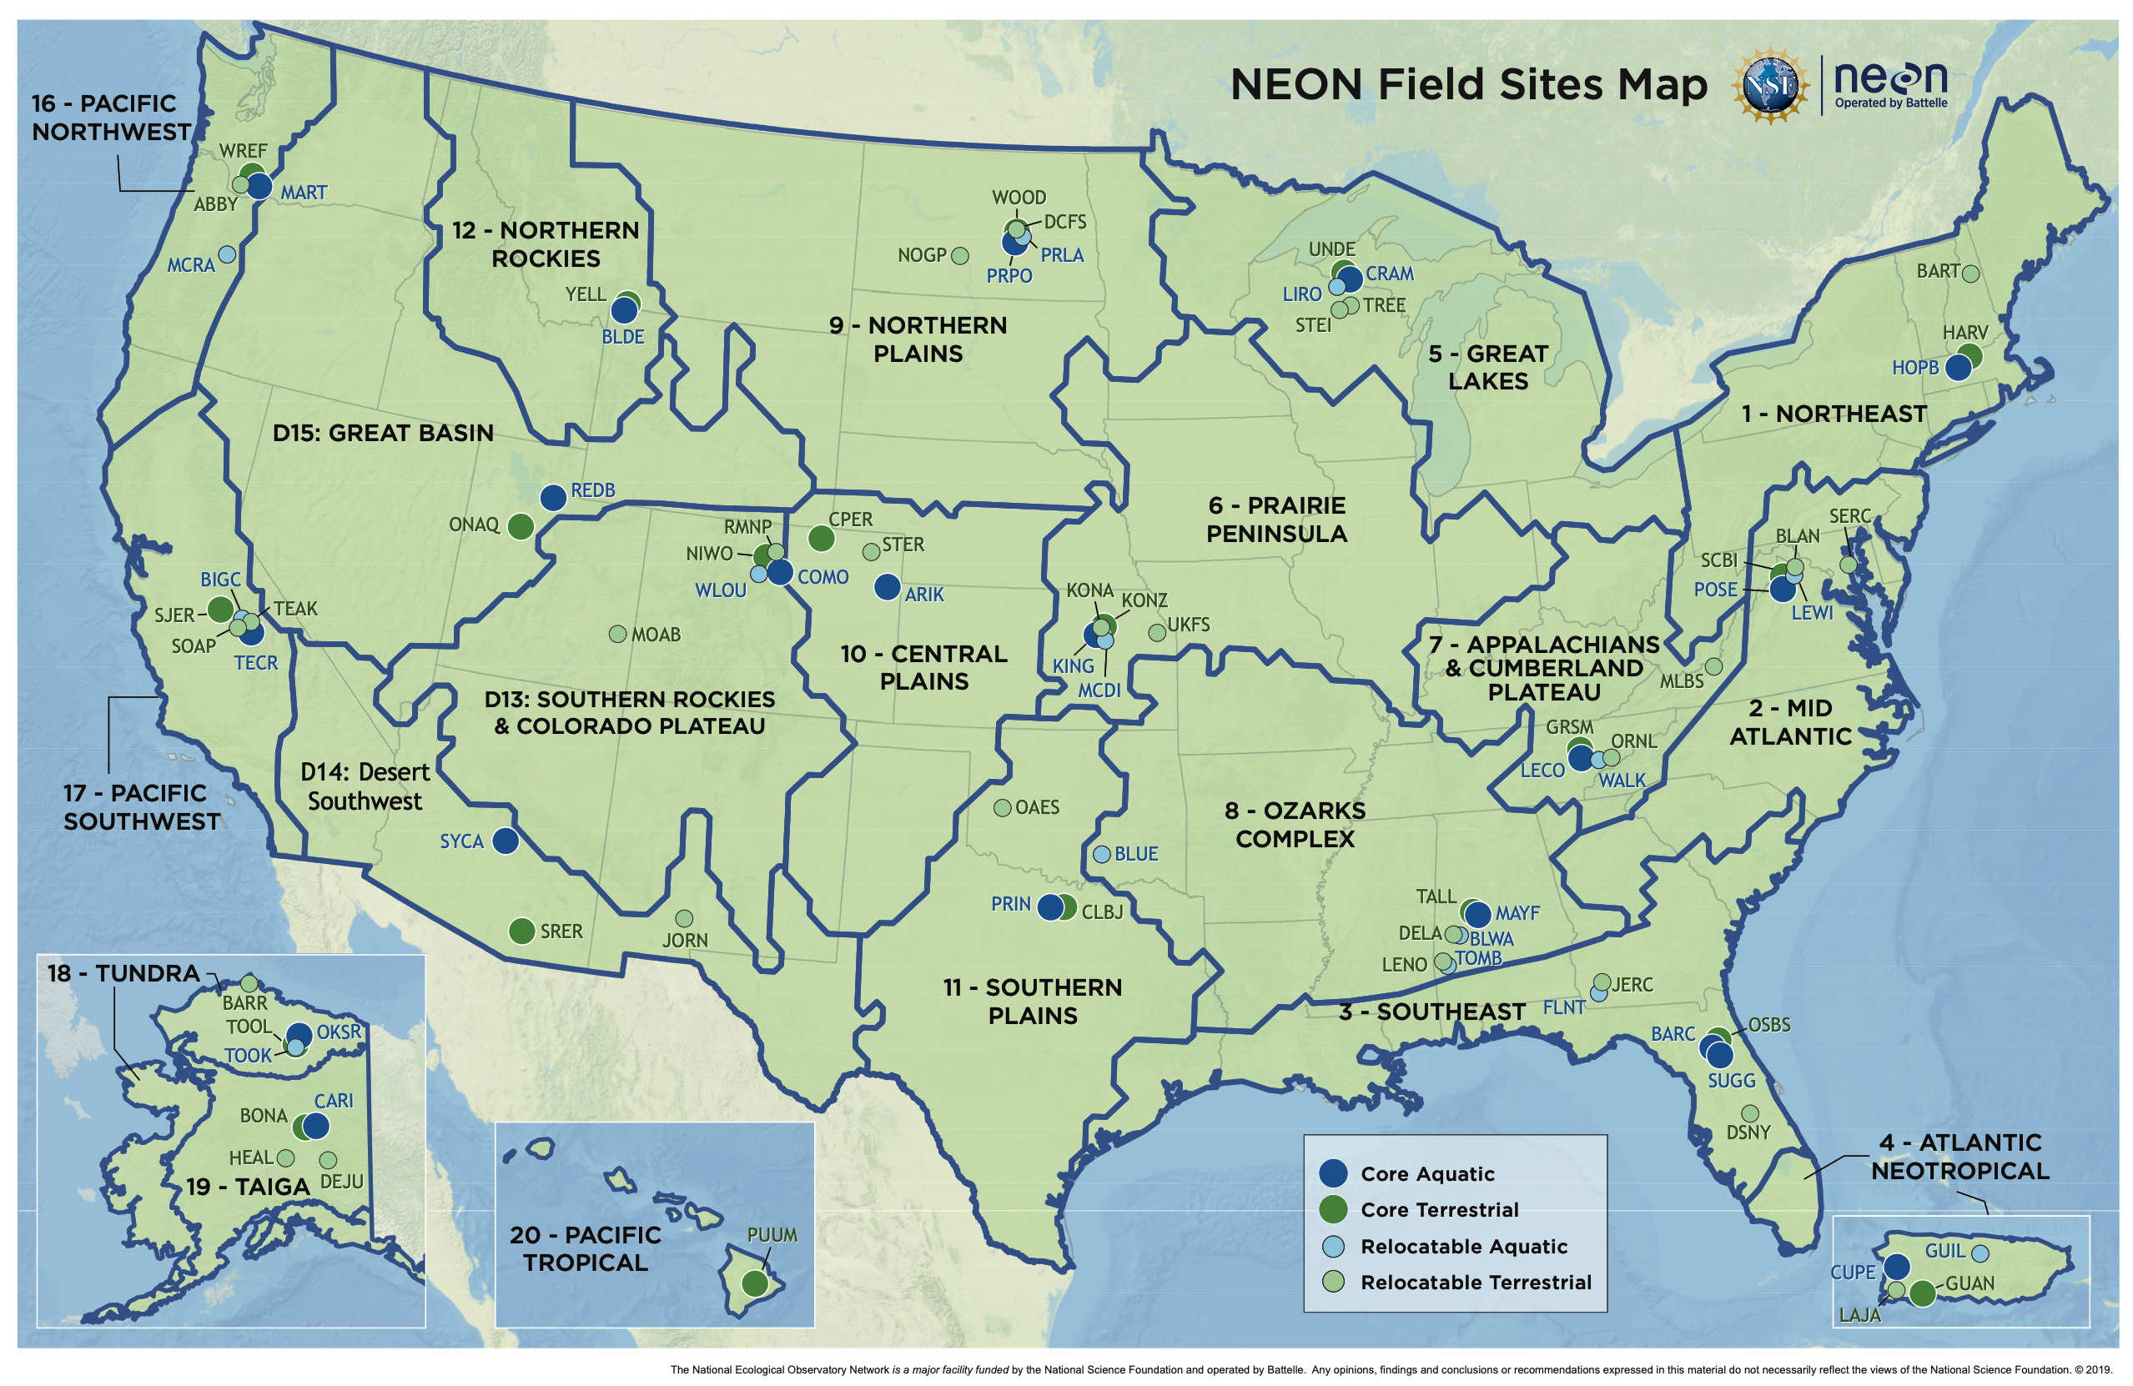
Project Overview
Harness environmental data collected across wide spatial and temporal scales to build a new database called the Stoichiometric Traits of Organisms In the Chemical Habitats (STOICH) database (database implementation)
Develop new analytical and visualization tools to address statistical and data visualization challenges related to studying elemental ratios and their ecological implications (analytical capabilities)
Build capacity across our jurisdictions for cutting-edge ecological and environmental research (human capacity)
Develop and apply ecological stoichiometry theory at regional and larger scales across a breadth of aquatic ecosystems (scientific advancement)
27th NSF EPSCoR National Meeting

Slide 3
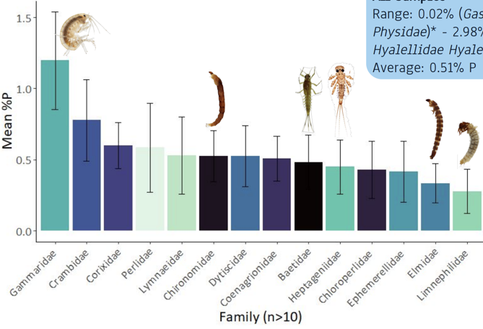
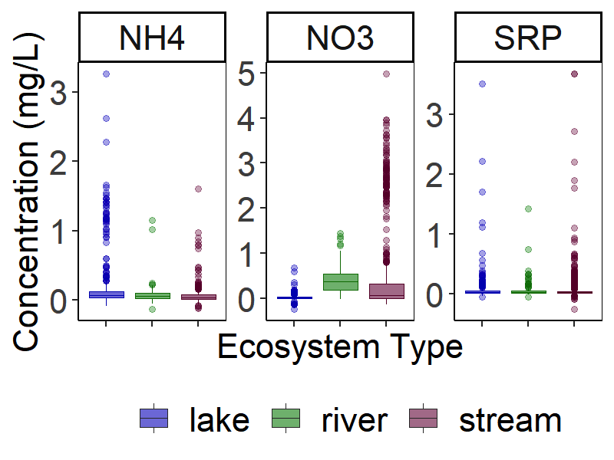
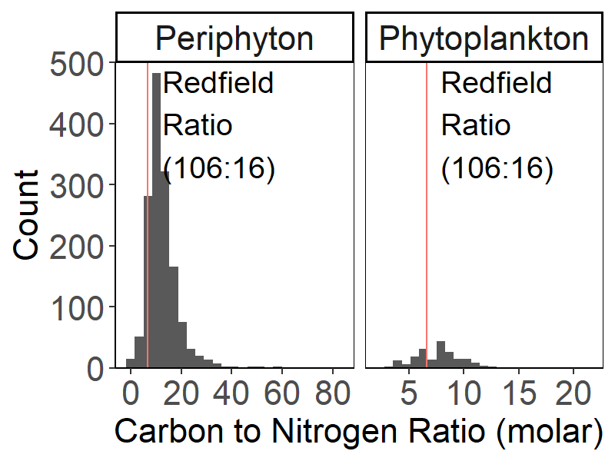
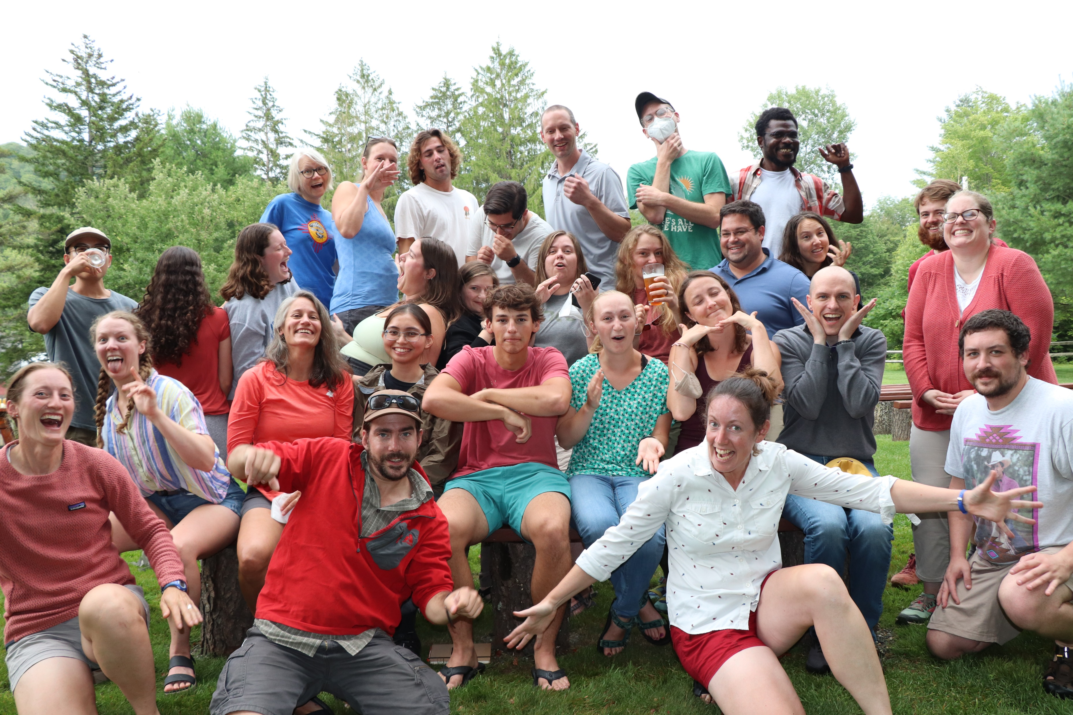
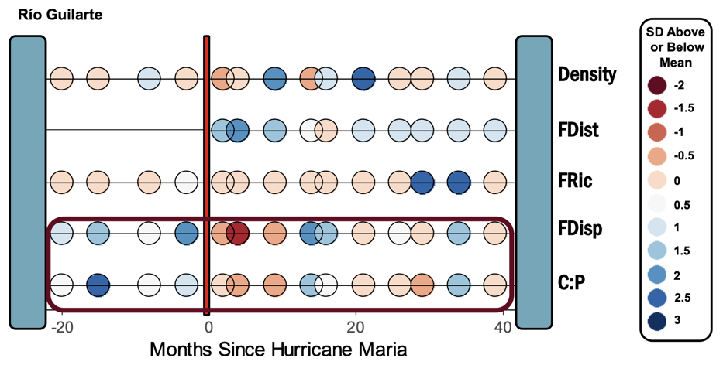
Outcomes as of 2022
27th NSF EPSCoR National Meeting

Slide 4
Key Lessons Learned
Support: Start hiring as soon as possible (particularly support staff)
Leverage: Ask questions on how your institution can support you
Transparency: On-boarding materials, committees, etc.
Evaluate and Iterate: Reflect on what is and isn't work well (e.g., External Evaluator, Advisory Board); adjust as needed
Have fun!
27th NSF EPSCoR National Meeting

