Slide 1
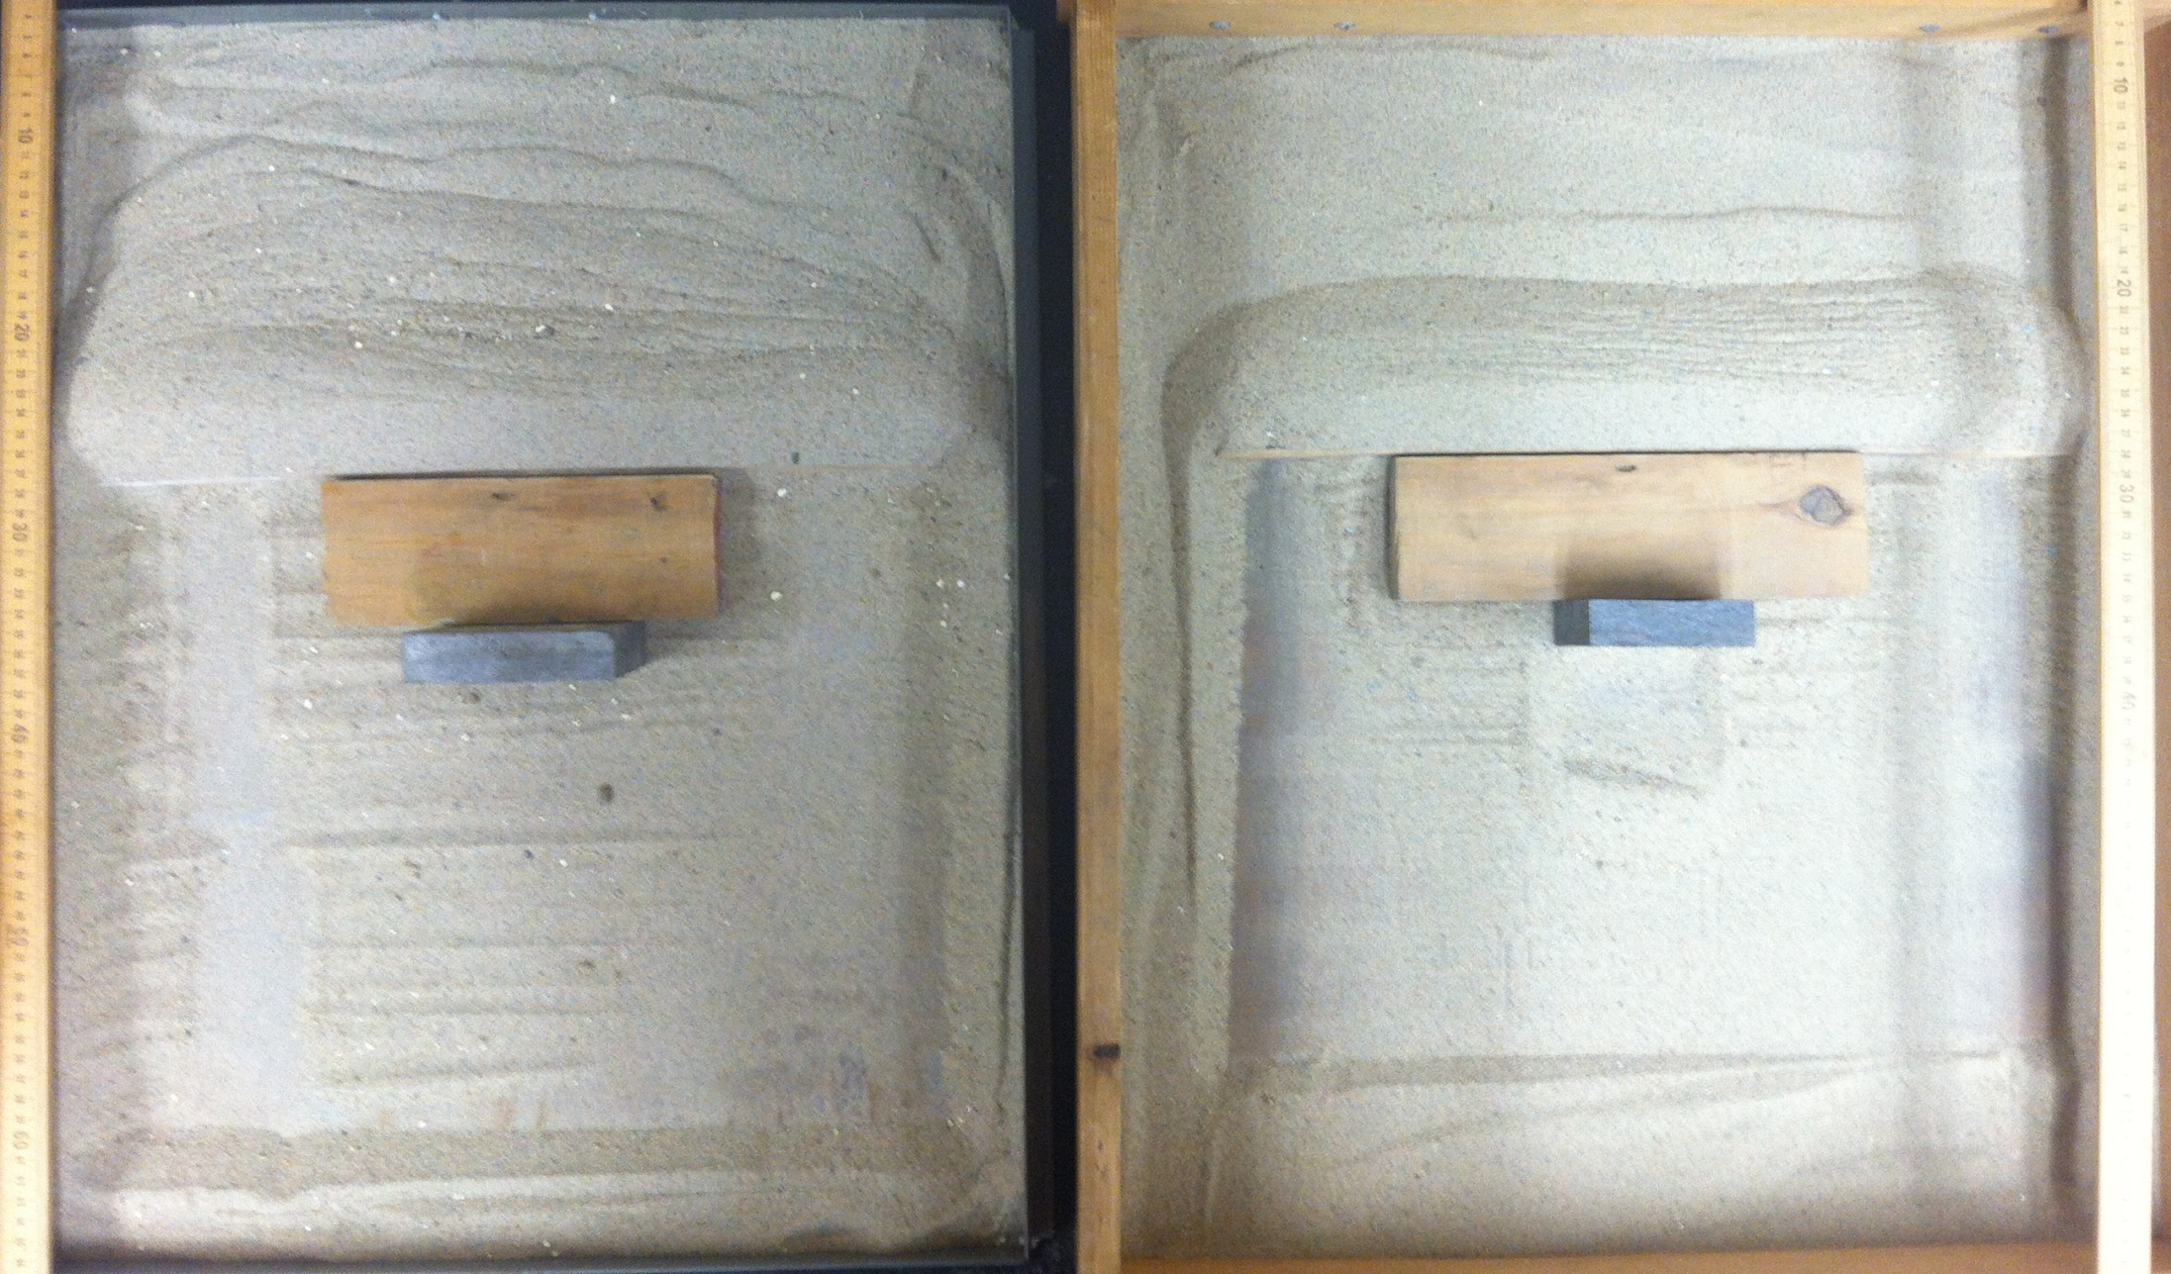
Sandbox analog models:
Sketch a cross section of the ‘mountain’ through the middle, normal to the plate boundary.
Which one has higher basal coefficient of friction?
A
B
A’
B’

Slide 2
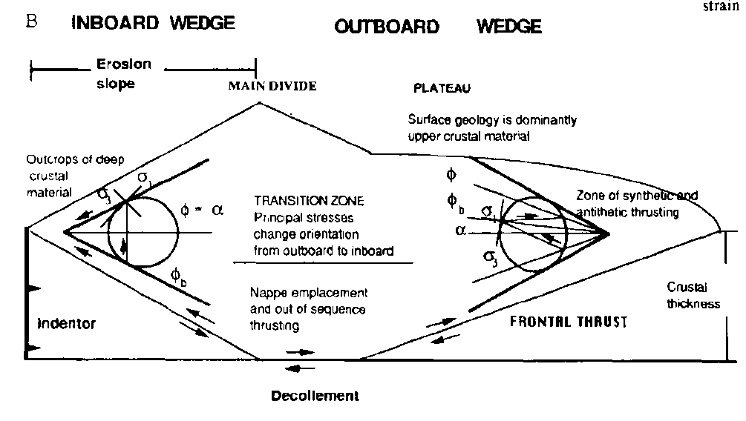
Critical taper equation
The relationship of the topographic slope (α) to
the material properties (angles of internal and basal frictions)
For cohesionless material,
$$α=\frac{μ_{b}}{N}$$
$μ_{b}=\tan{φ_{b}}$
$$N=\tan^{2}\left(\frac{π}{4}+\frac{φ}{2}\right)=\frac{1+sinφ}{1−sinφ}$$
(Koons, 1990)

Slide 3
Sandbox analog models:
Construct ‘beachball ‘ diagrams showing the seismogenic instantaneous strain and fault motion.

Slide 4
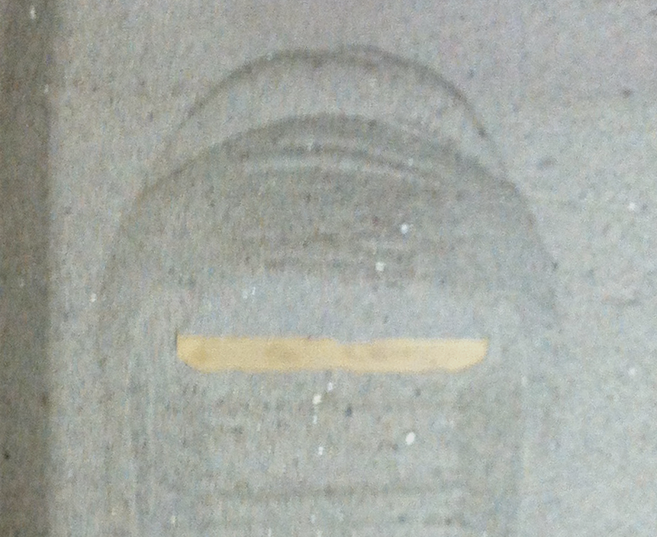
Sandbox analog models:
Construct beachball diagrams.
Where beachball diagrams show the predominantly strike-slip nature?

Slide 5
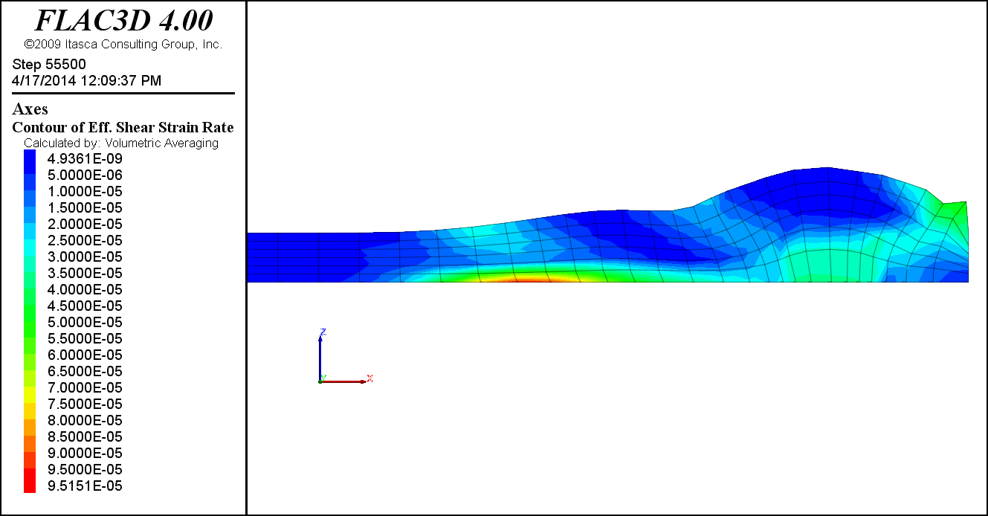
Shear strain rate of weak base (φ_{b} = 15˚ ) model

Slide 6
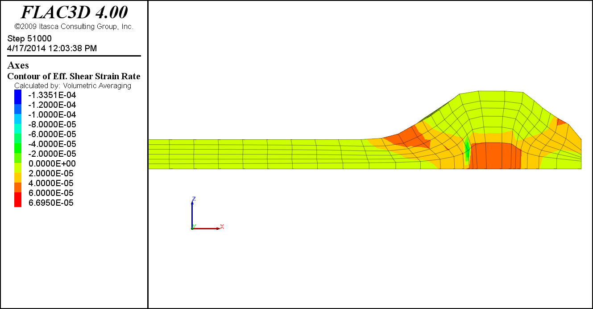
Shear strain rate of strong base (φ_{b} = 45˚ ) model

Slide 7
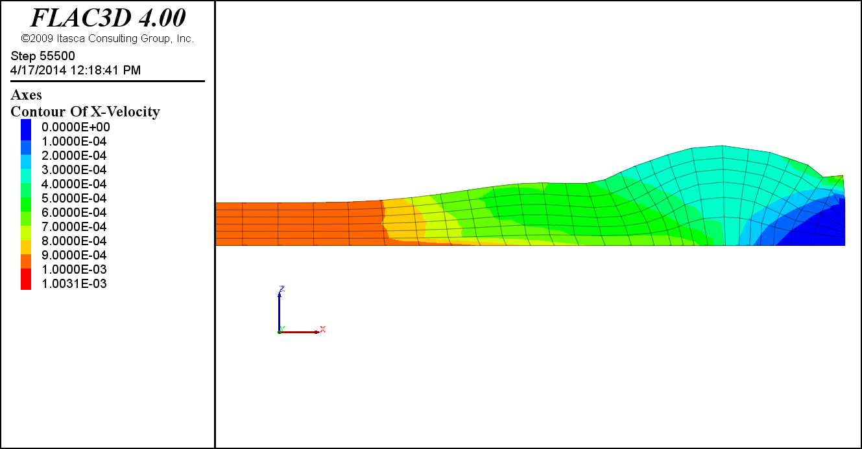
Horizontal velocity of weak base (φ_{b} = 15˚ ) model

Slide 8
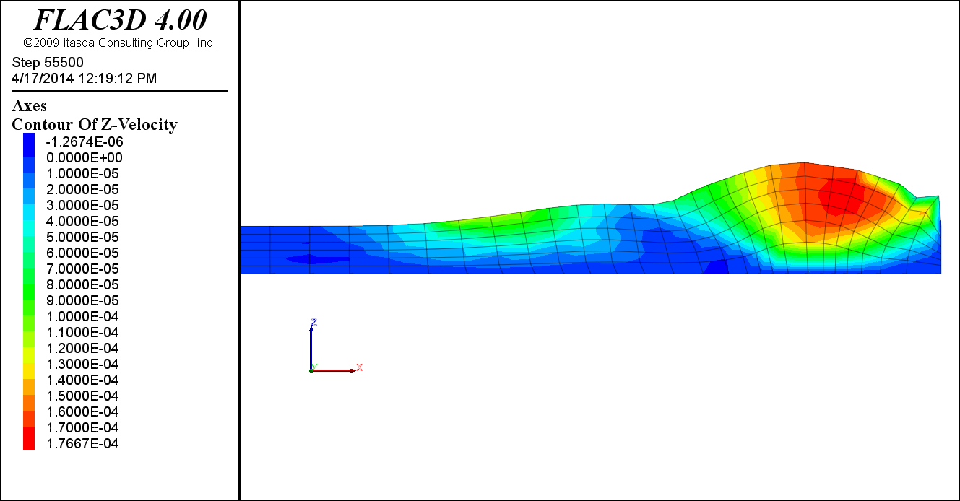
Vertical velocity of weak base (φ_{b} = 15˚ ) model

Slide 9
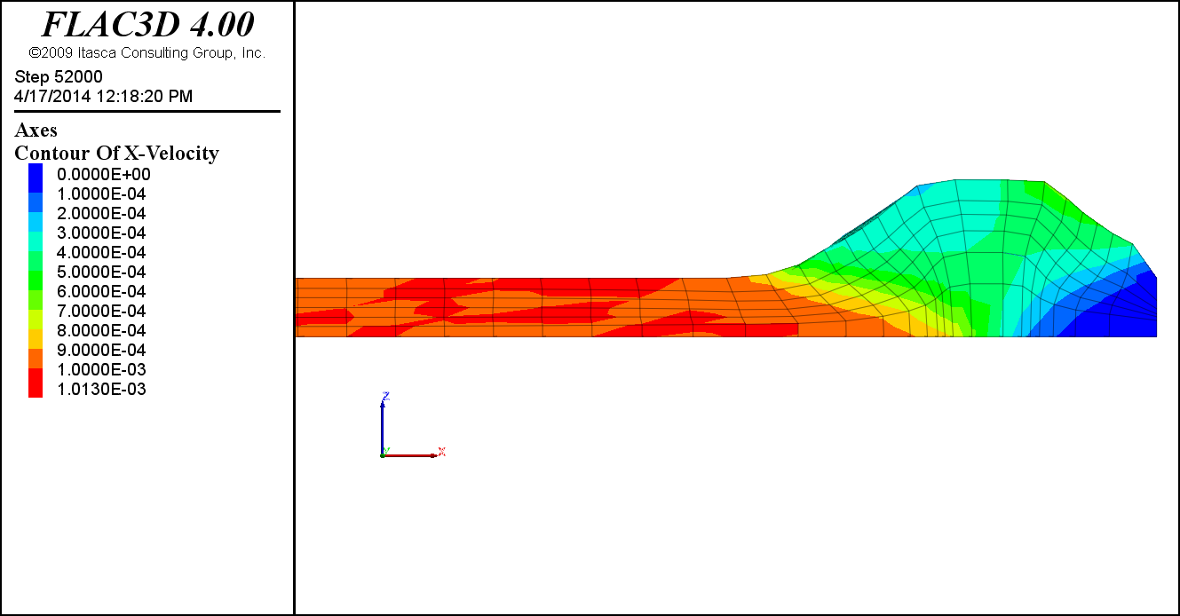
Horizontal velocity of strong base (φ_{b} = 45˚ ) model

Slide 10
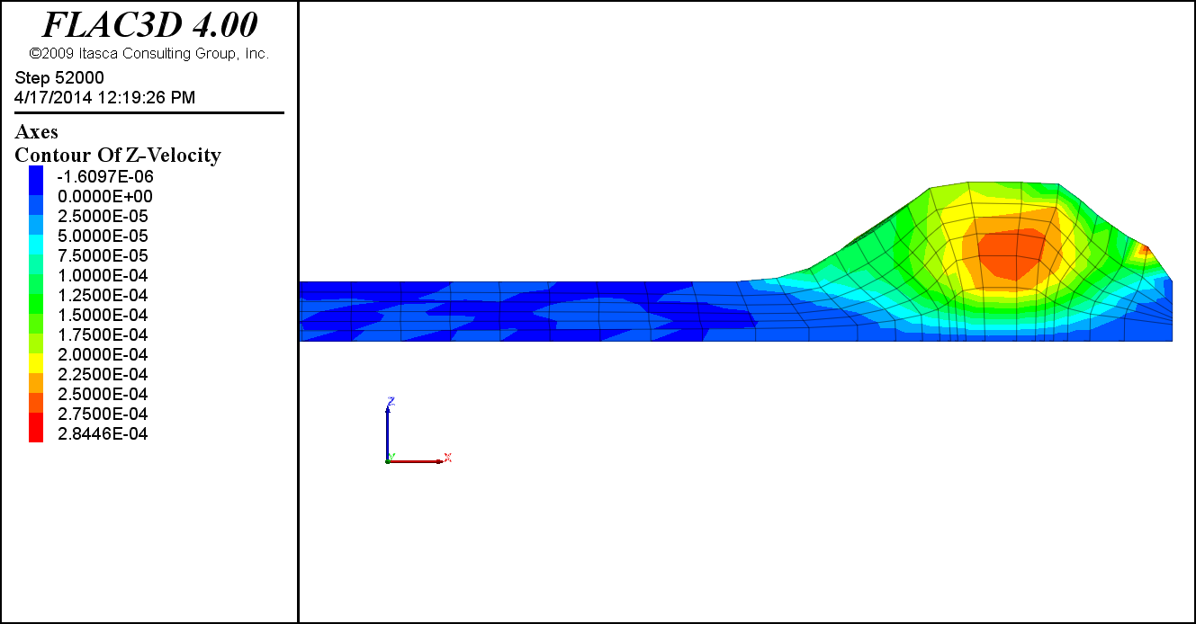
Vertical velocity of strong base (φ_{b} = 45˚ ) model

