Slide 1
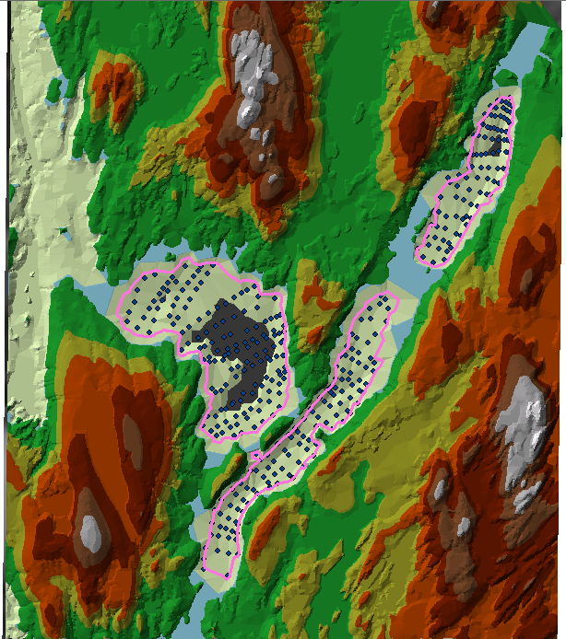
Lab 7 – Terrain Analysis

Slide 2
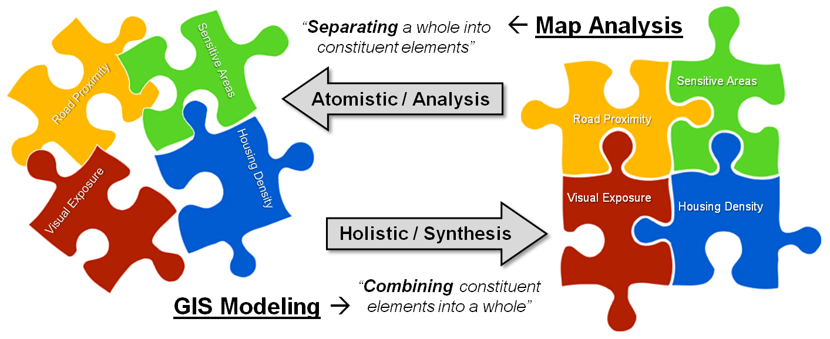
Spatial Models & Modeling
Ch. 13 Part 1

Slide 3
Introduction
A model is a description of reality.
A spatial model describes the basic properties or processes for a set of spatial features which helps us understand their form and behavior.
Spatial models may be (Bolstad):
  Prepared and run in a GIS
  Prepared in a GIS and exported to a model.
  Prepared outside a GIS and run inside a GIS

Slide 4
Introduction
A model is a description of reality.
A spatial model describes the basic properties or processes for a set of spatial features which helps us understand their form and behavior.
Spatial models may be:
  Prepared and run in a GIS
  Prepared in a GIS and exported to a model.
  Prepared outside a GIS and run inside a GIS

Slide 5
Types of Spatial Models
Cartographic Models (Automated Mapping Analysis & Processing)
  Often applied to ranking areas in support of decision making.
    Nominal or ordinal output
  Uses processes such as overlay, buffers, reclassification etc.
Simple Spatial Models –focus on applying mathematical relationships
  Subject of SIE 512
  Output is often interval or ratio
Spatio-Temporal Models (Process Models)

Slide 6
Cartographic Modeling
Subject of Exercises 5 and 6.
Can use “Model Builder” to automate.
Frequently used for suitability analysis.
Temporally static, but may be used to look at change over time for fixed boundaries

Slide 7
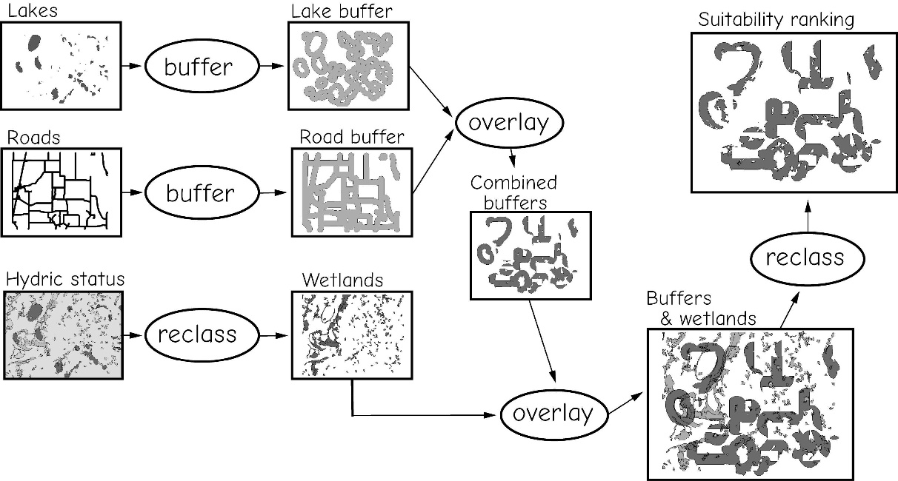
An Example of Cartographic Modeling

Slide 8
Types of Spatial Models
Cartographic Models (Automated Mapping Analysis & Processing)
  Often applied to ranking areas in support of decision making.
    Nominal or ordinal output
  Uses processes such as overlay, buffers, reclassification etc.
Simple Spatial Models –focus on applying mathematical relationships
  Subject of SIE 512
  Output is often interval or ratio
Spatio-Temporal Models (Process Models)

Slide 9
Process Models
Suitability modeling: where should I put it?
Distance modeling:
how far is it?
Hydrologic modeling: where will the water flow to?
Surface modeling:
what is the pollution level?
Describe the interaction or processes of the objects of real world, which are modeled in the representation model, by using map calculation

Slide 10
Why construct a process model?
We need to make decisions, and take actions about spatial phenomenon.
It may help us evaluate our understanding of complex processes.
Notes:
Where should we place a nuclear waste facility. Where should McDonald’s build its next facility?
Coastal erosion is a complex process if we think we understand the factors affecting southern Maine, we can build a model based on conditions that existed ten years ago, and see if it predicts what has actually occurred.
10

Slide 11
Creating a conceptual model to solve a spatial problem (1)
Step 1. Stating the problem.
  What is the goal?
Step 2. Breaking the problem down.
  What are the objectives.
  What are the objects and their interactions (process model).
  What datasets (data model and presentation model) will be needed

Slide 12
Creating a conceptual model to solve a spatial problem (2)
Step 3. Exploring the datasets
  What is contained in the datasets
  what relationships between the datasets
Step 4. Performing analysis (spatial analysis)
  Which tools to run the process models and build a overall model
Step 5. Verifying the model’s result
  Does any thing in the model need to be changed?
  If yes, go back to step 4
Step 6. Implementing the result
Notes:
Through spatial analysis you can interact with a GIS to answer questions, support decisions, and reveal patterns. Spatial analysis is in many ways the crux of a GIS, because it includes all of the transformations, manipulations, and methods that can be applied to geographic data to turn them into useful information.
While methods of spatial analysis can be very sophisticated, they can also be very simple. The approach this course will take is to regard spatial analysis as spread out along a continuum of sophistication, ranging from the simplest types that occur very quickly and intuitively when the eye and brain look at a map, to the types that require complex software and advanced mathematical knowledge.
There are many ways of defining spatial analysis, but all in one way or another express the fundamental idea that information on locations is essential. Basically, think of spatial analysis as "a set of methods whose results change when the locations of the objects being analyzed change."
For example, calculating the average income for a group of people is not spatial analysis because the result doesn't depend on the locations of the people. Calculating the center of the United States population, however, is spatial analysis because the result depends directly on the locations of residents.
Types of spatial analysis vary from simple to sophisticated. In this course, spatial analysis will be divided into six categories: queries and reasoning, measurements, transformations, descriptive summaries, optimization, and hypothesis testing.
Queries and reasoning are the most basic of analysis operations, in which the GIS is used to answer simple questions posed by the user. No changes occur in the database and no new data are produced.
Measurements are simple numerical values that describe aspects of geographic data. They include measurement of simple properties of objects, such as length, area, or shape, and of the relationships between pairs of objects, such as distance or direction.
Transformations are simple methods of spatial analysis that change data sets by combining them or comparing them to obtain new data sets and eventually new insights. Transformations use simple geometric, arithmetic, or logical rules, and they include operations that convert raster data to vector data or vice versa. They may also create fields from collections of objects or detect collections of objects in fields.
Descriptive summaries attempt to capture the essence of a data set in one or two numbers. They are the spatial equivalent of the descriptive statistics commonly used in statistical analysis, including the mean and standard deviation.
Optimization techniques are normative in nature, designed to select ideal locations for objects given certain well defined criteria. They are widely used in market research, in the package delivery industry, and in a host of other applications.
Hypothesis testing focuses on the process of reasoning from the results of a limited sample to make generalizations about an entire population. It allows us, for example, to determine whether a pattern of points could have arisen by chance based on the information from a sample. Hypothesis testing is the basis of inferential statistics and forms the core of statistical analysis, but its use with spatial data can be problematic.

Slide 13
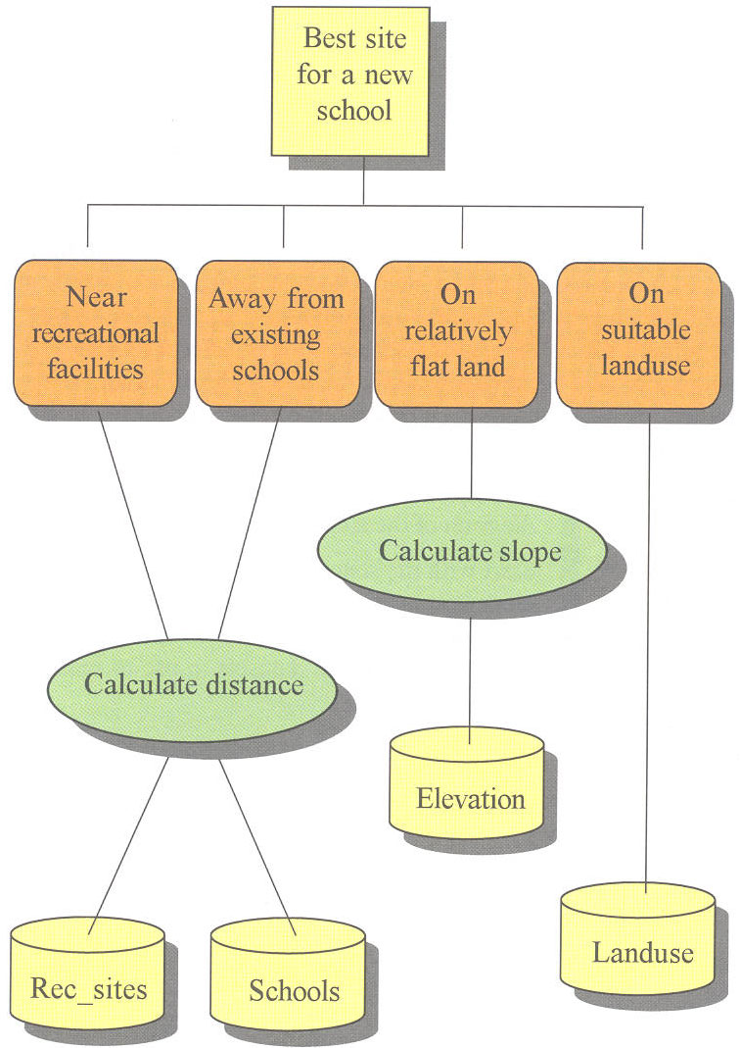
Example using conceptual model to create a suitability map
Step 1. Stating the problem
Step 2. Breaking the problem down

Slide 14
Process models
Datasets
(data models &
representation
model)

Slide 15
Step 3. Exploring the datasets
Datasets
(data models &
representation
model)

Slide 16
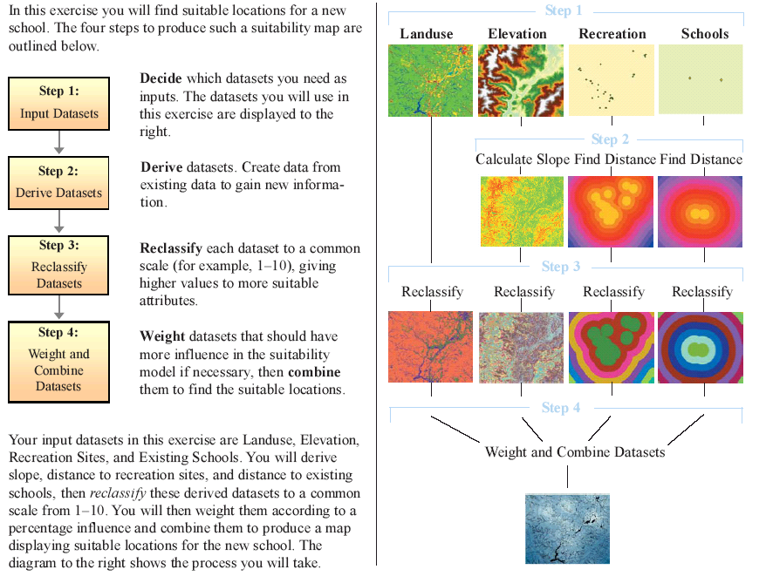
Step 4. Performing analysis (spatial analysis)

Slide 17
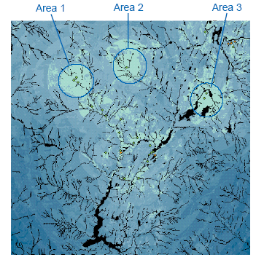
Step 5. Verifying the model’s result
to verify if the result is correct
Step 6. Implementing the result
to building a new school in the chosen location

Slide 18
Process Modeling and GIS
GIS uses:
  Natural and scale analog
  Conceptual and
  Mathematical modeling
Either in isolation or combined in an iterative process.
Proprietary GIS software provides few if any process models as part of the standard set of functions
  ArcGIS is good for Spatial Analysis
  Has a few predictive functions (Kriging)
  ArcGIS has Model Builder to automate functions
Notes:
Because of this limitation, GIS is frequently linked with other modeling software.
18

Slide 19
Modeling Physical and Environmental Processes
The following example comes from the Department of Conservation: Bureau of Geology, Natural Areas and Coastal Resources
http://www.maine.gov/doc/nrimc/mgs/explore/hazards/landslide/facts/nov10.htm

Slide 20
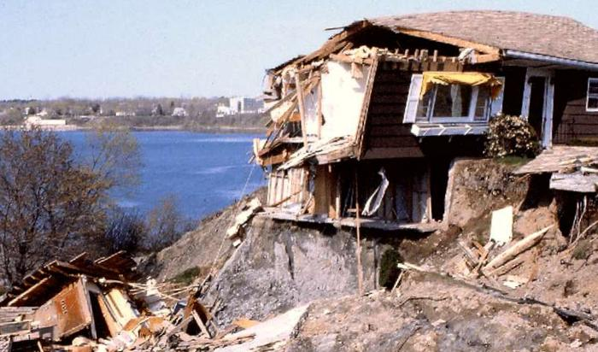
Modeling Physical and Environmental Processes
Figure 1. A clay bluff on the north shore of Rockland Harbor failed in 1996. This landslide formed a new scarp about 200 feet landward of the original top of the bluff in just a few hours. Two homes were destroyed as a result of this catastrophic slide.
Notes:
Landslides are one of the most common geologic hazards in Maine (Figure 1), causing damage in both rural and urban areas of the state. In many of Maine's landslide susceptible areas, factors affecting slope condition such as construction, seismic activity, or increased soil moisture may cause movement or may reactivate prior landslides. Until recently, only a few landslides have caused extensive property damage in Maine. Two landslides of note include one in Gorham, Maine in 1983 (Novak, 1987a) (Figure 2), and another in Rockland, Maine in 1996
20

Slide 21
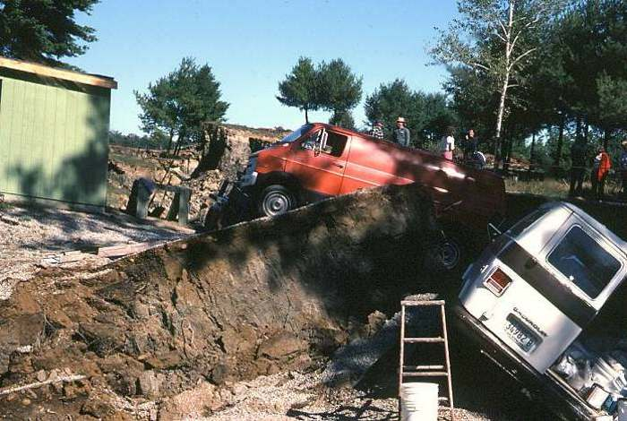
Notes:
Two landslides of note include one in Gorham, Maine in 1983 (Novak, 1987a) (Figure 2), and another in Rockland, Maine in 1996
21

Slide 22
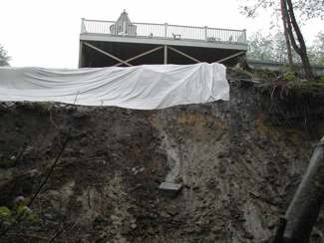
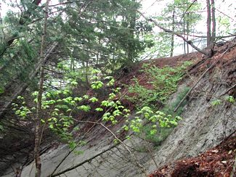
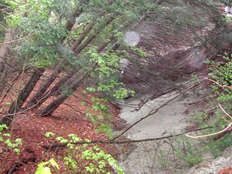
Figure 4. A large rotational slide occurred in the spring of 2006 along Hobbs Brook in Cumberland, Maine in an area of high relief and steeply sloped stream bank. The slide occurred after a heavy sustained rainfall.
Notes:
During the spring of 2005, 2006, and 2007, landslides severely damaged residential properties in the towns of Sanford, Wells, Brunswick, and Cumberland (Figure 4, Figure 5, Figure 6), and a major landslide occurred in Greenbush along the Penobscot River destroying parts of a major roadway (Figure 7). All of these landslides occurred after heavy rains and led to considerable concern among state and local authorities, and the general populace, about the stability of slopes in these areas and elsewhere in Maine.
22

Slide 23
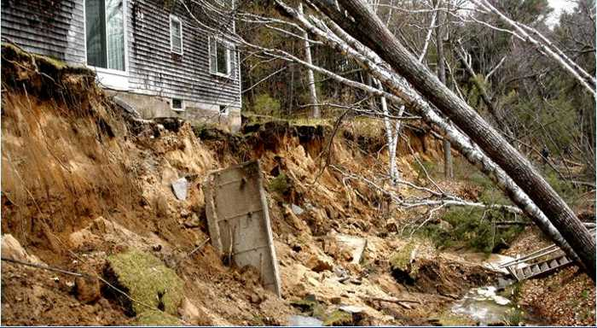
Figure 5. In May of 2005 a landslide occurred in Wells along the banks of the Merriland River. The slide destroyed a portion of a walking trail in the Rachel Carson National Wildlife Refuge and removed the backyard of a nearby house. Parts of the house's foundation were left exposed and the house was declared unsafe to inhabit.

Slide 24
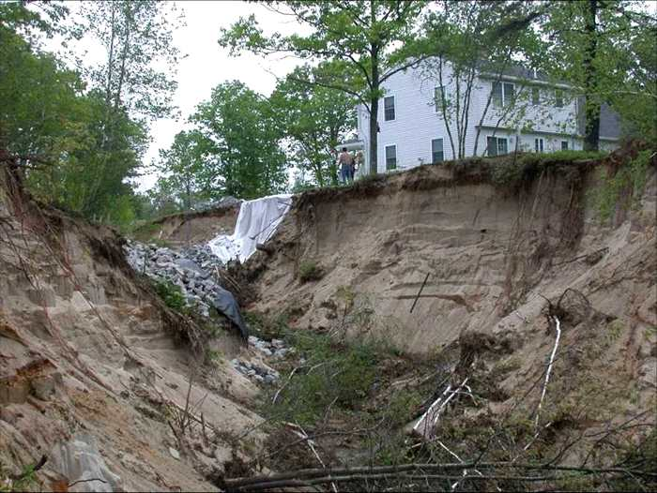
Figure 6. In May of 2006, a large earth flow caused by improper drainage due to recent road construction occurred in Sanford, Maine. The drainage focused heavy runoff towards this property, which then undercut the overlying sand, causing a large earth flow into Branch Brook.
Notes:
24

Slide 25
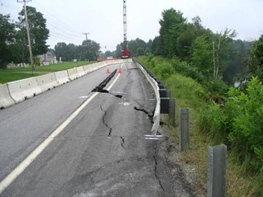
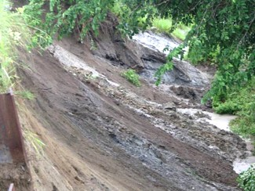
Figure 7. A landslide occurred along the Penobscot River in the town of Greenbush on June 30, 2006. The slide undercut Route 2 and caused this section of roadway to be closed until the river bank stabilized, and the roadway section was rebuilt.
Notes:
Initial investigation of these slides showed that they were not unique geologic events in the locations where they occurred. Many nearby areas exhibited evidence of earlier landslides. What they all had in common was that they occurred in areas underlain by a glaciomarine clay called the Presumpscot Formation, and usually occurred in areas with steep slopes. The Presumpscot Formation is a widespread blanket of glaciomarine silt, clay, and sand that covers much of coastal Maine and inland lowlands, and has proven to be highly susceptible to slope failure. Due to the increased landslide occurrences, the Maine Geological Survey (MGS) produced a series of Landslide Susceptibility Maps for areas in Maine underlain by glaciomarine deposits, and in particular, the marine clay of the Presumpscot Formation.
25

Slide 26
Risk Factor Analysis
The Landslide Susceptibility Maps were created using Risk Factor Analysis based on the following principles:
  It is likely that landslides will occur where they have occurred in the past.
  Landslides are likely to occur in similar geological, geomorphological, and hydrological conditions as they have in the past.
Simply put:
  All available data is collected for risk factors that are located within the area of study.
  Next, all landslide locations within this same area are systematically mapped.
  Using a Geographic Information System (GIS), mapped landslides are compared to each risk factor and examined to determine which risk factors are the most statistically significant causes of landslides.
  Once the analysis is complete, statistically significant risk factors are mapped, and zones of landslide susceptibility are created, ranging from areas of no risk factors (lowest landslide potential) to areas where there are 3 or more risk factors present (highest landslide potential).

Slide 27
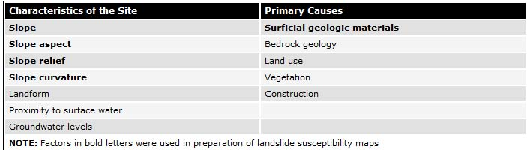
Landslide Risk Factors

Slide 28
Risk Factors Used in This Study
Geomorphic Risk Factors
  Slope: The steeper the slope, the larger the shear stress on the materials and the more susceptible the slope is to failure
  Curvature (concave): Concave topography will concentrate groundwater flow, raising pore pressures and reducing shear strength of the soil.
  Slope aspect: Repeated freeze/thaw cycles reduce the shear strength of the shallow soil material, increasing the likelihood of shallow soil slumps and creep.
  Relief/slope height: As the thickness of the potential landslide block increases, the shear stress on the lower section of block increases, making the block (slope) more susceptible to failure. Therefore, thicker sections of surficial materials will be more susceptible to landslides.
Soil properties
  Surficial geologic materials: Cohesive materials such as clays are prone to landslides along planes of weakness in the sediment. Less cohesive materials (sands) may slump if slopes oversteepen or ground water pore pressure increases and reduces internal friction.

Slide 29
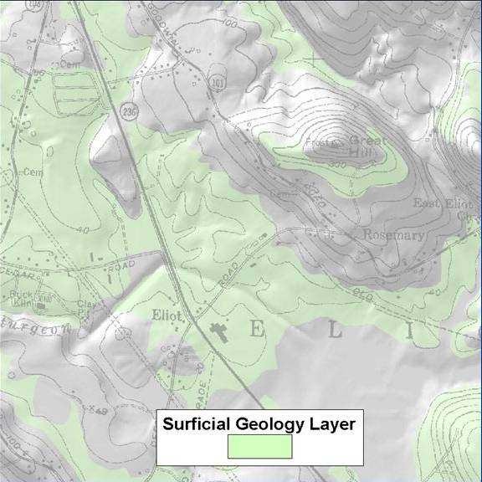
Figure 8
Notes:
Prepare a map that combines the permanent risk factors of surficial geology (Figure 8), slope steepness (Figure 9), slope aspect (Figure 10), slope curvature (Figure 11), and any other data available on a DEM (digital elevation model) base (Figure 12, Figure 13). These datasets would be available as GIS data layers, easily plotted on the map.
29

Slide 30
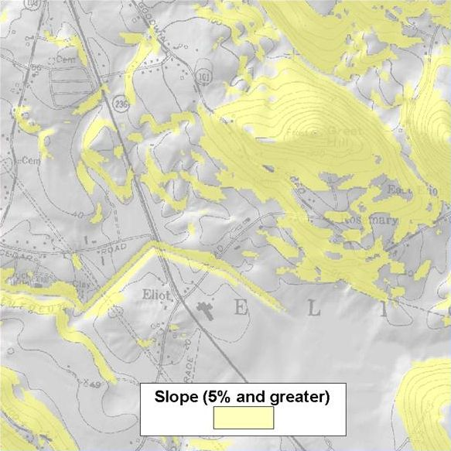
Figure 9

Slide 31
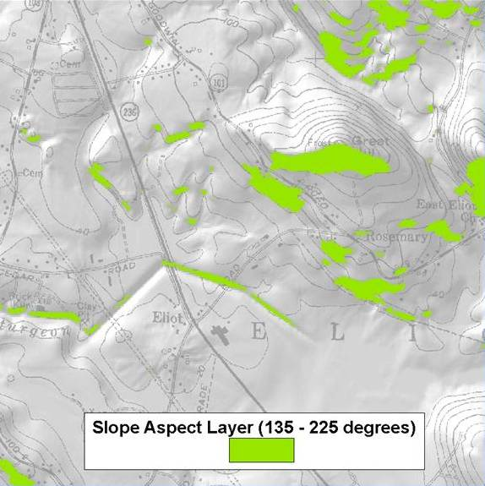
Figure 10
Notes:
31

Slide 32
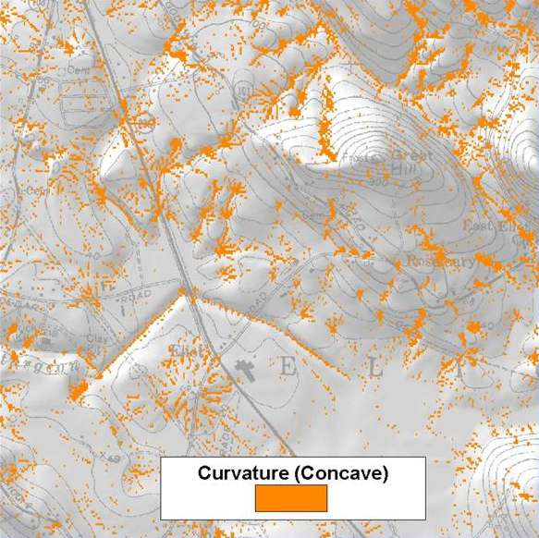
Figure 11

Slide 33
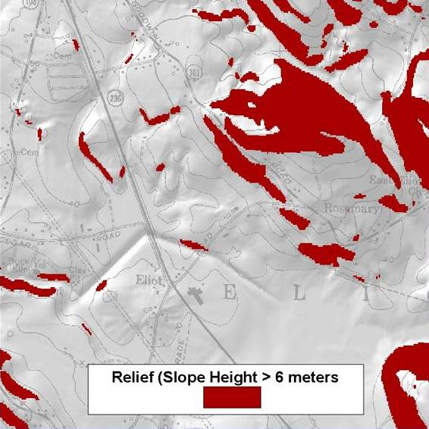
Figure 12

Slide 34
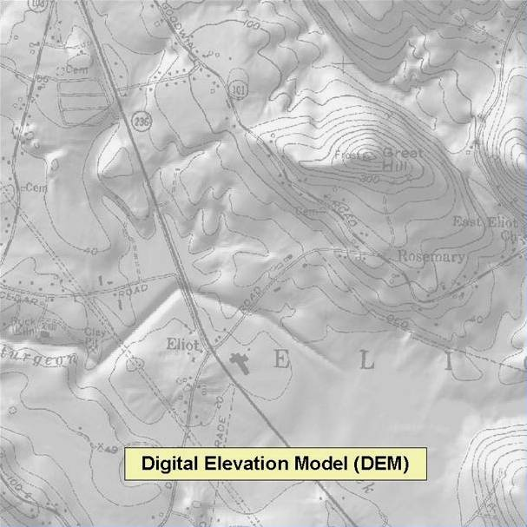
Figure 13

Slide 35
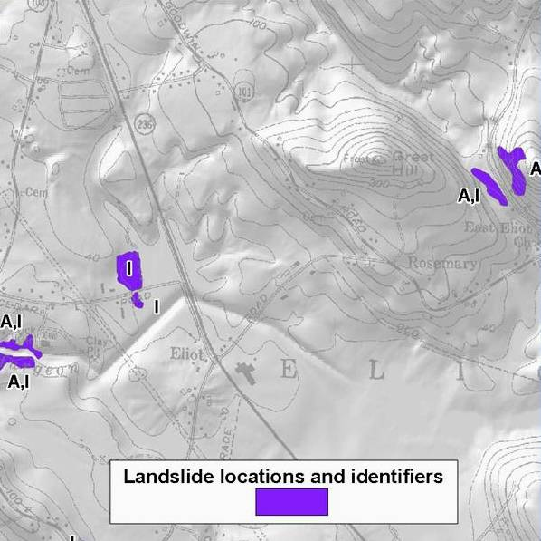
Figure 14
Notes:
Step Two: Overlay the landslide inventory map (Figure 14) onto the map of combined risk factors. This will identify areas where past landslide occurred and where current risk factors are located.
35

Slide 36
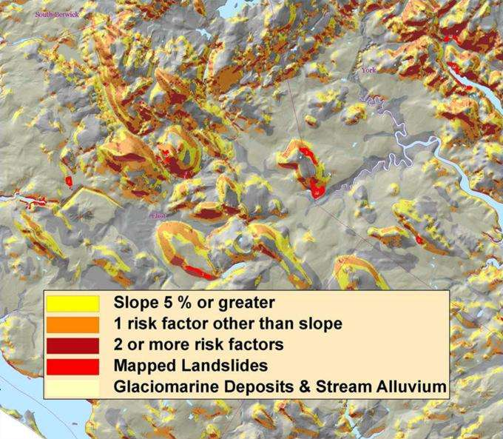
Figure 15
Notes:
Step Three: Run a statistical analysis on the risk factors versus the landslide inventory, and determine which risk factors are statistically significant to landslide susceptibility. Select the risk factors of the highest statistical significance to use for your Landslide Susceptibility zonation: areas with one (1) risk factor; two (2) risk factors; etc. (Figure 15).
36

Slide 37
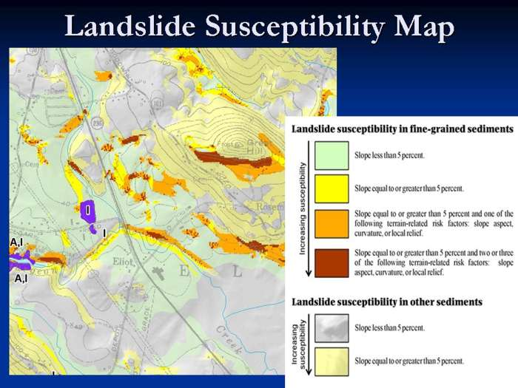
Figure 16
Notes:
Step Four: Produce a landslide susceptibility map layer delineating these risk factors zones for your area of study (Figure 16).
37

Slide 38
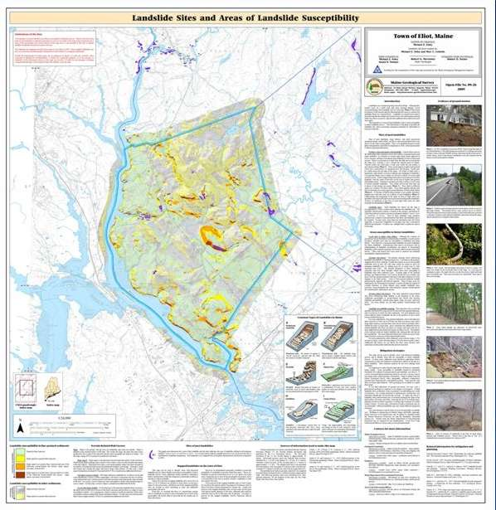
Figure 17
Notes:
After performing the Risk Factor Analysis and delineating the landslide susceptibility zones, the datasets are combined to create a final Landslide Susceptibility Map (Figure 17). These maps consist of a shaded relief base map overlain by surficial geology, landslide locations, and zones of relative landslide susceptibility. This final Landslide Susceptibility Map ranks the degree to which parts of the study area are prone to future landslides, based on the risk factors that produced past landslides. A landslide susceptibility map does not provide information on how often landslides occur, as in a landslide hazard map, or the extent of damages and injuries that might be anticipated from a future landslide event, as in a landslide risk map.
38

Slide 39
Limitations of the maps
Town-level landslide mapping is required to validate the susceptibility maps and provide credibility to local and State officials.
Landslide susceptibility maps indicate where landslides are likely to occur, not whether or when a landslide will occur.
The maps are based on landslide sites mapped below the glacial marine limit. Extension to other geologic settings would require additional study.
  18% of landslides occur on glacial till
Additional statistical analysis and incorporation of additional risk factors may improve the usefulness of the susceptibility maps. Data for additional risk factors must be available throughout the study area.

Slide 40
Applicability of the maps
The maps identify where landslides have already occurred and where future landslides may occur.
Public education.
The effects of future landslides may be mitigated by adopting appropriate building codes or land use policies in landslide prone areas.

Slide 41
Conclusions
Utilizing input and reviews of maps from local and state officials will enhance future map products.
Acquisition of LIDAR data will enhance quality and accuracy of maps.
Updating Maine's landslide inventory database will increase the accuracy and utilization of the maps.
Landslide susceptibility mapping is an ongoing process and will continually evolve into a more useful tool for landslide hazard mitigation.

