Slide 1
Test 1
Covers lecture and text material through Chapter 9.
Sunday (Oct. 15th) by 1:00 P.M. EST, I will email the exam to your maine.edu email account.
There will be no class on Tuesday (Oct. 17th), but I will be in my office from 7:30-10:30 to answer any questions.
Completed exams are to be emailed to me, no later than 8:00 P.M. EST, on Tuesday, October 17, 2017.

Slide 2
Labs
Lab 2 will be returned later today or first thing tomorrow.
Lab 4 will be posted on Tuesday, due Tuesday, Oct. 24.

Slide 3
Getting Data Into Your
GIS Project
Lecture 10
End of Chapter 9 & Chapter 10 to page 460.

Slide 4
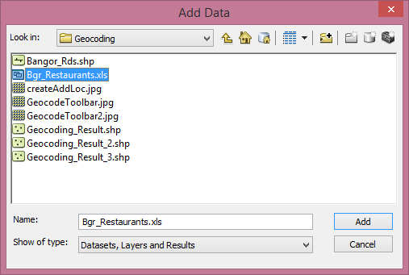
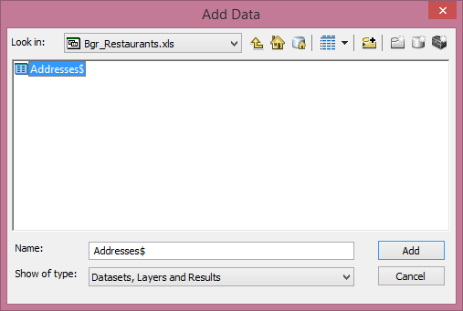
Adding Excel Tables
Be sure to save as a 1997-2003 Excel workbook.

Slide 5
Tables can then be joined or related to a feature attribute table using a common attribute.

Slide 6
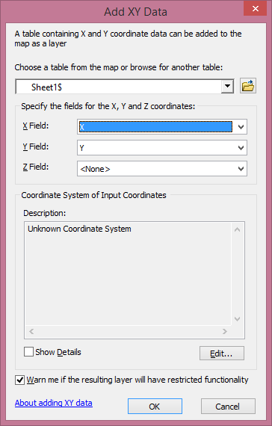
Adding X,Y Data

Slide 7
Geocoding
The Process of assigning locations to addresses so that they can be placed as points on a map.
Also called “address matching”.
The process assigns geographic coordinates to the original data.
Required: two tables
  A reference table containing street segments with address ranges.
  A table with street addresses and a city/zip code.

Slide 8
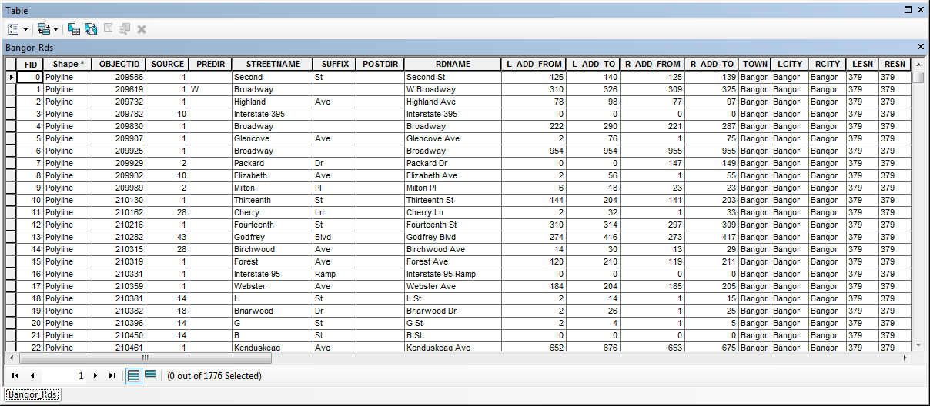

Slide 9
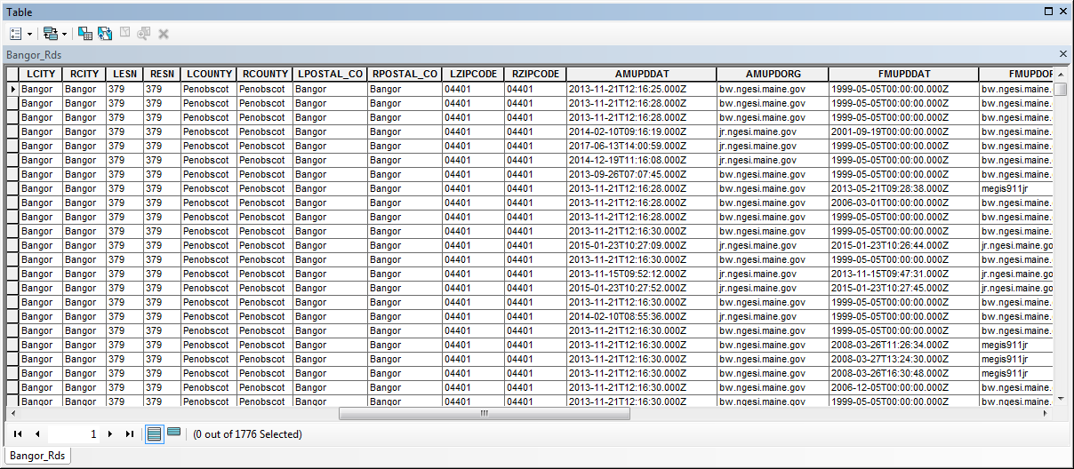

Slide 10
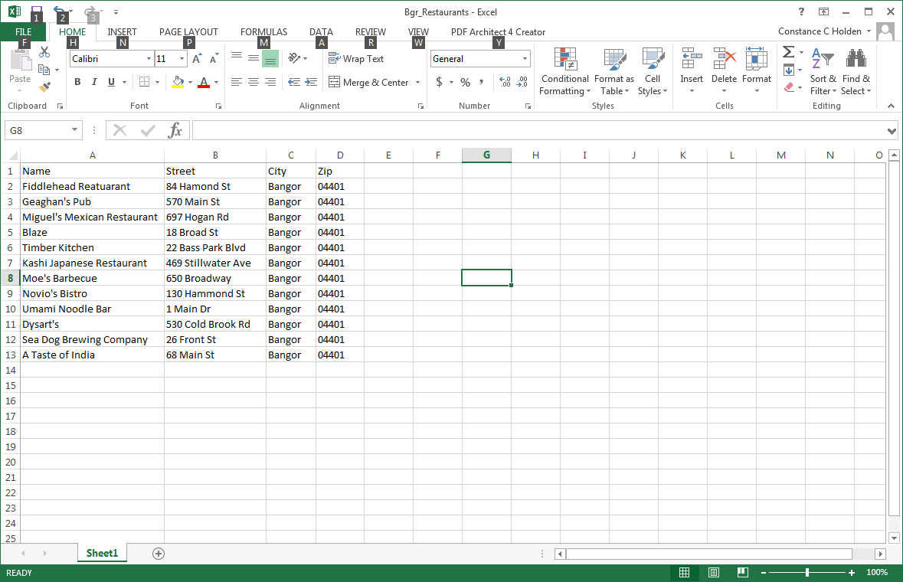
Misspelled
Incorrect Suffix
Not really in Bangor
Add both tables to ArcMap.

Slide 11
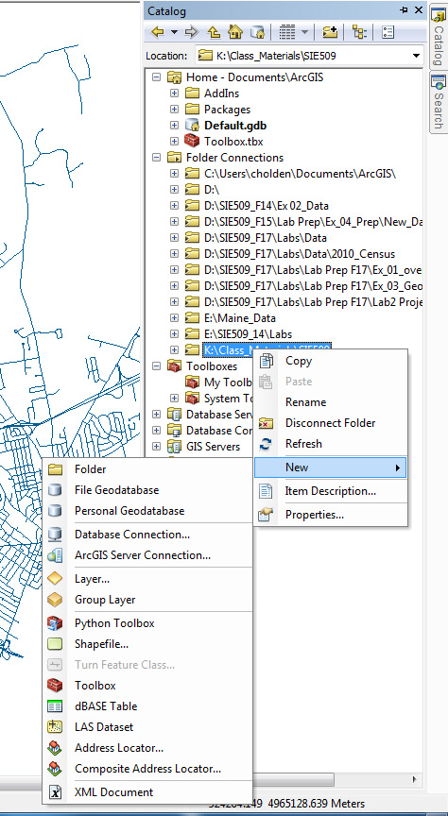
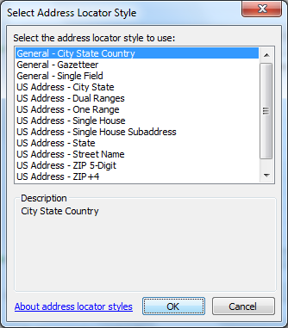

Slide 12
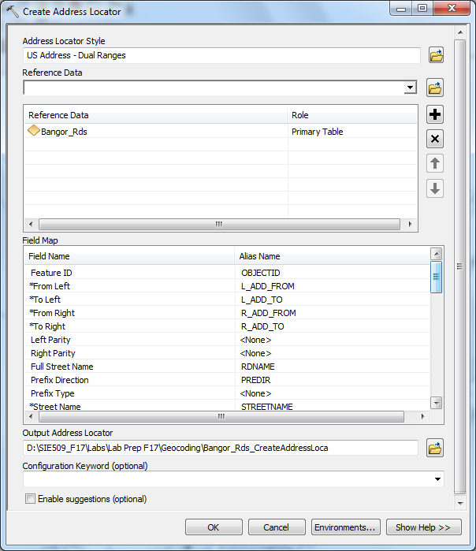
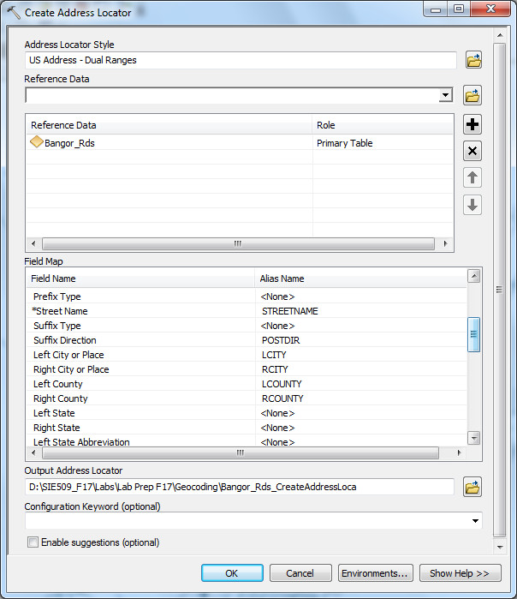

Slide 14
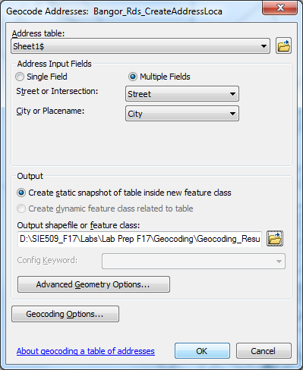

Slide 15
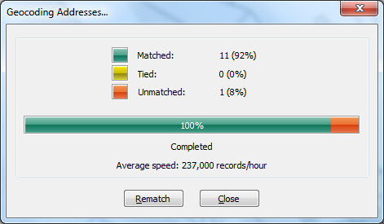

Slide 16
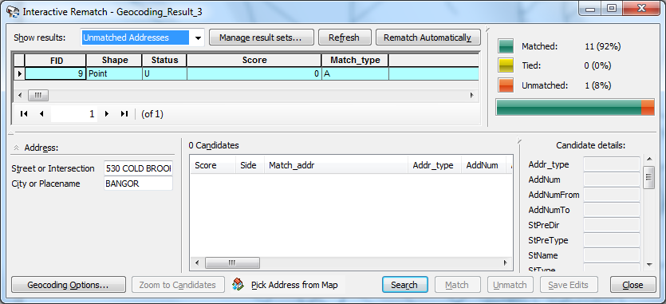

Slide 17
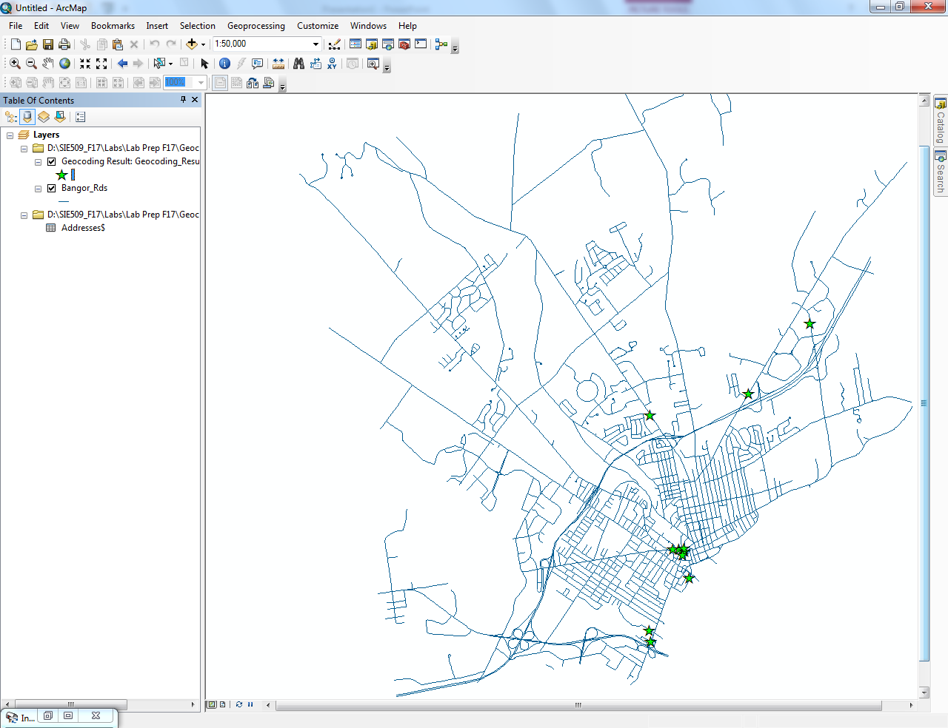

Slide 18
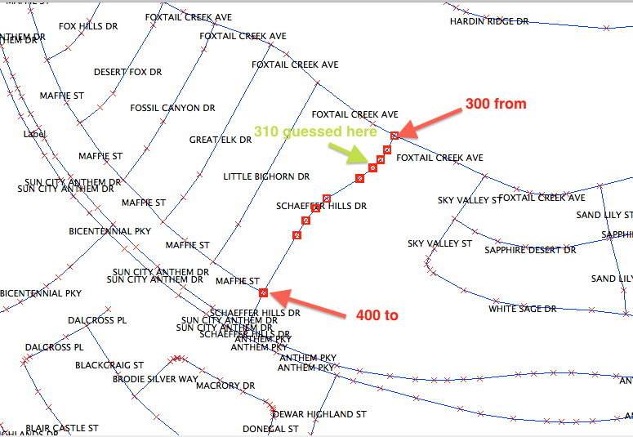
How Does Geocoding Work?
Starting from the downtown.
Addresses run even on left side of street.
Odd on the right side.

Slide 19
Find the location of 330 Schaffer Hills Drive.
Segment length: 300 feet

Slide 20
The Joys and Sorrows of Geocoding
IRINA GALKINA
PROFESSOR CONSTANCE C. HOLDEN
SIE 509
DECEMBER 15, 2011

Slide 21
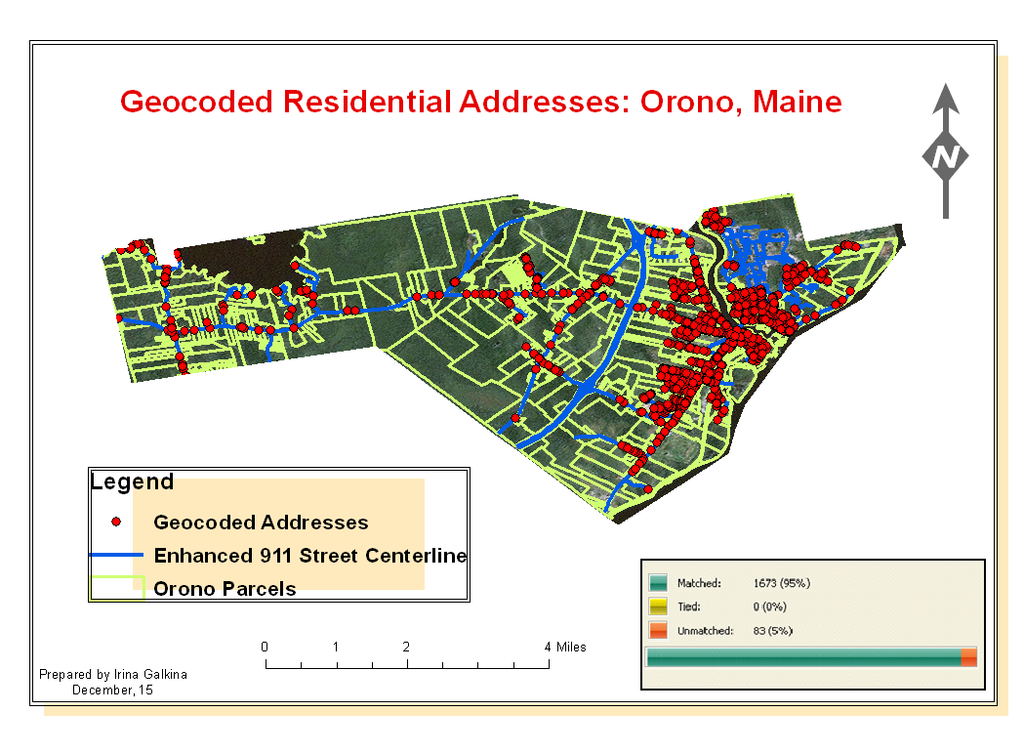
Geocoding White Pages Directories
How does it work?
How accurate is it?
How can it be used in different applica-tion settings?
Data provided by Maine Office of GIS

Slide 22
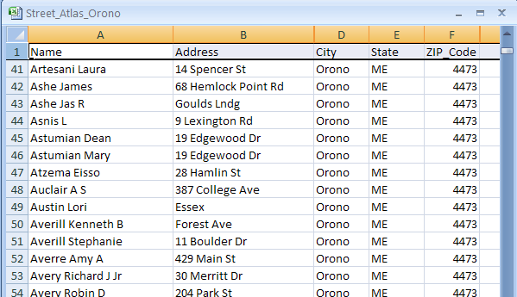
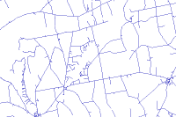
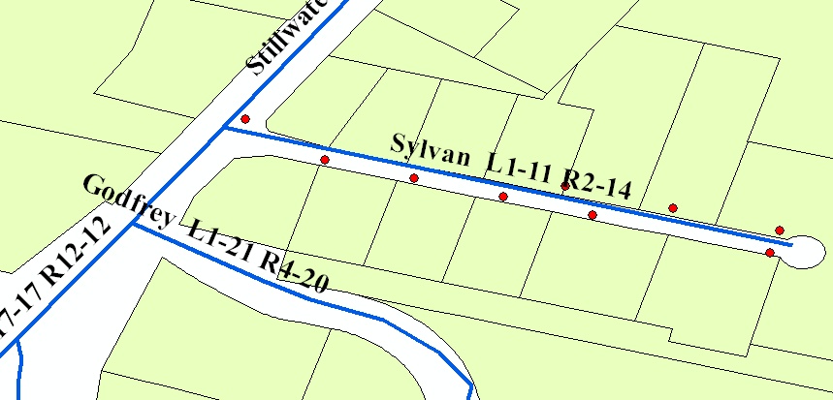
Work flow
obtaining data
preparing data
creating address locator
ge0coding
evaluating the results
Table of Addresses
E911 Roads File
Address Locator

Slide 23
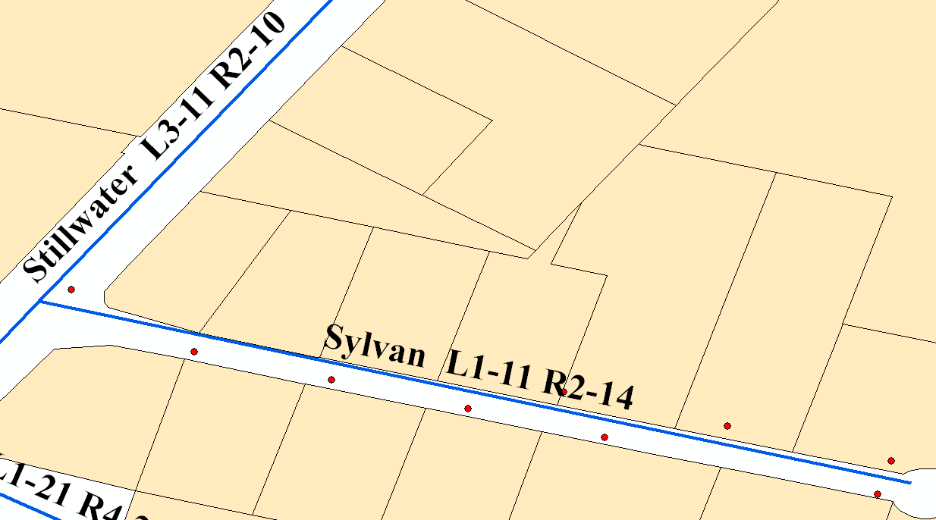
Offset Distance
Will work
Will not work
1 Sylvan Road
10 Sylvan Road

Slide 24

First Attempt

Slide 25

Failure to Match
errors in the address recording process
errors in the street segment data

Slide 26
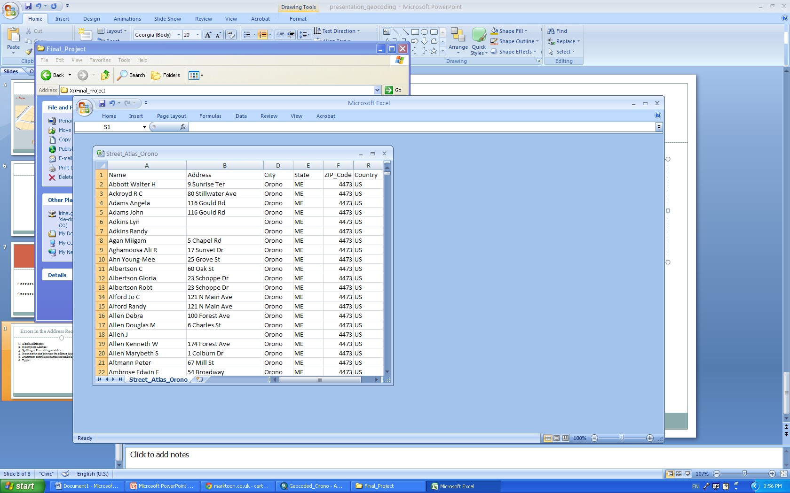
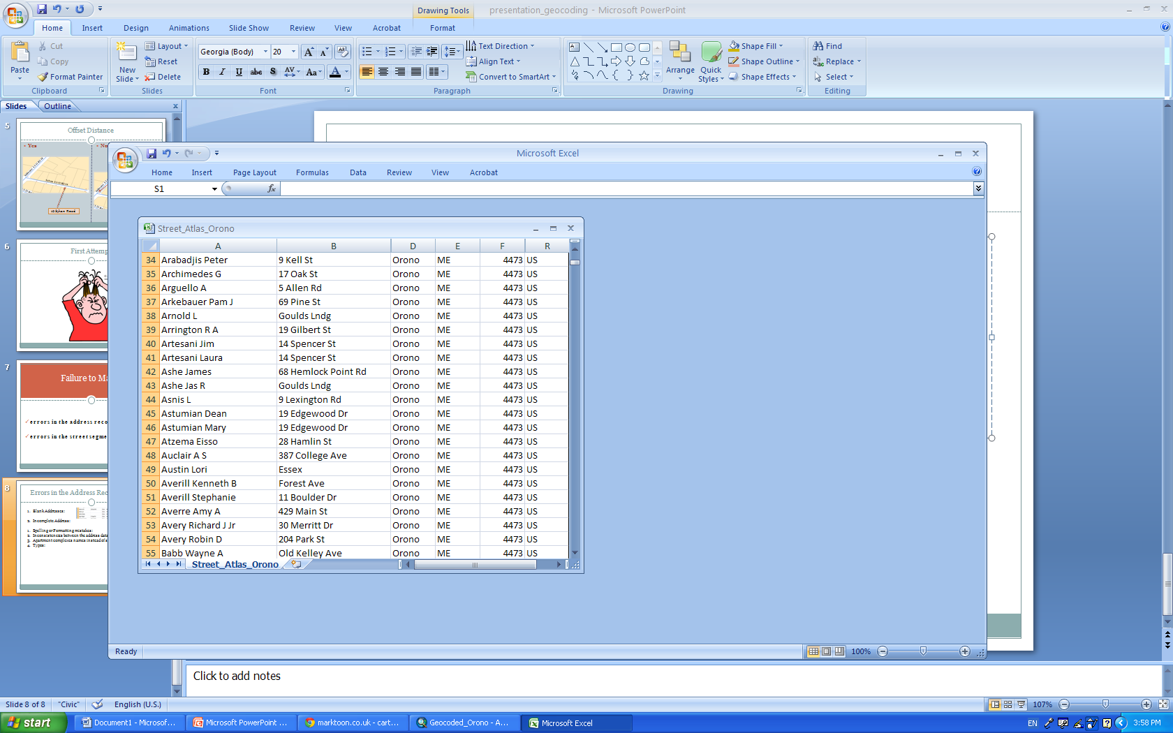
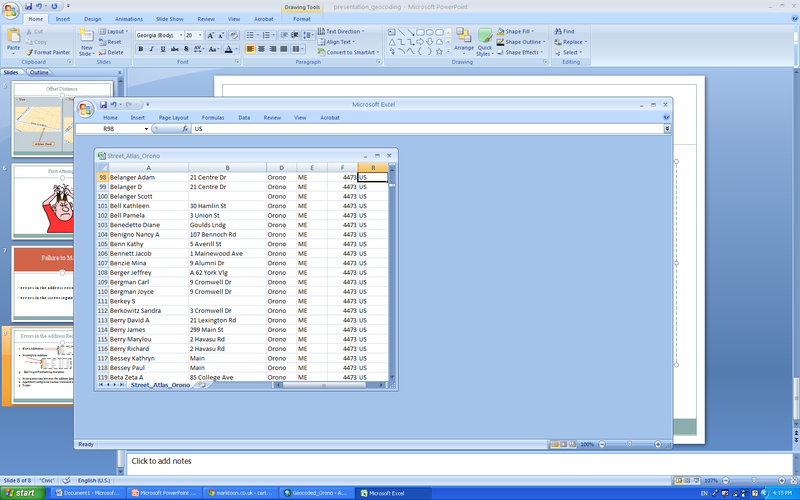
Errors in the Address Recording Process
Blank Addresses:
2. Incomplete Address:
3. Spelling or Formatting mistakes:
Inconsistencies between the address data and the street data file:
Address table: Newman Ln, Crestview Ln, Penobscot St.
E911 mapbook: Newman Rd, Crestview Rd, Penobscot Dr.

Slide 27
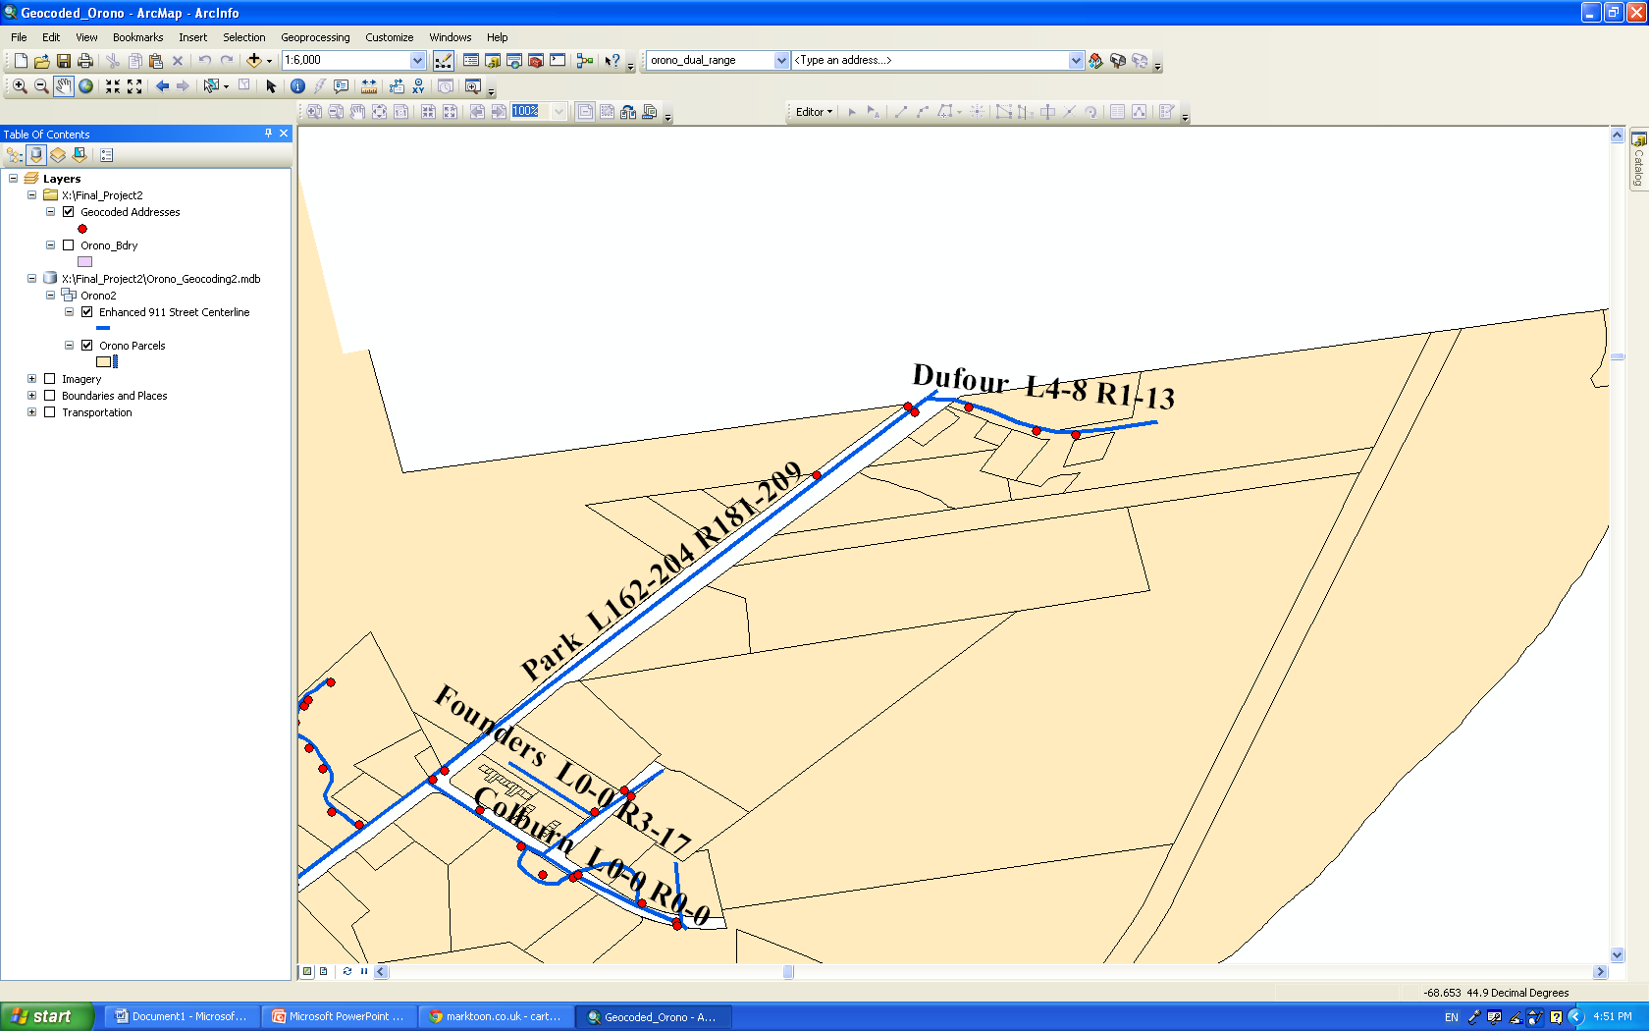
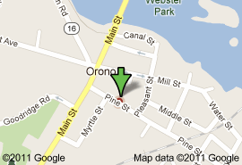
Errors in the Address Recording Process
Disagreement between the common name of a location and the official address:
Apartment complexes names instead of street names: Talmar Woods, Hasbrouck Court
Typos: 1952 Park Street?

Slide 28
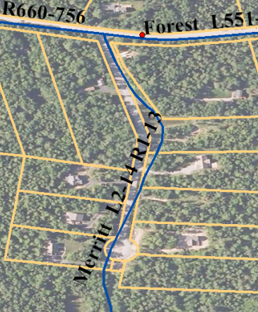
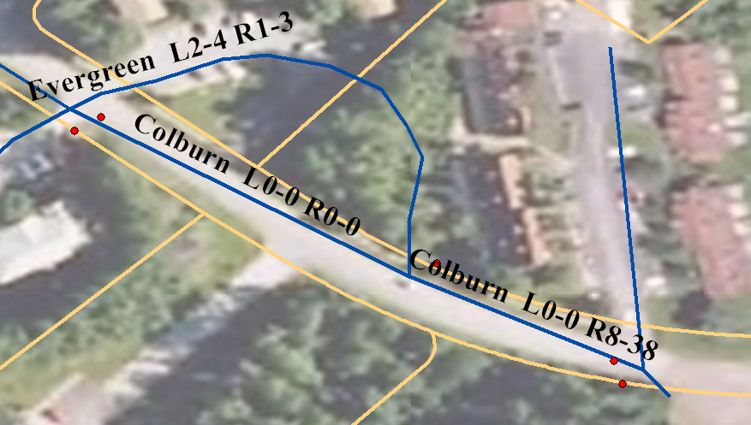
Errors in the Reference Data
1. Incomplete,
or erroneous
street ranges:
Missing street ranges:
30/51/35 Merritt Drive
7 Colburn Drive?

Slide 29
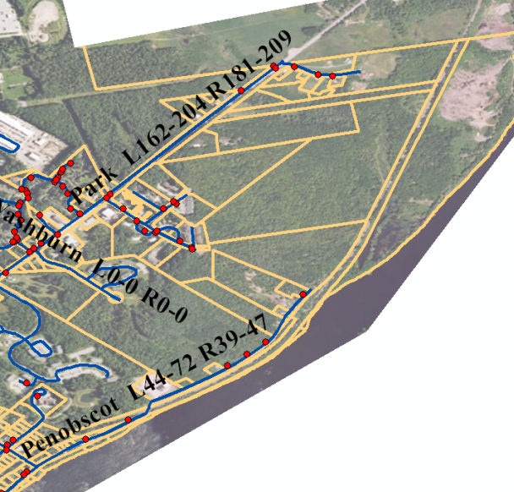
Error in the Reference Data
3. Missing street segments:
100/106
Penobscot St?
72 Penobscot St

Slide 30
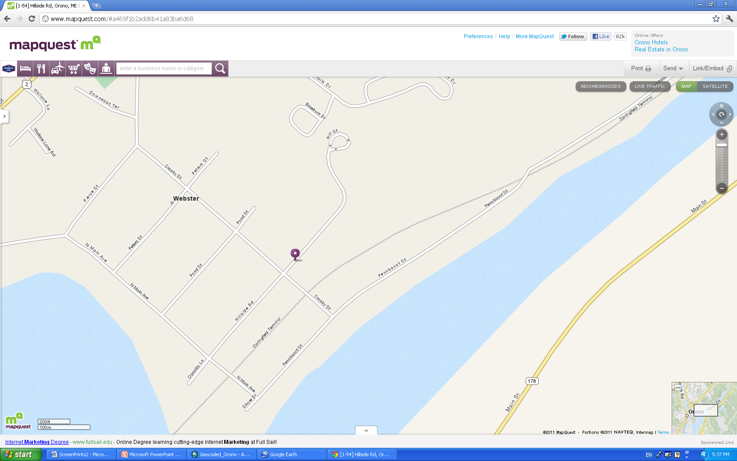
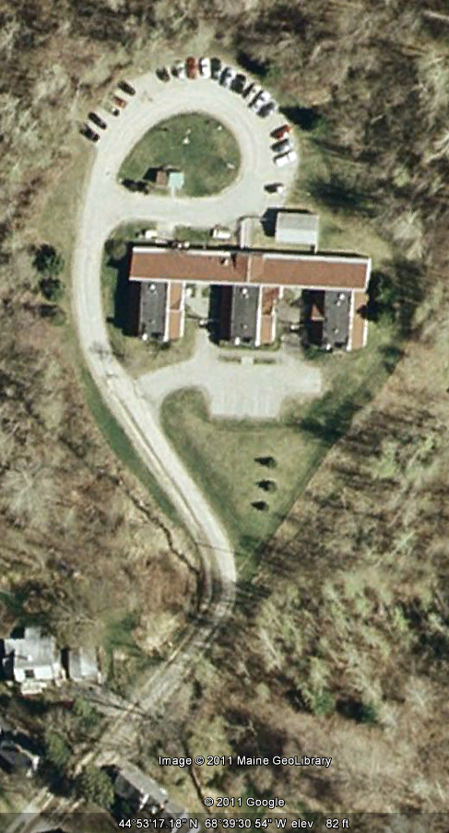
No street with the name given?
10 records with Hill for the street name?
Final decision:
Treats Fall House,
2 Hillside Road

Slide 31
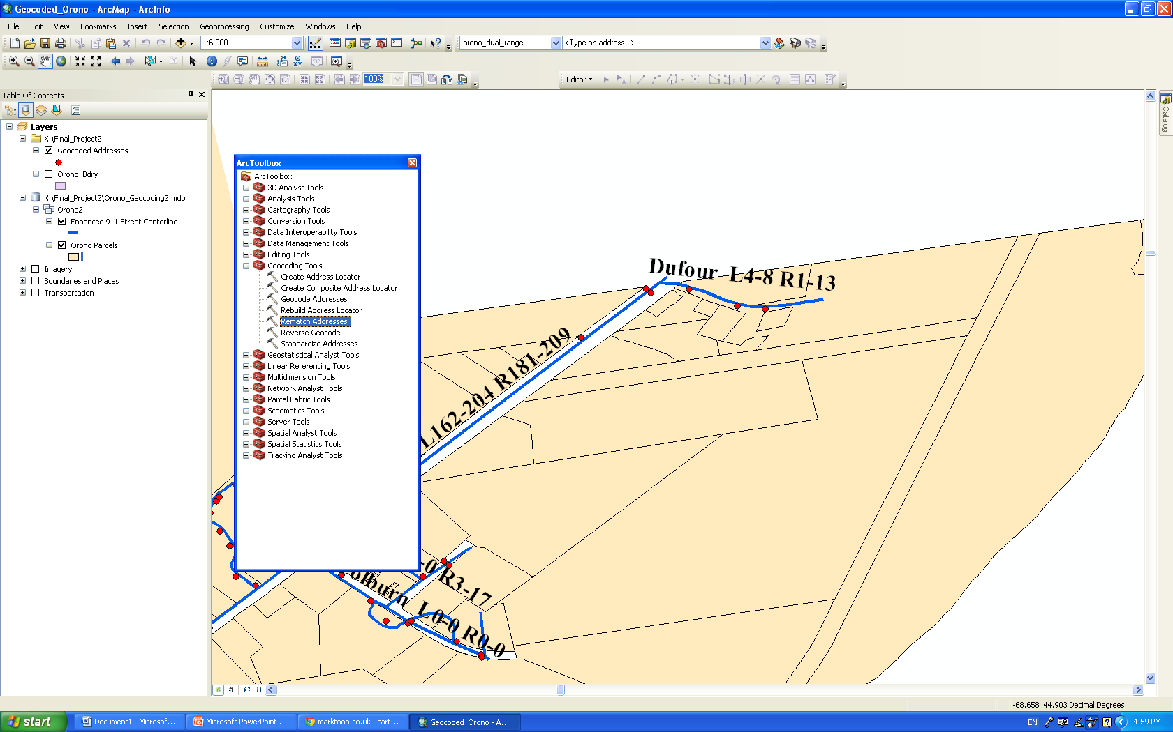
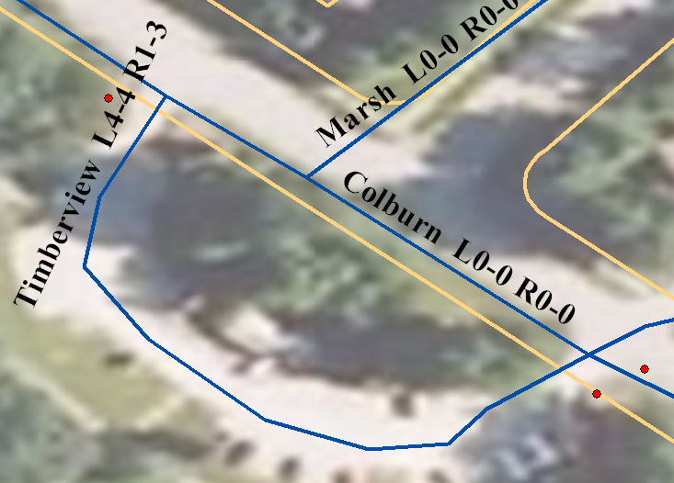
Rematching
Lower spelling sensitivity
Match to candidates in reasonable proximity
Use the Pick Address from the Map
Automatic
2 Timberview Drive
the ODD side of the street!

Slide 32
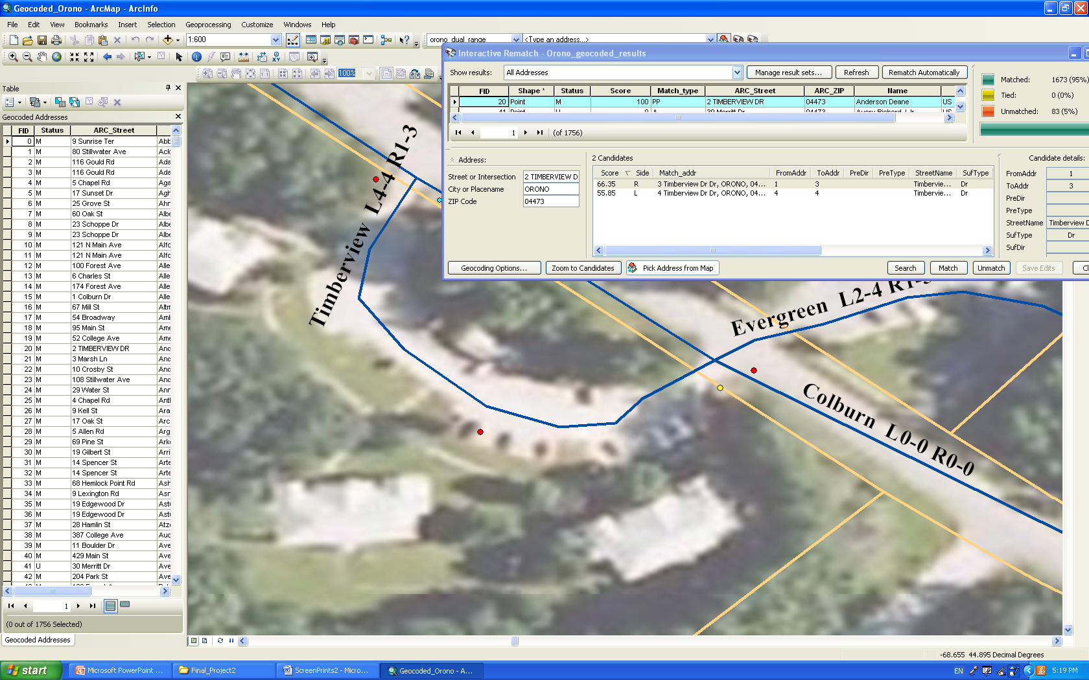

Slide 33
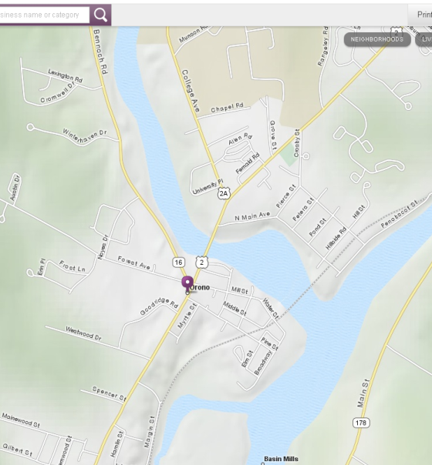


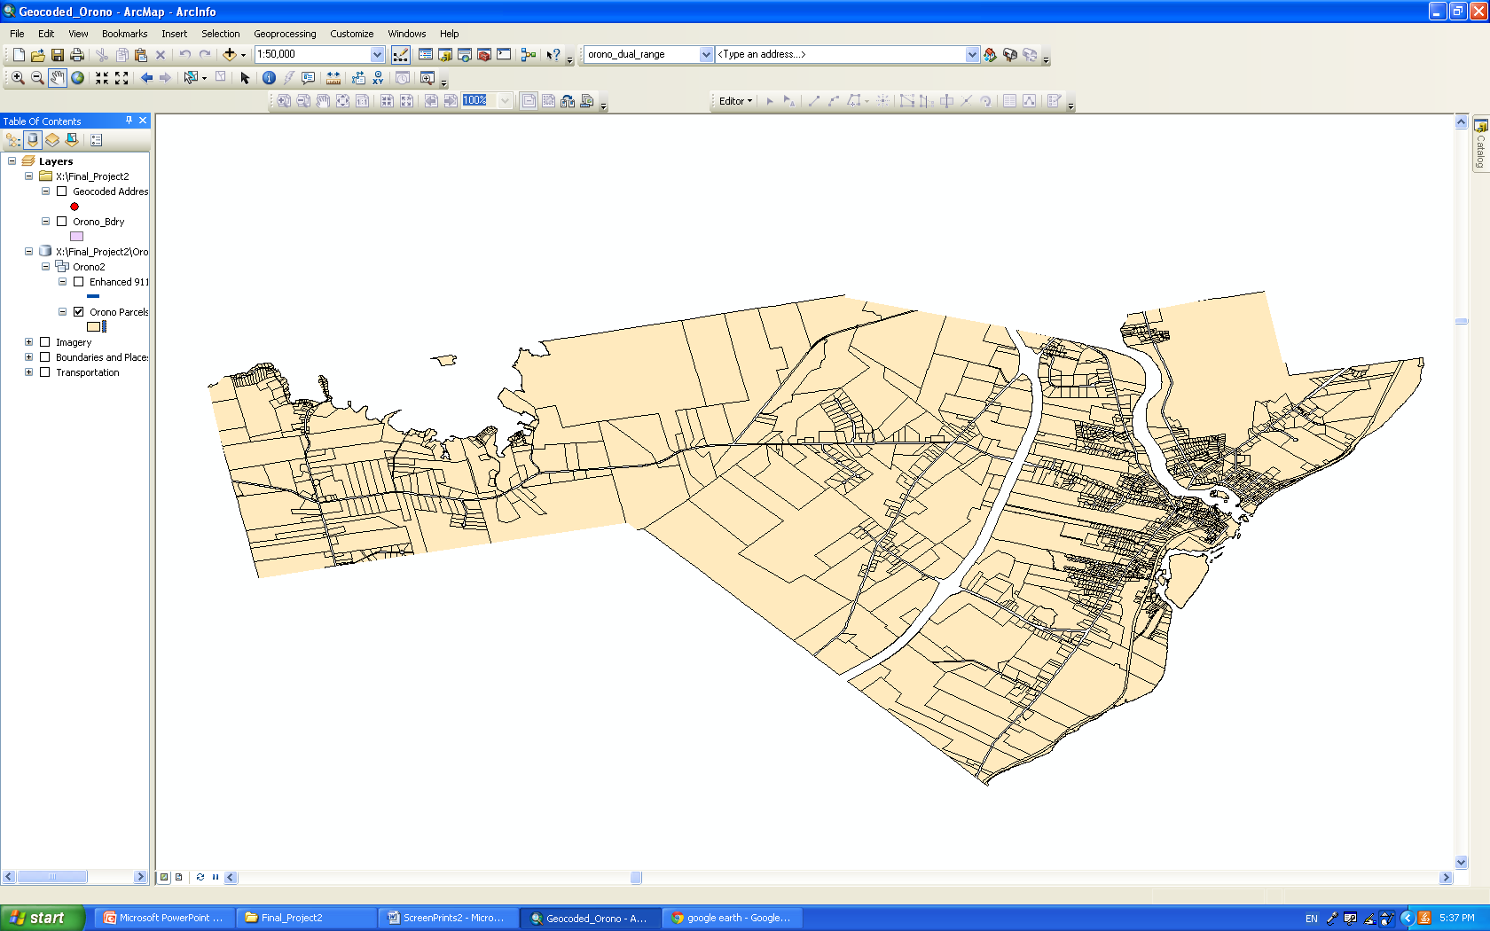

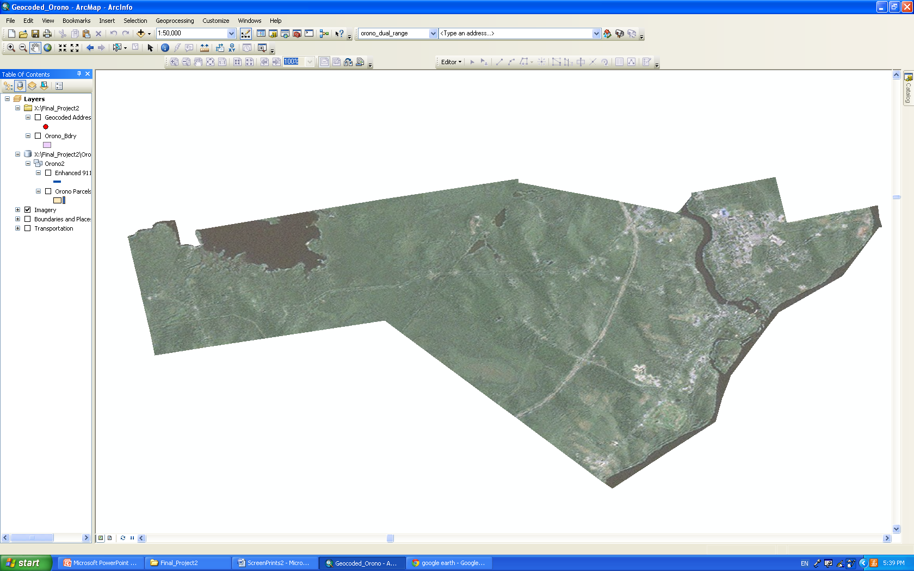
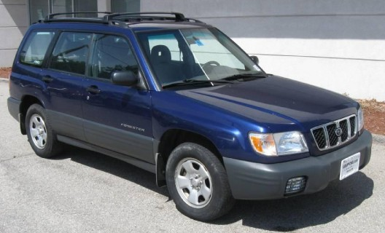
Analyzing Matched Addresses

Slide 34
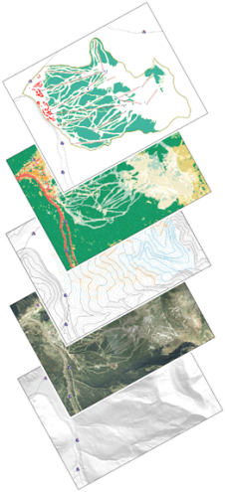
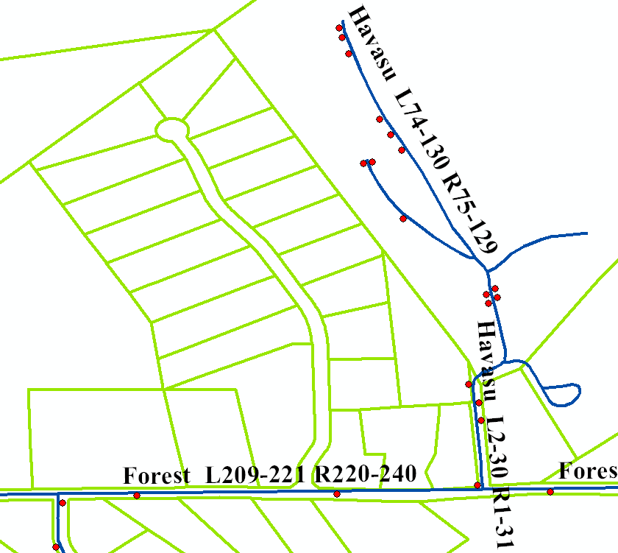
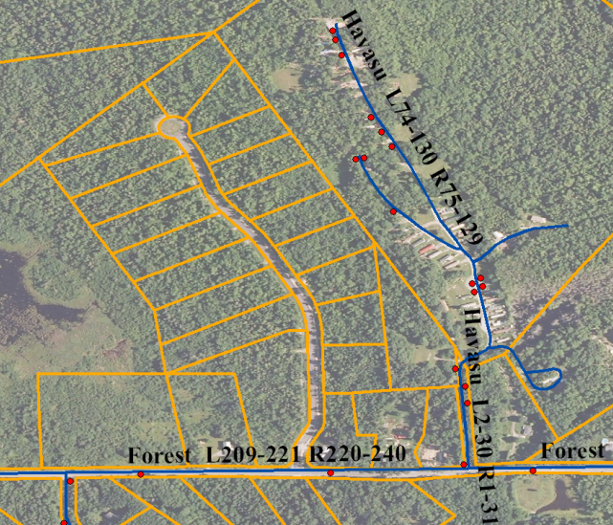
How does digital orthophotography help?
Misaligned?
Properly aligned!

Slide 35
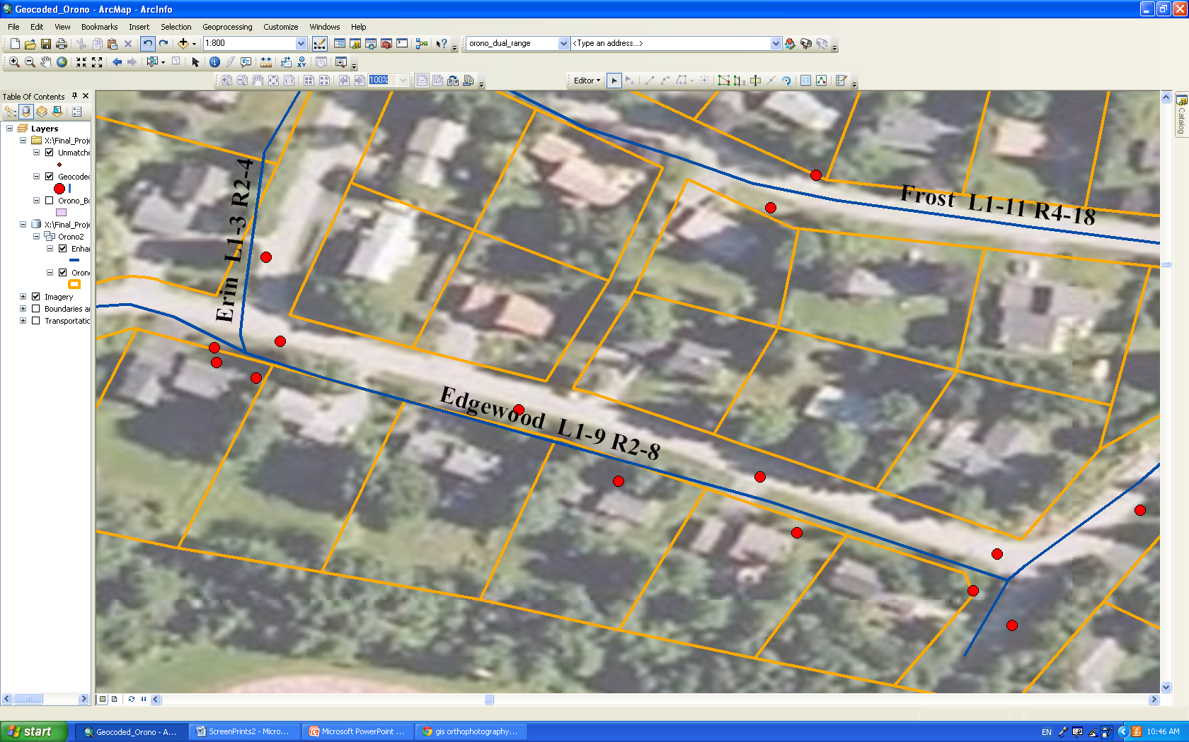
Issues with Spatial Interpolation
8
6
4
2
9
7
5
3
1
Geocoded Address Points:
8
6
4
2
House Numbers on the Parcel Layer vs. Geocoded Results

Slide 36
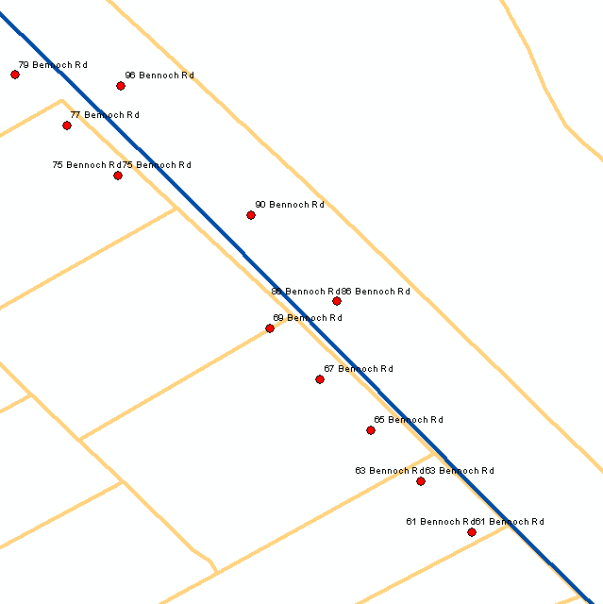
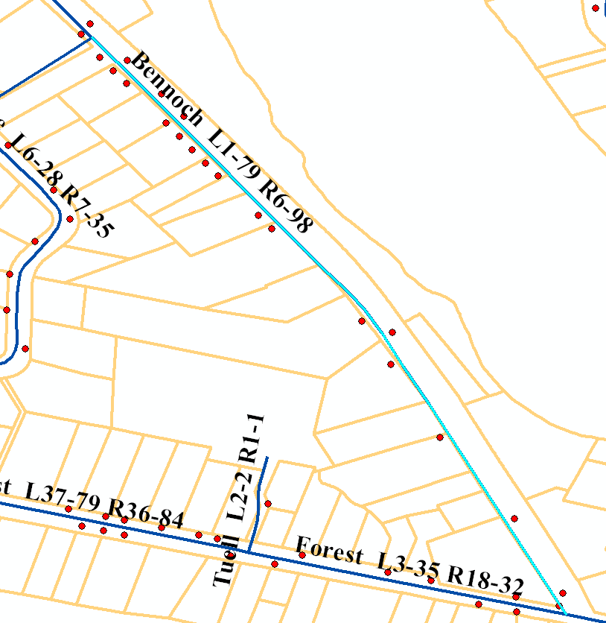
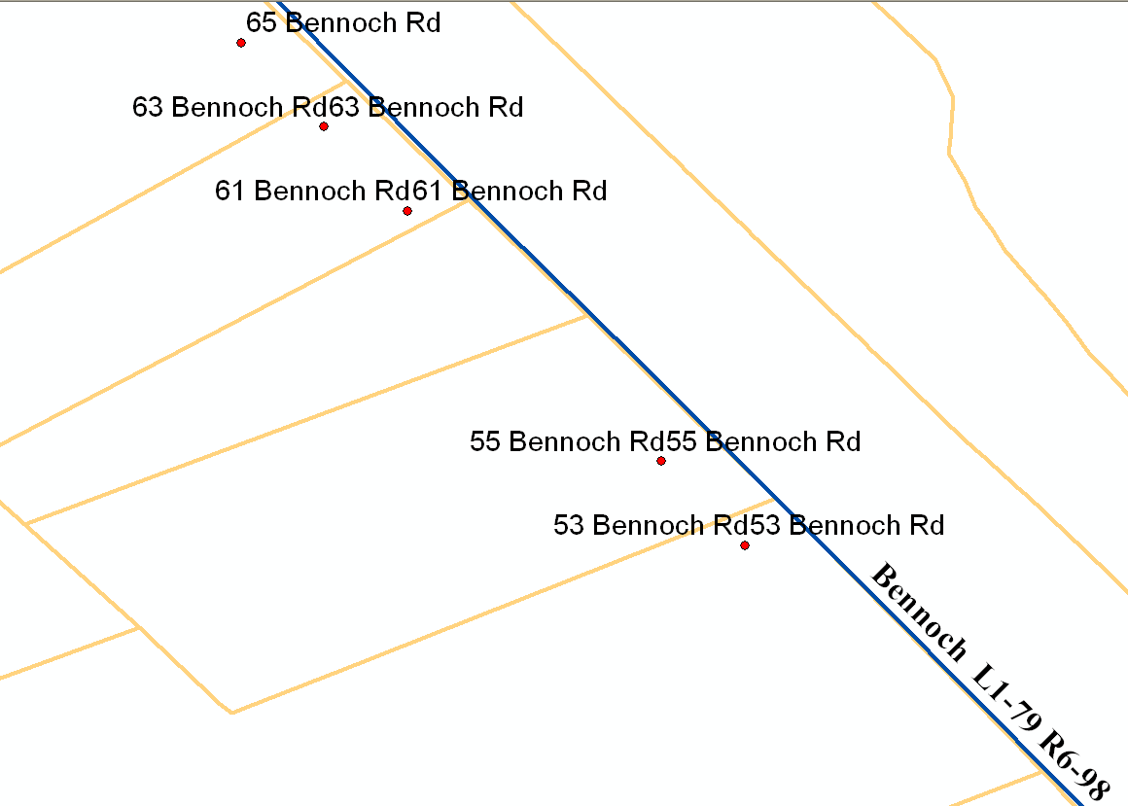
Issues with Spatial Interpolation
79
77
75
69
65
63

Slide 37
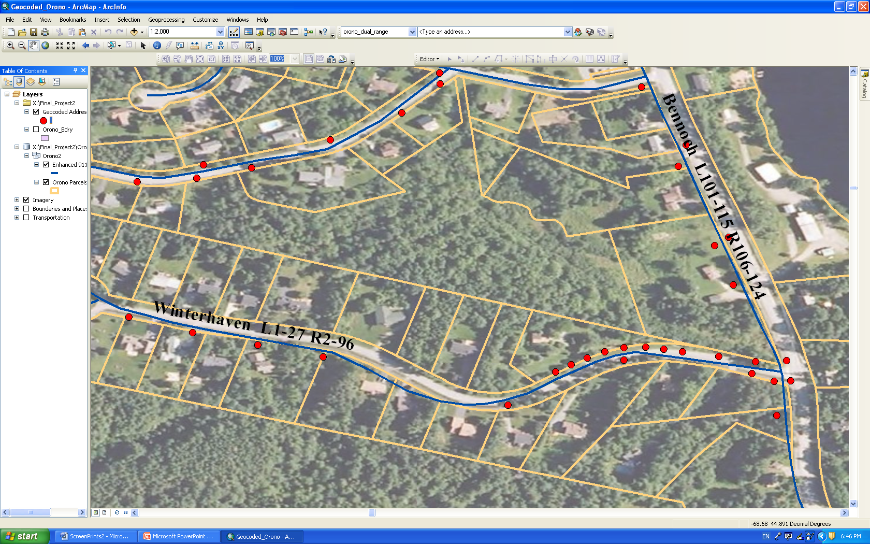
Errors in the Reference Data
Winterhaven Left: 1 – 27
Right 2 – 96

Slide 38
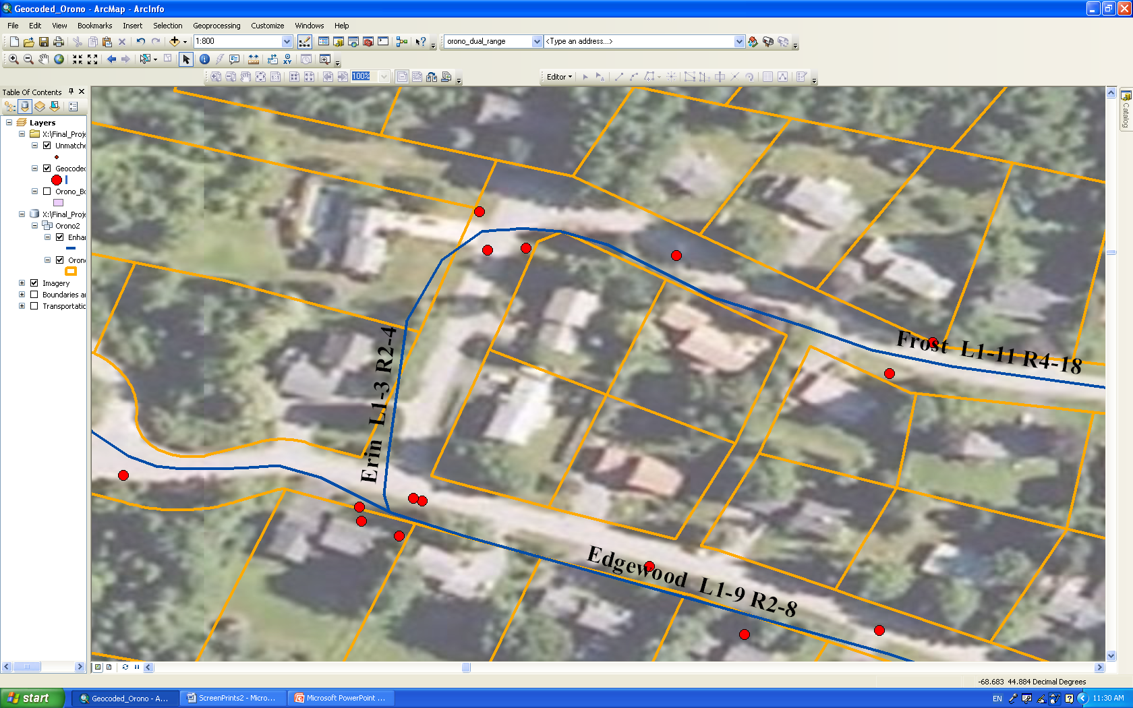
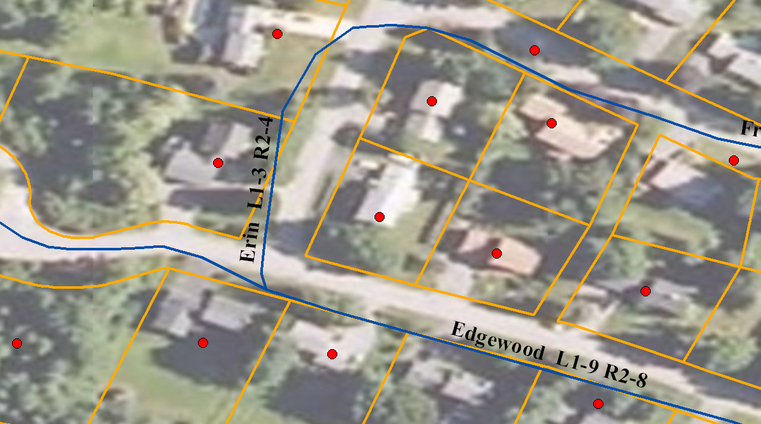
Editing
BEFORE
Offset is not an option.
Moving points manually in editing mode
AFTER

Slide 39

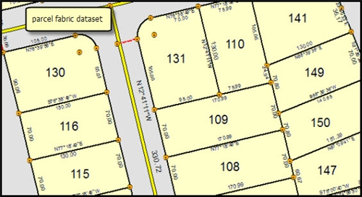
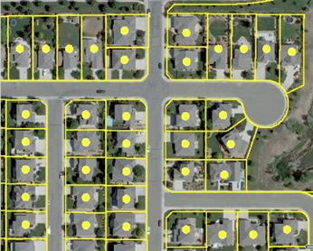
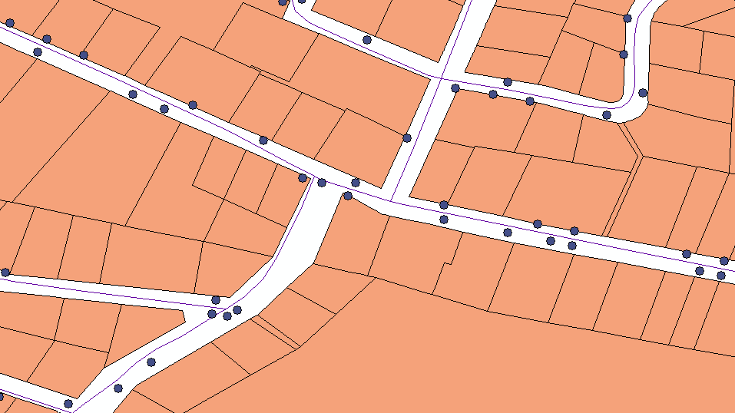
RESULTS
The match score of 95 % says nothing about the quality of results.
A Table of 83 unmatched addresses sums up possible reasons for geocoding failure.
Are there any better alternatives?
Geocoding to tax parcel layer
Rooftop geocoding
Geocoding to street centerline

Slide 40

Spatial Analysis
Part 3
Chapter 10 Raster Analysis – Part 1

Slide 41
Raster Data Model
Raster cells store data (nominal, ordinal, interval/ratio)
Forest
1,…9,10
259.63
Excellent for terrain and hydrological modeling
Complex constructs built from raster data
  -Connected cells can be formed in to networks
  -Related cells can be grouped into neighborhoods or regions

Slide 42
Examples of Raster Analysis
Predict fate of pollutants in the atmosphere
The spread of disease
Animal migrations
Crop yields
EPA - hazard analysis of urban superfund
sites
Market analysis
Watershed analysis
Terrain analysis

Slide 43


Slide 44
Map algebra
Concept introduced and developed by Dana Tomlin and Joseph Berry (1970’s)
Cell by Cell combination of raster data layers
  -Each number represents a value at a raster cell location
  -Simple operations can be applied to each number
  -Raster layers may be combined through operations such as addition, subtraction and multiplication

Slide 45


Slide 46

Incompatible cell sizes and boundaries confound multi-layer raster analysis.
Notes:
Incompatible cell sized and boundaries can cause problems with multi-layer raster operations. What cell value would you choose from layer 2 to combine with layer 1n and a portion of cell B is undefined.
Ambiguities are best resolved by resampling prior to layer combination

Slide 47

Scope: Local operations
Notes:
As with vector analysis, the scope of raster analysis can be classified as local , neighborhood or global

Slide 48

Many Local Functions
(page 448 of text)
Apply to interval/ratio data.

Slide 49

Logical Operations
AND
Non-zero values are “true”, zero values are “false”
N = null values

Slide 50

Logical Operations
OR
Non-zero values are “true”, zero values are “false”
N = null values

Slide 51

Logical Operations
NOT

Slide 52

More Local Functions – logical comparisons

Slide 53

An Example of a Logical Operation

Slide 54

Reclassification
Notes:
Raster reclassification assigns output values that depend on a specific st of input values.

Slide 55

Conditional
Function

Slide 56

Nested Functions

Slide 57
Raster Overlay
Typically applied to nominal or ordinal data
Cell by cell process which results in the combination of the two input layers
Pay attention to the number of possible combinations that may be possible and understand the effect on the output layer

Slide 58

Feature numbers increase in overlay

Slide 59

Overlay
Notes:
Many differences between vector and raster overlay due to differences in the data models. Raster overlay is often restricted to nominal data. Overlay with continuous data creates to many unique cell combinations to be of much use,

Slide 60

Raster Clip Operation
Notes:
The output layer includes only source values indicated by the output layer.

Slide 61

Raster Addition

Slide 62

Be Careful of Ambiguity

Slide 63

A raster clip operation preformed by multiplication of a binary mask.

Slide 64

Raster Overlay in Idrisi

Slide 65
1 | 0 | 1
1 | 0 | 1
1 | 0 | 1
1 | 1 | 1
0 | 0 | 1
0 | 0 | 1
1 | 0 | 1
0 | 0 | 1
0 | 0 | 1
First * Second
0*0=0
0*1=0
1*1=1

Slide 66
1 | 0 | 1
1 | 0 | 1
1 | 0 | 1
1 | 1 | 1
0 | 0 | 1
0 | 0 | 1
2 | 1 | 2
1 | 0 | 2
1 | 0 | 2
First + Second
0+0=0
0+1=1
1+1=2

Slide 67


